Slide 1
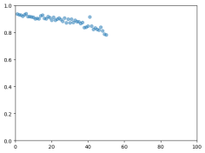
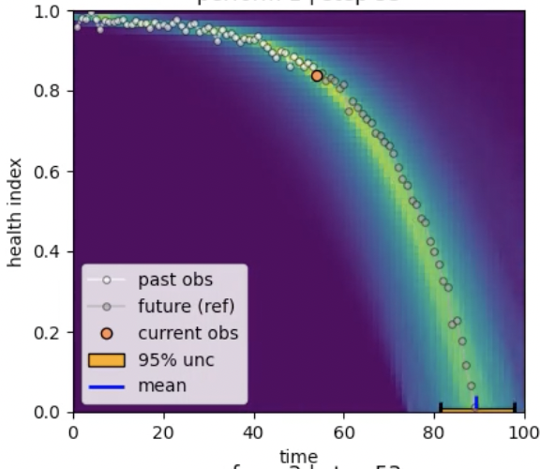
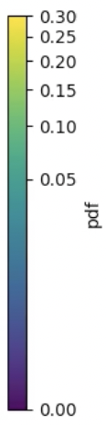
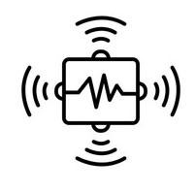
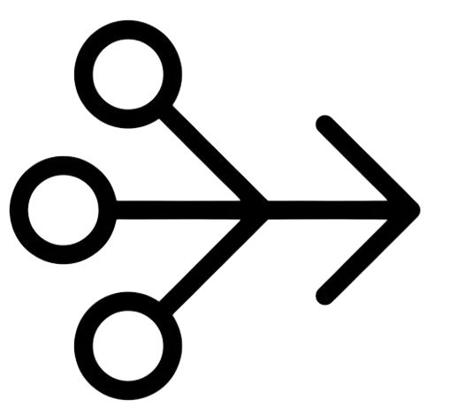
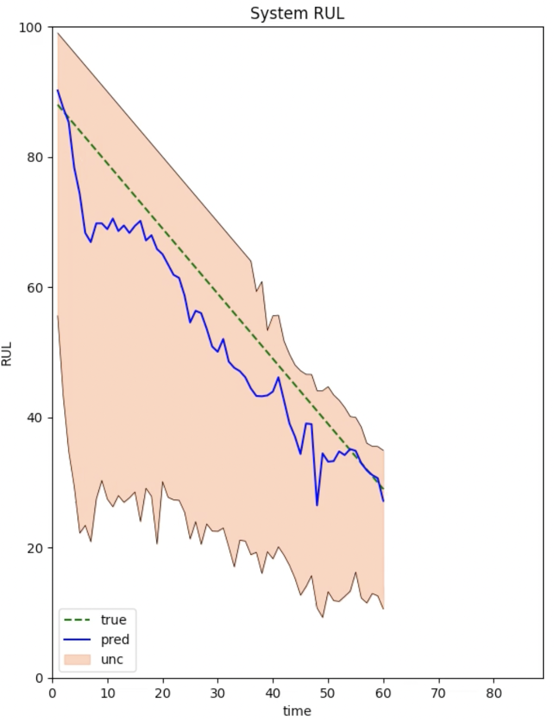
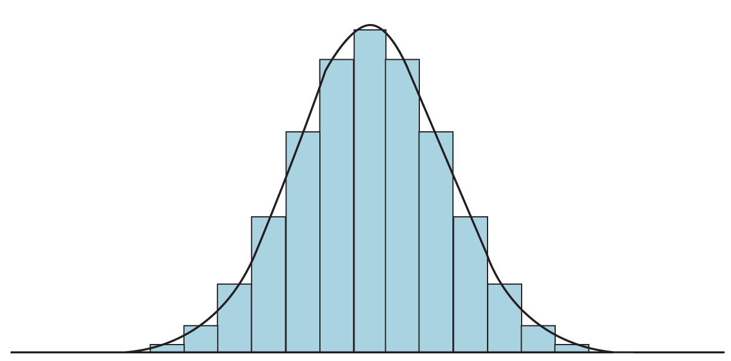
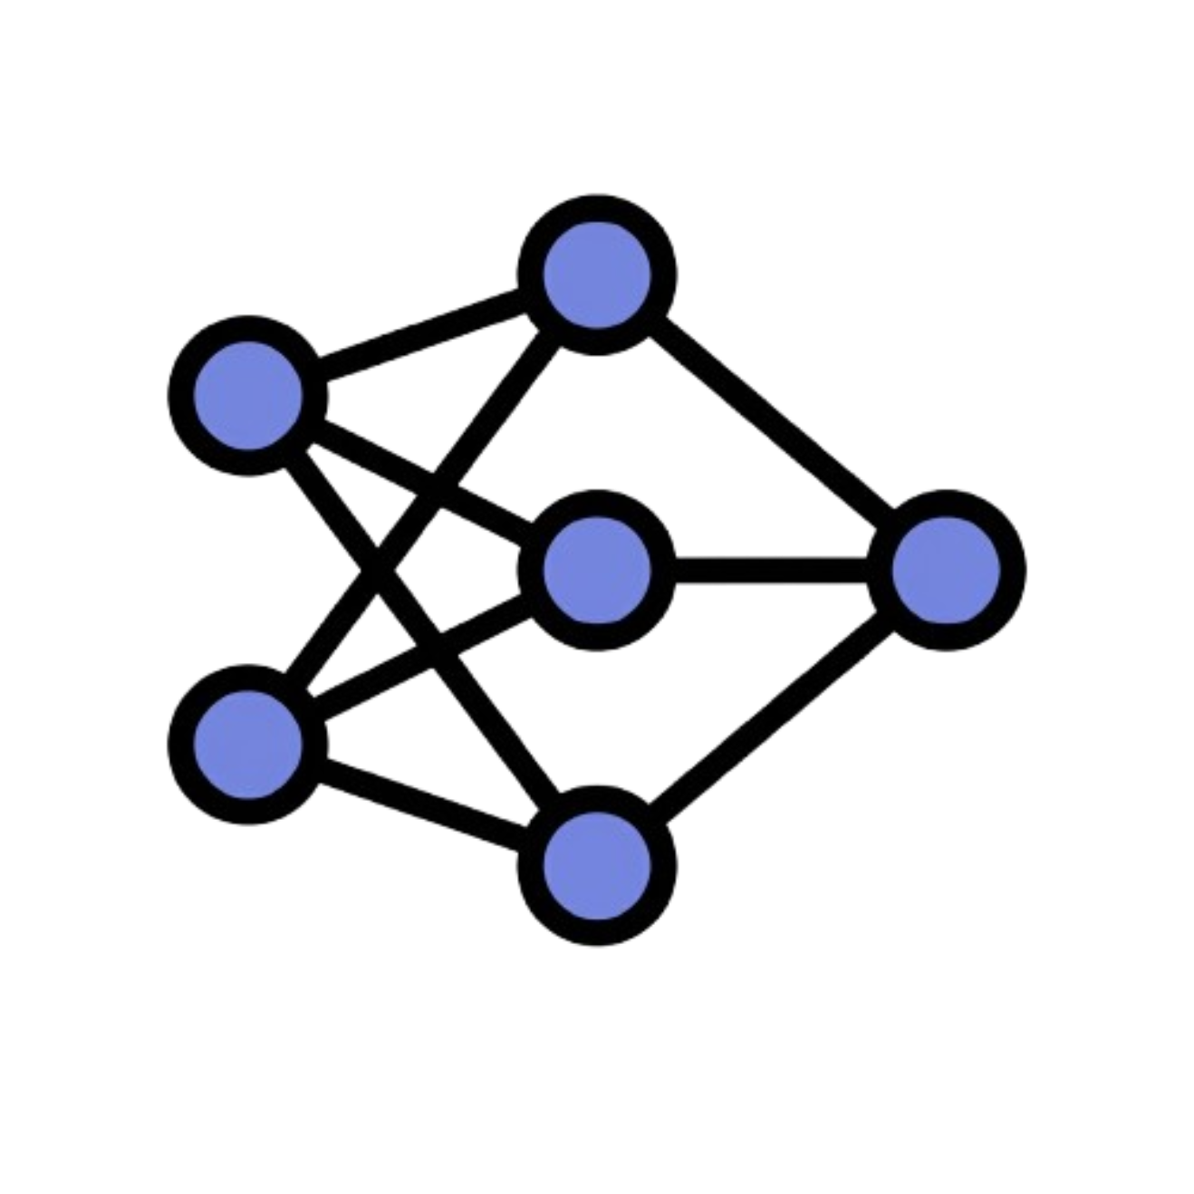

Performance-Based Probabilistic RUL Prediction via Particle Filtering
with Neural-Guided Inference.
Estimate System Health
Predict Degradation
Infer RUL Distribution
Aggregation
Sensor
measurements
Performance Metric Estimation
Stochastic Degradation Model
Neural PF
Controller
Particle Filter
Neural PF
Controller
Particle Filter
Neural PF
Controller
Particle Filter
Posterior Distribution
of Degradation Parameters
RUL Prediction with Uncertainty
Validated Using Multiple N-CMAPSS Benchmark Datasets
Competitive Accuracy
Interpretable Predictions
Calibrated Uncertainty
Separating Estimation and Prediction Improves Interpretable and Uncertainty-Aware RUL Prognostics

