Slide 1





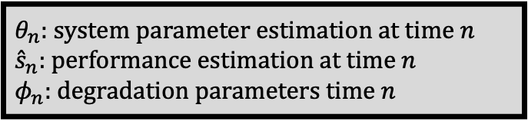
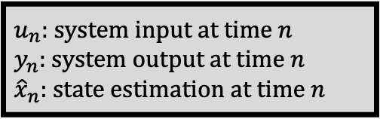

Estimation
Prediction
$$u_{n}$$
Dynamic
System Model
Performance
Degradation
Model
Performance
Degradation
Model
Performance
Degradation
Model
System
$$P(φ_{n}|u_{1:n},y_{1:n})$$
$$y_{n}$$
$${\hat{x}}_{n},{\hat{θ}}_{n}$$
System
Performance
Model
$$P(EOL|u_{1:n},y_{1:n})$$
$${\hat{s}}_{n}$$
RUL and ℓ - confidence interval computation
RUL with confident
intervals
Performance
constraints
Bayesian
Filter
Bayesian
Filter
Bayesian
Filter
$u_{n}$: system input at time $n$
$y_{n}$: system output at time $n$
${\hat{x}}_{n}$: state estimation at time $n$
$θ_{n}$: system parameter estimation at time $n$
${\hat{s}}_{n}$: performance estimation at time $n$
$φ_{n}$: degradation parameters time $n$

Slide 2
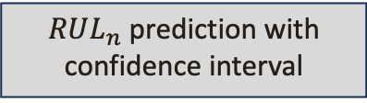
EOL Particle Filter
RUL Prediction
Propagation
Predictive EOL Distribution
Tempered Correction
$RUL_{n}$ prediction with confidence interval
Resampling

Slide 3
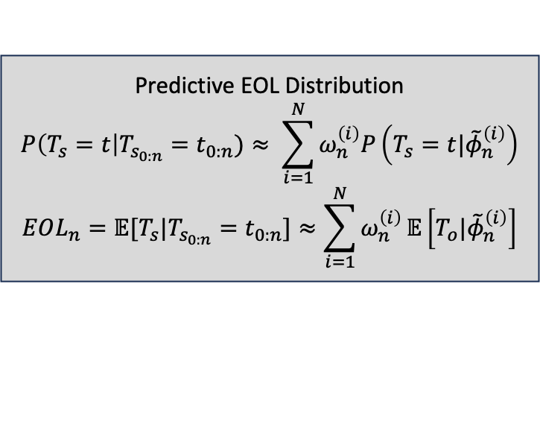
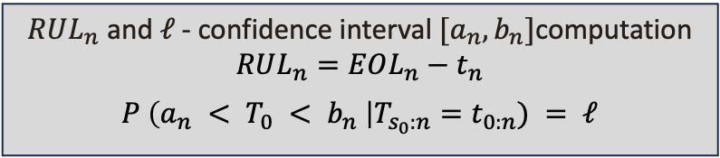
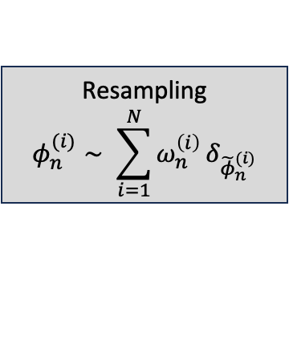

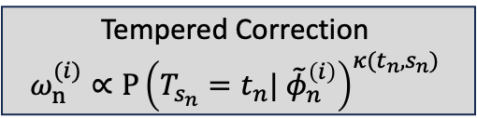
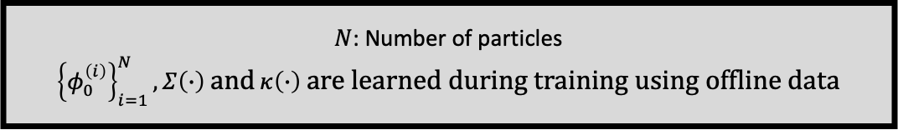
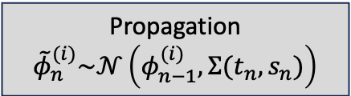



EOL Particle Filter
RUL Prediction
$${\left\{φ_{n−1}^{\left(i\right)}\right\}}_{i=1}^{N}$$
Predictive EOL Distribution
$$P\left(T_{s}=t\right|T_{s_{0:n}}=t_{0:n})≈ \sum_{i=1}^{N}{ω_{n}^{\left(i\right)}P}\left(T_{s}=t|{\tilde{φ}}_{n}^{\left(i\right)}\right)$$
$$EOL_{n}=𝔼[T_{s}|T_{s_{0:n}}=t_{0:n}]≈\sum_{i=1}^{N}{ω_{n}^{\left(i\right)}}𝔼\left[T_{o}|{\tilde{φ}}_{n}^{\left(i\right)}\right]$$
Propagation
$${\tilde{φ}}_{n}^{(i)}\sim 𝒩\left(φ_{n−1}^{(i)}, Σ(t_{n},s_{n})\right)$$
$${\left\{\left({(ω}_{n}^{\left(i\right)},{\tilde{φ}}_{n}^{\left(i\right)}\right)\right\}}_{i=1}^{N}$$
$$({t_{n},s}_{n})$$
Tempered Correction
$$ω_{n}^{(i)}∝P{\left(T_{s_{n}}=t_{n}| {\tilde{φ}}_{n}^{\left(i\right)}\right)}^{κ(t_{n},s_{n})}$$
Resampling
$$φ_{n}^{(i)}∼ \sum_{i=1}^{N}{ω_{n}^{\left(i\right)}}δ_{{\tilde{φ}}_{n}^{(i)}}$$
$RUL_{n}$ and $ℓ$- confidence interval $[a_{n},b_{n}]$computation
$$RUL_{n}=EOL_{n}−t_{n}$$
$$P \left(a_{n} < T_{0} < b_{n} \right|T_{s_{0}:n}=t_{0:n}) = ℓ$$
$${\left\{φ_{n}^{\left(i\right)}\right\}}_{i=1}^{N}$$
$N$: Number of particles
${\left\{φ_{0}^{\left(i\right)}\right\}}_{i=1}^{N}, Σ\left(∙\right)$ and $κ\left(∙\right)$are learned during training using offline data

