Slide 1
ASSIGNMENT 3: DEEP LEARNING ARCHITECTURES (CNNS)
Evolution of Convolutional Networks
A Comparative Analysis of LeNet-5 (1998) and AlexNet (2012) on CIFAR-10
Presented by: Abrham Yilma

Slide 2
INTRODUCTION & CONTEXT
The Path of CNN Evolution
Why do architectures evolve?
• Manual Feature Engineering was the bottleneck in early Computer Vision.
• CNNs introduced automated local receptive fields, shared weights, and spatial translation invariance.
• The core evolutionary drivers: availability of large datasets (ImageNet), GPU compute scale, and innovative activation/regularization methods.
Key Comparison Focus
LeNet-5 [1998]: The foundational pioneer of modern spatial layers.
AlexNet [2012]: The scalable power-house that initiated the deep learning boom.

Slide 3
PREDECESSOR ARCHITECTURE
LeNet-5: The Pioneer (1998)
Designed for handwritten digit recognition (MNIST), presenting the modern blueprint of conv-pool blocks.
• Input Layer: 32x32 grayscale images (single channel).
Perfect for highly restricted, clear digit topologies with minimal scale variation.
• Activations & Subsampling: Sigmoid / Tanh activations and Average Pooling.
Average pooling reduces feature localization sharply. Sigmoid and Tanh activations are prone to gradient saturation.
• Scale & Capacity: 7 layers, approximately 60,000 trainable parameters.
Extremely compact representation. Light on compute but struggles to scale to generalized color scenes.

Slide 4
SELECTED ARCHITECTURE
AlexNet: Scaling Up (2012)
Champion of the ILSVRC 2012 challenge, scaling capacity to handle generalized color classifications.
• Standard GPU Parallelism & 60 Million Parameters
Enabled deep 8-layer spatial hierarchies by training across two parallel GPUs.
• Introduction of ReLU Activation
Replaced Sigmoids with Rectified Linear Units, converging up to 6 times faster by removing vanishing gradients.
• Powerful Regularization: Dropout (0.5) & Overlapping Max Pooling
Prevented co-adaptation of neurons in massive linear classifiers while retaining key spatial topologies.

Slide 5
LENET-5 VS. ALEXNET
Comparative Architectural Paradigm
Feature | LeNet-5 (1998) | AlexNet (2012) | Evolutionary Impact / Relevance
Input Dimensions | 32 x 32 x 1 (Grayscale) | 224 x 224 x 3 (RGB) | Handles rich generalized textures & colors
Activation Type | Sigmoid / Tanh | ReLU (Rectified Linear Unit) | Prevents vanishing gradient; 6x convergence
Pooling Method | Average Pooling (learnable) | Overlapping Max Pooling | Reduces spatial loss, controls overfitting
Regularization | None (Weight decay only) | Dropout (0.5) & Augmentation | Permits scaling layers without overfitting
Normalization | None | Local Response Normalization | Promotes competitive neuron generalization
Compute Target | CPU | Dual GPU Parallelization | Unlocks scaling parameters from 60K to 60M
Total Parameters | ~60,000 | ~60,000,000 | 1000x capacity increase for complex spaces

Slide 6
THEORETICAL INSIGHTS
Deep Analysis: Drivers of the Evolution
1. Gradient Dynamics
Tanh / Sigmoid activations in LeNet-5 saturate when input is high, causing vanishing gradients. ReLU in AlexNet operates on f(x) = max(0, x), keeping gradients constant for active values and permitting scaling to 8+ deep layers without saturation.
2. Regularization & Noise
With 60M parameters, AlexNet would overfit instantly on ImageNet. By dropping out 50% of neuronal features on standard layers, Dropout controls overfitting and forces the network to learn robust co-adaptations, while LeNet relied solely on weight decay.
3. Parallel Compute
Early networks were constrained strictly by single-core CPUs. AlexNet's success is due to GPU implementations that distribute high filter workloads across independent cores, opening the doors to huge scale and parameters.

Slide 7
CIFAR-10 EVALUATION
Experimental Validation Design
Evaluating architectures fairly using standard CIFAR-10 images on Google Colab (Tesla T4 GPU).
• Dataset Structure & Target Classes:
60,000 color images (3 channels) across 10 balanced semantic classes.
• LeNet-5 Setup (Input size 32x32):
Modified channels from 1 to 3 to handle RGB. Trained with Adam (learning rate 0.001) for 5 epochs with batch size 128.
• AlexNet Setup (Input size 224x224):
Images scaled up dynamically to 224x224. Trained with Adam (learning rate 0.0001) for 5 epochs with batch size 64.

Slide 8
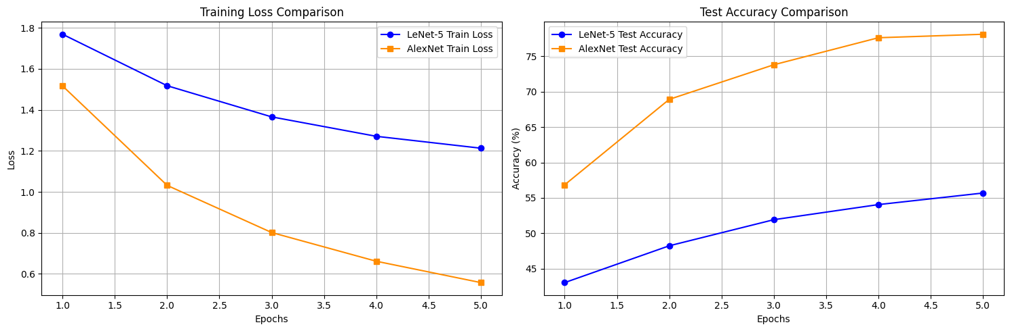
TRAINING RESULTS
Empirical Performance: Convergence & Loss
Learning Dynamics & Optimization Curve:
• Loss Minimization (Epoch 5):
- AlexNet: 0.5577 (over 2.1x lower loss!) - LeNet-5: 1.2130
• Test Validation Accuracy (Epoch 5):
- AlexNet: 78.08% (+22.39% absolute gain!) - LeNet-5: 55.69%
• Computational Epoch Time (Tesla T4):
- LeNet-5: 13.71 seconds / epoch - AlexNet: 133.06 seconds / epoch (9.7x slower) Tradeoff: Accuracy gains vs. spatial resize workloads.

Slide 9
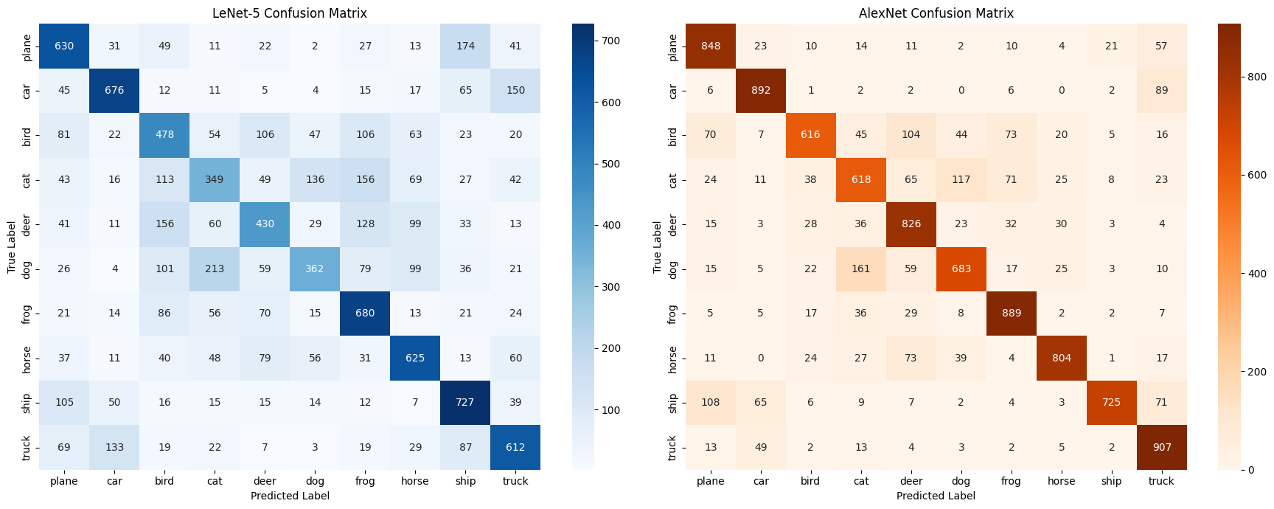
EVALUATION RESULTS
Empirical Performance: Confusion Analysis
Detailed Class Performance Summary:
• Overall F1-Score / Accuracy:
- AlexNet: 78% (macro avg F1-score: 0.78) - LeNet-5: 56% (macro avg F1-score: 0.55)
• Top and Bottom Class Scores:
- AlexNet top: ship (94% prec), truck (91% recall) - LeNet top: car (70% prec), ship (73% recall) - Confusions: LeNet-5 struggled on cat (42% prec) and dog (54% prec). AlexNet boosted cat to 64% and dog to 74% precision, proving deeper visual representations.

Slide 10
Summary of Learnings
The evolution from LeNet-5 to AlexNet is the story of scaling up. By introducing ReLU activations, Dropout regularization, and utilizing GPU compute capacity, AlexNet unlocked the true potential of spatial networks, laying the foundation for all modern visual architectures.
Thank you! Questions are welcome.

