Slide 1
Design for Testability
Doing the right things vs. doing things right
@4calibr4
Pawel Kalbrun, 23 July 2014

Slide 2
Design Goal
High Cohesion
Low coupling
Good encapsulation

Slide 3
Design Goal : How
Single responsibility principle
Open/closed principle
Liskov substitution principle
Interface segregation principle
Dependency inversion principle

Slide 4
TESTABILITY KPI of your DESIGN

Slide 5
Testability Actors
System Under Test (SUT)
Depended On Component (DOC)
Test Doubles

Slide 6
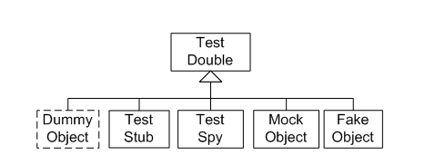
Test Double aka Imposter
Replace a component on which the SUT depends with a test-specific equivalent
Does not need to implement whole interface of DOC
SUT unaware it isn't talking to real collaborator
EasyMock, PowerMock, Mockito, JMock, etc

Slide 7
Four-Phase Test
Fixture Setup
Exercise SUT
Results verification
Fixture teardown

Slide 8
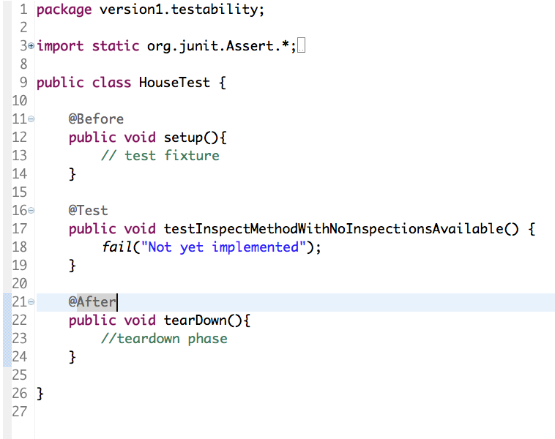
JUnit :Four-Phase Test

Slide 9
WHAT TO KEEP AN EYE ON

Slide 10
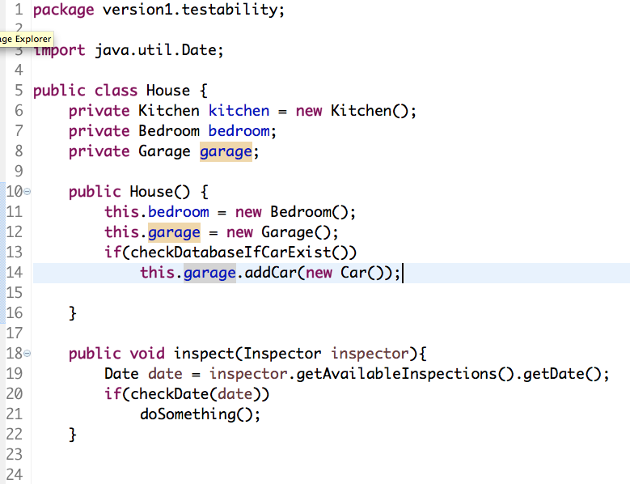
Object Instantiation/Collaborators

Slide 11
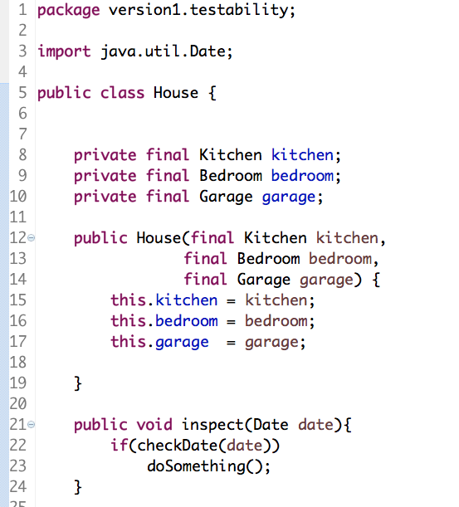
Object Instantiation/Collaborators

Slide 12
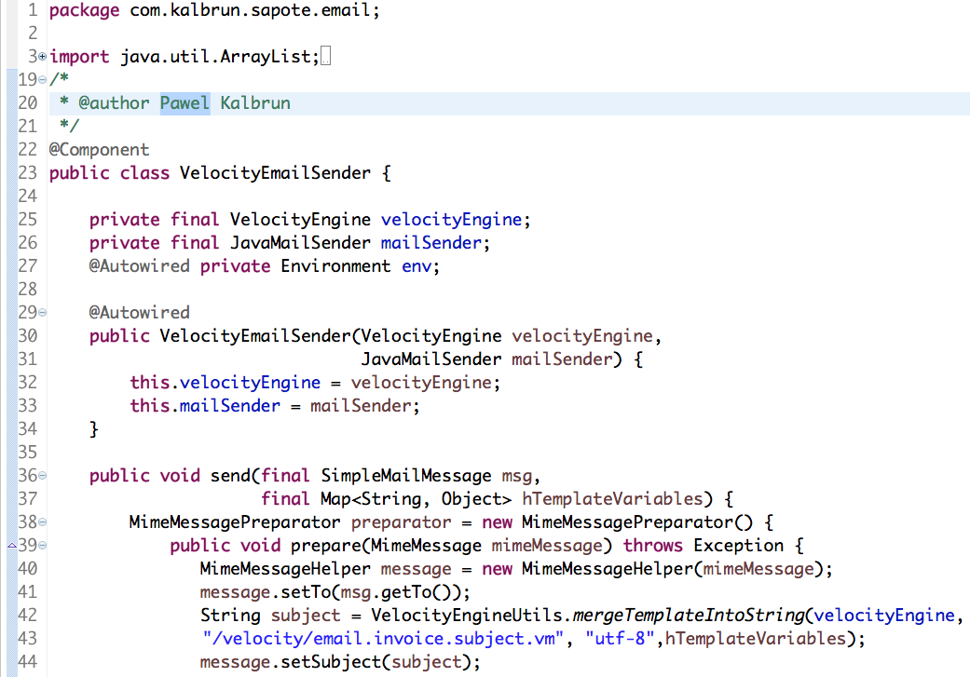
Recognizing the flaw…

Slide 13
SOLUTION

Slide 14
IoC aka Hollywood Principle
Minimize coupling
Increase modularity
Promotes extensibility
IoC containers, ie. Spring, Google Guice
Object coupling is bound at runtime by an assembler object (dependency injection)

Slide 15
Law Of Demeter
Only talk to your immediate friends
Minimize coupling
Prevent you from reaching into an object to gain access to a third object's methods

Slide 16

Law Of Demeter vs. Mockito
when(mock.getBar().getName()).thenReturn("deep");

Slide 17
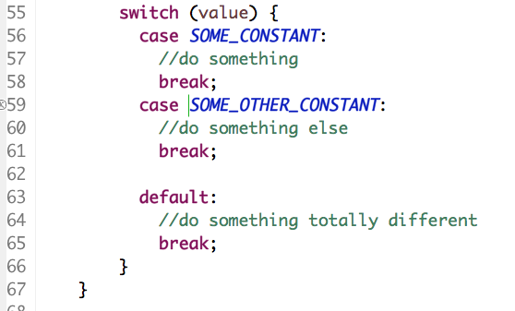
Conditionals?

Slide 18
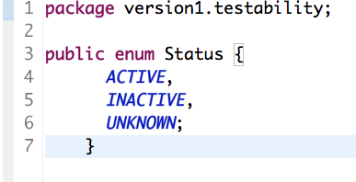
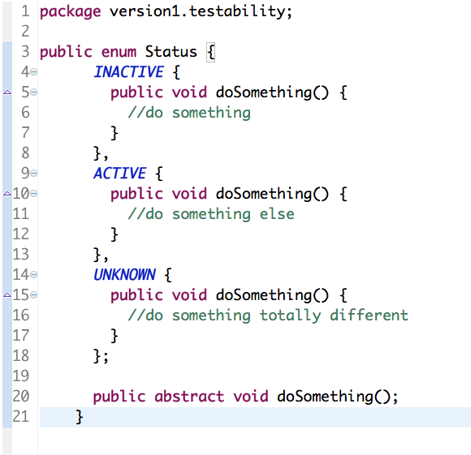
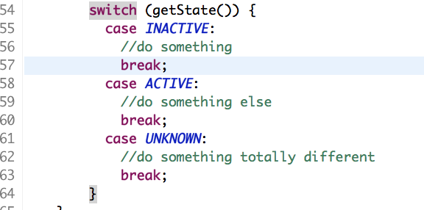
Favor polymorphism over conditionals

Slide 19
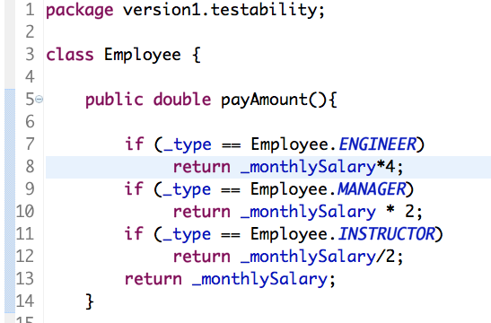
Conditionals…Again?

Slide 20
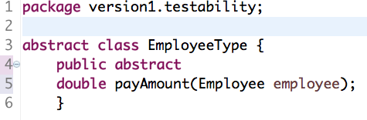
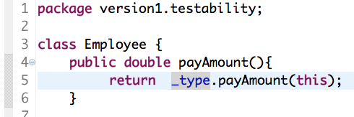
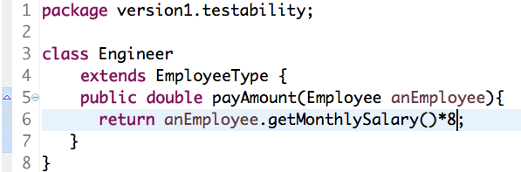
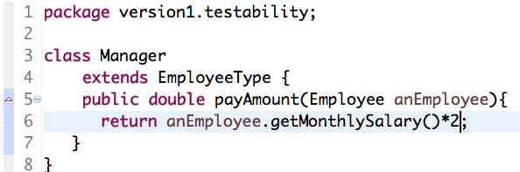
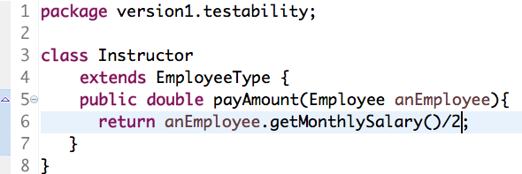
Favor polymorphism over conditionals

Slide 21
Conditionals, why not?
Polymorphic system easier to maintain
Methods easier to read and test
Most conditionals can be replaced by polymorphism
Refactoring patterns your best friends
null vs. NullObject , etc…

Slide 22
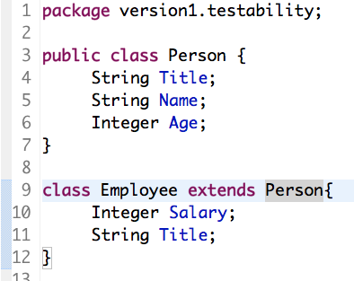
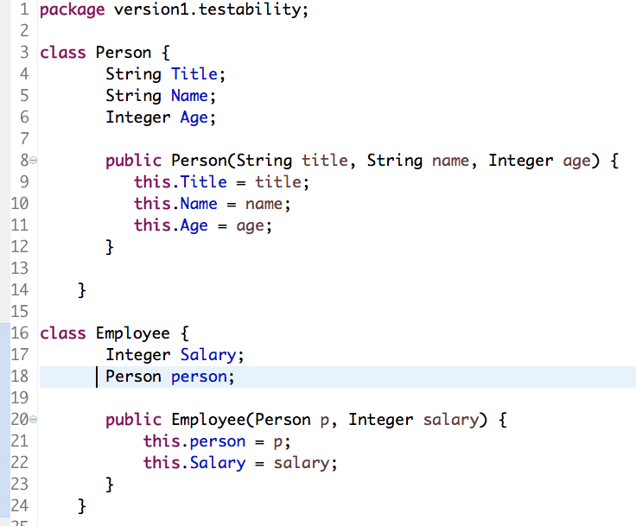
Inheritance vs. Composition

Slide 23
Favor composition over inheritance
Achieve categorization and facilitate polymorphism
Inheritance can not be changed at runtime
Can not use Test Doubles
Using inheritance for code reuse is wrong

Slide 24
Global state
Acessibility
Ideally object should interact only with other objects which were directly passed into it
Introduces a certain amount of coupling into a system

Slide 25
Static methods
Procedural code
Where is this?
Death to testability
Test Doubles

Slide 26
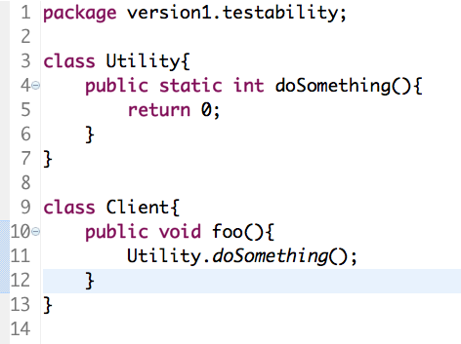
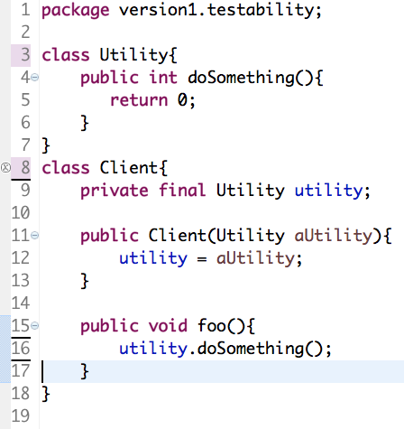
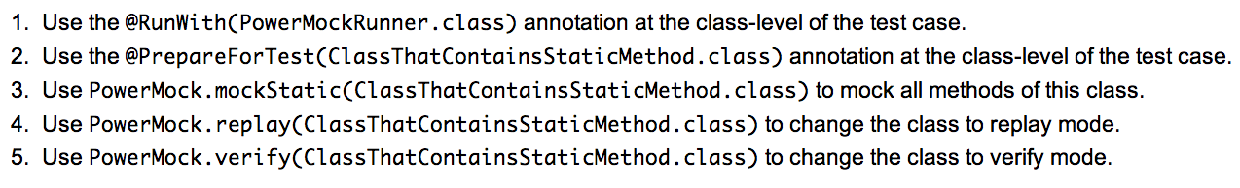
Static methods

Slide 27
Warning signs – Wrap up
DI is your friend, new is NOT
Conditionals all over your codebase
Global state
Mixing object graph construction with app logic
Static methods

Slide 28
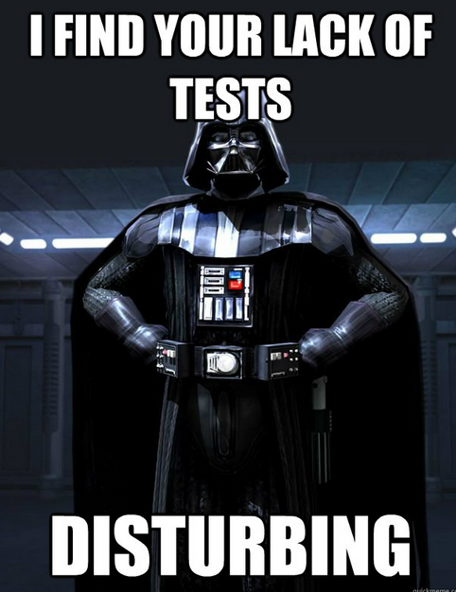

Slide 29
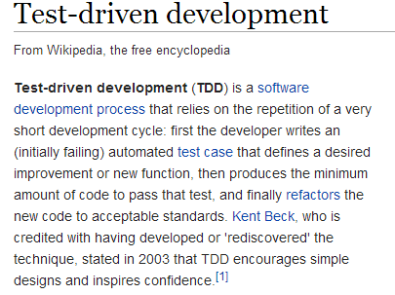
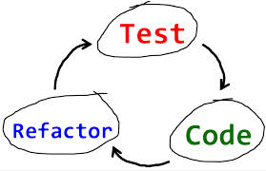
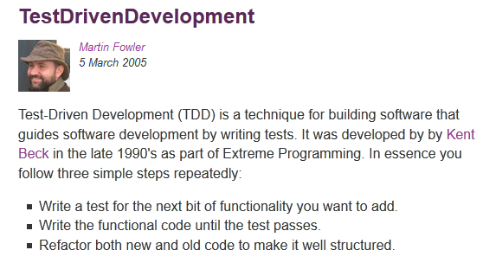
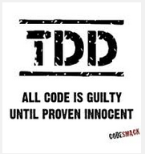
Test Driven Development TDD

Slide 30
TESTING Best Practices

Slide 31
#0 TESTS ARE MUST HAVE
SDLC and Testing
The definition of DONE
Developer mindset
Time against value

Slide 32
#1 ASK
Finding bugs ?
Detecting regression ?
Designing software components robustly ?
Document your design?
Refactoring confidence ?

Slide 33
#2 Learn
Explore available libraries
Understand the scope
Identify critical modules and focus on them
Learn from mistakes

Slide 34
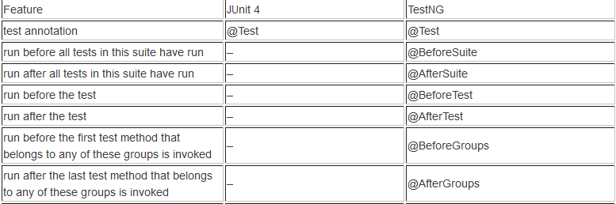
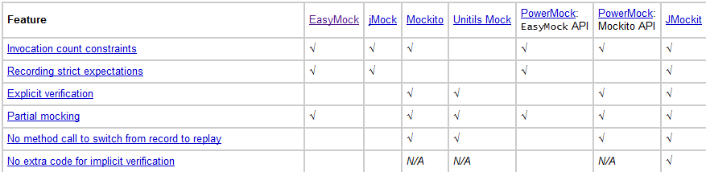
#2 Learn

Slide 35
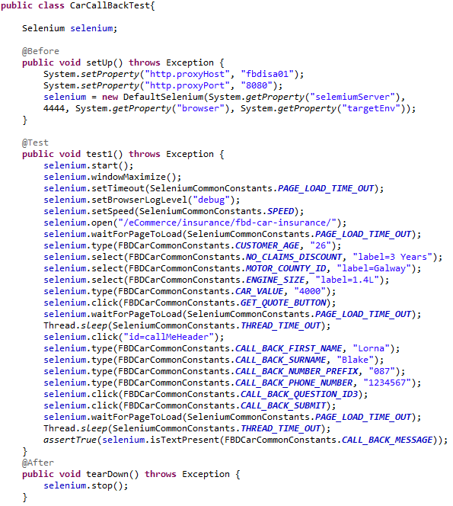
#3 Design

Slide 36
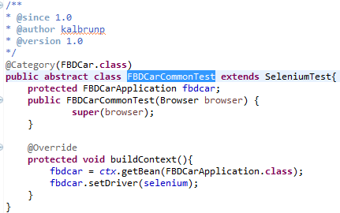
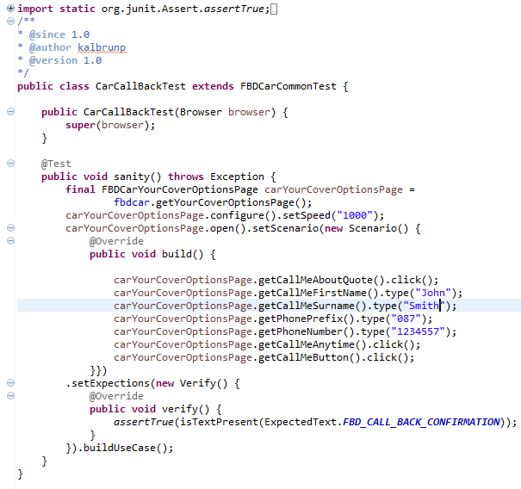
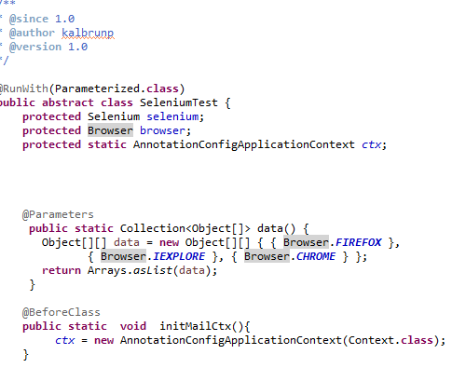
#3 Design

Slide 37
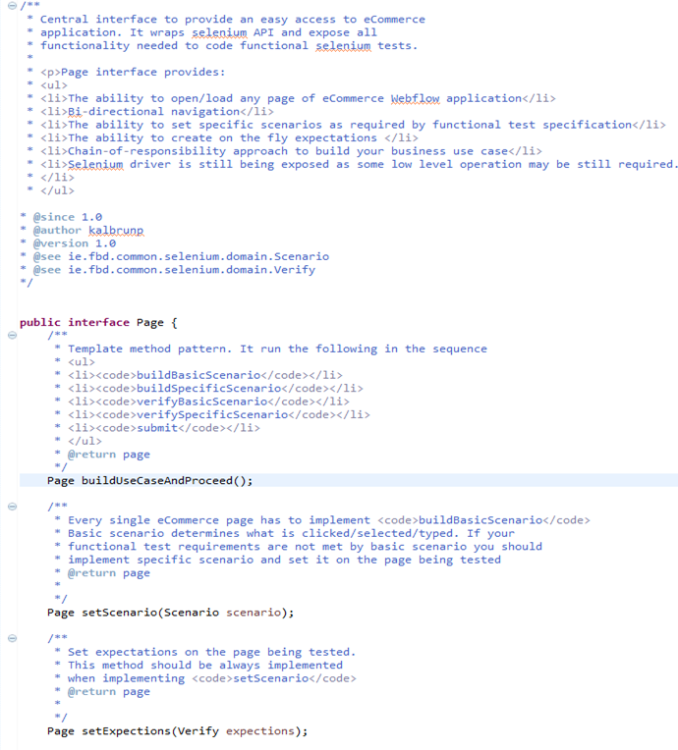
#3 Design

Slide 38
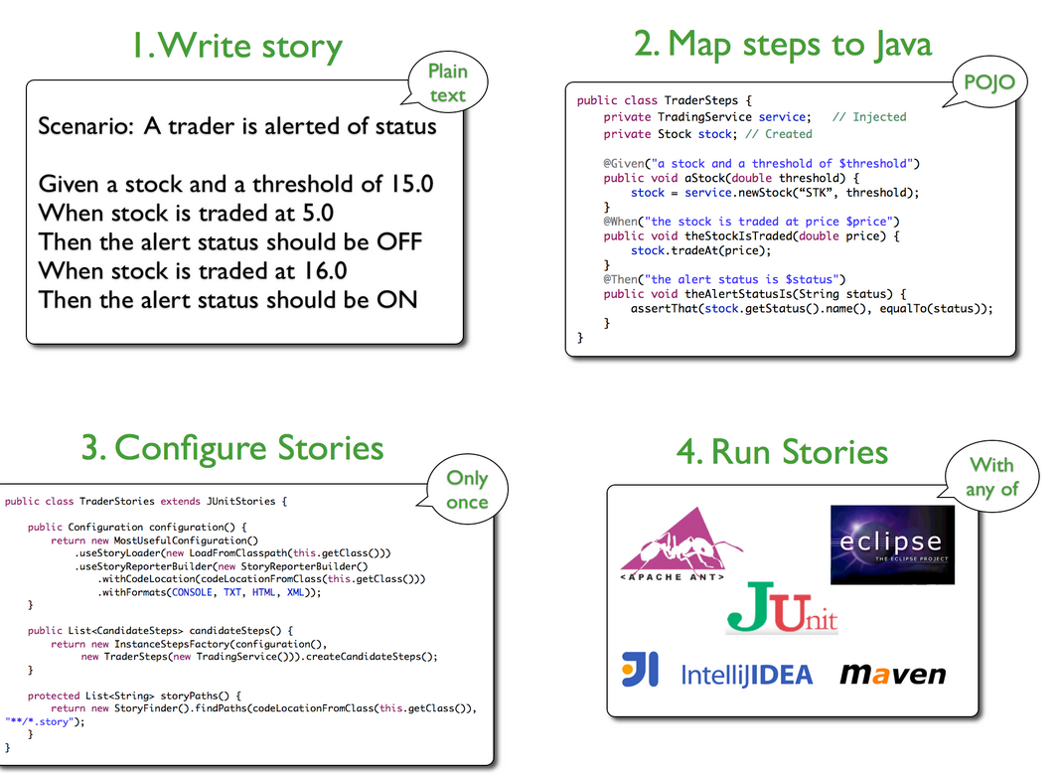
#3 Design

Slide 39
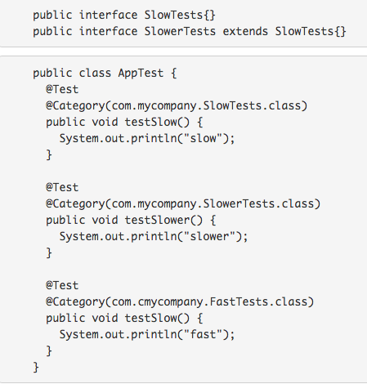
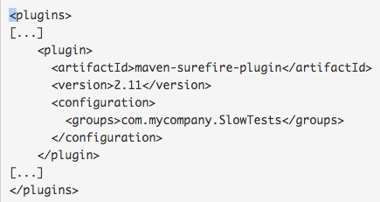
#4 @Categorize

Slide 40
#5 Forget @Ignore

Slide 41
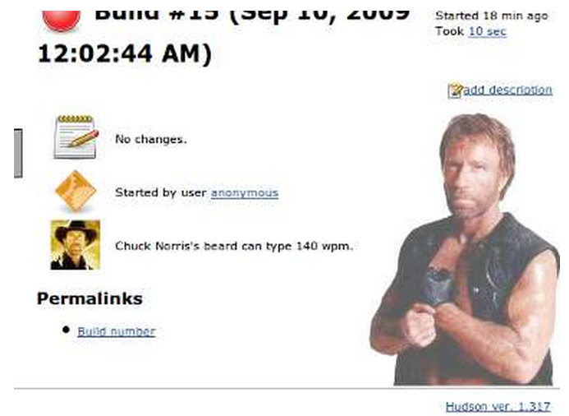
#6 Continuous integration
Chuck is just waiting for -DskipTests

