Slide 1
SERVICE PROVIDER BRIEFING
How we protect the portal
you will work in
TM ANTOINE Advisory Portal · Built in-house · portal.tmantoinelaw.com
Webinar handout · 22 September 2026 · Version 1.0

Slide 2
What we will cover
01
Who we are on the internet
02
Who may enter
The live domain, the staging mailbox, built in-house.
Four access types. Invitation is not enough.
03
How we lock the door
04
Files, copies, encryption
Codes today. Authenticator after this session.
PDF and images. Three copies. Plain-English encryption.
05
Help when it breaks
06
Answers for your file
Bespoke AI, Messages, support@tmantoinelaw.com.
The questions compliance teams have already sent.
TM ANTOINE Advisory Portal · Confidential · 22 September 2026
2 / 16

Slide 3
This is the real portal
One firm. Two addresses that used to confuse people. Live work is only on tmantoinelaw.com.
Use these
Staging — do not use
portal.tmantoinelaw.com
portal@tmantoinelaw.com
support@tmantoinelaw.com
support@tmantoine.com
was the staging mailbox
not the live contact
Built in-house. Not a white-label product. There is no underlying portal vendor to name.
If the address bar is not portal.tmantoinelaw.com, stop. Write to support before you type a code.
TM ANTOINE Advisory Portal · Confidential · 22 September 2026
3 / 16

Slide 4
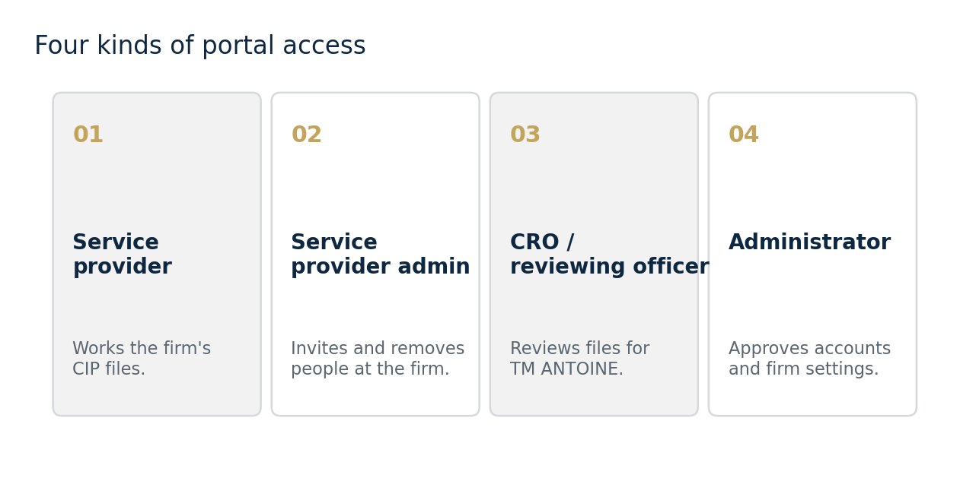
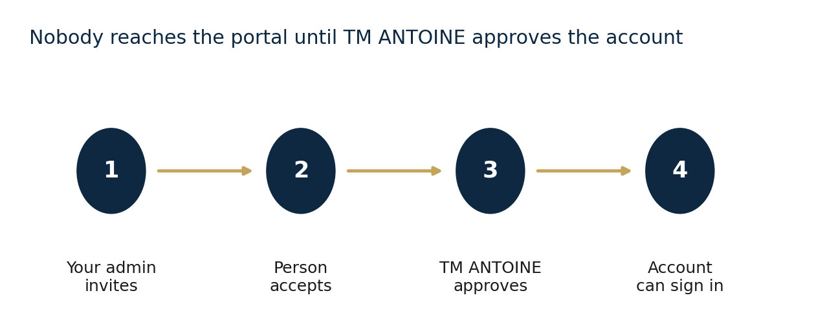
Four kinds of access
Your firm uses two
Service provider — works every CIP file for the company, not only ones they created.
Service provider admin — invites and removes people at your firm. TM ANTOINE still approves each new account.
CRO / reviewing officer and Administrator belong to TM ANTOINE. No service-provider person is a portal administrator.
TM ANTOINE Advisory Portal · Confidential · 22 September 2026
4 / 16

Slide 5
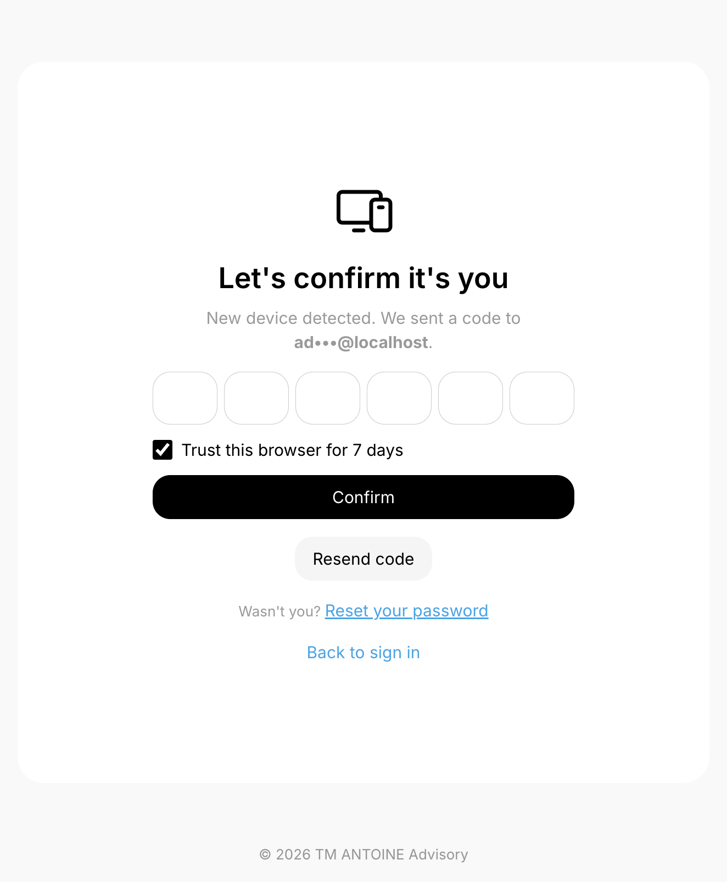
Sign-in today · authenticator after this session
NOW
AFTER THIS WEBINAR
A dual check
Authenticator required
First sign-in from a known setup uses email. If the device changes, a six-digit code is sent only to the address already on the account. Nobody can redirect that code.
Every service-provider account will connect an authenticator app. A new six-digit number every thirty seconds, on your phone. Password plus email is no longer enough.
Settings → Account Security → Authenticator app → scan the QR code. Keep recovery codes offline. Never send a code in chat.
TM ANTOINE Advisory Portal · Confidential · 22 September 2026
5 / 16

Slide 6
The portal is not open to the whole map
We keep the countries where our service-provider clients operate. We refuse the rest, including North Korea, South Korea, and Russia. The country is read at the edge, before sign-in.
Allowed
Countries where our provider firms actually work
Refused
North Korea, South Korea, Russia, and other non-client locations
VPN
Anonymising proxies can be refused — turn them off if the page asks
TM ANTOINE Advisory Portal · Confidential · 22 September 2026
6 / 16

Slide 7
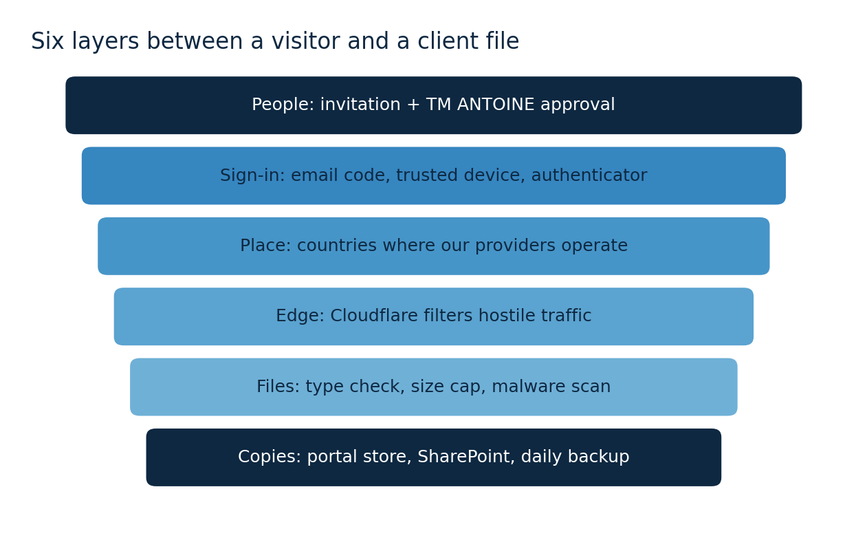
Six layers, not one lock
TM ANTOINE Advisory Portal · Confidential · 22 September 2026
7 / 16

Slide 8
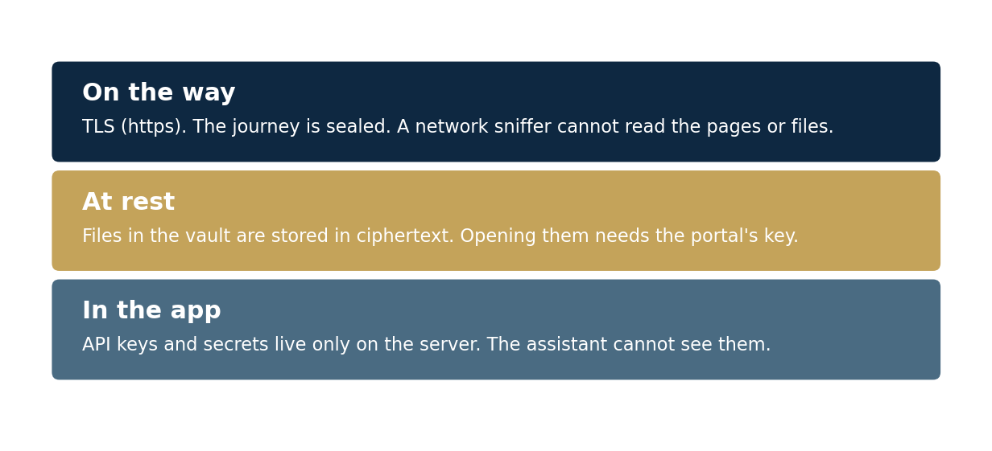
Encryption, in ordinary words
Intercepting tools on the network can see that traffic exists. They cannot read it. API keys never leave the server. Bespoke AI cannot see them.
TM ANTOINE Advisory Portal · Confidential · 22 September 2026
8 / 16

Slide 9
What may be uploaded
PDF or image
5–10 MB
Malware scan
CIP files. The portal reads the bytes, not just the name.
Public upload links. No room for a giant hidden payload.
A failed scan cannot be opened or downloaded.
A renamed program posing as a PDF is refused. Do not zip software into an application folder.
We are still hardening this door. Size limits and type checks are in place. Independent testing is still to come.
TM ANTOINE Advisory Portal · Confidential · 22 September 2026
9 / 16

Slide 10
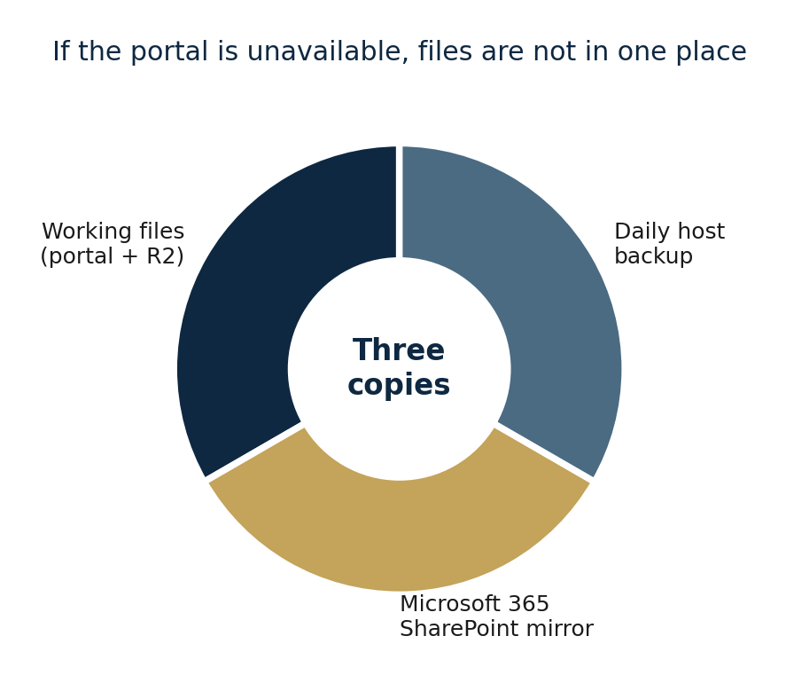
Where it lives · how it comes back
Application and database run together on Laravel Cloud (AWS, United States). Cloudflare in front. Documents in a private store, mirrored to Microsoft 365.
Portal + R2
The files you open while you work.
SharePoint
If the portal is down, the document set is still in Microsoft 365.
Daily backup
A once-a-day copy of the site with the host.
Audit log
Who did what, and when. Not editable by users.
TM ANTOINE Advisory Portal · Confidential · 22 September 2026
10 / 16

Slide 11
Ask Bespoke AI first
It knows this portal. Workflows, missing fields, who to write to. It does not know other firms' files. It does not know API keys.
Workflow
This file
How does Pre-Approval move from one step to the next?
What is still missing on the application I have open?
People
Never
Who do I speak with if the portal errors?
Do not paste passwords or authenticator codes into the assistant.
TM ANTOINE Advisory Portal · Confidential · 22 September 2026
11 / 16

Slide 12
If the portal is the problem
support@tmantoinelaw.com
Shared with TM ANTOINE administrators. Target reply: within an hour, pending availability. Primary contact: Vernon Francis.
Vernon Francis
Cindy McLean
Emmanuel McLean
Krishna Manru
Primary technical contact
Administrator · email or Messages
Administrator · email or Messages
Administrator · email or Messages
Say the page, the account email, and the CIP number. Never send a sign-in or authenticator code.
Messages inside the portal is equally valid when you can still sign in.
TM ANTOINE Advisory Portal · Confidential · 22 September 2026
12 / 16

Slide 13
On your compliance file · security
Host
Laravel Cloud on AWS, United States, plus Cloudflare.
Encryption
TLS in transit. Ciphertext at rest in the vault and R2.
MFA
Email code on a new device now. Authenticator required after this webinar.
Company members
See every application for the company, not only their own.
Testing / ISO / SOC 2
Independent testing planned, not yet complete. No ISO 27001 or SOC 2 today.
Backup
Portal store, SharePoint mirror, daily host backup.
Audit
Who did what, when, including document activity.
TM ANTOINE Advisory Portal · Confidential · 22 September 2026
13 / 16

Slide 14
On your compliance file · data
DPA
Transfers
Yes — pending review by our legal team. Your paper or ours.
Only what CIU, NIC, and Immigration need. Same practice as before the portal. SCCs where legal review says they apply.
Retention
Sub-processors
We keep the file unless the applicant asks us to delete it after the case is closed.
AWS / Laravel Cloud (USA), Cloudflare including R2, Microsoft 365 / SharePoint.
Breach
Staff leaving
Playbook being finalised. Confirmed personal-data incidents: notify affected firms without delay.
Your admin removes them that day. TM ANTOINE is notified. We still approve every new account.
TM ANTOINE Advisory Portal · Confidential · 22 September 2026
14 / 16

Slide 15
After this session
1
Name your service-provider administrator if you have not.
2
Connect an authenticator app on every account you will use.
3
Bookmark portal.tmantoinelaw.com. Treat any other host as suspect.
4
Use Bespoke AI for how-the-screen-works questions.
5
Use support@tmantoinelaw.com or Messages for faults — never for codes.
6
File this briefing with your compliance papers.
TM ANTOINE Advisory Portal · Confidential · 22 September 2026
15 / 16

Slide 16
We would rather walk it through
than leave a gap on your file.
support@tmantoinelaw.com
Vernon Francis · Cindy McLean · Emmanuel McLean · Krishna Manru
A written copy of this briefing will follow by email.

