Slide 1
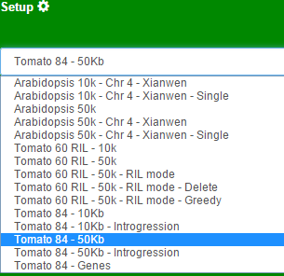
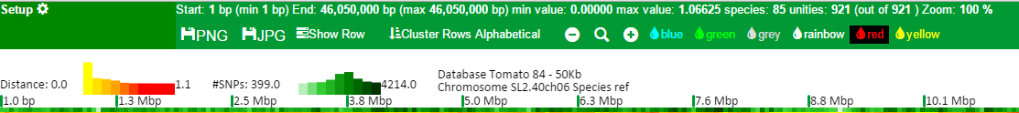
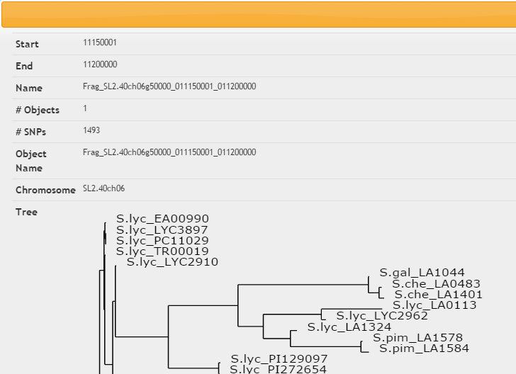
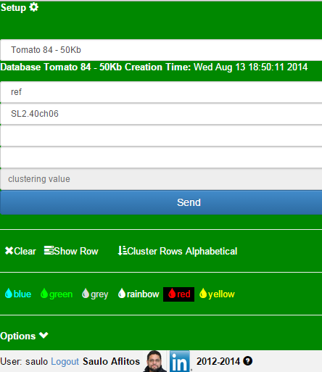
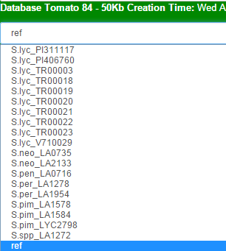
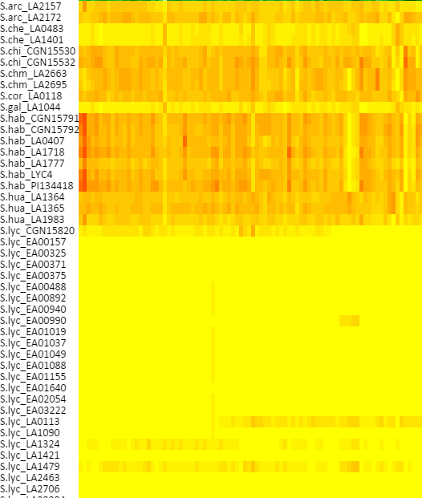

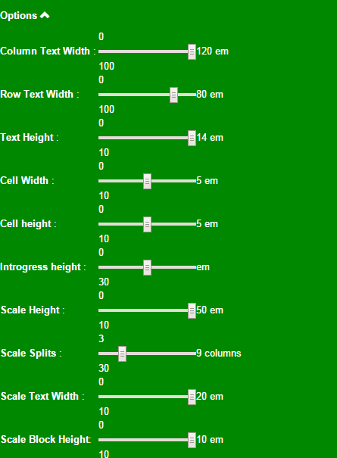

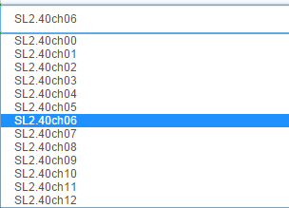
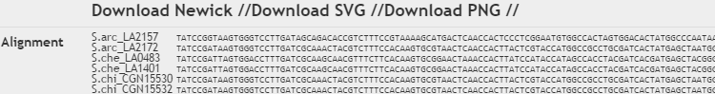
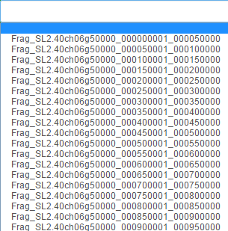
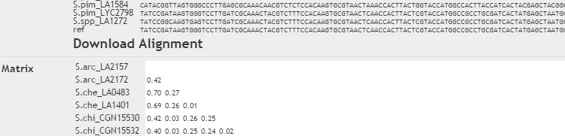

Hover to open setup
Choose Database
Visualization information
Download as image
Show row names
Cluster
Zoom: out, reset, in
Choose colour scheme
Row information (double click in cell or select a fragment in the setup tab)
Choose Reference Genome
Histogram of phylog. distance
Histogram of SNP count
Number of SNPs in the coordinate
Graph information
Coordinates
Cell information
(1 click in cell)
Send request
Choose Chromosome
Show row names
Select colour scheme
Pick a fragment to analyse individually
Formatting options
Species names
I’m thinking. Please wait
Choose clustering
Cluster by alphabetical order of species names
A manually entered clustering
Full chromosome clustering

