Slide 1

Drink and Be Happy
January 23, 2019

Slide 2
Initial Questions
Why do we care?
What are the most/least happy countries in the world?
What are the components of that score?
How are they measured?
Which elements are most impactful/weighted?
Which countries have the most/least alcohol consumption?
Is it specific to a region/continent/sub-continent?
Do countries have preferences for wine/beer/spirits?
Which countries have the most/least income inequality?
Do these countries have similar governmental policies?
Are they considered developed or developing nations?
Is either income inequality or alcohol consumption a potential indicator of happiness a country’s happiness?

Slide 3



A Deep Data Dive
Where’s the information?
Data Collection
3
main sources of merged data
Google APIs – geocode latitudes and longitudes
UN World Happiness Rankings
World Bank – Total Alcohol consumption per capita
156
countries around the world
averaged datasets from
2010-2016

Slide 4
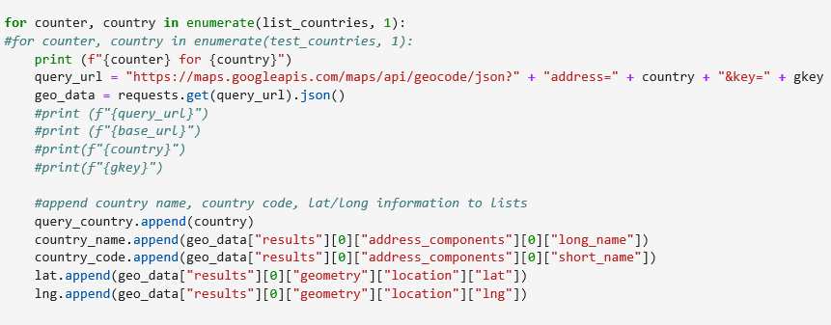
A Deep Data Dive
Where’s the information?
Data Exploration
Google APIs – geocode
The data exploration and cleanup process (accompanied by your Jupyter Notebook)
The analysis process (accompanied by your Jupyter Notebook)

Slide 5
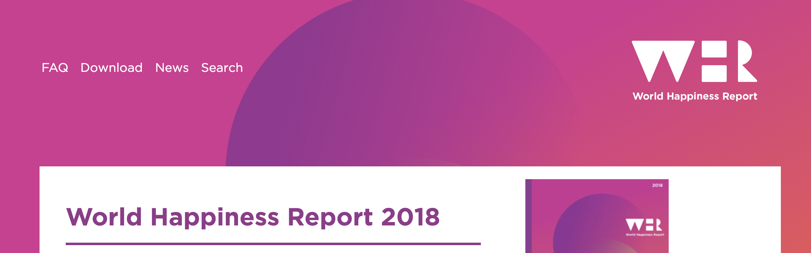
The key variables that have been found to support well-being:
Income
Healthy Life Expectancy
Social Support
Freedom
Trust
Generosity
Gallup World Poll: Cantril ladder: it asks respondents to rate their life, best possible for them being a 10, and the worst possible life being a 0. The typical annual sample is 1,000 people to reduce random sampling errors. The confidence interval is measured at 95% accuracy.

Slide 6
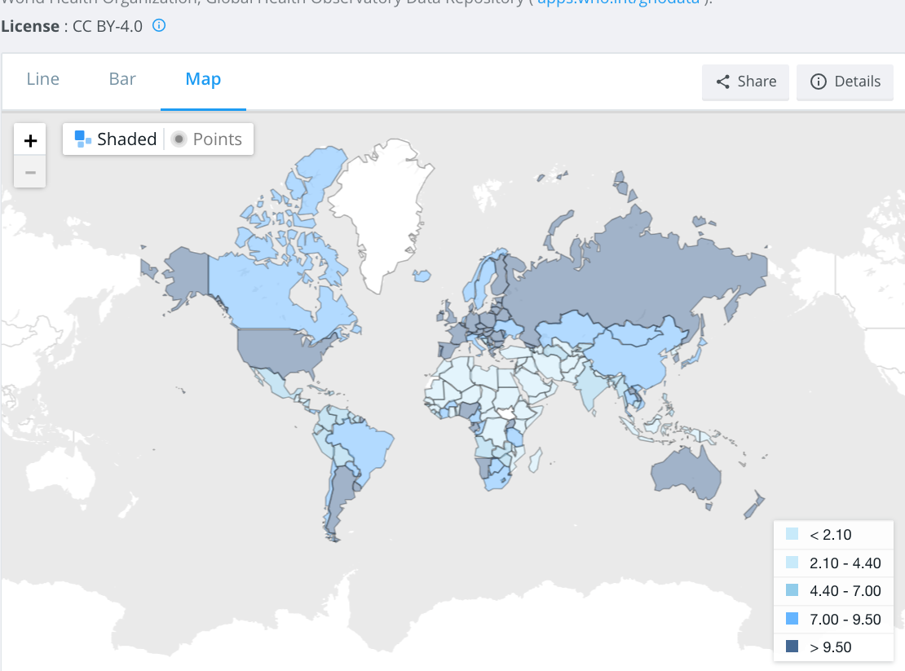
total alcohol consumption per capita
(liters of pure alcohol, projected estimates, 15+ years of age)

Slide 7
Data Exploration & Clean-up Process
Where’s the information?
The data exploration and cleanup process (accompanied by your Jupyter Notebook)
The analysis process (accompanied by your Jupyter Notebook)
Your conclusions. This should include a numerical summary as well as visualizations of that summary
Discuss the implications of your findings. This is where you get to have an open-ended discussion about what your findings "mean
Q&A session to follow your presentation

Slide 8
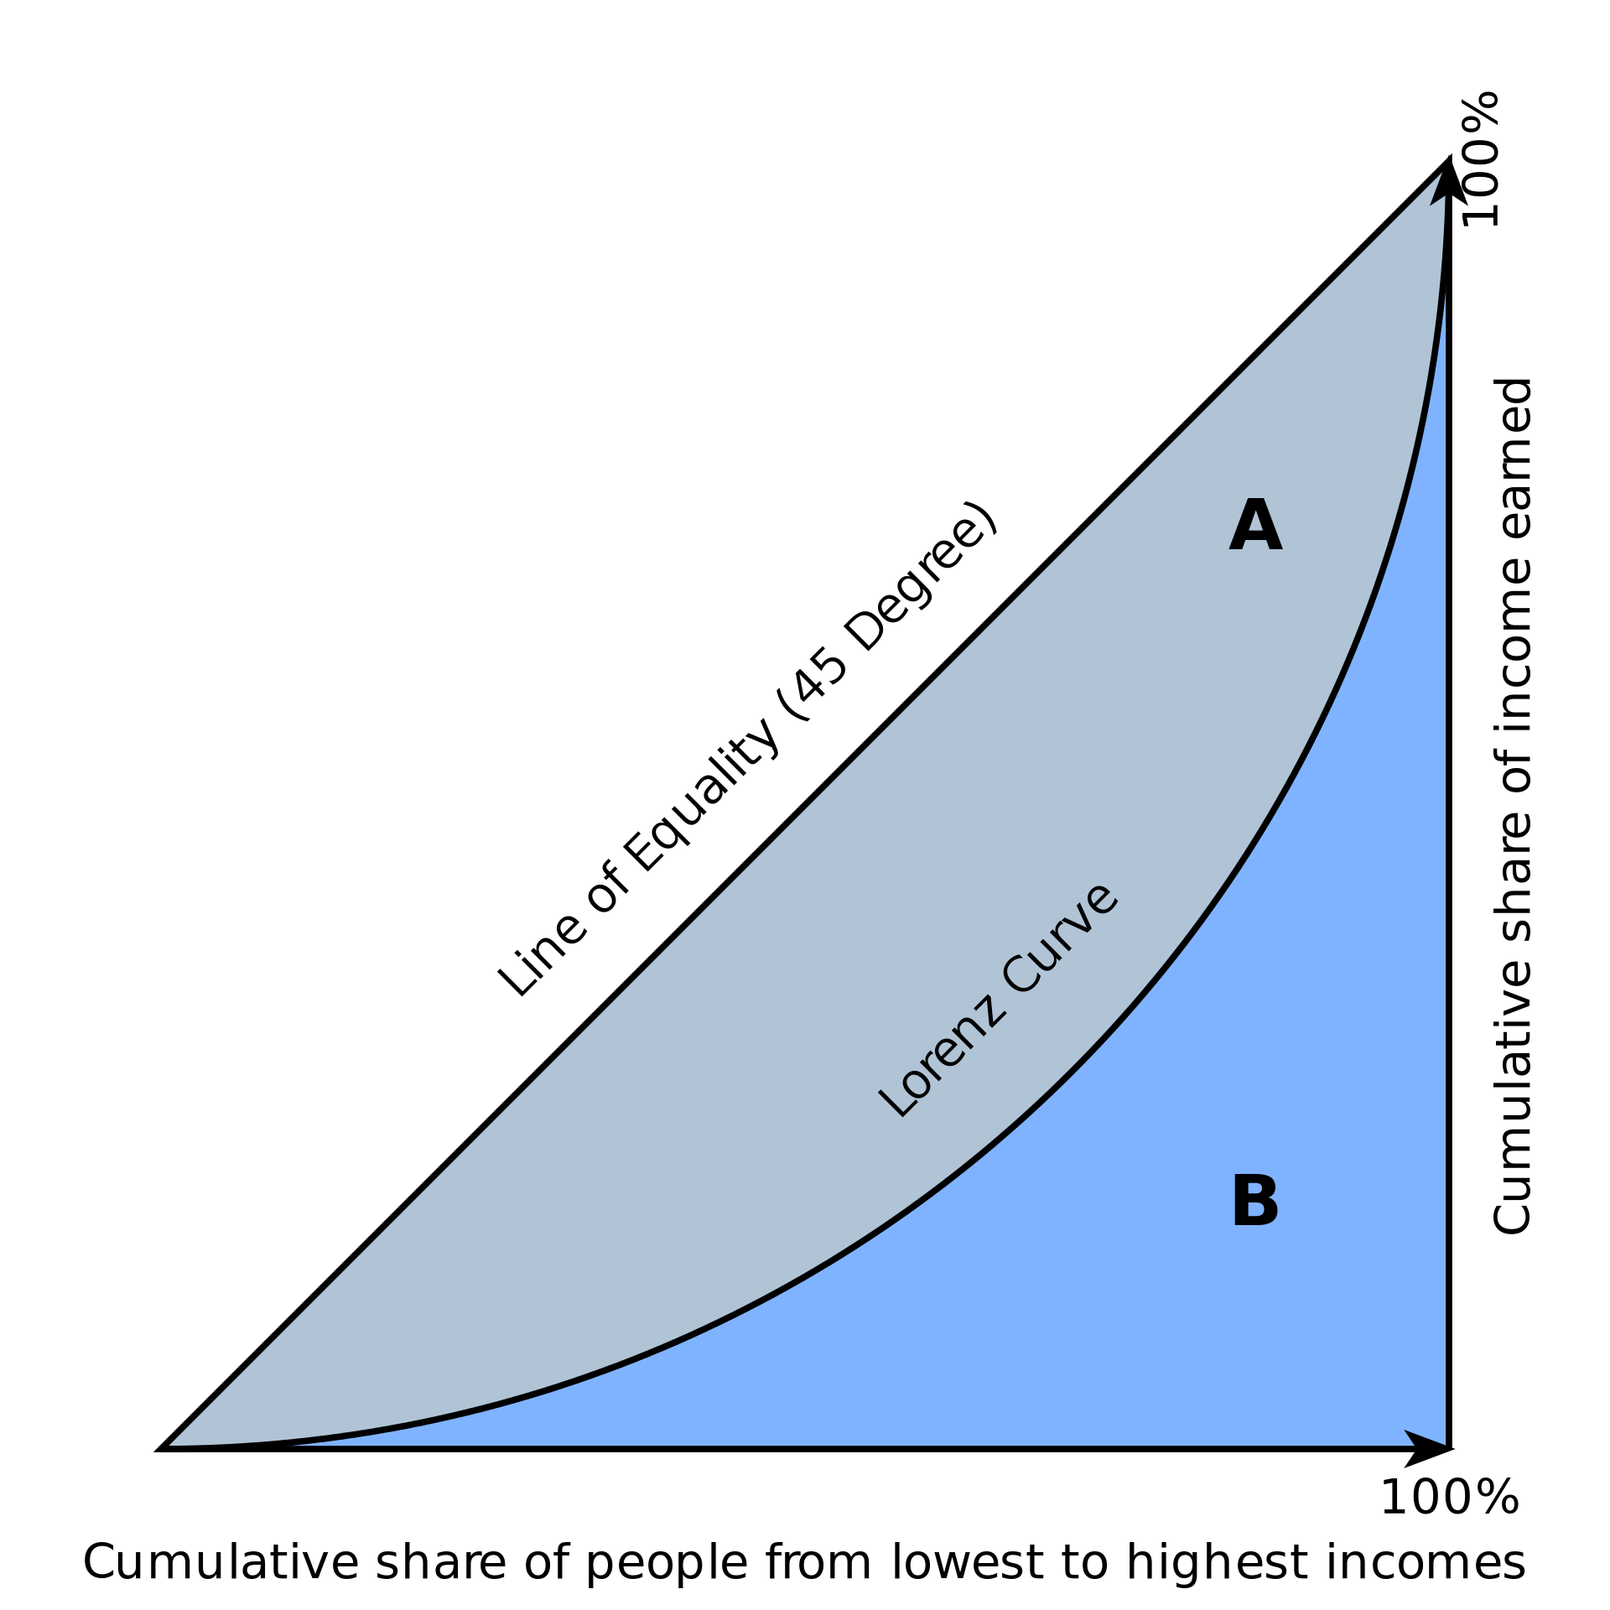
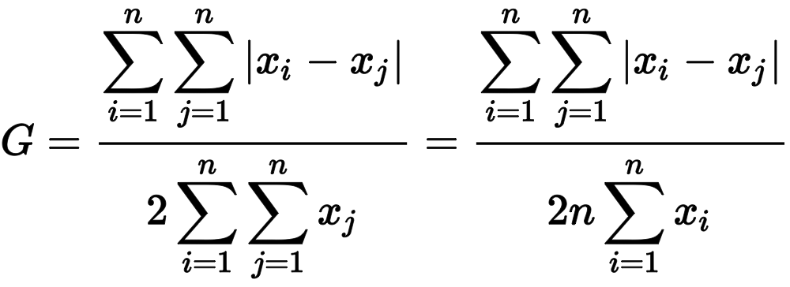
Data Exploration & Clean-up Process
The Gini Coefficient
relative mean absolute difference
which is mathematically equivalent to the Lorenz curve definition
A single number aimed at measuring the degree of inequality in a distribution. It is most often used in economics to measure how far a country's wealth or income distribution deviates from a totally equal distribution

Slide 9
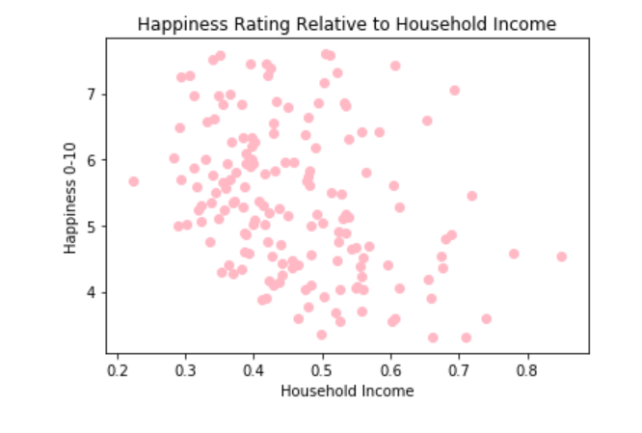
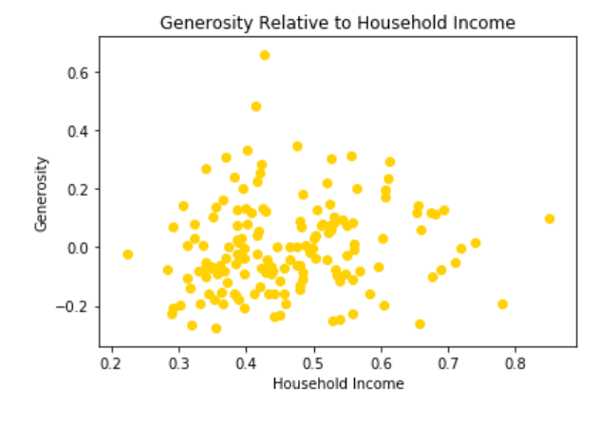
Conclusions: Happiness Factors
How do the different happiness factors correlate?
Analyzing household income

Slide 10
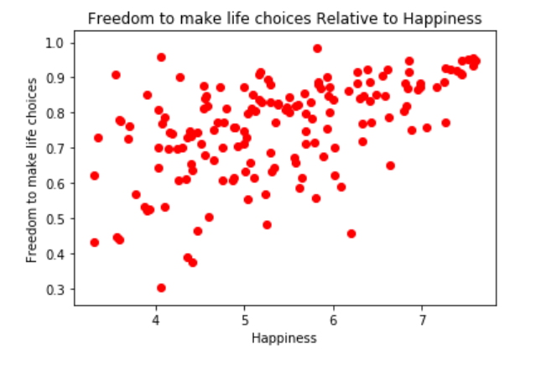
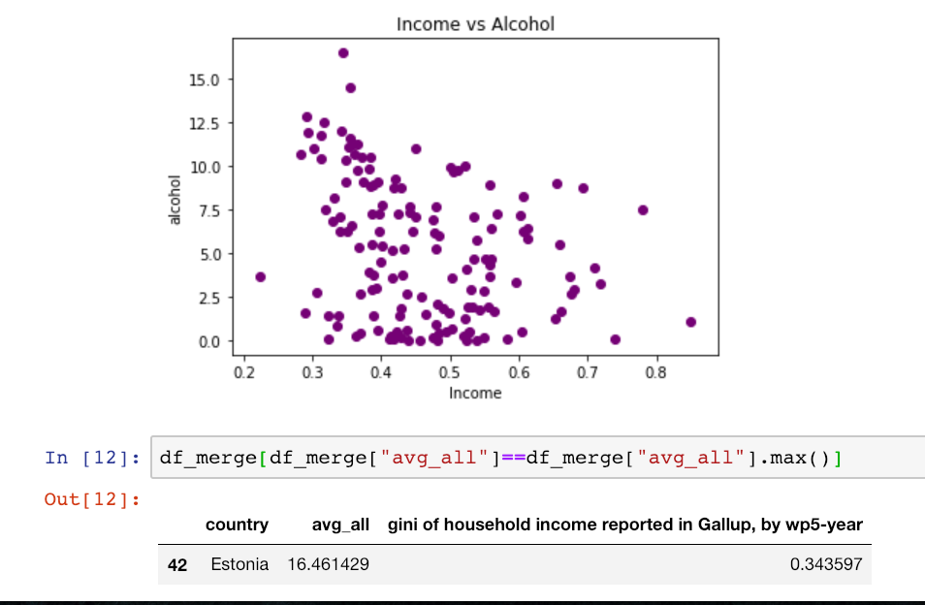
Happiness Factors

Slide 11
Happiness Factors

Slide 12
Conclusions
Thots?
What are the most/least happy countries in the world?
The happiest countries appear to be located primarily in Scandinavia (3) and (7) Europe. The least happy countries are primarily found in Africa, with 9 of the bottom 10.
Which countries have the most alcohol consumption? Least?
Least alcohol consumption title belongs to Somalia, but it is closely followed by a slew of Middle Eastern and North African countries that are in the surrounding geographical area
Most alcohol consumption title belongs to Estonia, with European countries rounding out the top 20 alcohol consumers, all above 10 liters per year consumption.

Slide 13
Conclusions
More Thots?
Which countries have the most income inequality?
South Africa has highest instance of GINI coefficient, but South America appears to have the highest concentration of income inequality, with countries such as Honduras, Brazil, Colombia, Paraguay, and making the top 10.
Countries with increased income equality were primarily located in Europe, with 4 of the 10 lowest GINI coefficient countries also being 4 of the 10 happiest nations.
Is there a correlation between alcohol consumption and happiness?
The data doesn’t suggest that there is a correlation between alcohol consumption and happiness. The data appears to be randomly distributed.
Is there a correlation between alcohol consumption and income inequality?
There appears to be a trend where reduced income inequality leads to higher alcohol consumption.
Is there a correlation between income inequality and happiness?
The data shows a seemingly significant trend indicating that reduced income inequality correlates with increased happiness.

Slide 14
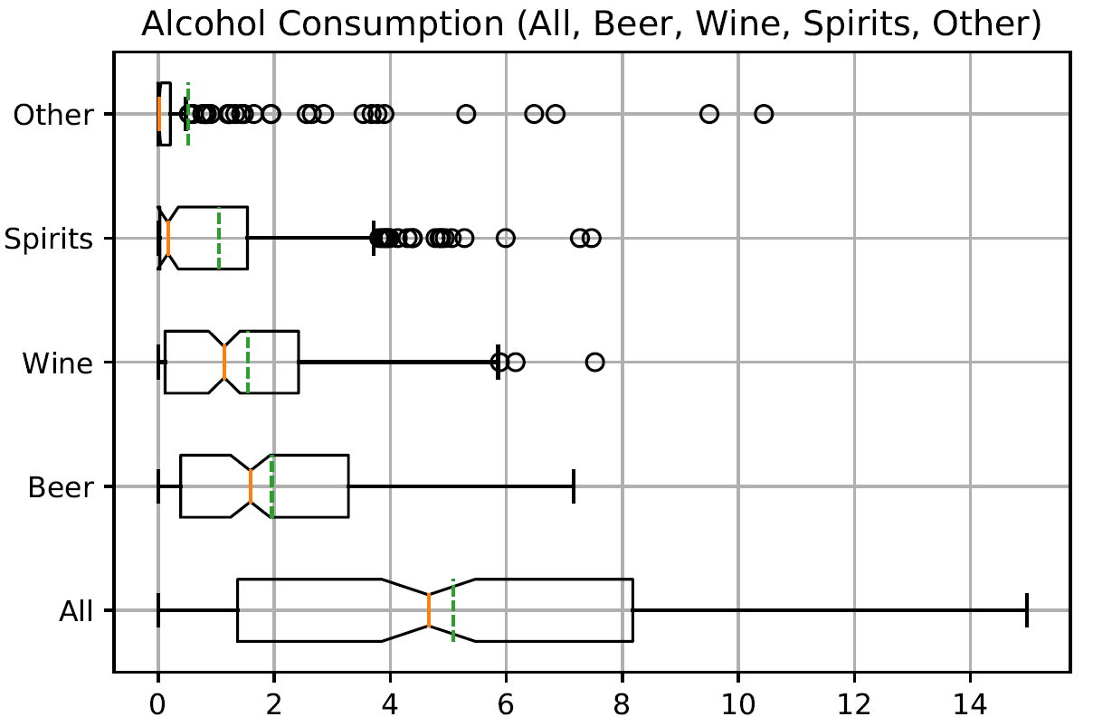
WHISKERS

Slide 15
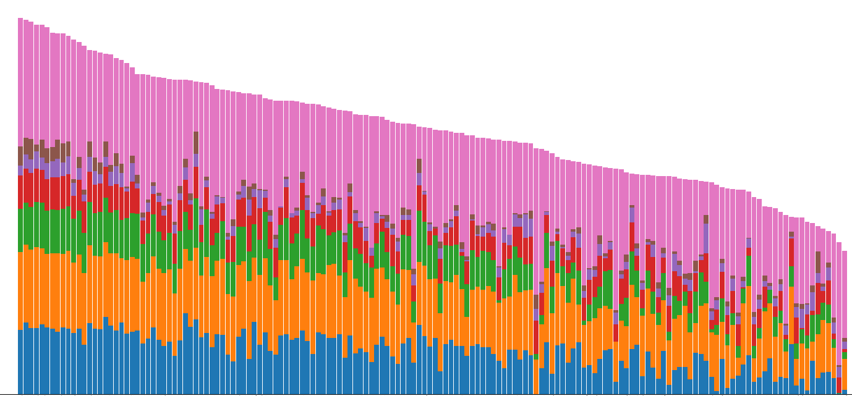
HAPPINESS IS A WARM GUN

Slide 16
INITIAL DATA and QUESTIONS
DATA
QUESTIONS?
WORLD HAPPINESS REPORT
WORLD ALCOHOL CONSUMPTION
INCOME INEQUALITY BY COUNTRY
What countries are happiest? And are they located in specific geographic region?
What countries consume the least/most amount of alcohol?
Which countries suffer from greatest amount of income inequality?
How do these three pieces of data correlate? Is income inequality an indicator of happiness? Or is alcohol consumption?

