Slide 1

Drink and Be Happy
January 23, 2019

Slide 2

Happiness defined!
The key variables that have been found to support well-being:
Gallup World Poll: Cantril ladder: it asks respondents to rate their life, best possible for them being a 10, and the worst possible life being a 0. The typical annual sample is 1,000 people to reduce random sampling errors. The confidence interval is measured at 95% accuracy.
Income
Healthy Life Expectancy
Social Support
Freedom
Trust
Generosity

Slide 3
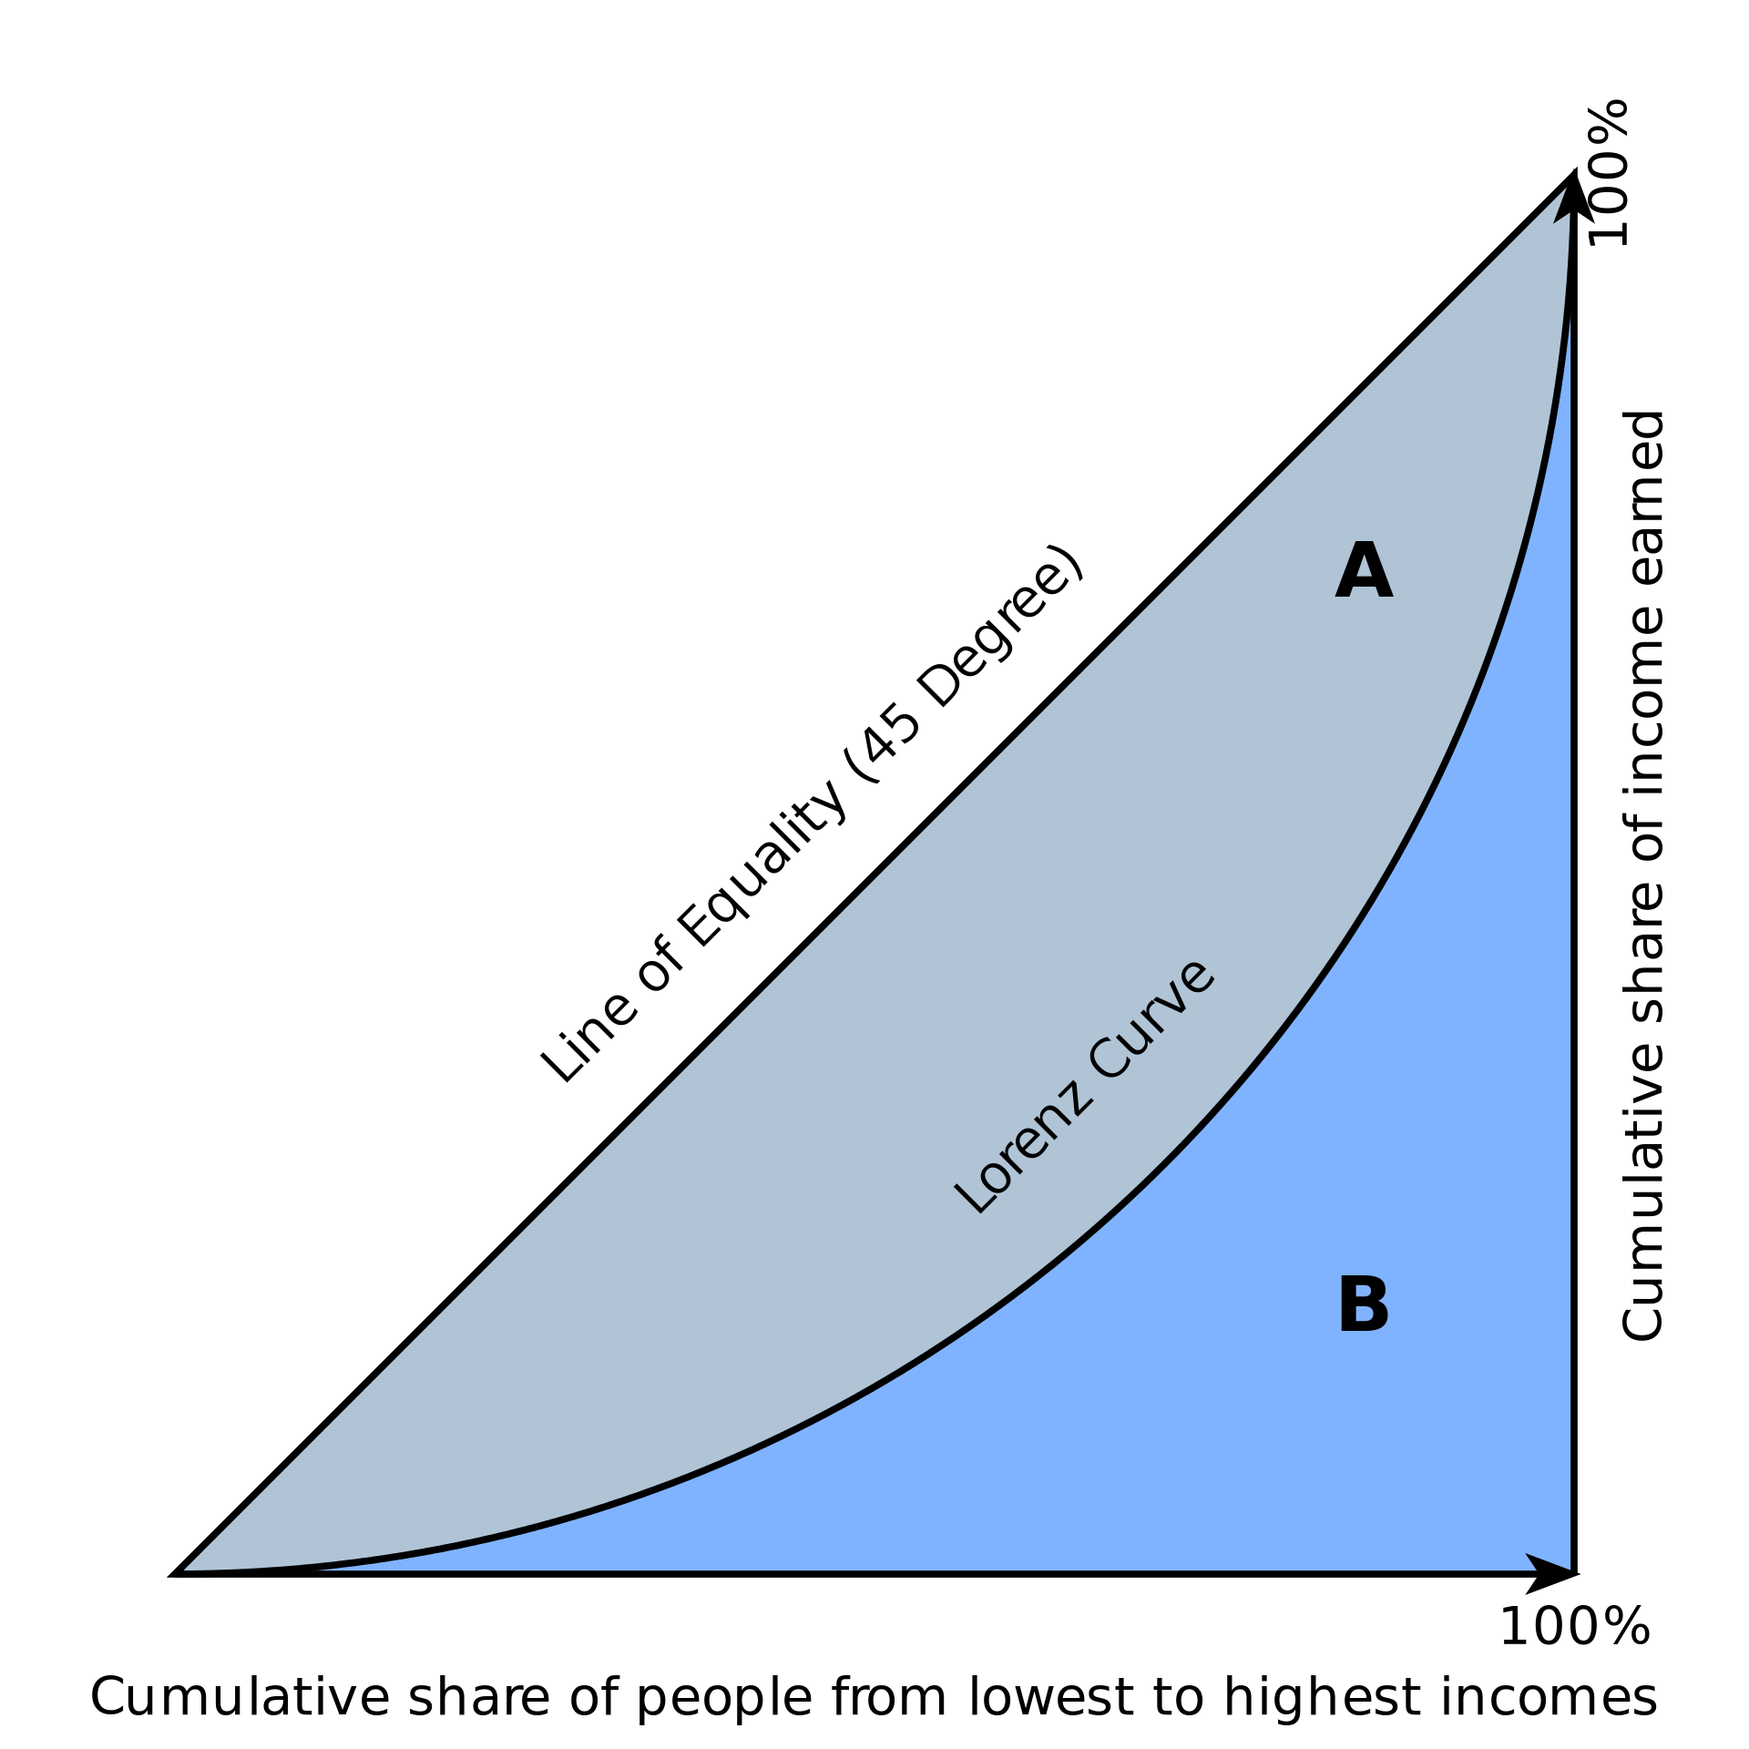

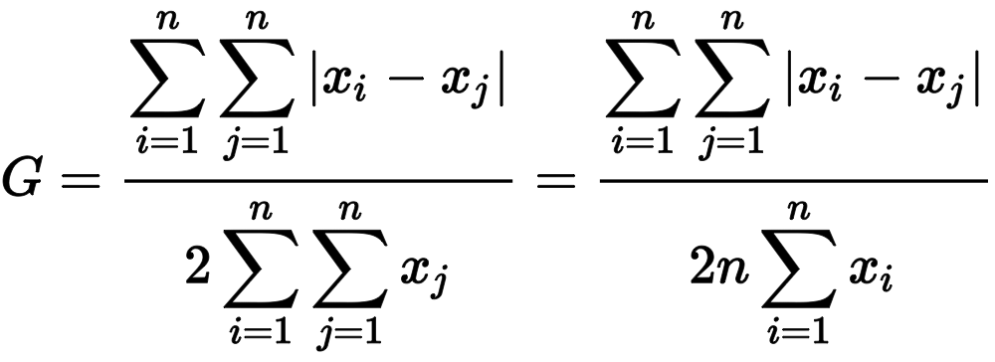
Gini coefficient measures relative, not absolute, wealth
A single number aimed at measuring the degree of inequality in a distribution. It is most often used in economics to measure how far a country's wealth or income distribution deviates from a totally equal distribution
The Gini Coefficient
relative mean absolute difference
which is mathematically equivalent to the Lorenz curve definition

Slide 4
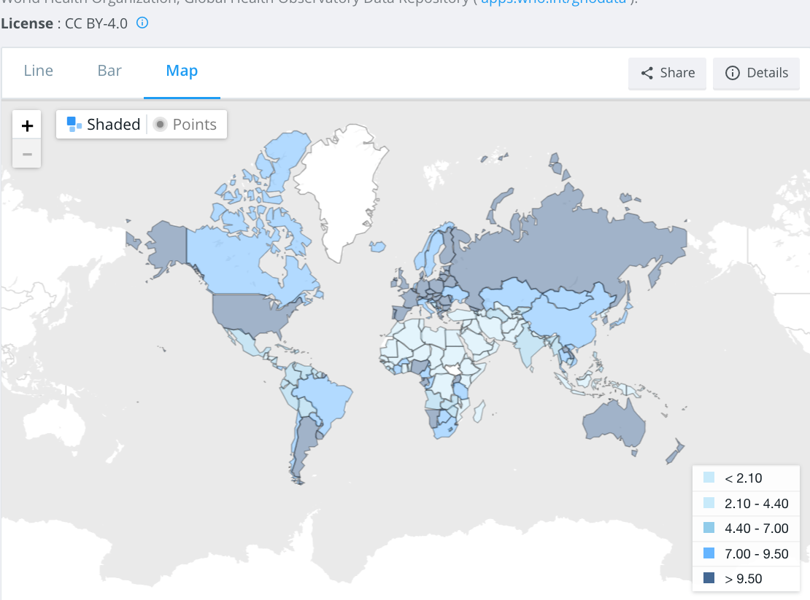
total alcohol consumption per capita
(liters of pure alcohol, projected estimates, 15+ years of age)

Slide 5
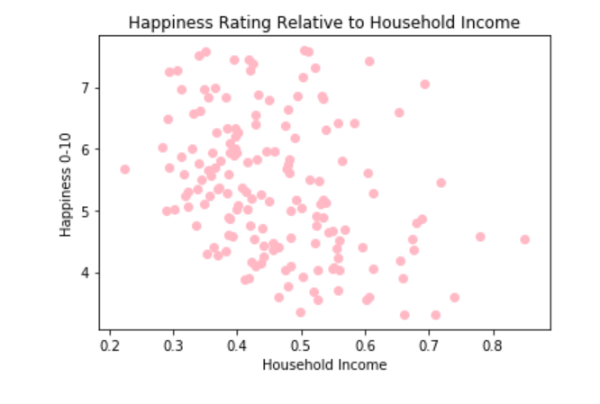
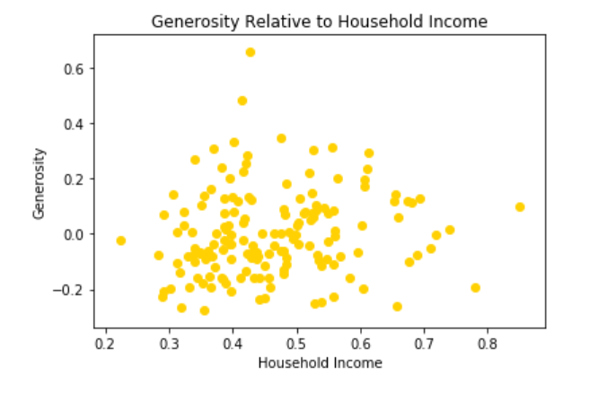
Income
text
text

Slide 6
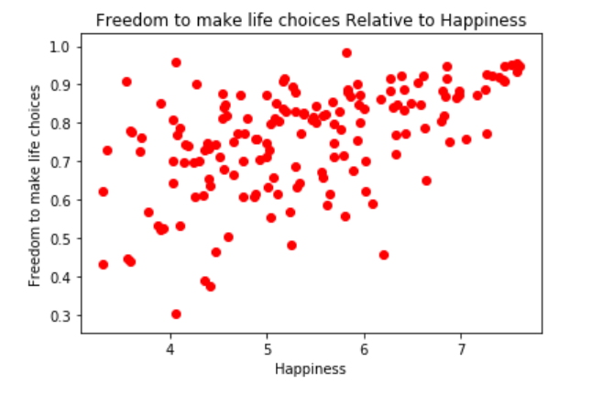
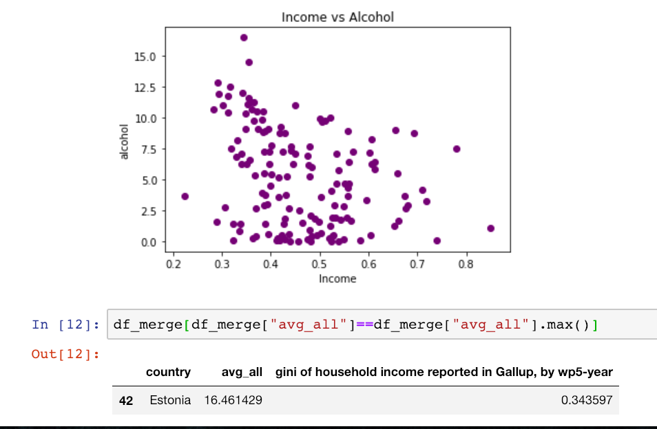
Happiness
Text
text

Slide 7
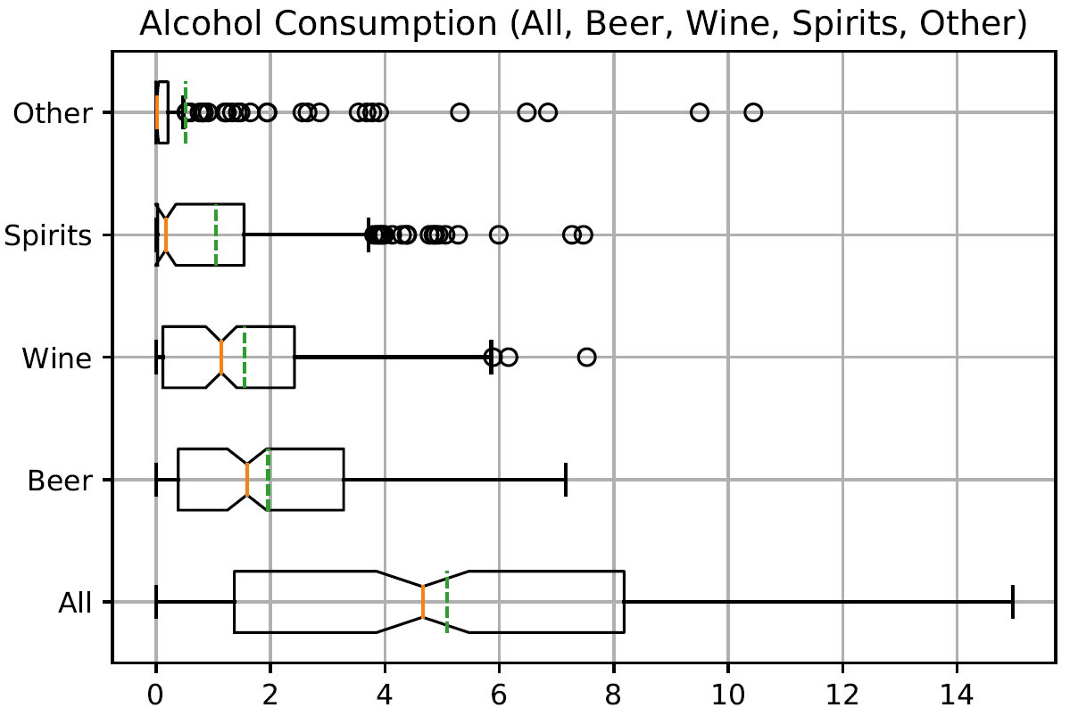
WHISKERS

Slide 8
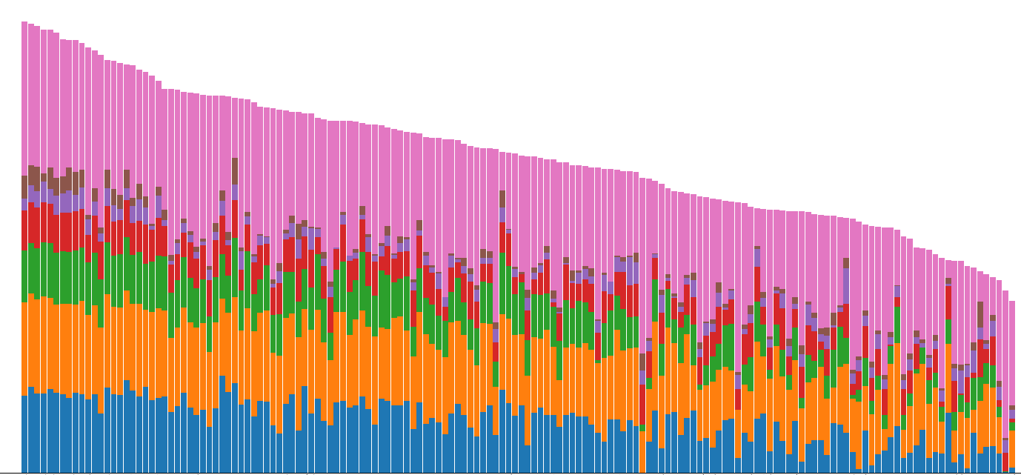
HAPPINESS IS A WARM GUN

Slide 9
INITIAL DATA and QUESTIONS
DATA
QUESTIONS?
WORLD HAPPINESS REPORT
WORLD ALCOHOL CONSUMPTION
INCOME INEQUALITY BY COUNTRY
What countries are happiest? And are they located in specific geographic region?
What countries consume the least/most amount of alcohol?
Which countries suffer from greatest amount of income inequality?
How do these three pieces of data correlate? Is income inequality an indicator of happiness? Or is alcohol consumption?

Slide 10
Conclusions

