Slide 1

Drink and Be Happy
January 23, 2019

Slide 2
Initial Questions
Why do we care?
What are the most/least happy countries in the world?
What are the components of that score?
How are they measured?
Which elements are most impactful/weighted?
Which countries have the most/least alcohol consumption?
Is it specific to a region/continent/sub-continent?
Do countries have preferences for wine/beer/spirits?
Which countries have the most/least income inequality?
Do these countries have similar governmental policies?
Are they considered developed or developing nations?
Is either income inequality or alcohol consumption a potential indicator of happiness a country’s happiness?

Slide 3



A Deep Data Dive
Where’s the information?
Data Collection
3
main sources of merged data
Google APIs – geocode latitudes and longitudes
UN World Happiness Rankings
World Bank – Total Alcohol consumption per capita
156
countries around the world
averaged datasets from
2010-2016

Slide 4
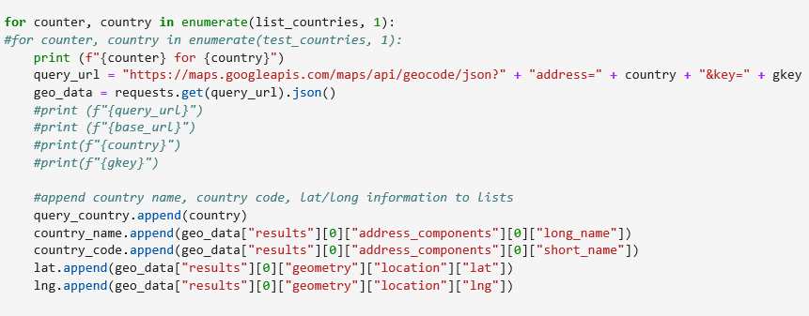
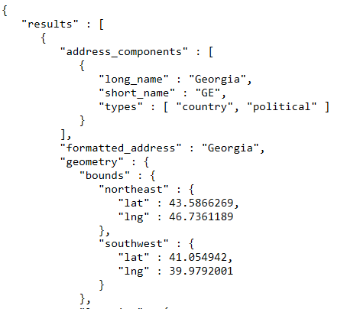
A Deep Data Dive
Where’s the information?
Data Exploration
Google APIs – geocode

Slide 5

The key variables that have been found to support well-being:
Income
Healthy Life Expectancy
Social Support
Freedom
Trust
Generosity
Gallup World Poll: Cantril ladder: it asks respondents to rate their life, best possible for them being a 10, and the worst possible life being a 0. The typical annual sample is 1,000 people to reduce random sampling errors. The confidence interval is measured at 95% accuracy.

Slide 6
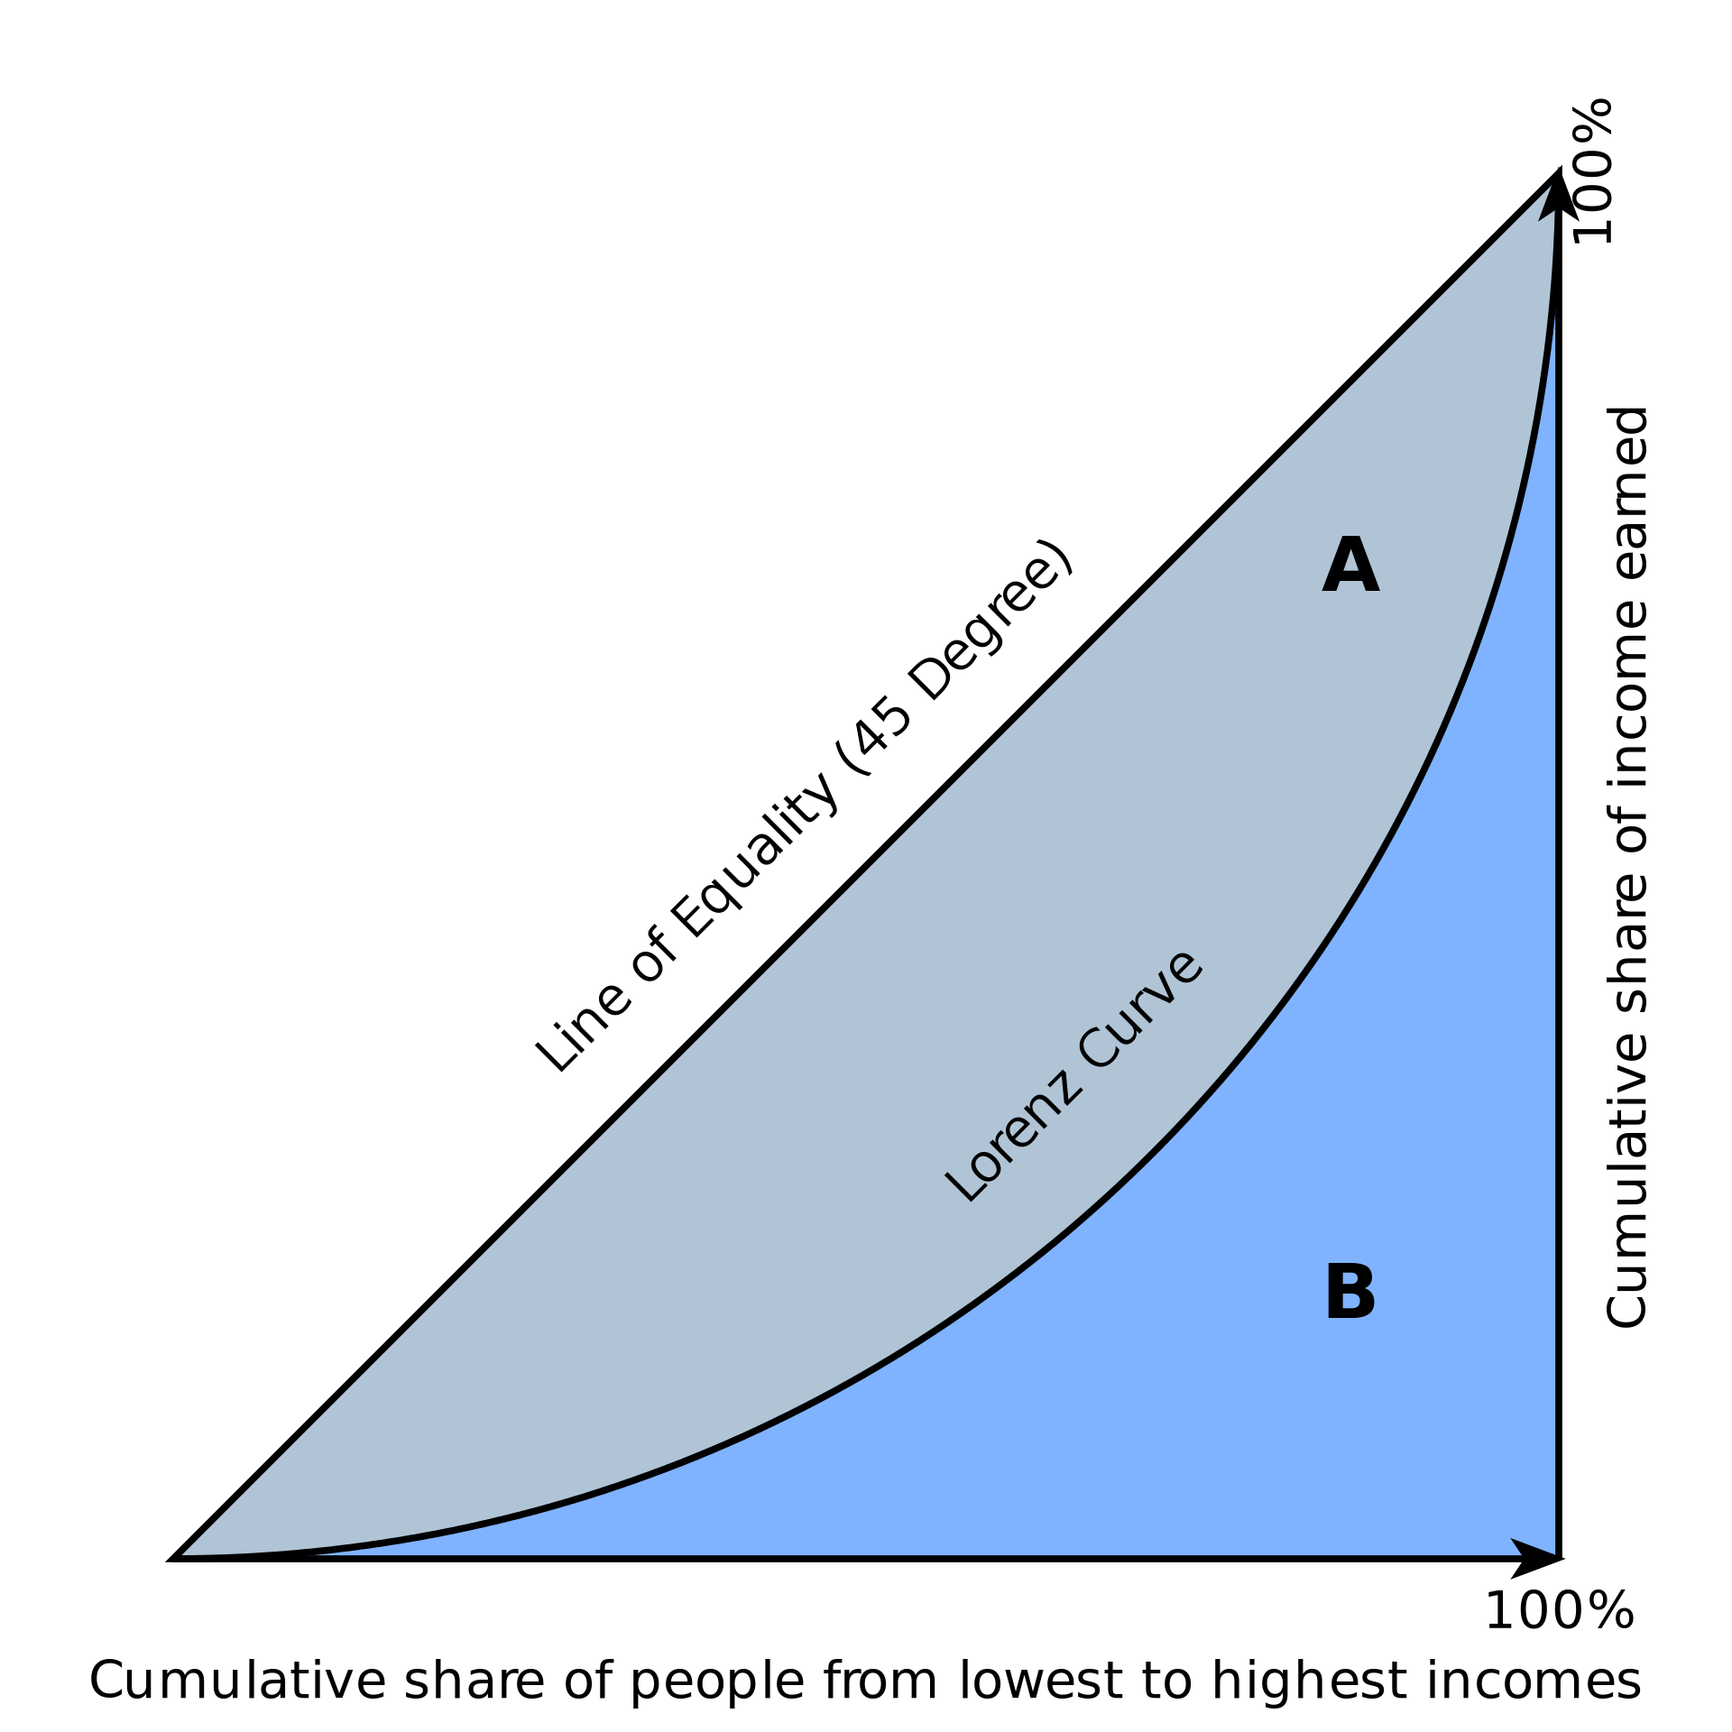
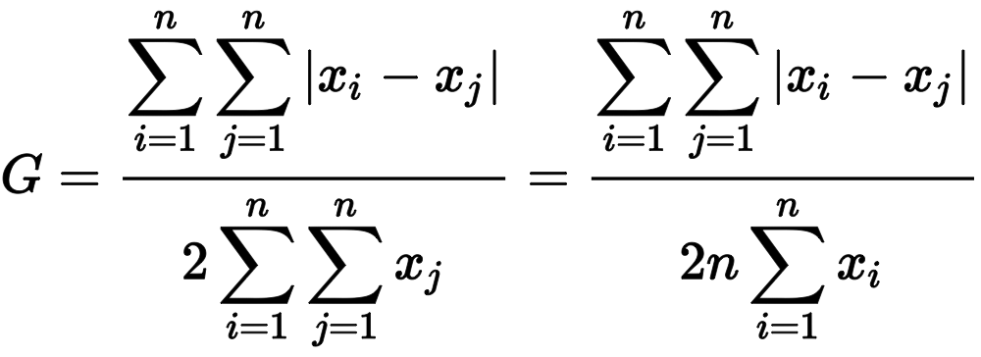
Data Exploration: Happiness Factors
UN World Happiness Rankings
The Gini Coefficient
relative mean absolute difference
which is mathematically equivalent to the Lorenz curve definition
A single number aimed at measuring the degree of inequality in a distribution. It is most often used in economics to measure how far a country's wealth or income distribution deviates from a totally equal distribution

Slide 7
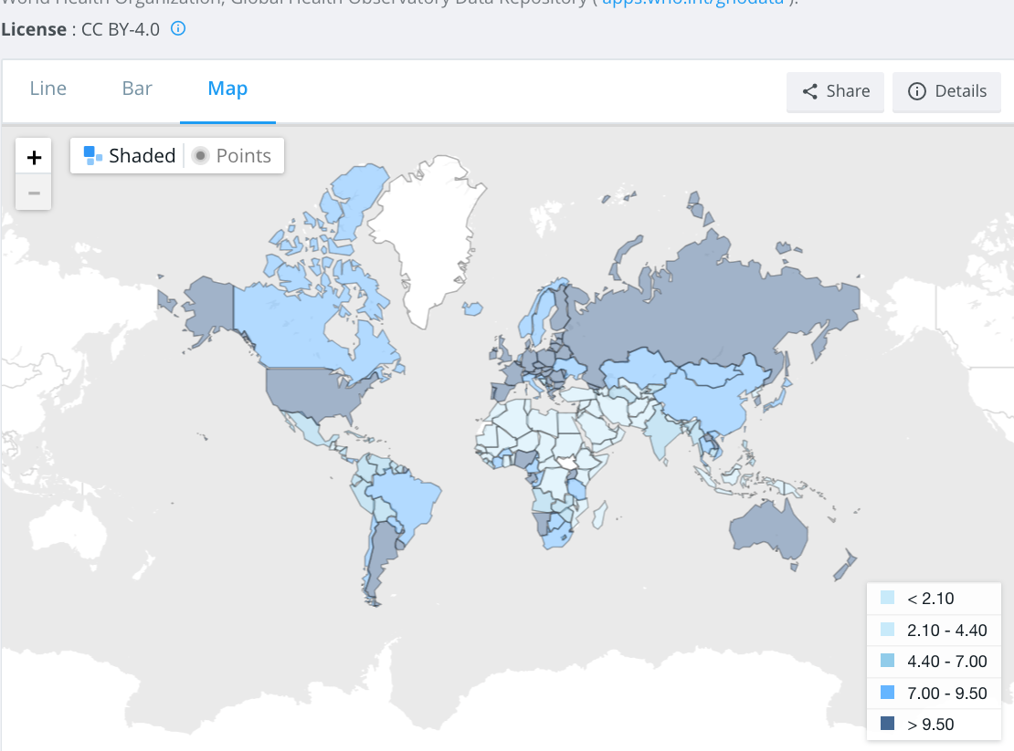
total alcohol consumption per capita
(liters of pure alcohol, projected estimates, 15+ years of age)

Slide 8


A Deep Data Dive
Where’s the information?
Data Cleanup Process
Create country master list
Determine master source of country codes and names
VLOOKUPs, comparisons between .csvs
Resolve Google API country code misalignment

Slide 9
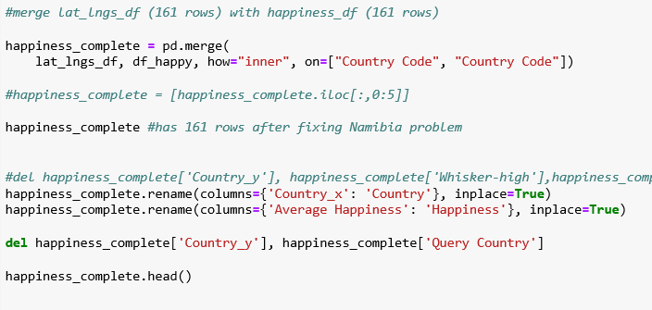

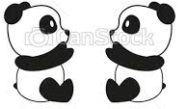
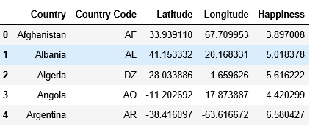
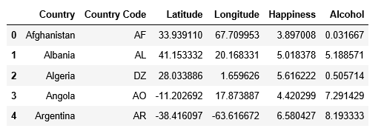
A Deep Data Dive
Where’s the information?
Data Cleanup & Analysis Process
Create Pandas DataFrames for:
Alcohol data
Happiness data
Lat/Long data
Merge Pandas DataFrames

Slide 10
Conclusions
What did we learn?
Your conclusions. This should include a numerical summary as well as visualizations of that summary
Discuss the implications of your findings. This is where you get to have an open-ended discussion about what your findings "mean
Q&A session to follow your presentation

Slide 11
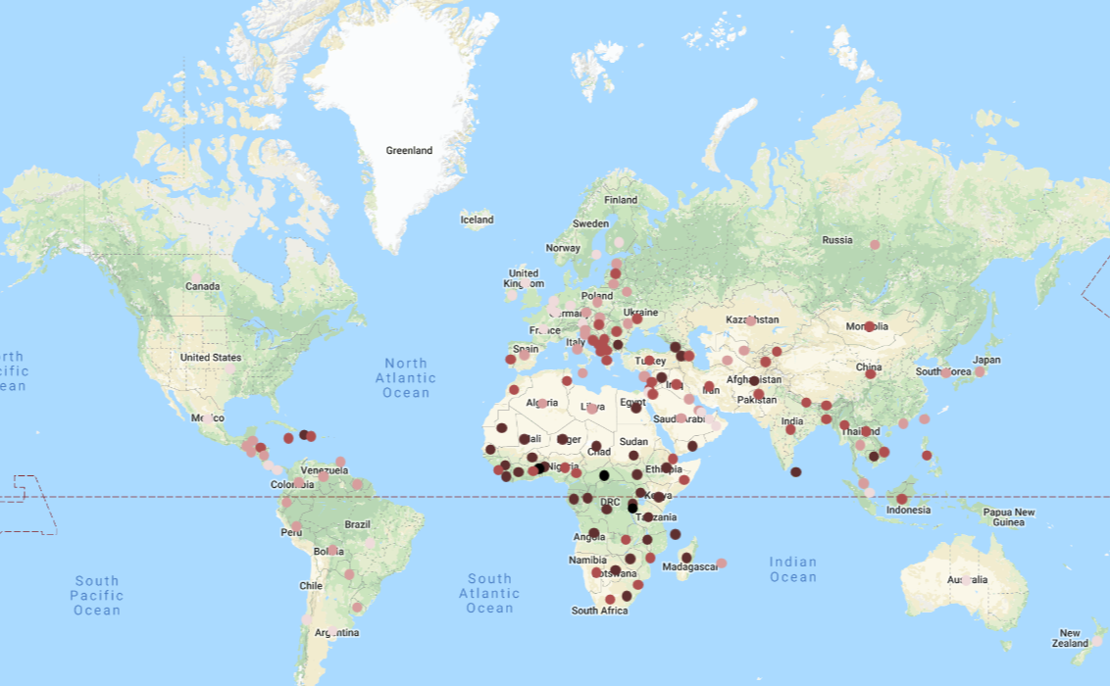
Conclusions
Happiness: most / least
What are the most/least happy countries in the world?
The happiest countries appear to be located primarily in Scandinavia (3) and (7) Europe. The least happy countries are primarily found in Africa, with 9 of the bottom 10.
Happiness Rating of:
7.0
6.0
5.0
4.0
3.0

Slide 12
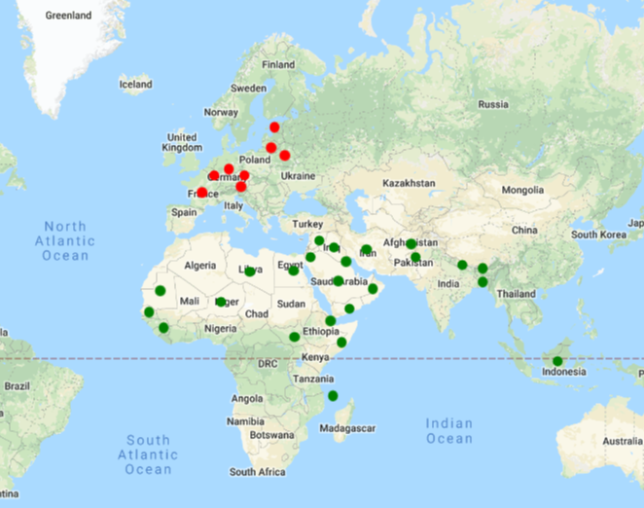
Conclusions
Alcohol Consumption: most / least
Which countries have the most alcohol consumption? Least?
Least alcohol consumption title belongs to Somalia, but it is closely followed by a slew of Middle Eastern and North African countries that are in the surrounding geographical area
Most alcohol consumption title belongs to Estonia, with European countries rounding out the top 20 alcohol consumers, all above 10 liters per year consumption.
most alcohol
12+ liters
least alcohol
>1 liter

Slide 13
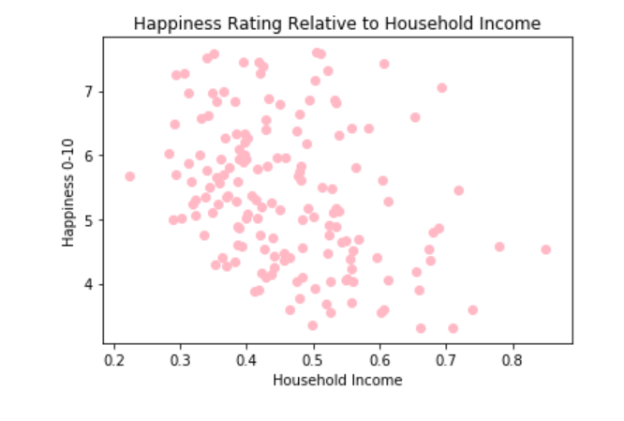
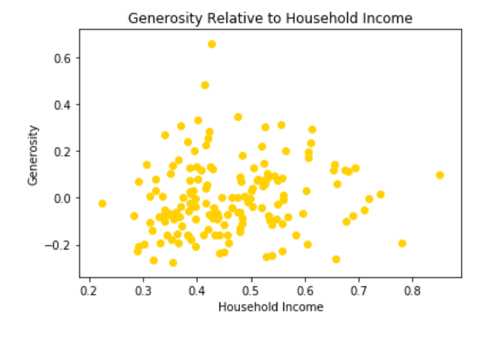
Conclusions: Happiness Factors
How do the different happiness factors correlate?
Analyzing household income

Slide 14
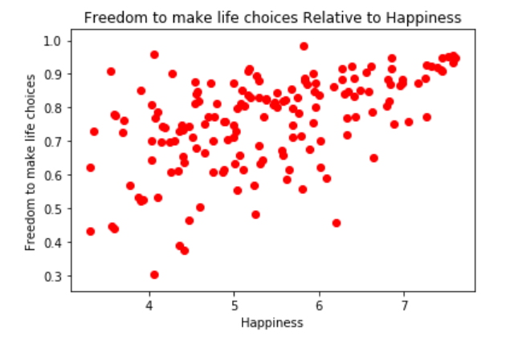
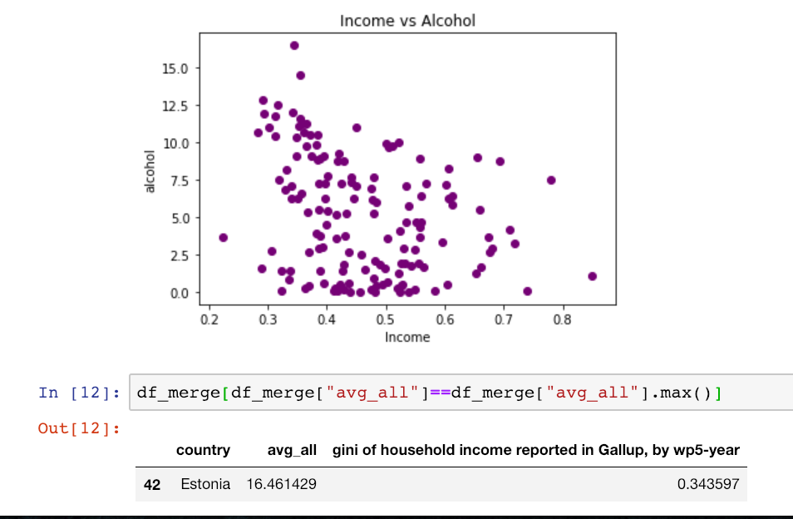
Conclusions: Happiness Factors

