Slide 1

Drink and Be Happy
January 23, 2019

Slide 2

Happiness defined!
The key variables that have been found to support well-being:
Gallup World Poll: Cantril ladder: it asks respondents to rate their life, best possible for them being a 10, and the worst possible life being a 0. The typical annual sample is 1,000 people to reduce random sampling errors. The confidence interval is measured at 95% accuracy.
Income
Healthy Life Expectancy
Social Support
Freedom
Trust
Generosity

Slide 3
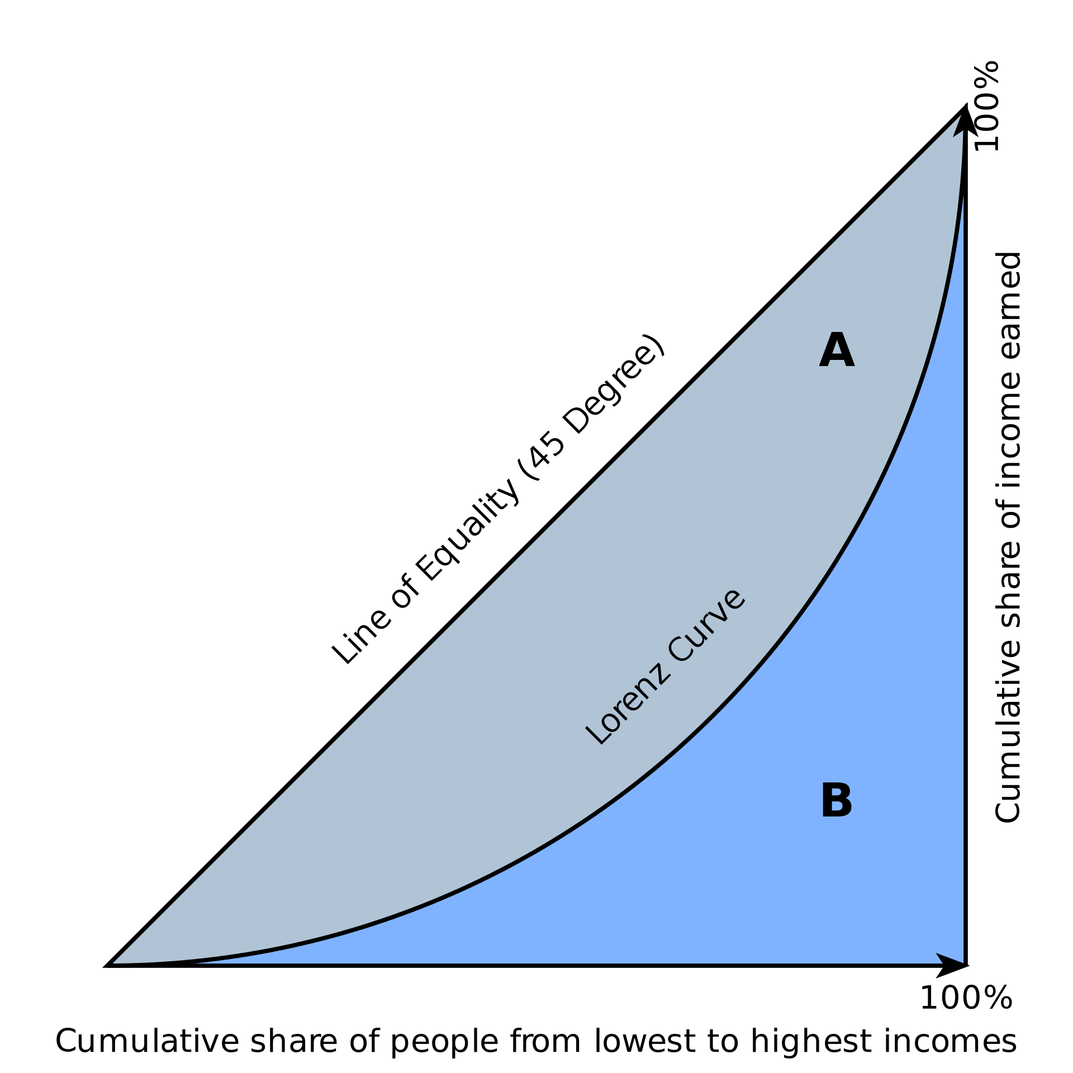

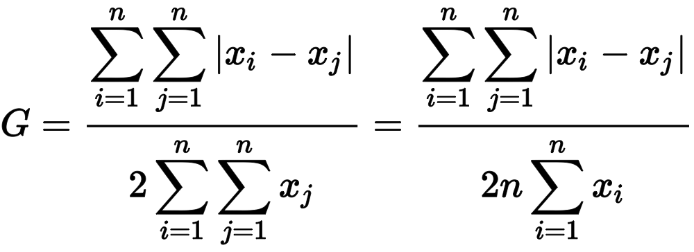
Gini coefficient measures relative, not absolute, wealth
A single number aimed at measuring the degree of inequality in a distribution. It is most often used in economics to measure how far a country's wealth or income distribution deviates from a totally equal distribution
The Gini Coefficient
relative mean absolute difference
which is mathematically equivalent to the Lorenz curve definition

Slide 4
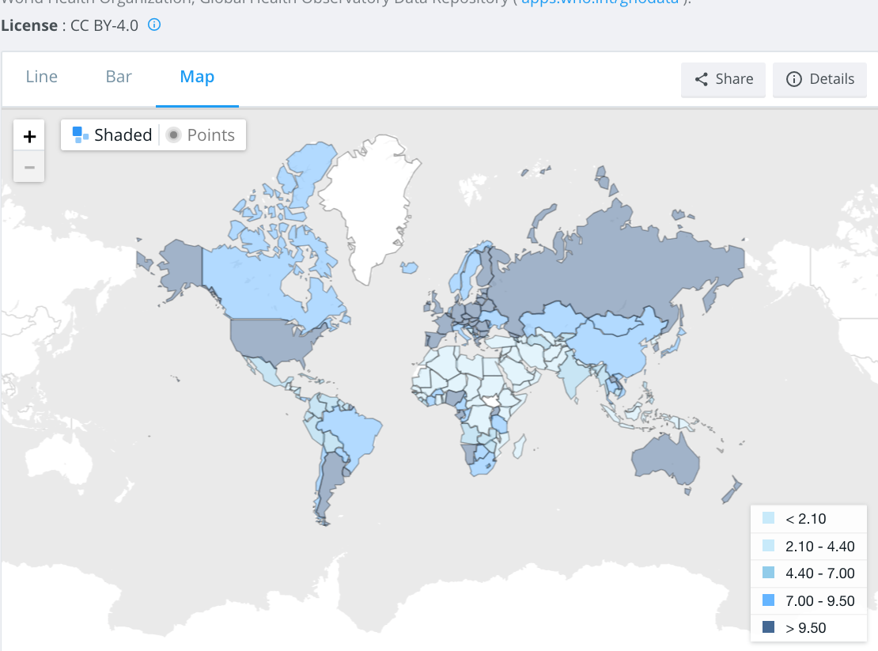
total alcohol consumption per capita
(liters of pure alcohol, projected estimates, 15+ years of age)

Slide 5
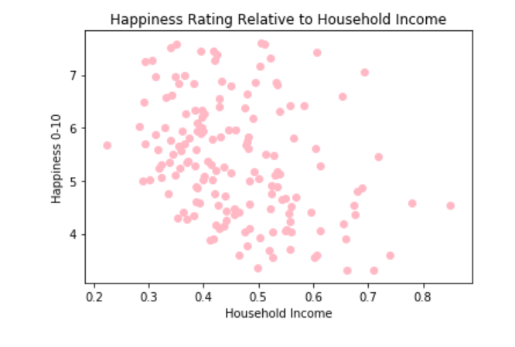
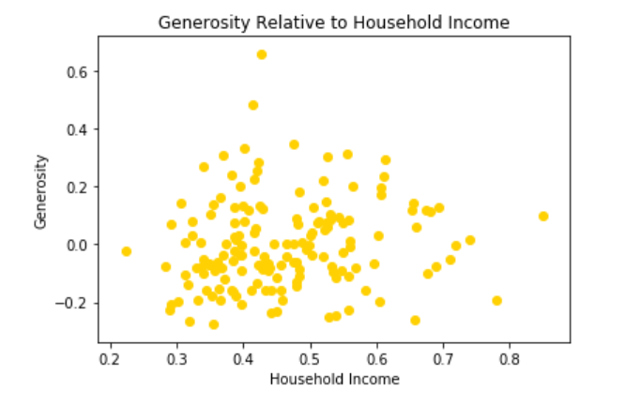
Income
text
text

Slide 6
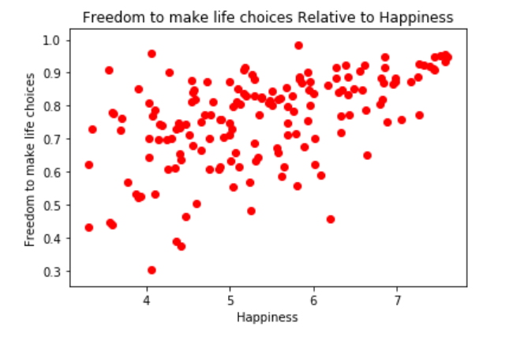
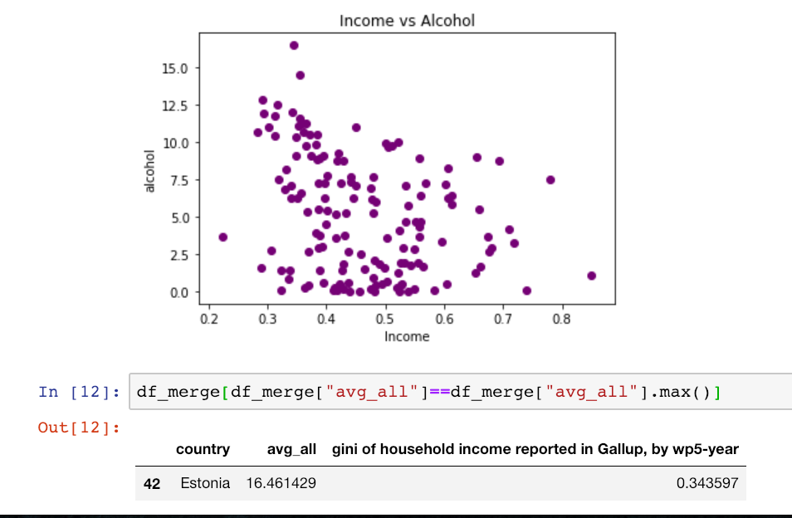
Happiness
Text
text

Slide 7
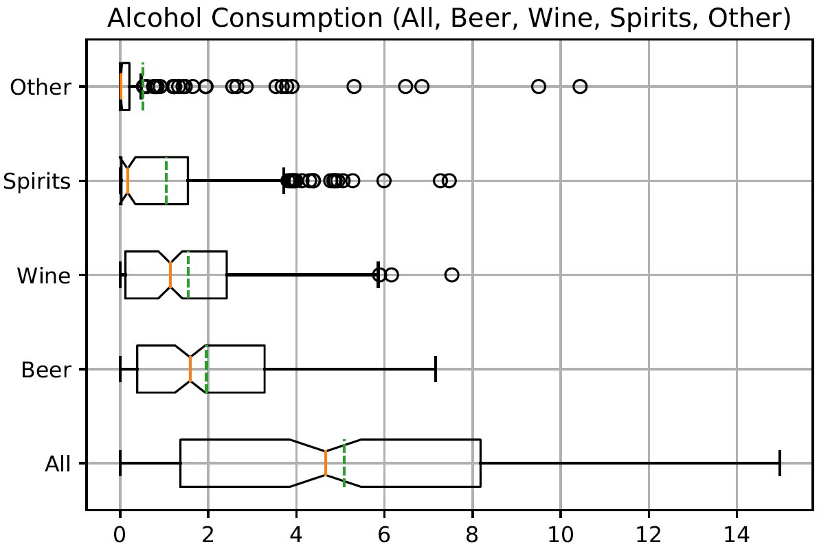
WHISKERS

Slide 8
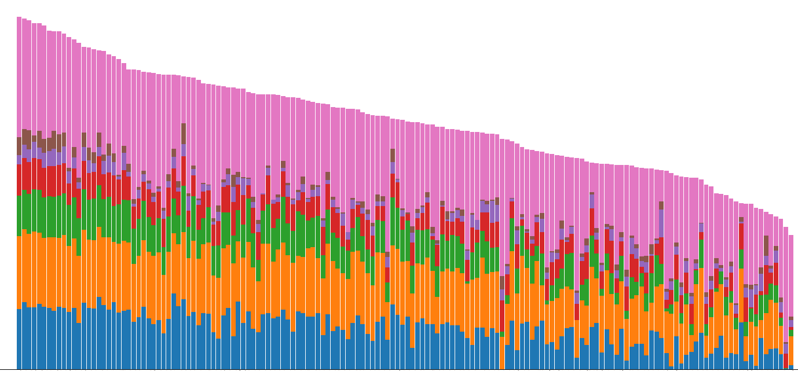
HAPPINESS IS A WARM GUN

