Slide 1

Happiness defined!
The key variables that have been found to support well-being:
Gallup World Poll: Cantril ladder: it asks respondents to rate their life, best possible for them being a 10, and the worst possible life being a 0. The typical annual sample is 1,000 people to reduce random sampling errors. The confidence interval is measured at 95% accuracy.
Income
Healthy Life Expectancy
Social Support
Freedom
Trust
Generosity

Slide 2
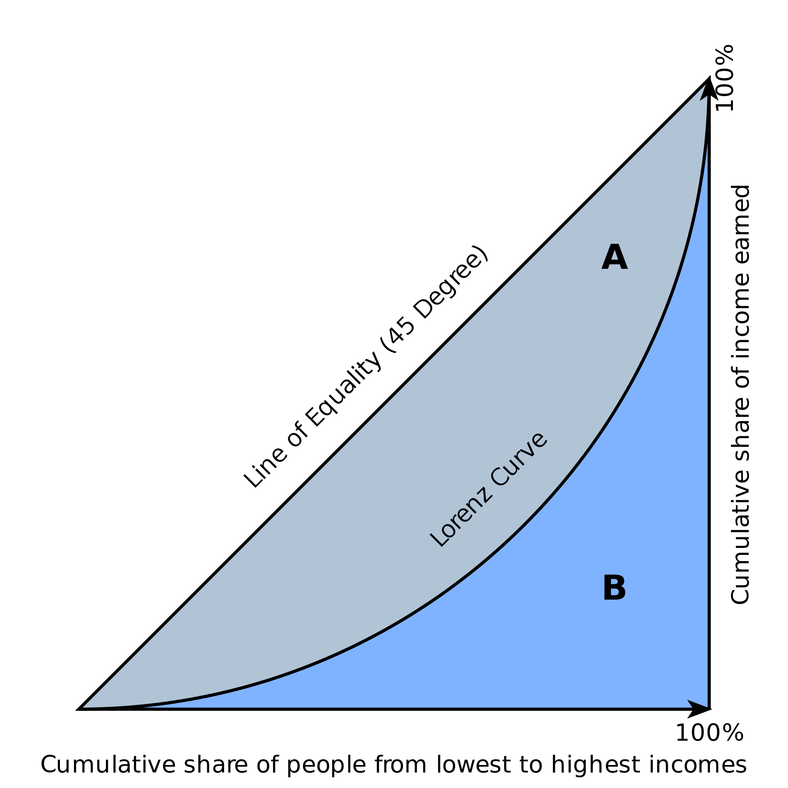

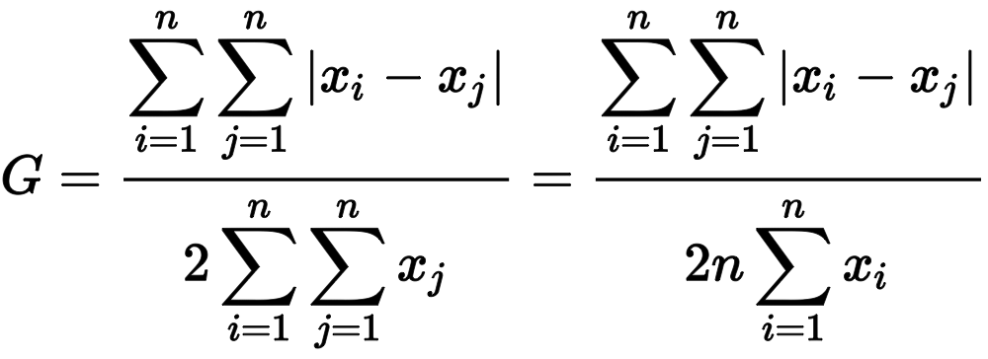
Gini coefficient measures relative, not absolute, wealth
A single number aimed at measuring the degree of inequality in a distribution. It is most often used in economics to measure how far a country's wealth or income distribution deviates from a totally equal distribution
The Gini Coefficient
relative mean absolute difference
which is mathematically equivalent to the Lorenz curve definition

Slide 3
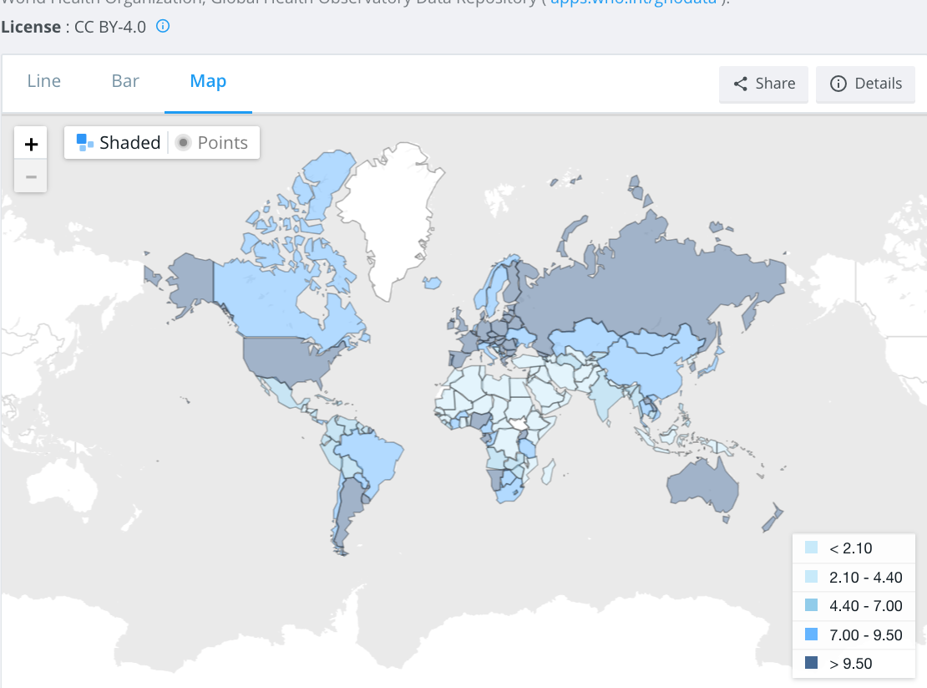
total alcohol consumption per capita
(liters of pure alcohol, projected estimates, 15+ years of age)

Slide 4
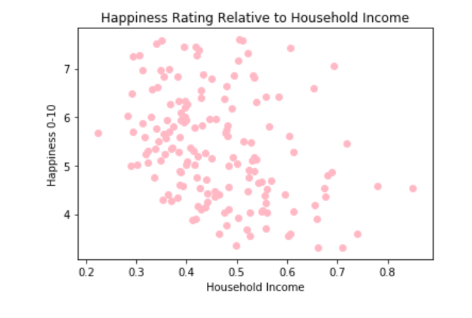
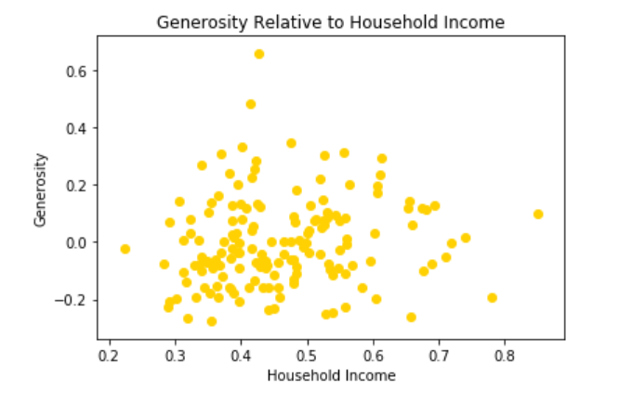
Income
text
text

Slide 5
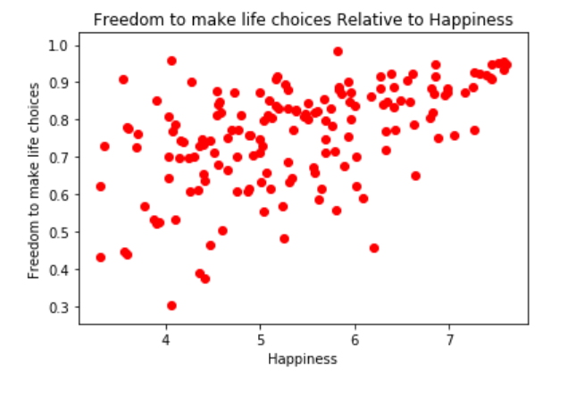
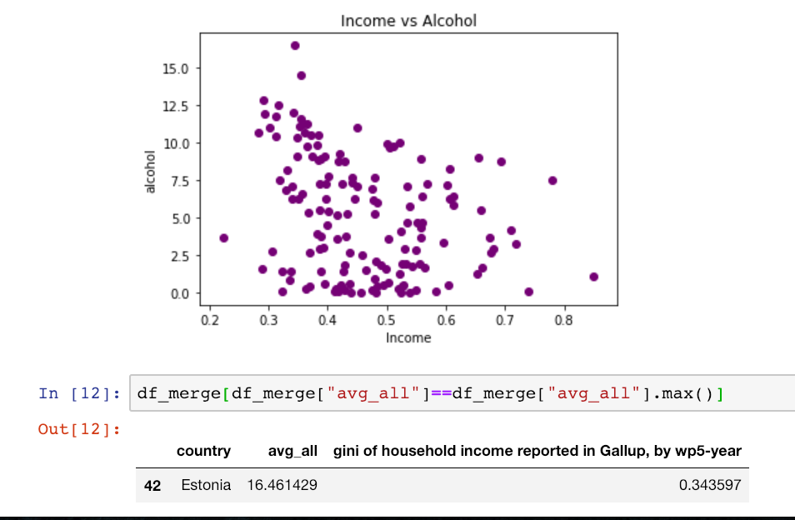
Happiness
Text
text

Slide 6
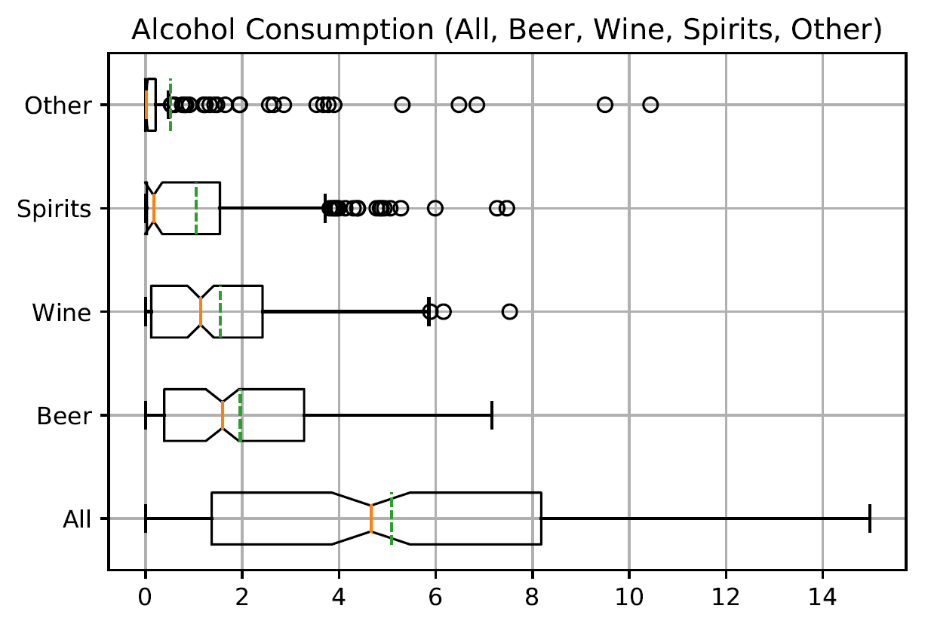
Whiskers
Data taken as a whole shows no outliers
But looking at specific categories of data we find several outliers

Slide 7
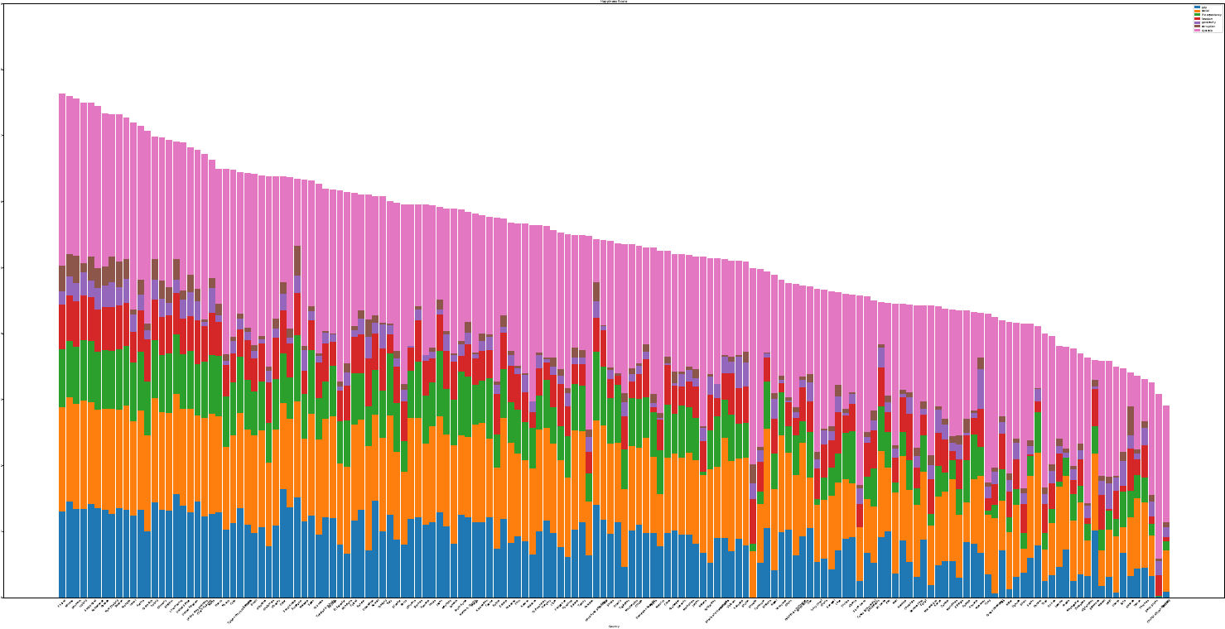
WORLD HAPPINESS BY COUNTRY
Notes:
This plot fucking sucks

