Slide 1
Smart Dustbin
Adarsh Kumar
2001CS02
CS225-226 Project

Slide 2
Objective
To design a smart dustbin which will help in keeping our environment clean and also eco friendly.
It should be efficient and easy to use.
To get familiar with the working of Arduino, Ultrasonic Sensor and Servo Motor.

Slide 3
Components Used
Arduino UNO R3
Ultrasonic Module HC-SR04
Micro Servo Motor
Jumper Wires

Slide 4
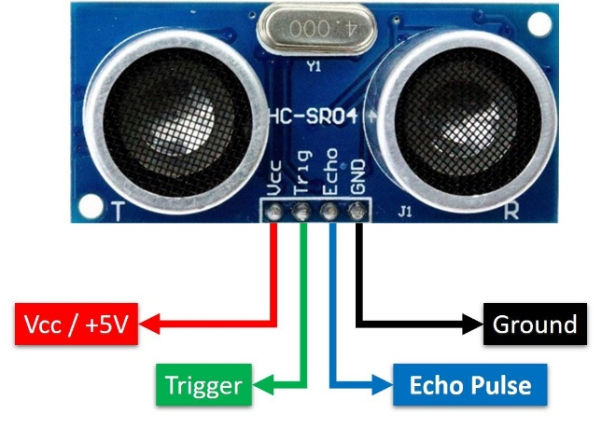
Ultrasonic Sensor
An ultrasonic sensor is an electronic device that measures the distance of a target object by emitting ultrasonic sound waves.
Ultrasonic waves travel faster than the speed of audible sound (i.e. the sound that humans can hear).
Ultrasonic sensors have two main components: the transmitter (which emits the sound using piezoelectric crystals) and the receiver (which encounters the sound after it has travelled to and from the target).

Slide 5
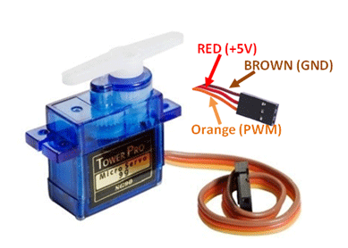
Servo Motor
It is a small device that has an output shaft. This shaft can be positioned to specific angular positions by sending the servo a coded signal.
As long as the coded signal exists on the input line, the servo will maintain the angular position of the shaft.
Servo Motor can be rotated from 0 to 180 degrees, but it can go up to 210 degrees, depending on the manufacturing.

Slide 6
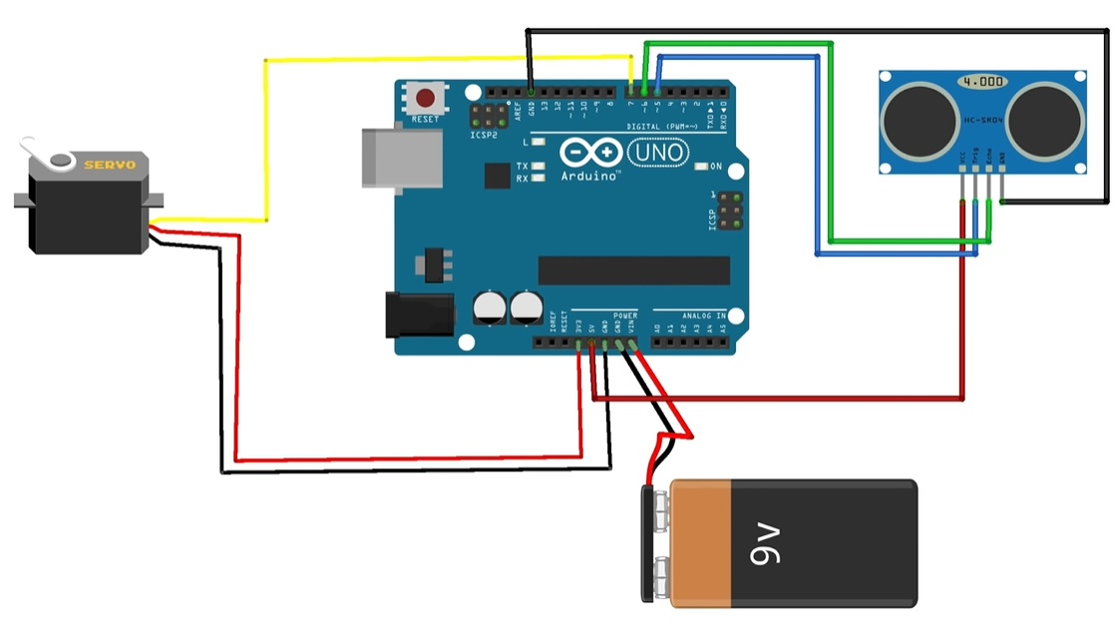
Circuit Diagram

Slide 7
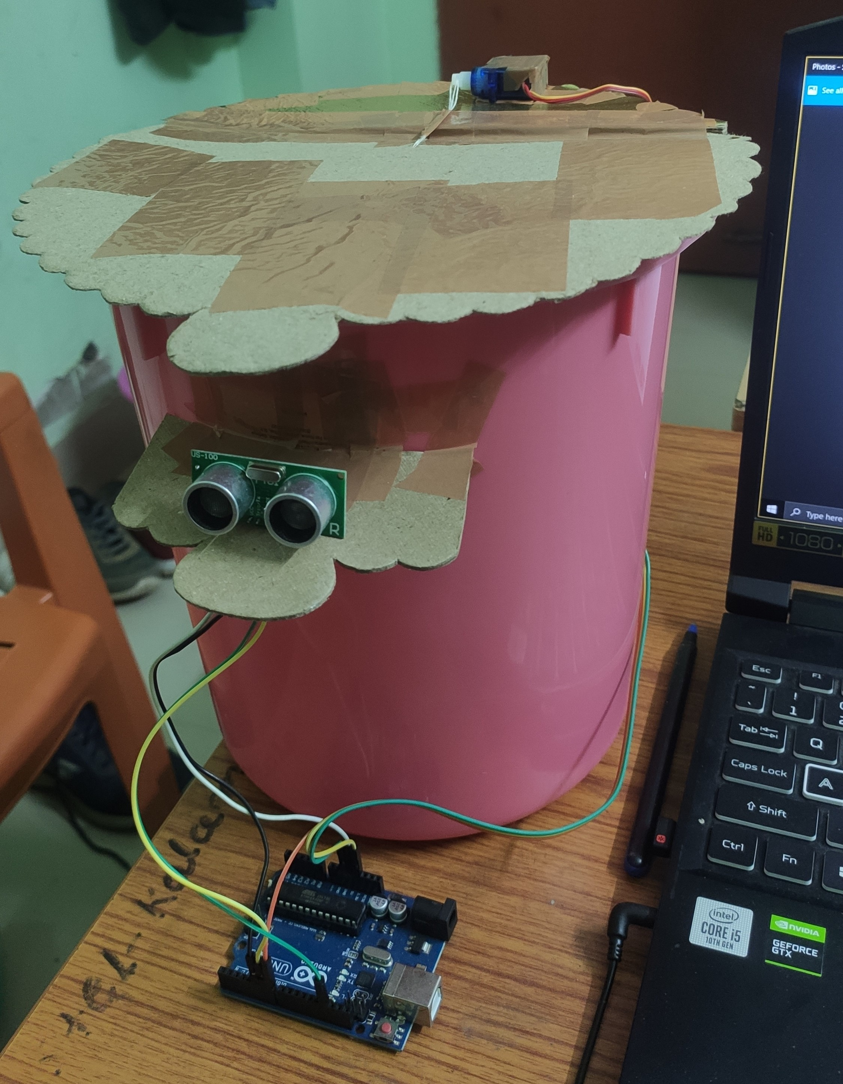

Slide 8
Working Principle
It is based on the same principle as a radar system. The microcontroller sends a trigger signal to the ultrasonic sensor. The duty cycle of this trigger signal is 10 microseconds for the HC-SR04 ultrasonic sensor. When triggered, the ultrasonic sensor generates eight acoustic (ultrasonic) wave bursts and initiates a time counter. As soon as the reflected (echo) signal is received, the timer stops.
Let T be the time the pulse took to travel back to the transducer, then we can say that it took T/2 time to reach the object after being emitted by the transducer.
Therefore, distance of the object from the transducer = speed of sound x T/2
If this distance is less than 50 cm, we trigger the servo motor and it opens the lid of the dustbin. After some delay (which is 5 seconds), we again trigger the servo and it closes the lid.

Slide 9
Advantages
Opening the lid of the dustbin by our bare hands increases the risk of us getting various diseases. This project makes this process contactless, thus preventing us from getting any disease.
Since it has very low power consumption, it can be used multiple times.
In the current time, where waste management is a major issue, this project helps in keeping the surrounding clean.

Slide 10
Thank You

