Slide 1

Stock Prediction Using RL
Sithara KrishnaMurthy
Pragya Gautam
Reetika Goel
Vidhi Shah

Slide 2
Introduction
Problem statement
Dataset
Goals
Deliverables

Slide 3
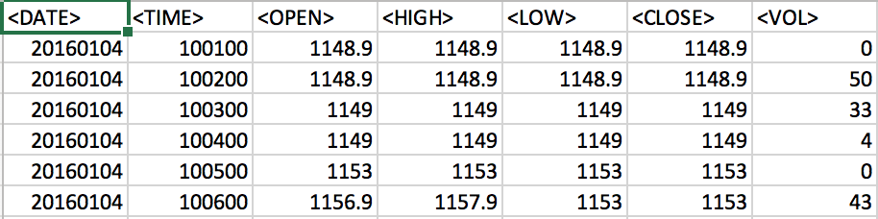
Yandex Company Stock Market Prices

Slide 4
Scope
Prices: Open, high, low, and close prices
Tuning of the RL model will be with:
Different hyperparameter values
Different training algorithms
Risks
Converting “Open, high, low, and close” prices to three numbers as high, low, and close prices
Loss of price information
Notes:
Currently, the scope of the system consists of open, high, low, and close prices given to an agent. The environment is implemented in the StocksEnv class. To improve the overall
system, we will be tuning the RL model with:
● Different hyperparameter values
● Different training algorithms
For future work, we will try to tune the model including different datasets to see how the
model performs in different conditions.
The existing model is built with an assumption to convert every bar “open, high, low, and
close” prices to three numbers as high, low, and close prices. However, this is a risk since we
will have a loss of price information which may lead to a suboptimal solution.

Slide 5
RL Terminologies for Stock Trading
Agent
Actions
Environment
Observations
Rewards

Slide 6
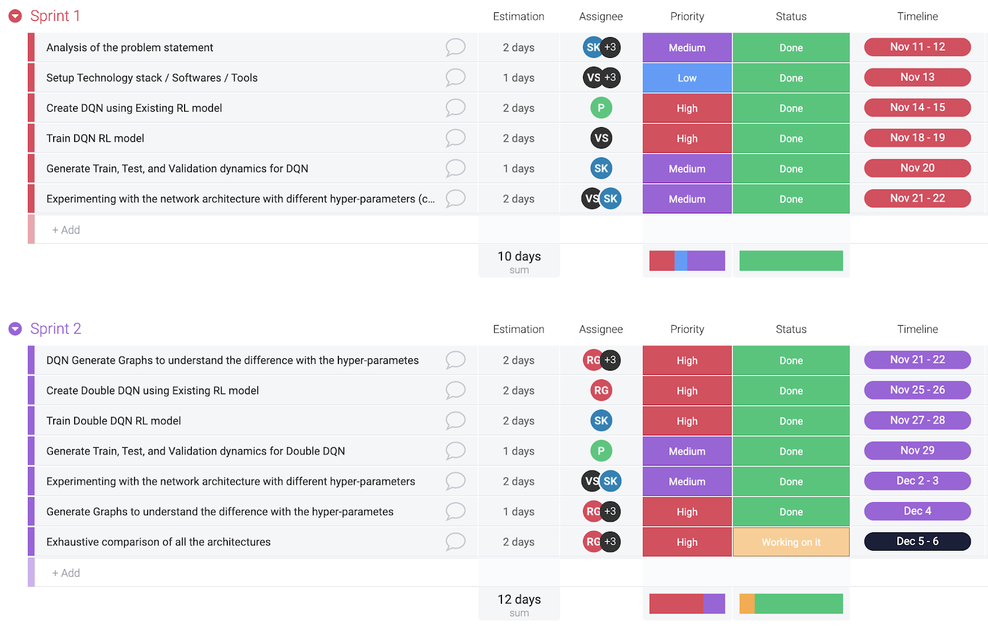
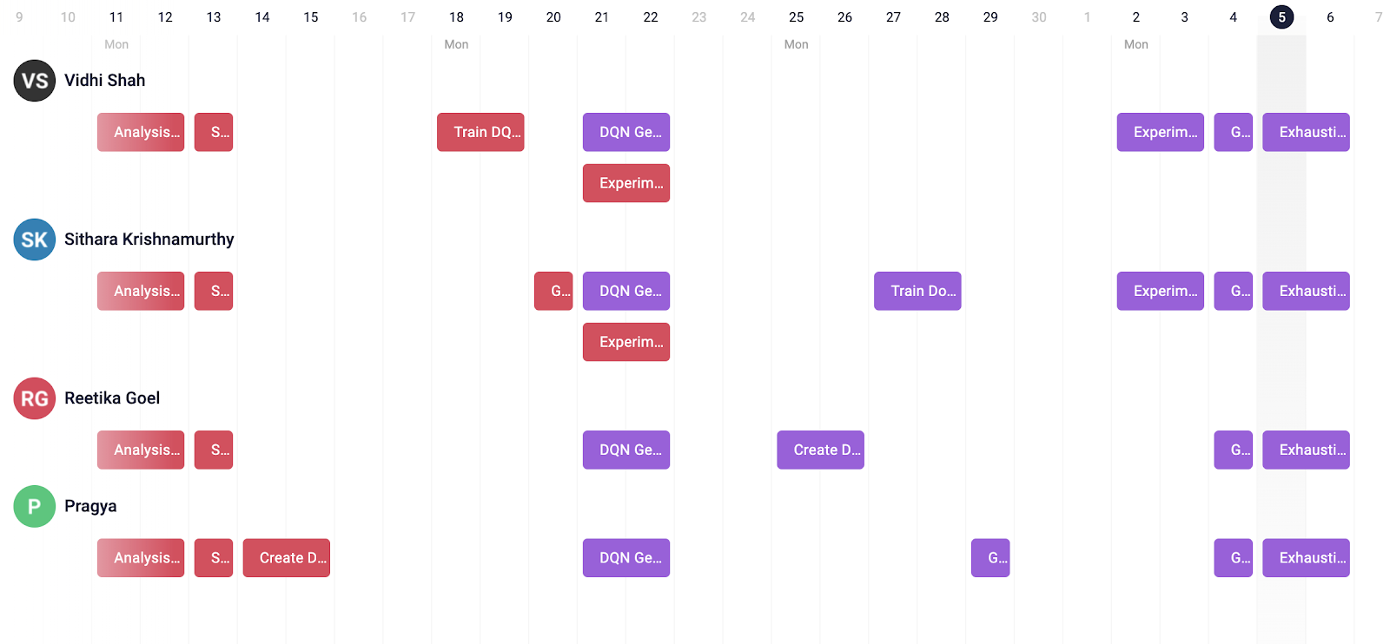
Project Planning
Sprint 1 & Sprint 2 Chart
Individual Task Break Up

Slide 7
Implementation
train_DQNDouble.py
data.py
models.py
common.py
environ.py
run_model.py
Notes:
train_DQNDouble.py - This is the main class, which is used to load the data, create an environment, define the actions, observations, and agent, gather rewards. The training of the agent is defined here, and the model is saved here.
data.py - This class has functions to read the CSV, load the data and generate the prices dictionary.
models.py - Class with the DQN neural net layer.
common.py - This class has a function that takes the batch of transitions and packs it into the set of NumPy arrays. It also has functions to calculate the loss.
environ.py - The environ class has class to create the environment. It has functions to reset env, step function for environment and action, and state class.
run_model.py - This class loads the model, trades on prices provided to it and draws the plots with the profit change over time.

Slide 8
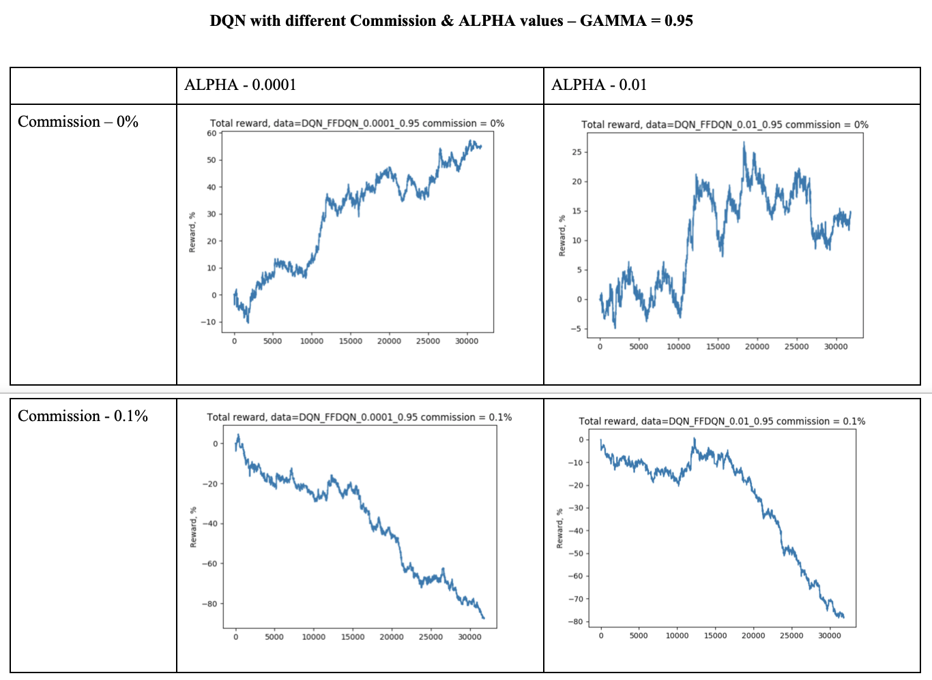
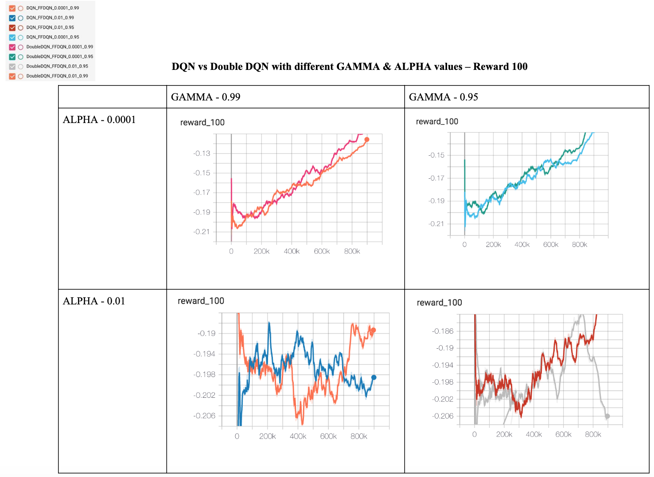
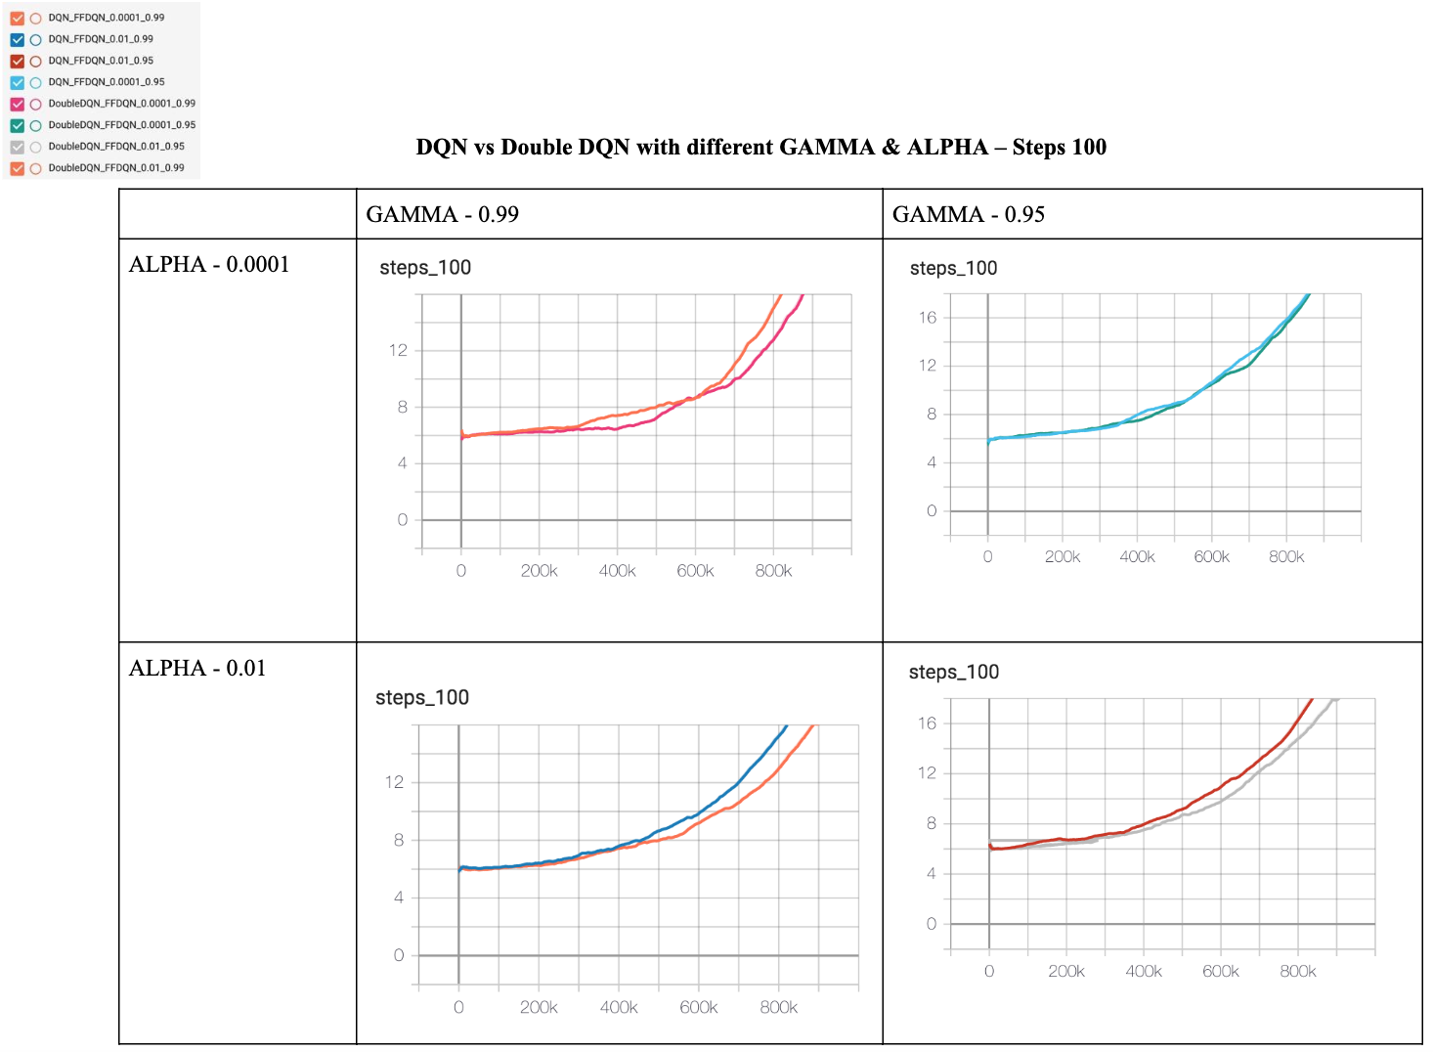
INTRA Algorithm Comparison (For distinct hyperparameter values)

Slide 9
INTER Algorithm Comparison (For different Training Algorithms)

Slide 10

Thank You

