Slide 1
Ethics

Slide 2
U.S. context (also described in Bit by Bit)
Ethical failures
Tuskegee Syphilis Study
Stanford prison experiment
Milgram experiment
Wakeup call
Need for improved governance of research ethics
New guidelines for human-subject research
Lawsuites…

Slide 3
Context in Finland
1. The study involves an intervention in the physical integrity of subjects,
2. The study deviates from the principle of informed consent (ethical review is not required if the research is based on public documents, registries or archived data),
3. The subjects are children under the age of 15, and the study is not part of the normal activities of a school or an institution of early childhood education and care, and the data are collected without parental consent and without providing the parents or guardians the opportunity to prevent the child from taking part in the study,
4. The study exposes research subjects to exceptionally strong stimuli and evaluating possible harm requires special expertise (for example, studies containing violence or pornography),
5. The study may cause long-term mental harm (trauma, depression, sleeplessness) beyond the risks encountered in normal life,
6. The study can signify a security risk to subjects (for example, studies concerning domestic violence).
Research ethics mostly considered by the researcher
Ethical review required only in special cases

Slide 4
Context in Finland
1. The study involves an intervention in the physical integrity of subjects,
2. The study deviates from the principle of informed consent (ethical review is not required if the research is based on public documents, registries or archived data),
3. The subjects are children under the age of 15, and the study is not part of the normal activities of a school or an institution of early childhood education and care, and the data are collected without parental consent and without providing the parents or guardians the opportunity to prevent the child from taking part in the study,
4. The study exposes research subjects to exceptionally strong stimuli and evaluating possible harm requires special expertise (for example, studies containing violence or pornography),
5. The study may cause long-term mental harm (trauma, depression, sleeplessness) beyond the risks encountered in normal life,
6. The study can signify a security risk to subjects (for example, studies concerning domestic violence).
Research ethics mostly considered by the researcher
Ethical review required only in special cases
➔ All the research I’ve done does not require formal approval, but is based on my own considerations.

Slide 5
What about your country?

Slide 6
Research design: what we should do, not anymore what we could do?

Slide 7

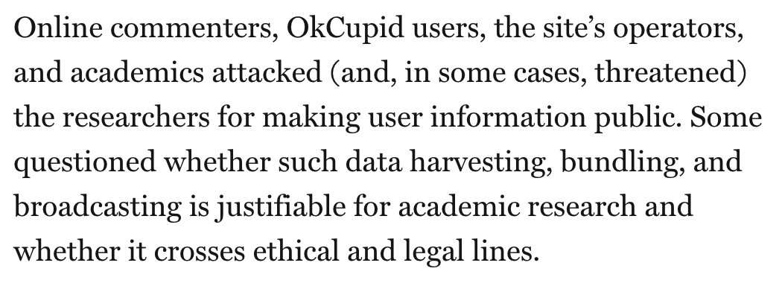

Slide 8
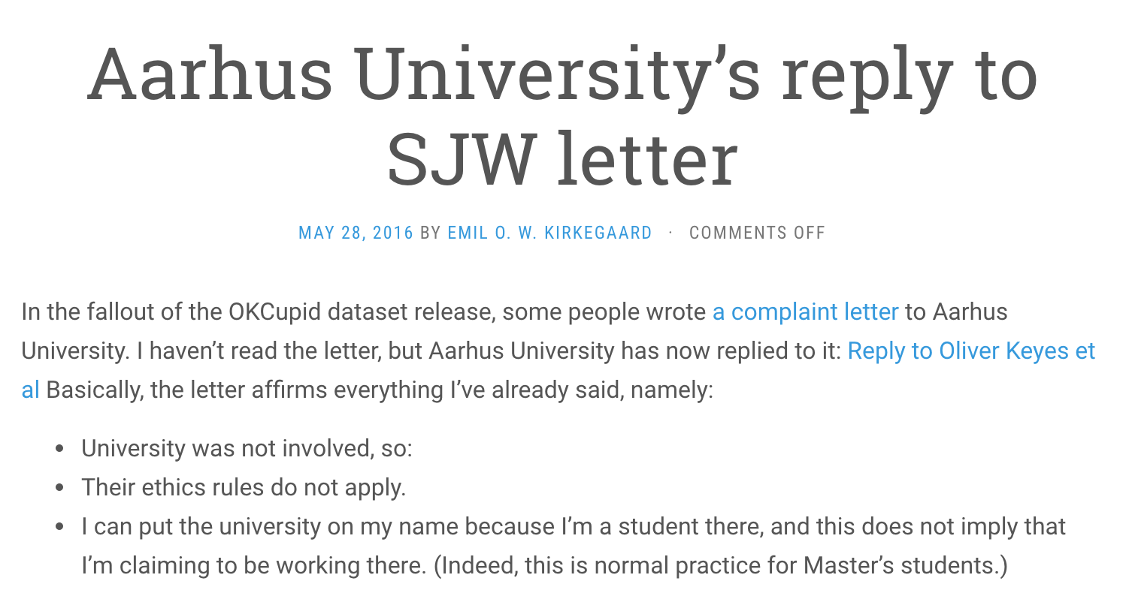

Slide 9
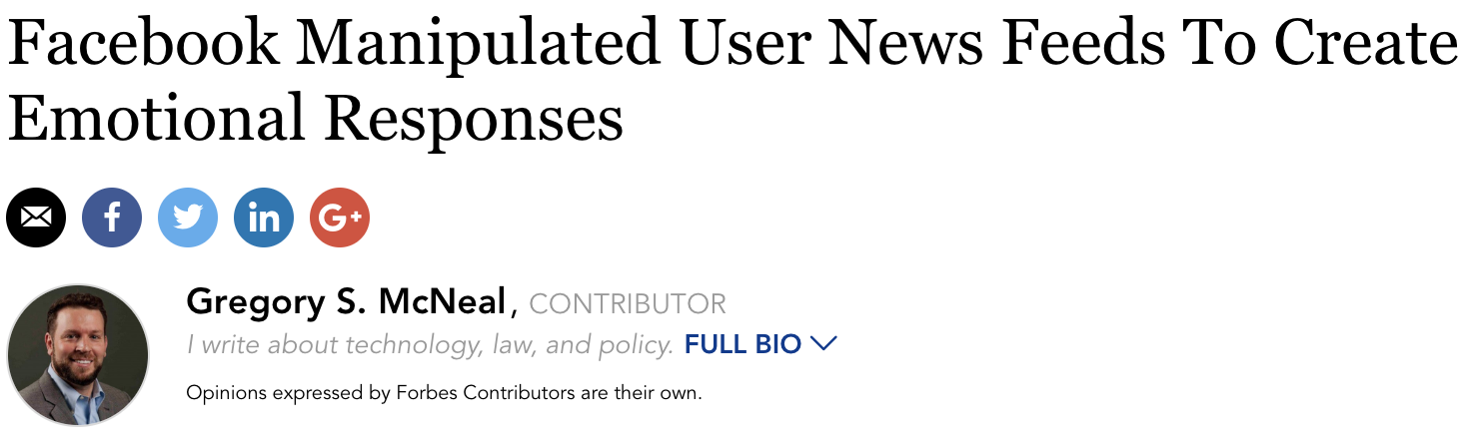

Slide 10
Bit by bit:
Rules based approach
Ad hoc approach
Principles-based approach

Slide 11
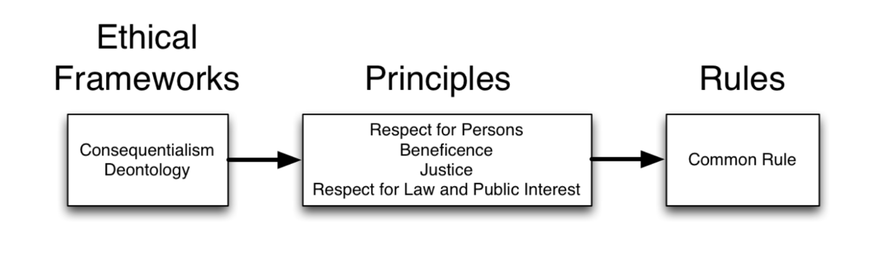

Slide 12
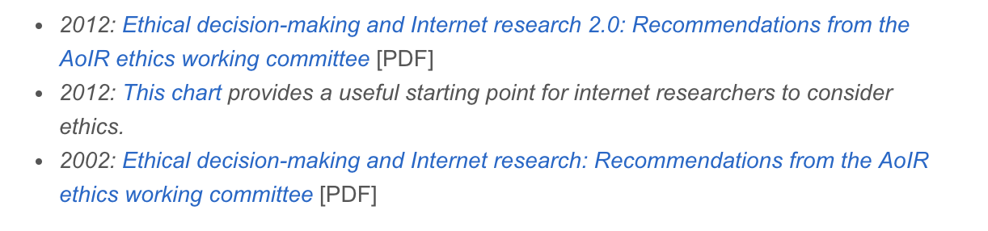
Development of “rule based”

Slide 13

Development of “rule based”

Slide 14
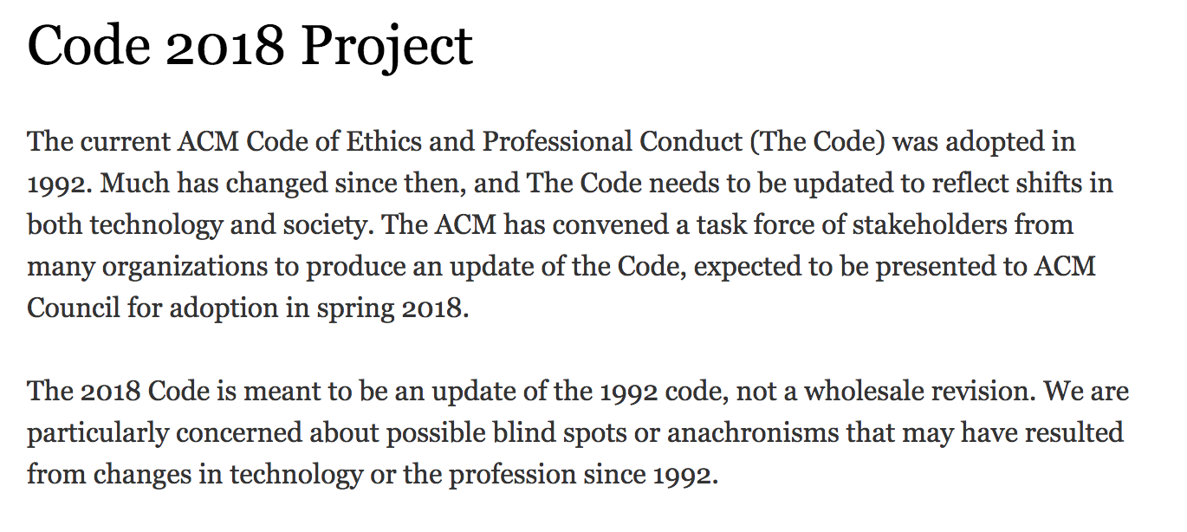
Development of “rule based”

Slide 15

Data and GDPR

Slide 16
https://www.youtube.com/watch?v=j6wwBqfSk-o

Slide 17
information about the processing of your personal data;
obtain access to the personal data held about you;
ask for incorrect, inaccurate or incomplete personal data to be corrected;
request that personal data be erased when it’s no longer needed or if processing it is unlawful;
object to the processing of your personal data for marketing purposes or on grounds relating to your particular situation;
request the restriction of the processing of your personal data in specific cases;
receive your personal data in a machine-readable format and send it to another controller (‘data portability’);
request that decisions based on automated processing concerning you or significantly affecting you and based on your personal data are made by natural persons, not only by computers. You also have the right in this case to express your point of view and to contest the decision.

Slide 19


Slide 20
information about the processing of your personal data;
obtain access to the personal data held about you;
ask for incorrect, inaccurate or incomplete personal data to be corrected;
request that personal data be erased when it’s no longer needed or if processing it is unlawful;
object to the processing of your personal data for marketing purposes or on grounds relating to your particular situation;
request the restriction of the processing of your personal data in specific cases;
receive your personal data in a machine-readable format and send it to another controller (‘data portability’);
request that decisions based on automated processing concerning you or significantly affecting you and based on your personal data are made by natural persons, not only by computers. You also have the right in this case to express your point of view and to contest the decision.

