Slide 1
ABIS Backend Overview
Daniel Derstappen • ABIS Backend • September 2022
<number>

Slide 2
<number>
Agenda
Features
Architecture
Deliverables

Slide 3
<number>
Features
Use cases
REST APIs
ABIS Webservice
WebABIS
WebABIS NIST Extension
NIST Converter
Documentstore
WebABIS Frontend
NIST Import Tool
Pluggable biometrics
Configurable
Monitorable
Scalable

Slide 4
<number>
Features - Use cases
Functional
Non functional
Identification
Verification
Feature extraction
Comparison 1:1
Templates conversion
Templates modification
Quality check
NIST format conversion
Pluggable biometry
Scalability
High availability
Fault tolerance

Slide 5
<number>
ABIS BE Biometric operations
Enrolment: feature extraction and add biometric sample into ABIS BE database.
Verification: Confirming the claim of identity.
Identification: Comparison a biometric set with all biometric sets in ABIS BE database.
Latent fingerprint support.
Latent palm print support.

Slide 6
<number>
ABIS Webservice REST API
Low level API
CRUD operations ABIS ID
Enrollments (templates)
Identification (templates)
Comparision (templates)
Feature extraction for all supported biometrics
Face ICAO check
Face liveliness
…

Slide 7
<number>
WebABIS API
Higher abstraction level API then ABIS Webservice
Identity ID support (CRUD)
Enrollments (images)
Identification (images, templates)
Comparision (images, templates)

Slide 8
<number>
WebABIS NIST Extension API
NIST files as payload
Enrollment
Identification
Delete

Slide 9
<number>
NIST Converter API
Parsing of NIST files (NIST ITL, NIST XML)
Creation of NIST files
JSON representation format for better integration
Wraps Aware NISTPack parser SDK (required for creation of NIST files)
DERMALOG NIST parser implementation (parser production ready)
DERMALOG NIST creation in development (working POCs)

Slide 10
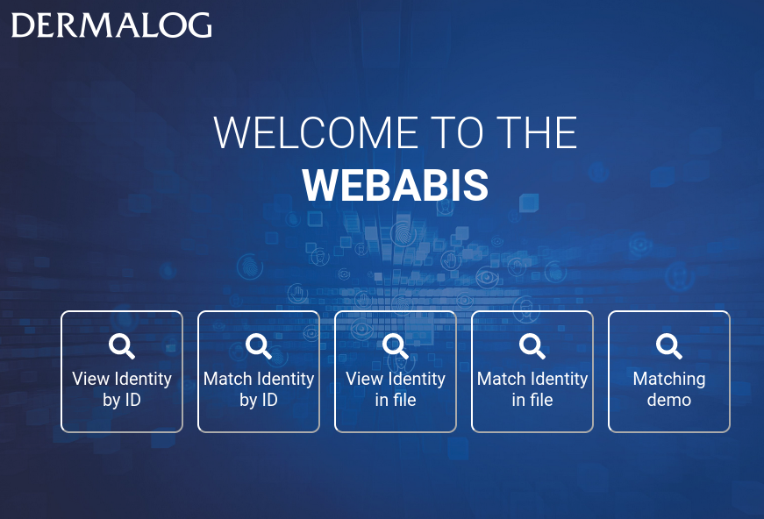
<number>
WebABIS Frontend
View identities (export)
Match
Matching demo
…

Slide 11
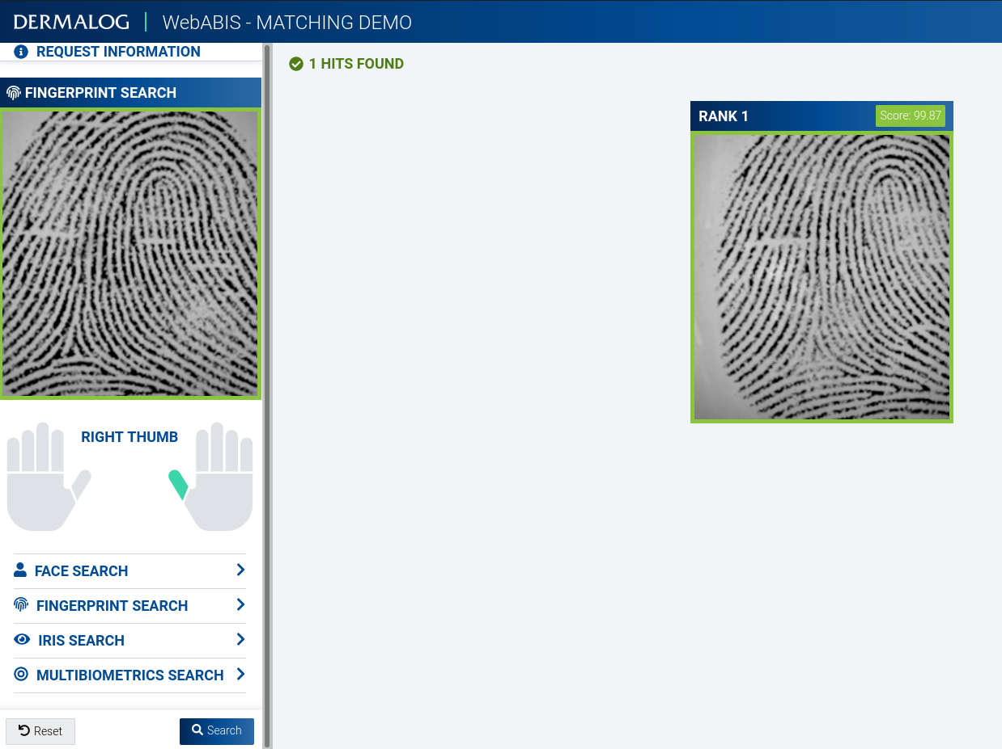
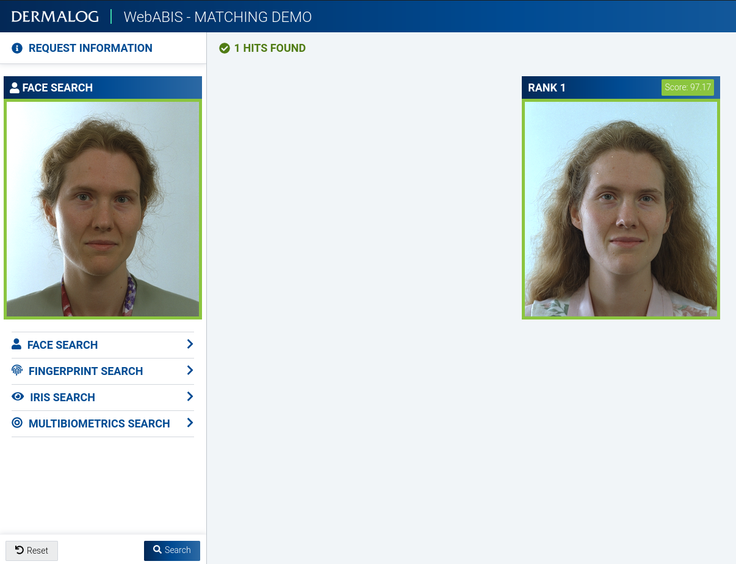
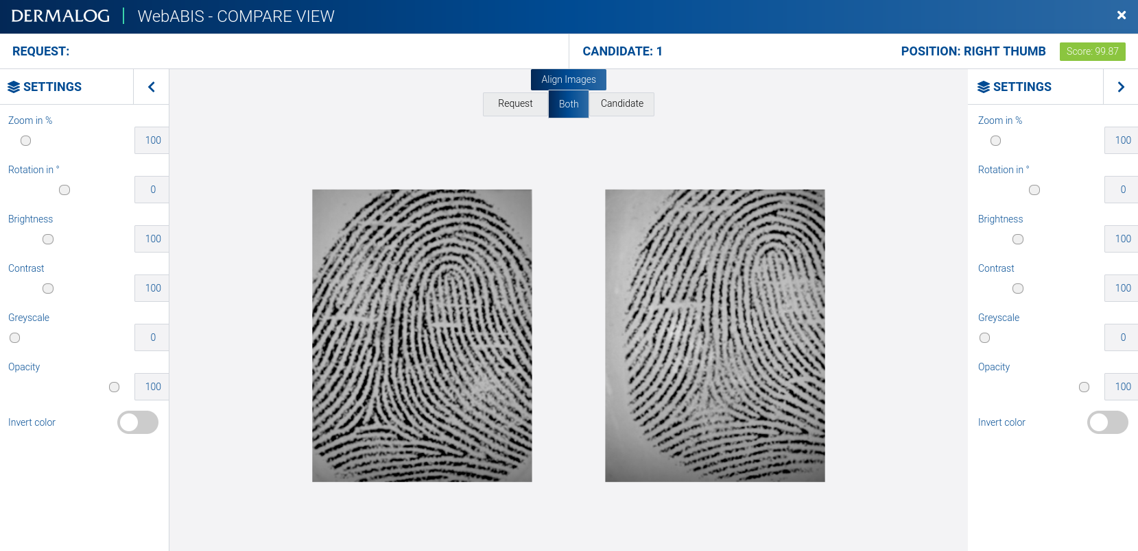
<number>
WebABIS Frontend-Matching Demo
Search by modality and display candidate list
Work in progress...

Slide 12
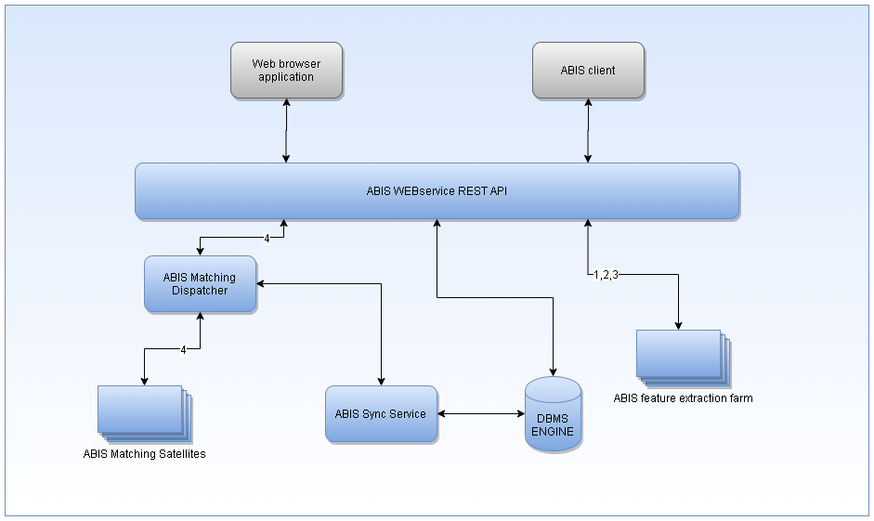
<number>
ABIS Webservice Integration

Slide 13
<number>
ABIS Webservice encapsulating SDKs
Client C#
Client C++
Client C#
Client C++
Browser
APEX
Python
PLSQL
JavaScript
FP Recording SDK
ABIS Web Service
ABIS Matcher
Load Balancer
FC3 SDK
Iris SDK
Matching Result SDK
Template Accessor SDK
Matching Result
ITL-Converter SDK
FC3 SDK
Iris SDK
ABIS SDK
NFIQ2.0 SDK
Aware SDK
ABIS SDK
Palm SDK
ITL-Converter SDK
FP Recording SDK
Template Accessor SDK
NFIQ2.0 SDK
Aware SDK
Palm SDK

Slide 14
<number>
ABIS Webservice REST API
ABIS Webservice REST API
Load balancer
ABIS Dispatcher
Face feature extractor
Fingerprint Feature extractor
LP Feature extractor
NFIQ 2.0
ABIS Sync
Biometric Store
Palm print feature extractor
Iris feature extractor
ITL Converter
Matching Result
ABIS Satellites
Template Accessor
Template Recoder
1:1 Compare
Latent palm feature extractor
Galleries
DB

Slide 15
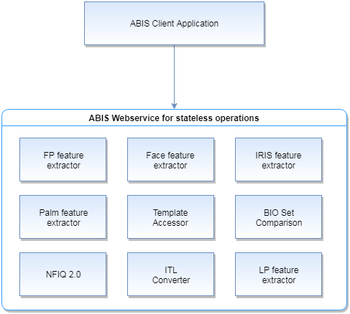
<number>
ABIS Webservice feature extraction

Slide 16
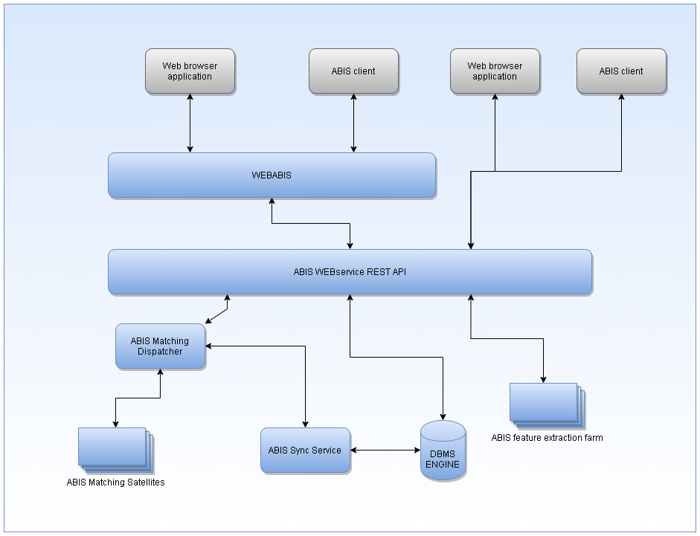
<number>
WebABIS

Slide 17
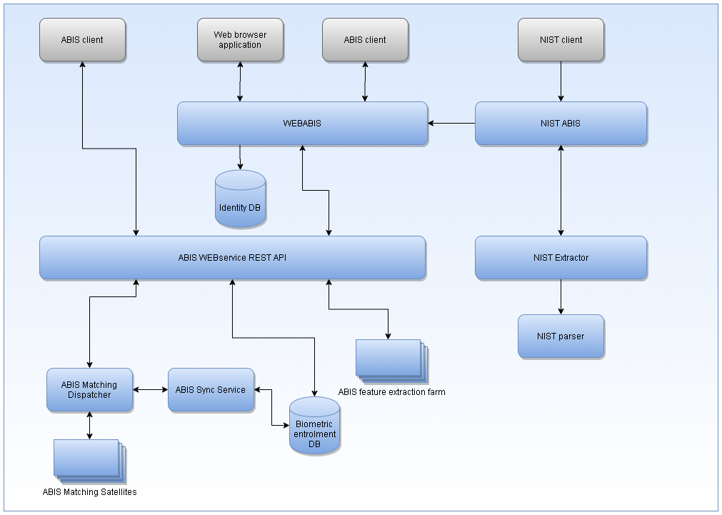
<number>
WebABIS NIST Extension

Slide 18
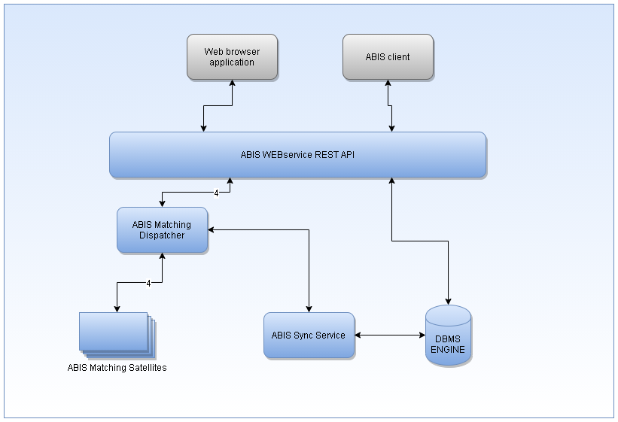
<number>
Matching Subsystem

Slide 19
<number>
ABIS gallery structure
Galleries as distributed cache
Satellites with n galleries of size y
ABIS gallery is a container for ABIS records ready for matching and optimized for performance but not for memory size.
Insertion O(1)
Erase O(1)
Access O(1)
Find O(1)
ABIS template and ABIS record (with initialized templates) is not the same
ABIS template
ABIS SDK
Initialization
ABIS record

Slide 20
<number>
ABIS galleries
HEADER
RECORDS
HEADER
RECORDS
HEADER
RECORDS

Slide 21
<number>
ABIS record
ABISID
Face
Plain TP
Rolled TP
Palms
Irises
ABISID
Face
Plain TP
Rolled TP
Palms
Irises
ABISID
LP
Plain TP
Rolled TP
Palms
Irises

Slide 22
<number>
Distribution, synchronization
Distribution
Synchronization
Restart full system
Change ABIS configuration
Recoding one of biometry
One of satellites is lost
ABIS dispatcher restart
Synchronizing delta DB <-> galleries

Slide 23
<number>
Licensing with wibu
ABIS Dispatcher
Face feature extractor
FP feature extractor
Wibu CodeMeter
Service
24 hours check
Wibu CodeMeter
Service
Wibu CodeMeter
Service
ABIS Satellite
Wibu CodeMeter
Service
ABIS licenses
Licenses must be available for every Dermalog SDK used by ABIS BE and the number of license instances shall be equal to the number of host e.g. There are two hosts with face feature extractor(coding). It will be needed Dermalog Face SDK with instance count 2
ABIS BE has separated license with customer license data. The license data contains maximal number of record for every biometry. This information must be generated during license creation and attached into license container.
Wibu Server
SDKs license container
ABIS BE license container with custom limits

Slide 24
<number>
ABIS Backend Releases
ABIS BE release deliverables
Docs (manual, release notes, API definitions)
YUM repos (el7, el8)
Ansible Collection
Puppet modules
Installer (Puppet Bolt plans)
NIST Import tool
Generated Java libs (for implementing clients)

Slide 25
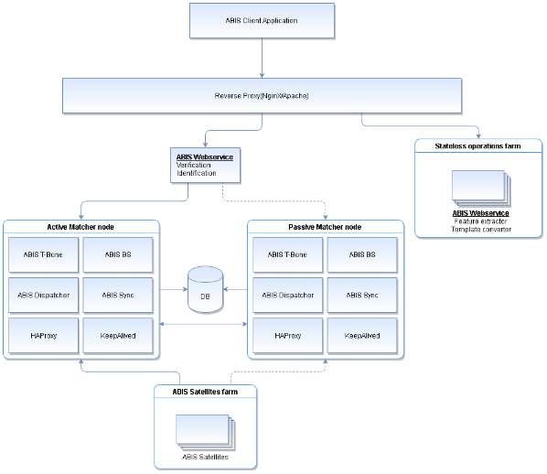
<number>
ABIS BE with Active/Passive
Active Matcher node

Slide 26
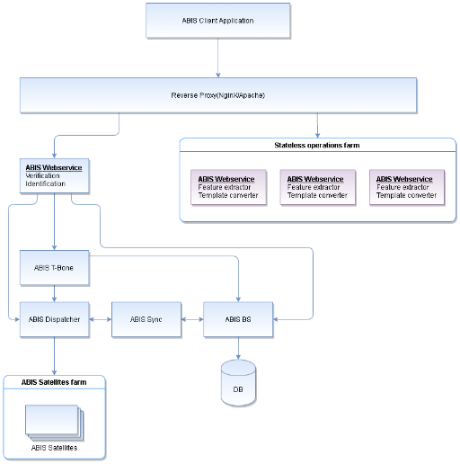
<number>
ABIS BE with Load-Balancing for stateless operations

Slide 27
<number>
References
https://confluence.dc.dermalog.com/display/ABISBE/
http://abis.backend.dc.dermalog.hh/

Slide 28
<number>

Slide 29
<number>

