Slide 1
MLSA INTERNSHIP PROJECT
Name: ADITYA PANDEY
Roll No: 2300290100020 Section: 3A

Slide 2

PROJECT OVERVIEW
QUIZ APP
A dynamic quiz application that fetches questions from a public API, providing users with interactive answer selection and immediate feedback on their choices. This app is designed for an engaging, educational experience, featuring score tracking and the potential for customized categories.
CALCULATOR
A user-friendly calculator with basic arithmetic functions, designed for clear and efficient calculations. It includes real-time display updates and an operator display for a guided user experience, with error handling for cases like division by zero.

Slide 3



TECH STACK
HTML
CSS
JAVASCRIPT

Slide 4
KEY FUNCTIONALITIES
QUIZ APP
CALCULATOR
Dynamic Question Loading: Fetches questions from a public API, refreshing content with each quiz session.
Interactive Answer Selection: Allows users to select answers, highlighting correct and incorrect choices.
User Feedback: Provides immediate feedback on selected answers, making the experience educational.
Basic Arithmetic Operations: Supports addition, subtraction, multiplication, division, and modulo operations.
Real-time Display Update: Shows results and current operations instantly, updating the display as buttons are pressed.
Error Handling: Prevents division by zero and shows an error message if attempted.

Slide 5

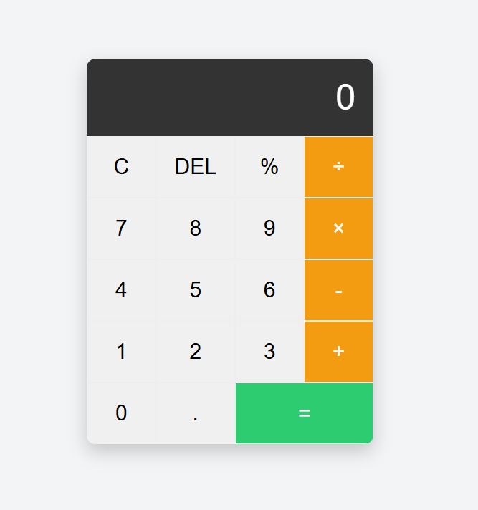
IMAGE SHOWCASE
Calculator
Quiz App

Slide 6
FUTURE ENHANCEMENTS
Quiz App
Calculator
Add Timer and Score Tracking: Introduce a countdown timer for each question to increase the challenge and keep track of the user’s score to provide feedback on their performance.
Category and Difficulty Selection: Allow users to select question categories and difficulty levels before starting, creating a more tailored quiz experience.
History and Memory Functions: Implement a calculation history display and memory functions (M+, M-, MR) to allow users to store and recall previous results.
Scientific Mode: Add an option to switch to a scientific calculator mode with advanced functions like square roots, exponents, and trigonometric operations for more versatile use.

