Slide 1

Bachelor Of Technology
Computer Science and Engineering (Data Science)
311 Program in collaboration with Virginia Tech. USA
Mini-Project Presentation
SVKM’s NMIMS
Mukesh Patel School of Technology Management and Engineering, JVPD, Vile Parle, West
Mumbai- 400056

Slide 2

A PRESENTATION ON
“Sector-wise Stock
trends(In accordance with serving government)”
By: Priyansh Pradhan L030
Aditya Jain L011
Faculty Mentors:
Prof. Ami Munshi, Prof. Mahesh Mali and Prof. Khinal Parmar

Slide 3
Contents
Introduction
Literature Survey
Problem Statement
System Description
Implementation
Result and Analysis
Conclusion
Future Scope
References

Slide 4
Introduction
The data set used consists of information about the top 50 stocks listed on the National stock exchange of India, for everyday from 2000-2021.
The information of each stock is classified date wise, and consists of useful monetary information such as volume weighted average price of the stock, or the highest price of the stock, on a particular day.
Each stock can be classified into a sector which gives us useful insight.
Through these insights we can determine and compare the trends through each government.
Our data set enables us to visualize over 20 years of data from various sectors and over various governments and finance ministers.

Slide 5
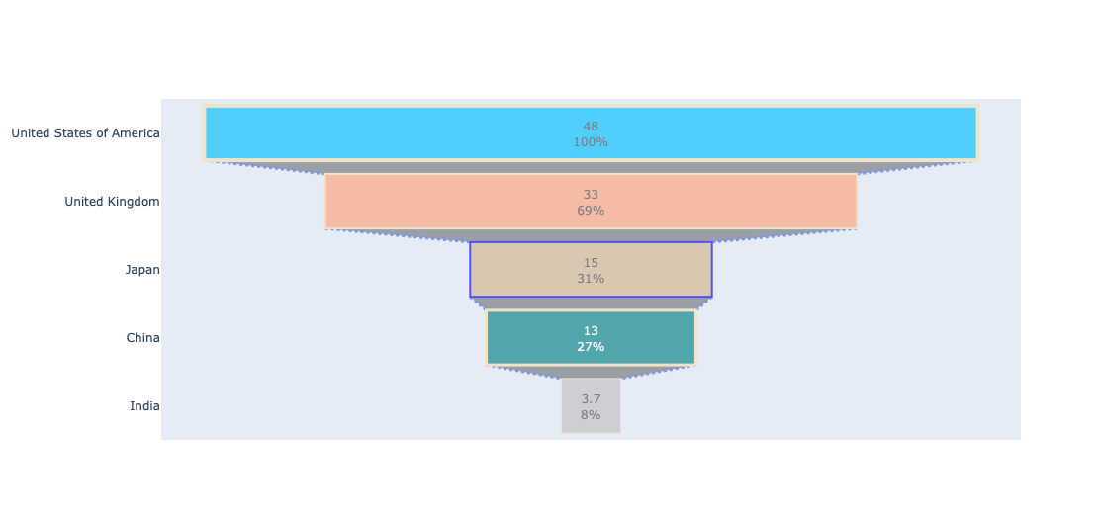
Introduction
We chose this particular data set because of the large disparity, in the participation of the stock market in India compared to other countries, as only 3.7% people in India own stocks.
Today India is the 7th largest stock market in the world, and yet very few people have access to information and data about it.
Funnel Chart

Slide 6

Literature Survey
A Study of Indian Stock Market Scenario with Reference to Its Growth
The profitability of moving average trading rules in South Asian stock markets

Slide 7
Problem Statement
“To compare stock trends, through out major sectors across several governments”

Slide 8
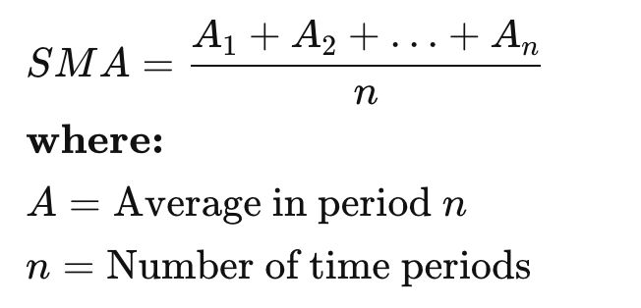
System Description
Simple Moving Average is the most common type of average used. In SMA, we perform a summation of recent data points and divide them by the time period. The higher the value of the sliding width, the more the data smoothens out, but a tremendous value might lead to a decrease in inaccuracy.

Slide 9

System Description
Time series consist of real values and continuous data. It is assembled over a successive time duration to predict future values based on current data.
We have used python and graph plotting library “Plotly” and we have used Dash which is a python framework.
Then we will present the data in a way where the user can easily maneuver through time periods and major government figures.

Slide 10
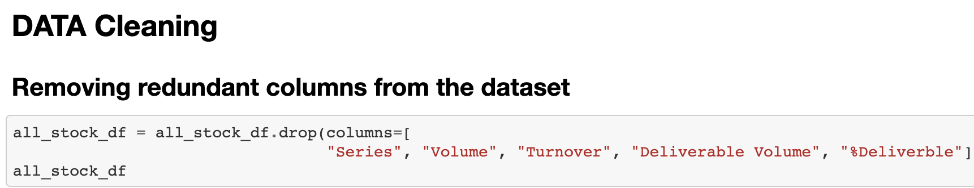
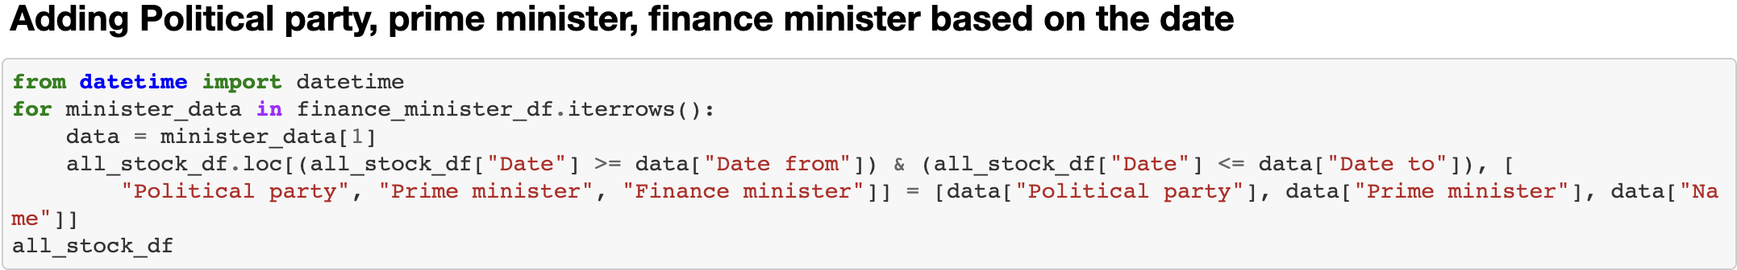
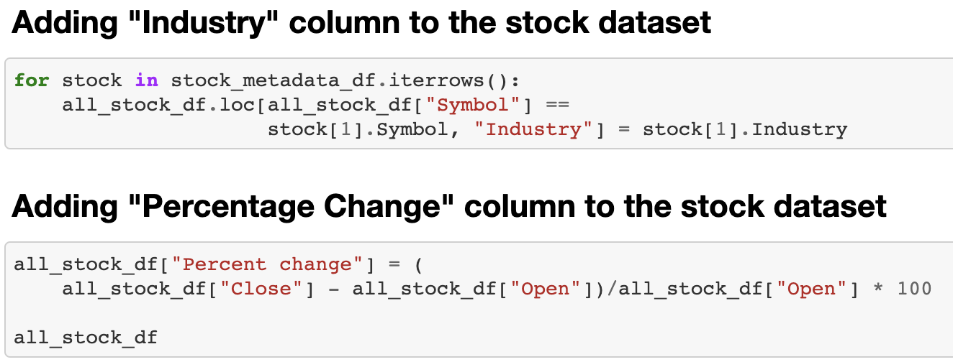
Implementation

Slide 11
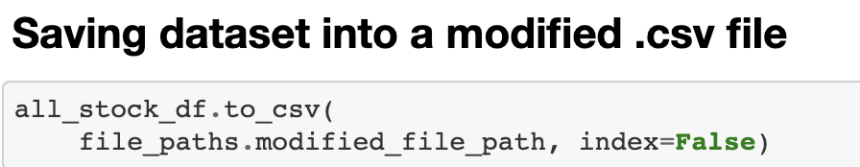
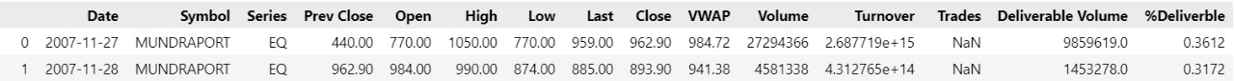
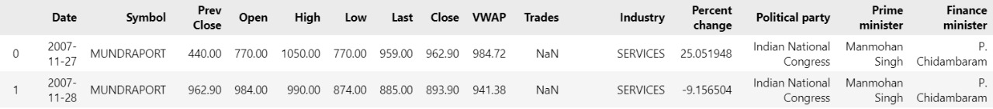
Implementation
Data Set before
Data Set after

Slide 12
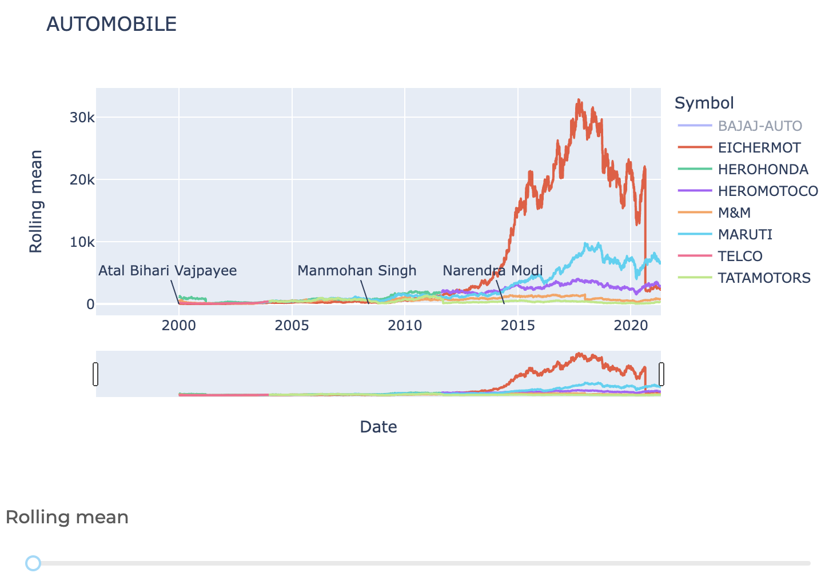
Data Visualization

Slide 13
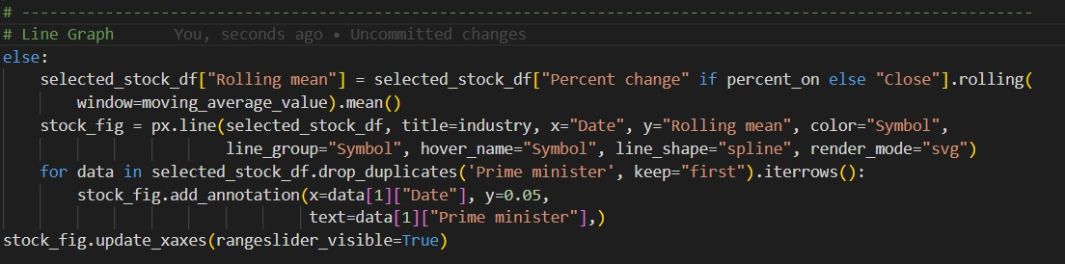
Implementation

Slide 14
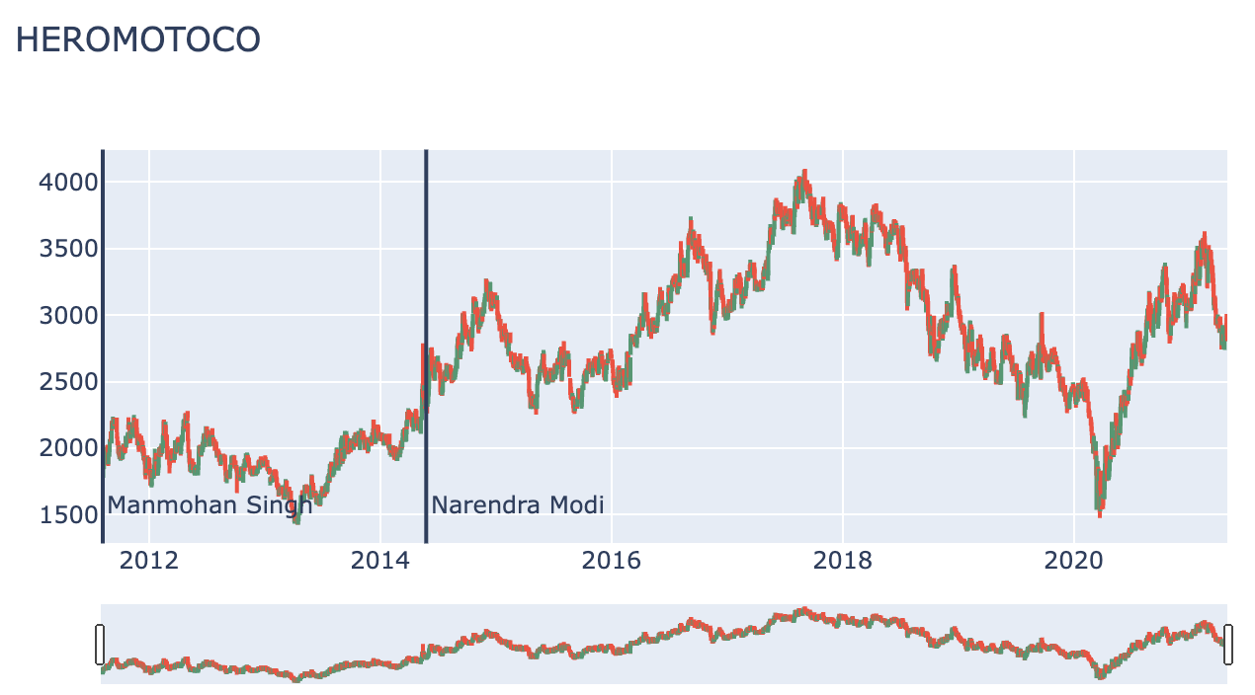
Data Visualization

Slide 15
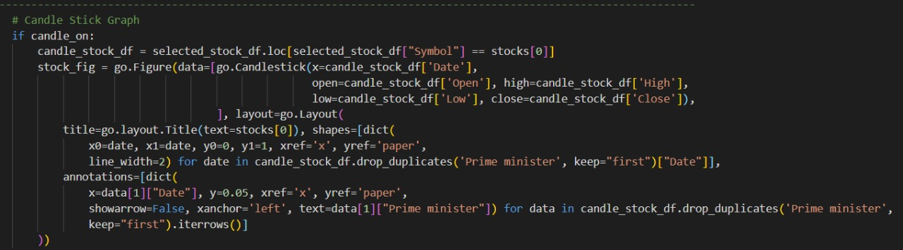
Implementation

Slide 16
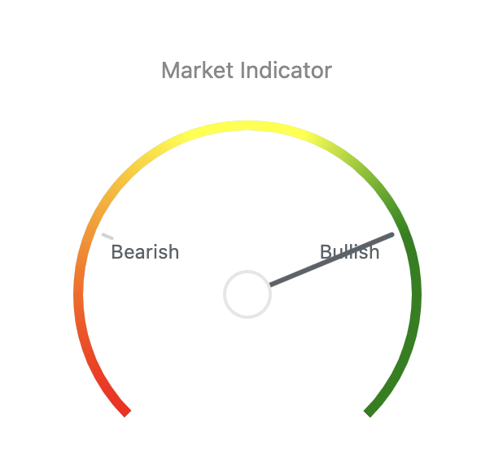
Data Visualization

Slide 17
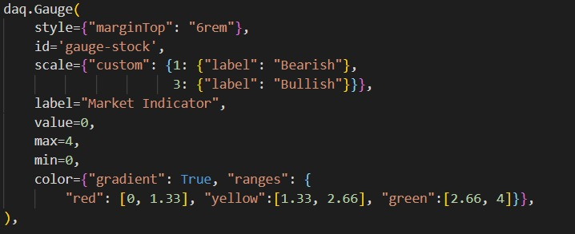
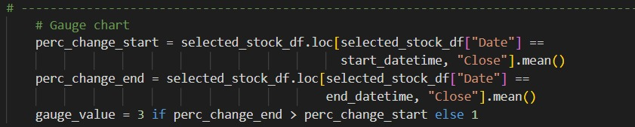
Implementation

Slide 18
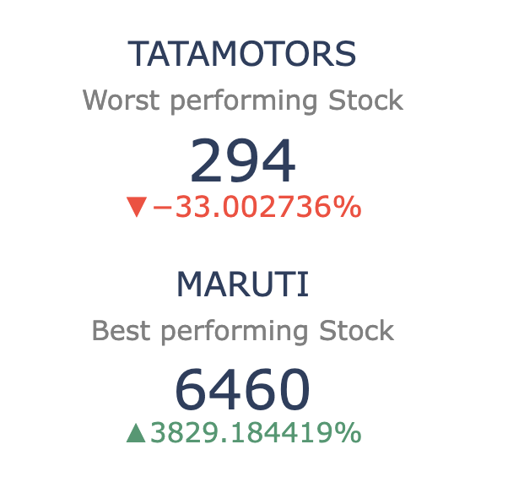
Data Visualization

Slide 19
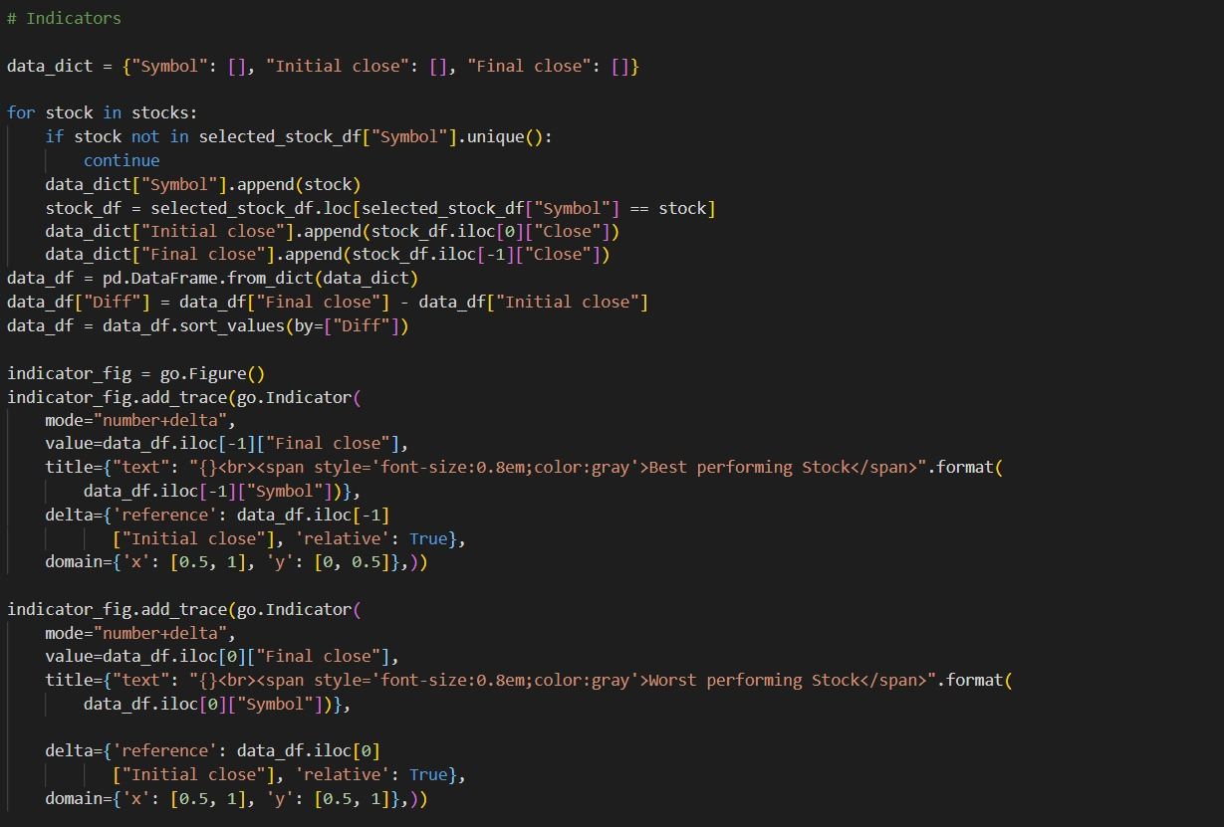
Implementation

Slide 20
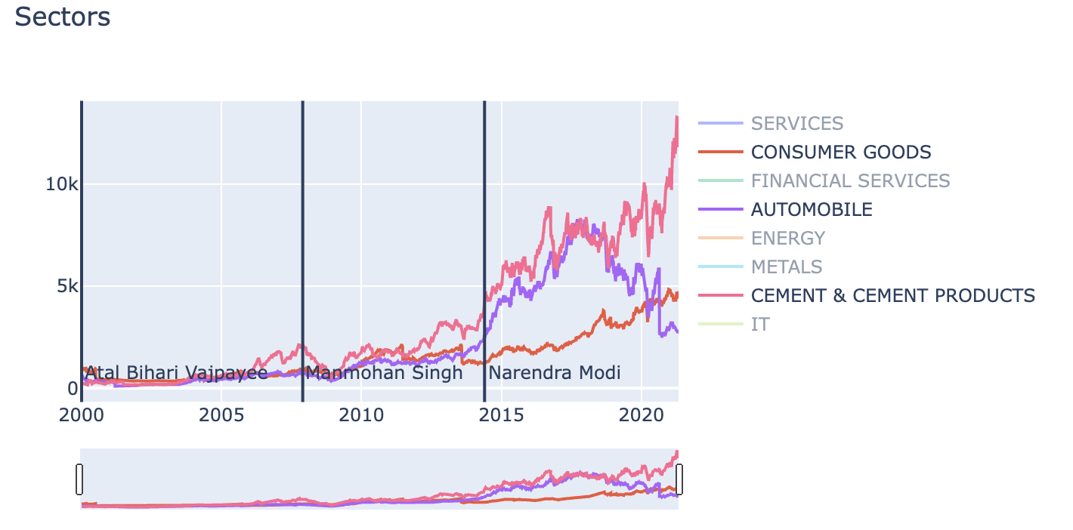
Data Visualization

Slide 21
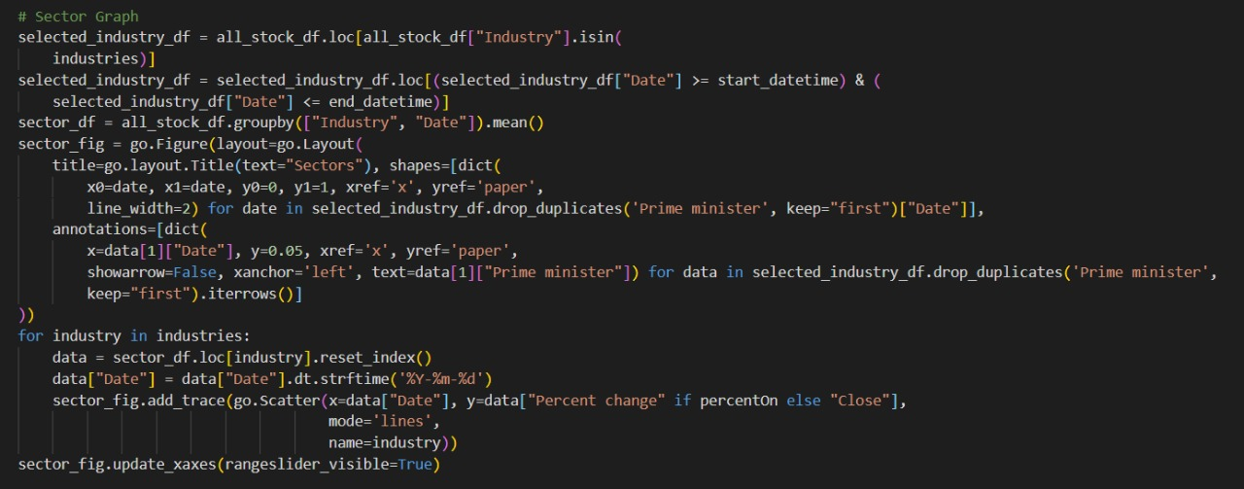
Implementation

Slide 22
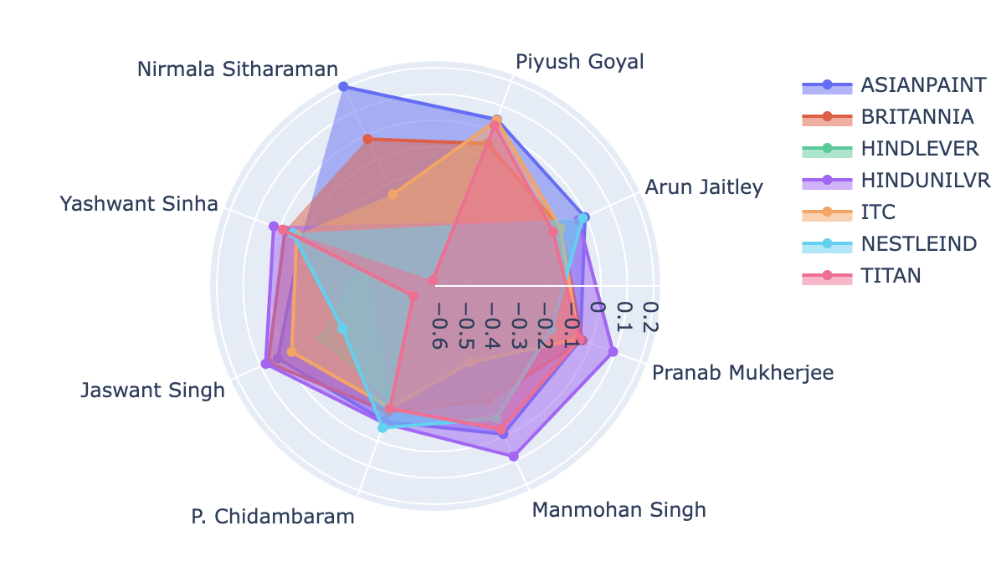
Data Visualization

Slide 23
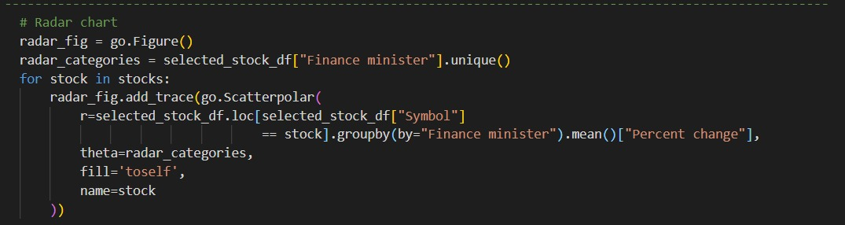
Implementation

Slide 24
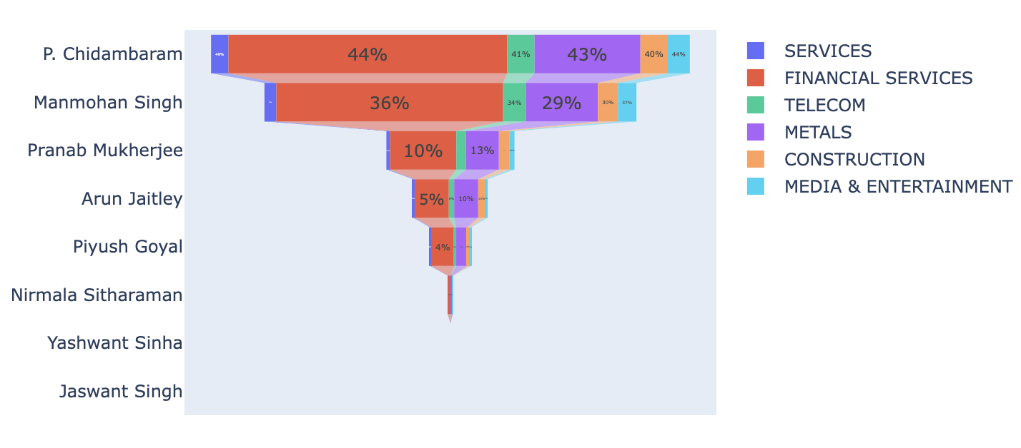
Data Visualization

Slide 25
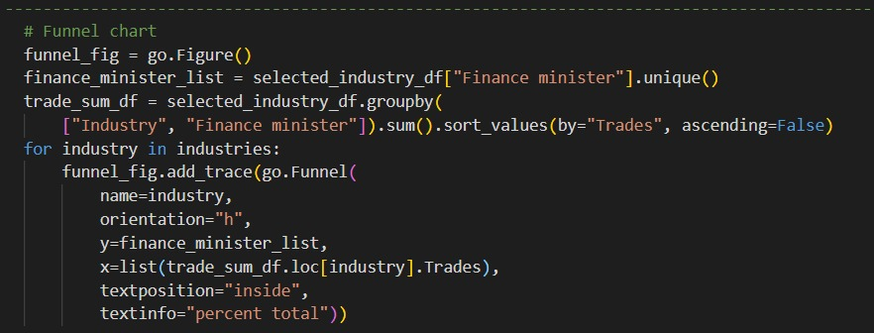
Implementation

Slide 26
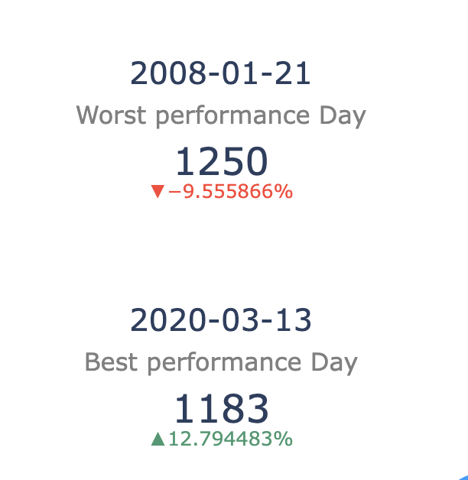
Data Visualization

Slide 27
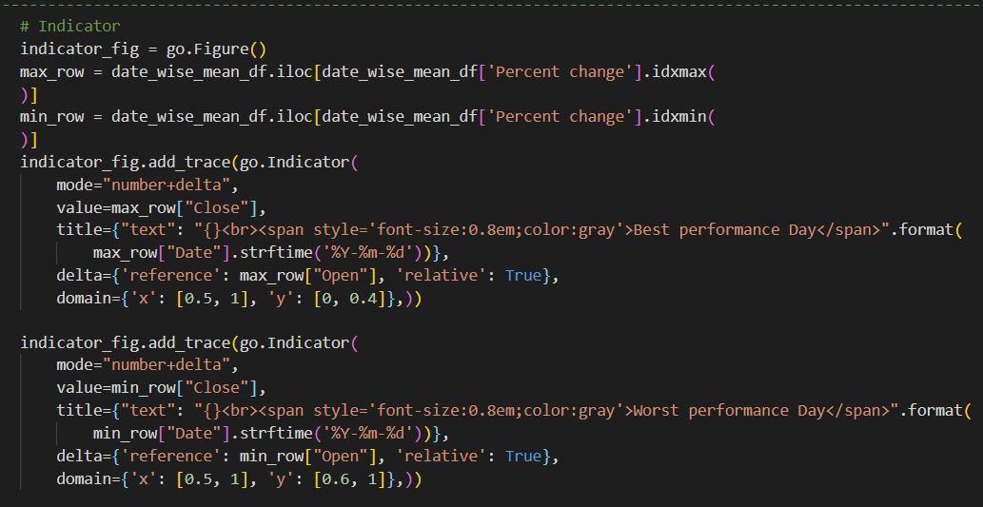
Implementation

Slide 28
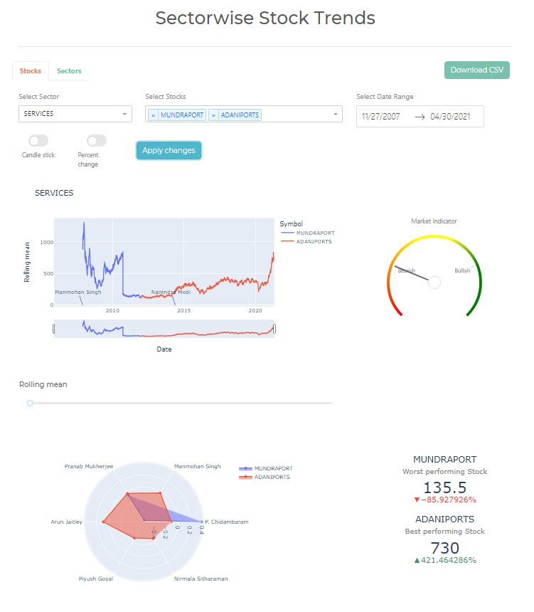
Data Visualization Final dashboard

Slide 29
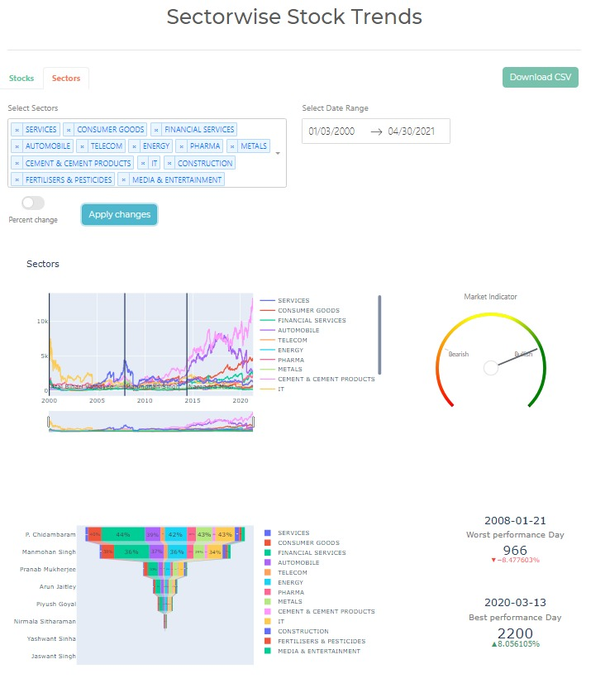
Data Visualization Final dashboard

Slide 30
Result and Analysis
Every user can make multiple conclusions from each of the graphs, and multiple conditions can be applied to obtain insight into multiple sectors.
In the services sector we can observe that the sector performed best when P. Chidambaram was the finance minister of India, and we learned that the Adani ports stock rose 421% from it’s initial price.
In the consumer goods sector Nestle is the best performing stock and rose 553% and that Asian paints did the best when Nirmala Sitharaman was finance minister.
In the finance sector Bajaj finance rose 2000% and did
the best when Jaswant Singh was the finance minister.

Slide 31
Result and Analysis
In the automobile sector it can be observed that Eicher motors moved the most between 2014 and 2018, but Maruti was a better performing stock with 3829% overall increase. We can also observe that Bajaj-auto had the highest percentage increase when Manmohan Singh was finance minister.
In the telecom sector the best performing stock is Bharti airtel and the highest percentage change happened under Arun Jaitley, and it can be observed that the sector has had an overall bullish run.
The energy sector performed the best under finance
ministers Arun Jaitley and Jaswant Singh, and Reliance
has been the top gainer in this sector.

Slide 32
Result and Analysis
The pharma sector performed best when Arun Jaitley and P.Chidambaram were finance ministers, and Dr.Reddy is the best performing stock in this sector.
The metals sector did particularly well when Atal Bihari Vajpayee was serving as the prime minister.
The construction sector did the best compared to all other sectors in 2006.
The media sector has been bearish for all long time, and hasn’t made any particular changes compared to the other sectors.

Slide 33
Future Scope
This dashboard has many future further optimization options, as we can turn it into a insight dashboard for trading platforms.
The dashboard could be converted into a real-time dashboard by changing the source of the data from our Excel file to an API or cloud based data source.
We could also in this case host this dashboard on a website/server and give meaningful insight to many people about trading and they can make thousands of their own inferences and conclusions.
We are planning to implement forecasting in this as well in the future which will give even more insight into how each stock will perform in the future.

Slide 34
Conclusion
Through this dashboard the user can perform a deep-rooted analysis of the stock market and how sectors have performed and stocks under Finance ministers and Prime ministers of the country.
The overall dashboard debunks the common myth that the stock market cannot be analyzed and is only a “gamble” of sorts, this can be observed as every drop or increase in the prices over the years has happened for a reason which can be easily traced back, or observed using our the dashboard.

Slide 35
References
[1] Plotly.com. 2021. Financial Charts. [online] Available at: <https://plotly.com/python/financial-charts/> [Accessed 19 October 2021].
[2] MITCHELL, C., 2021. How to Use a Moving Average to Buy Stocks. [online] Investopedia. Available at: <https://www.investopedia.com/articles/active-trading/052014/how-use-moving-average-buy-stocks.asp> [Accessed 19 October 2021].
[3] P. Srivastava, “A study of Indian stock market scenario with reference to its growth,” Onlinejournal.in. [Online]. Available: http://www.onlinejournal.in/IJIRV3I4/100.pdf. [Accessed: 19-Oct-2021].
[4] Gunasekarage, A. and Power, D., 2001. The profitability of moving average trading rules in South Asian stock markets. Emerging Markets Review, 2(1), pp.17-33.
[5] Python.org. 2021. Welcome to Python.org. [online] Available at: <https://www.python.org/> [Accessed 19 October 2021].

Slide 36
THANK YOU

