Slide 1
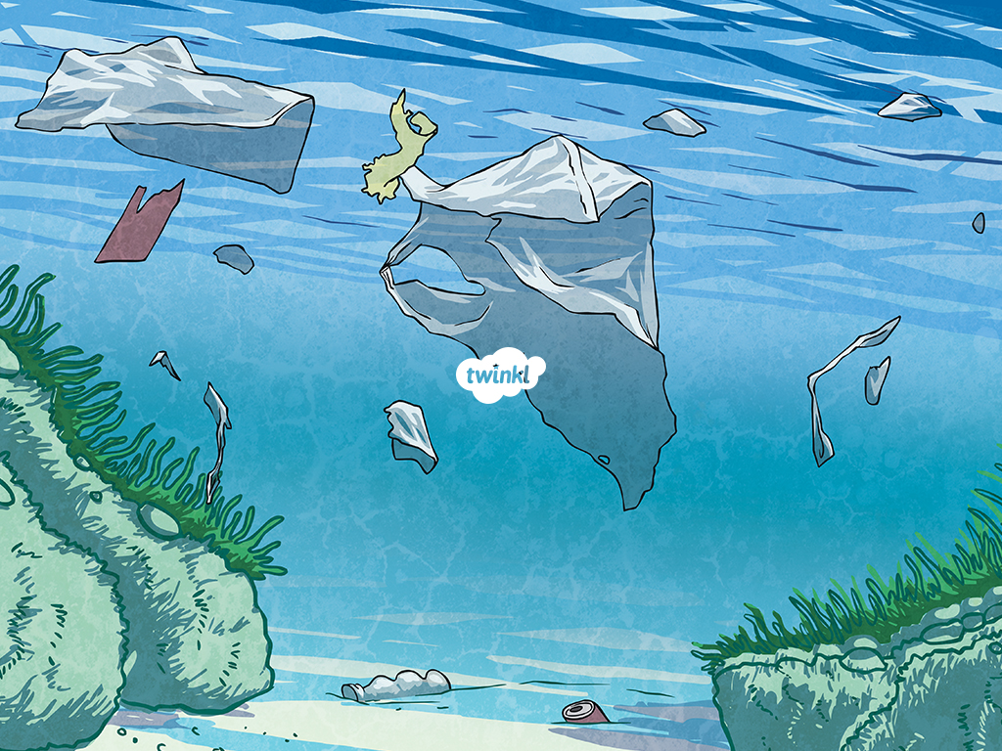

Topic: Harmful effects of plastics and polyethylene on environment
Branch: C.S. (Vth Sem)
Subject: Professional Development
Submitted By
Adnan Khan
Submitted To
Deepti Madam

Slide 2
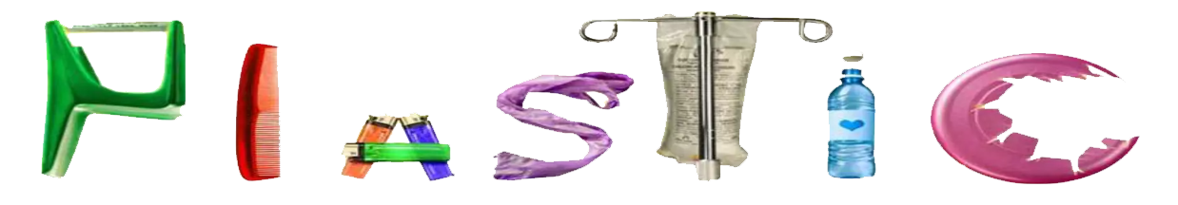
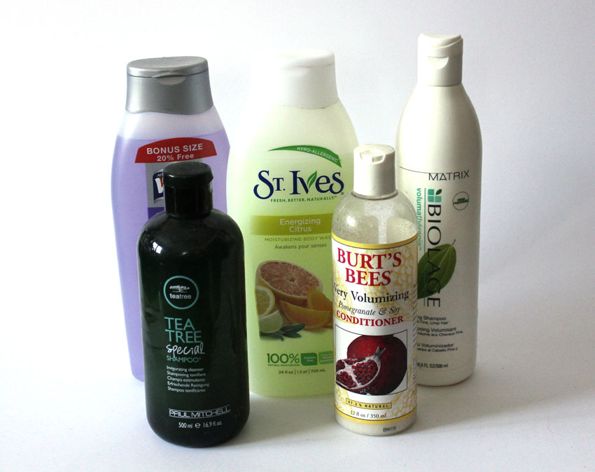
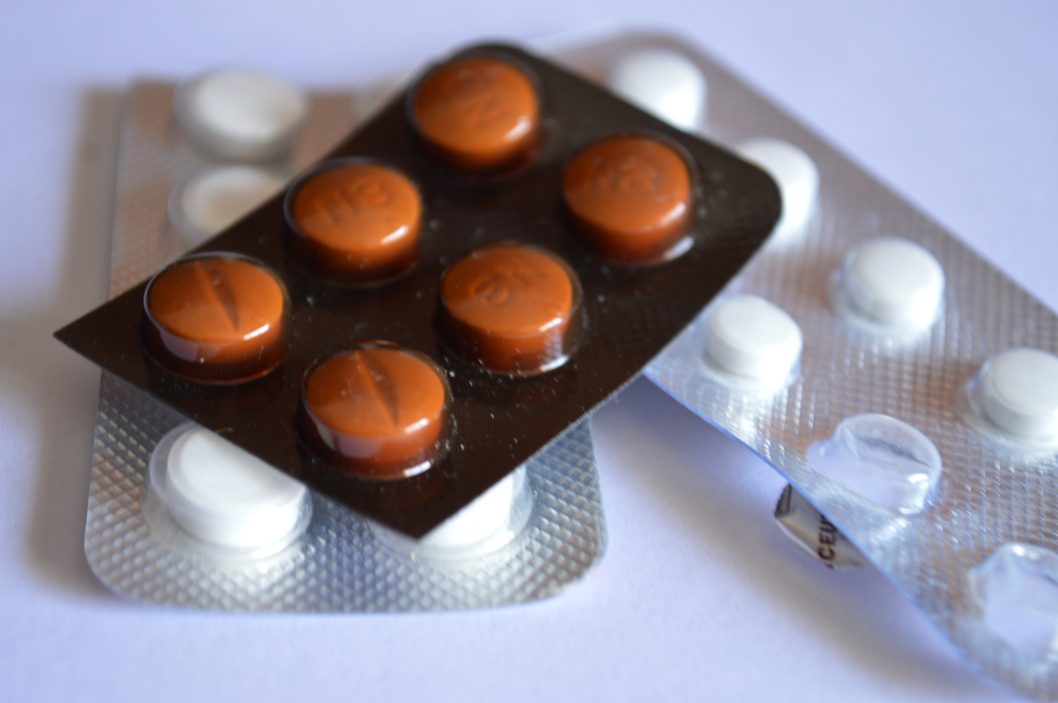
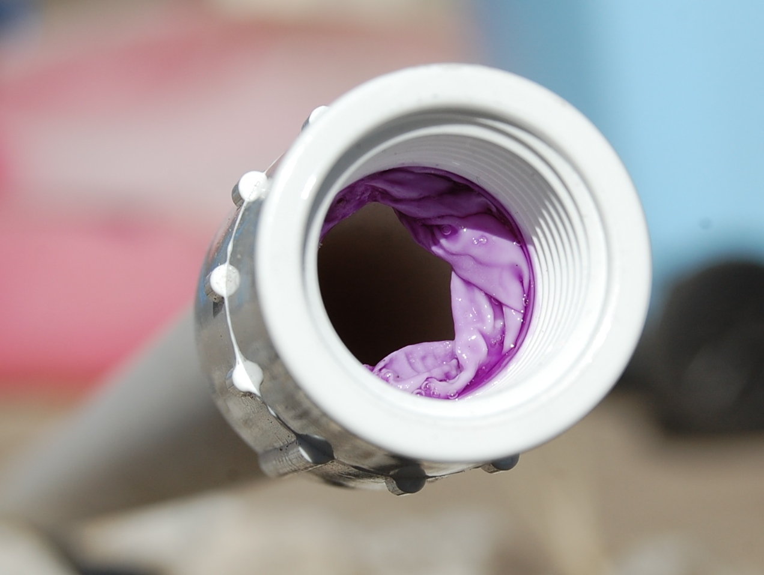
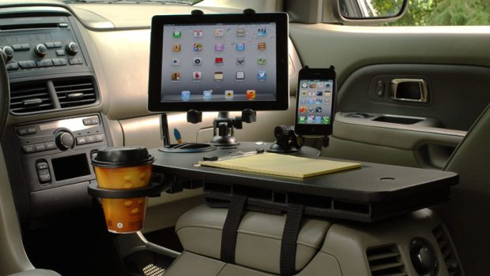
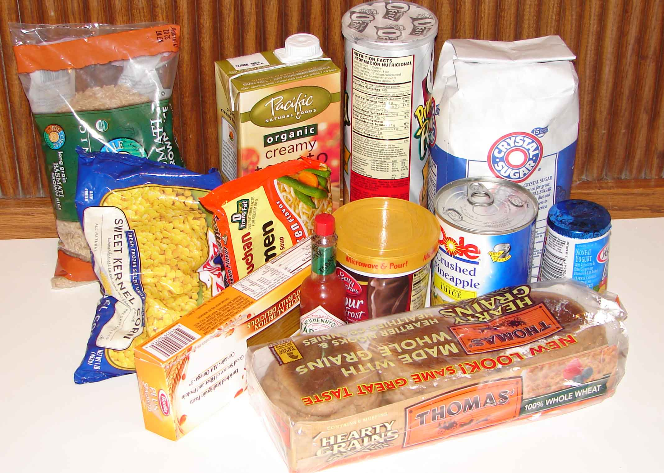
Plastic & Polyethylene Here and There
Plastic is a very popular material. They are found in virtually everything these days.
Plastic is used in medical devices and equipment such as syringes, tubing, and containers..
Plastic pipes, fittings, and other construction materials are often made from polyethylene.
Your Car, Phone and Computers are made from it.
Many consumer products, from shampoo bottles to yogurt containers, are made from plastic.
Your Food and Hygiene products are packed in it.

Slide 3
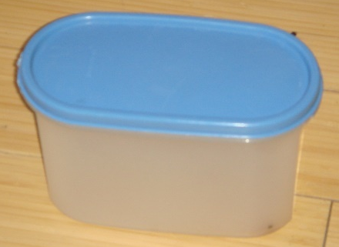
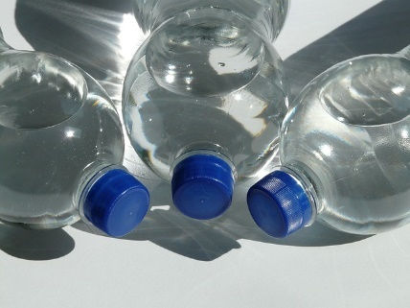
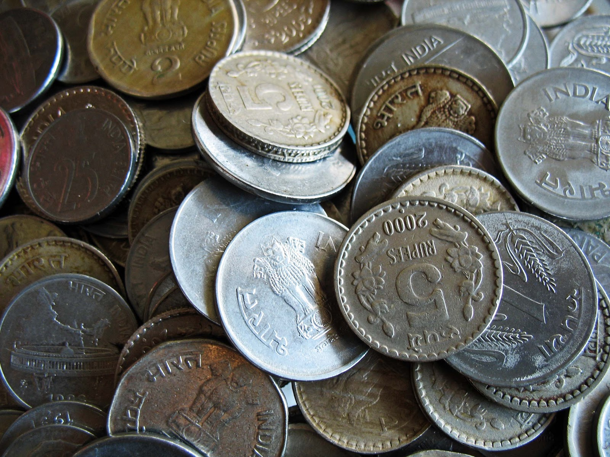
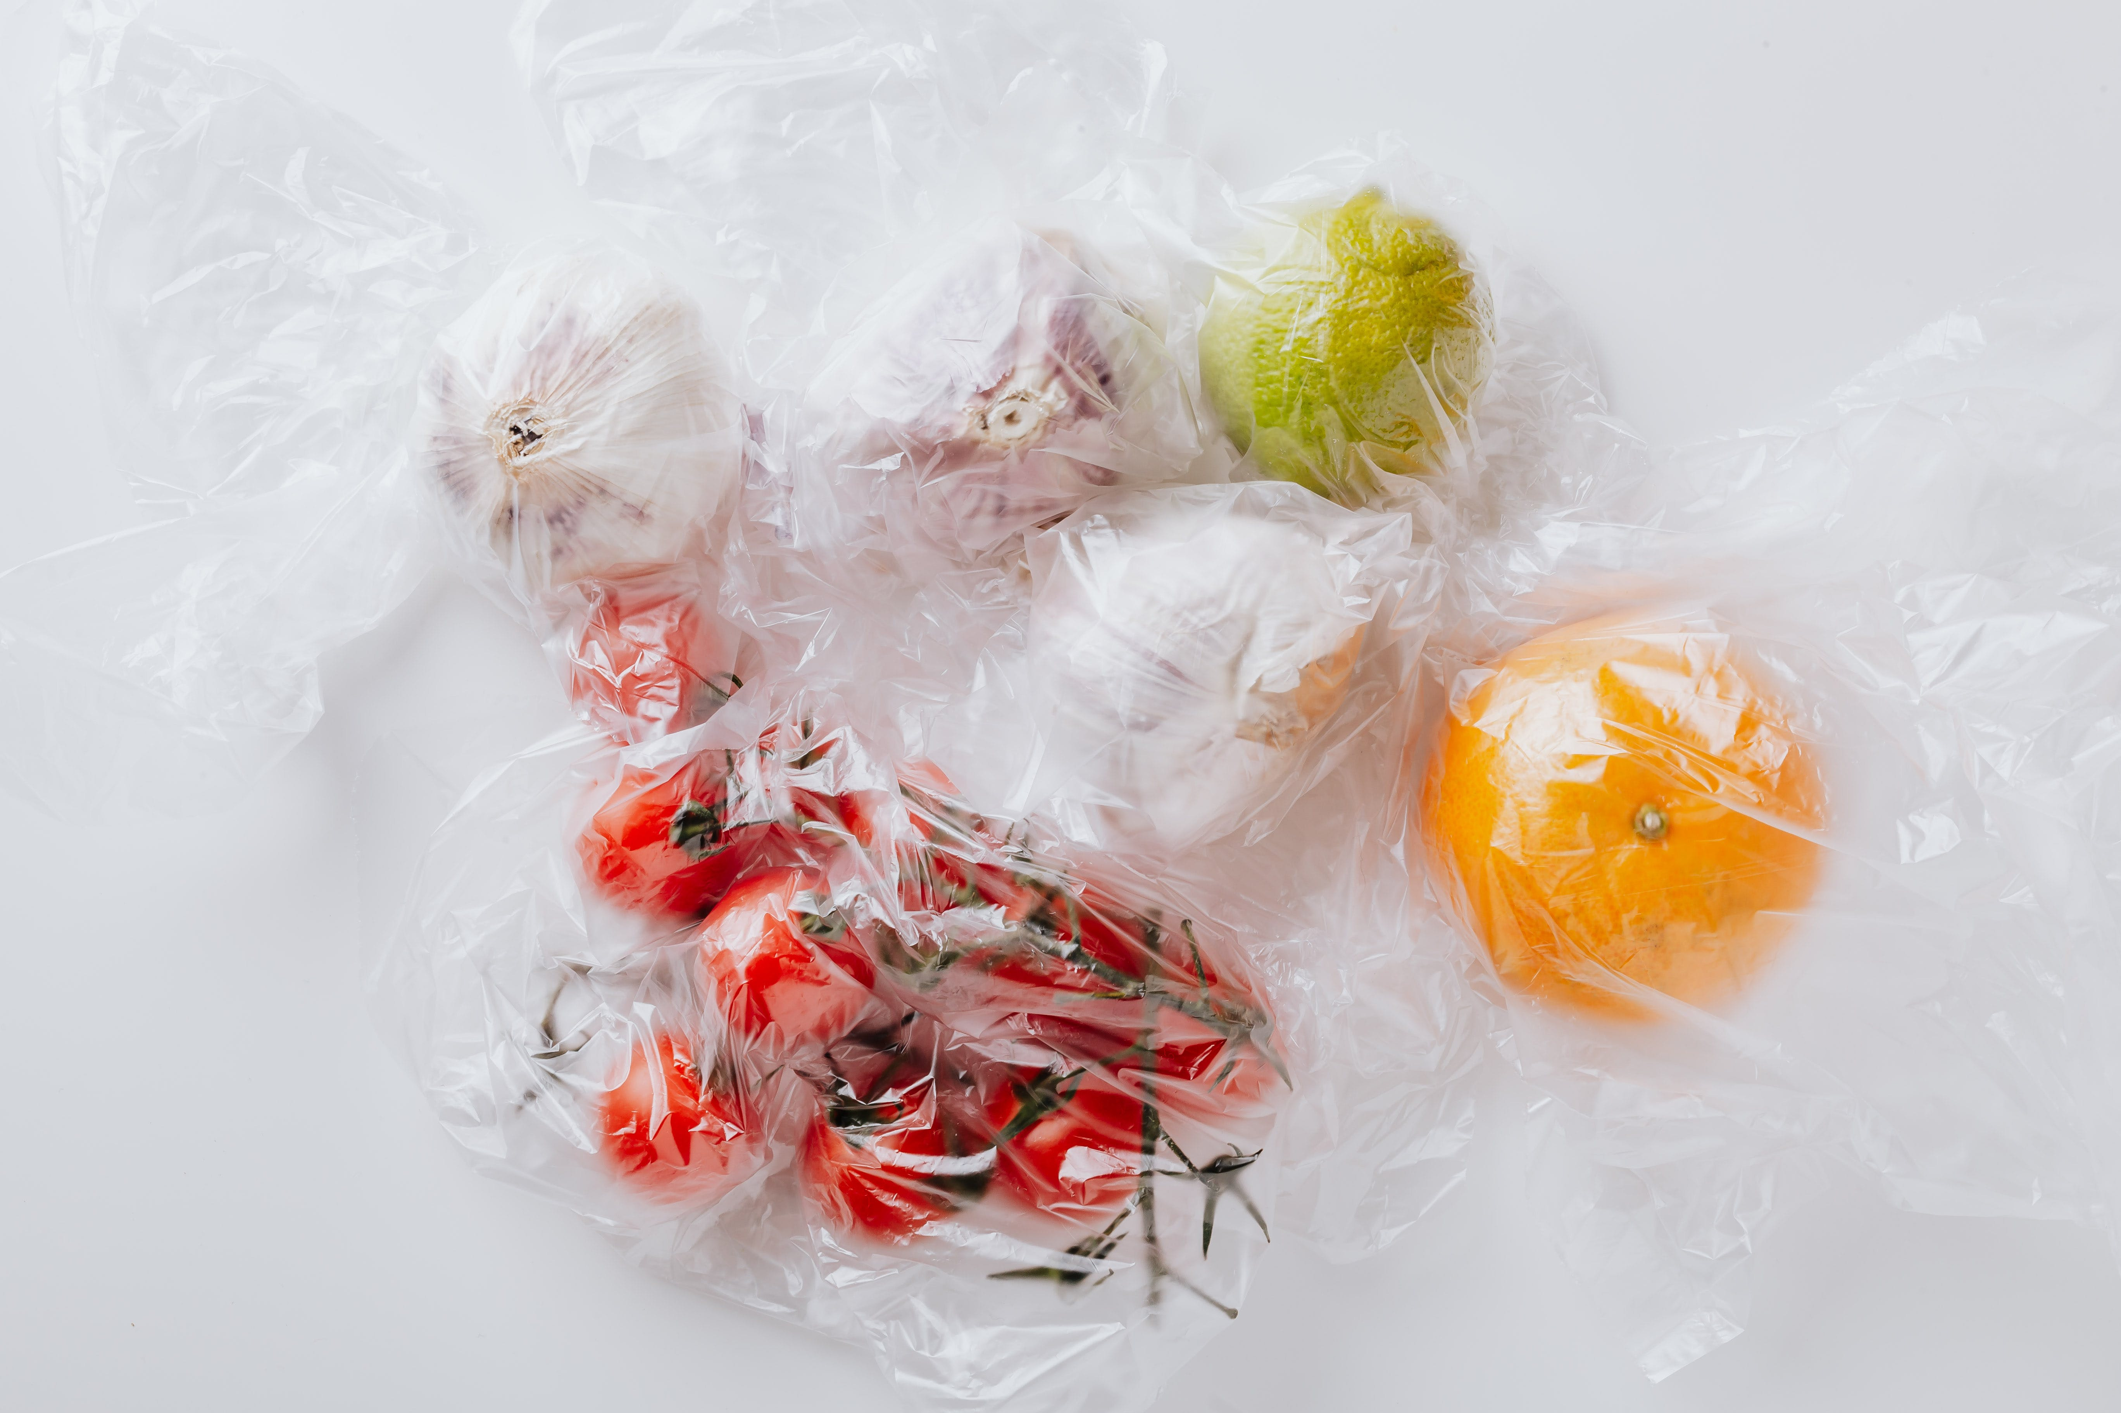
Advantages of Plastic and Polyethylene
It keeps things airtight, which is ideal for keeping food fresh.
It is waterproof so nothing leaks out or drips in.
The production of plastic is often cost-effective compared to other materials like metal or glass
plastics are transparent, allowing for clear visibility of the contents.

Slide 4
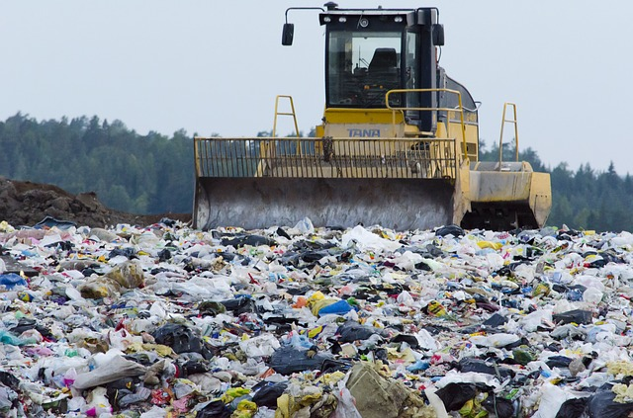
Is Plastic Durability and Biodegradability ?
Plastic is incredibly durable and it is not biodegradable. It does not decompose like vegetables, fruit or meat.
Getting rid of unwanted plastic is a challenge. If it is burned, harmful gases are released into the atmosphere. This causes air pollution.
It is usually buried in huge landfill sites. Even though we don’t see it, it is still there and it can last for many decades.

Slide 5
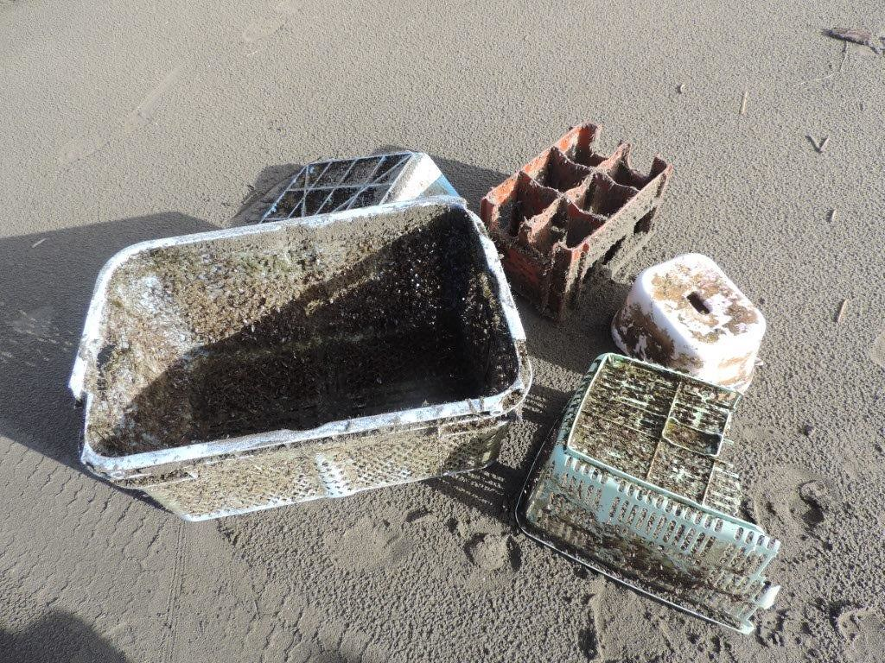
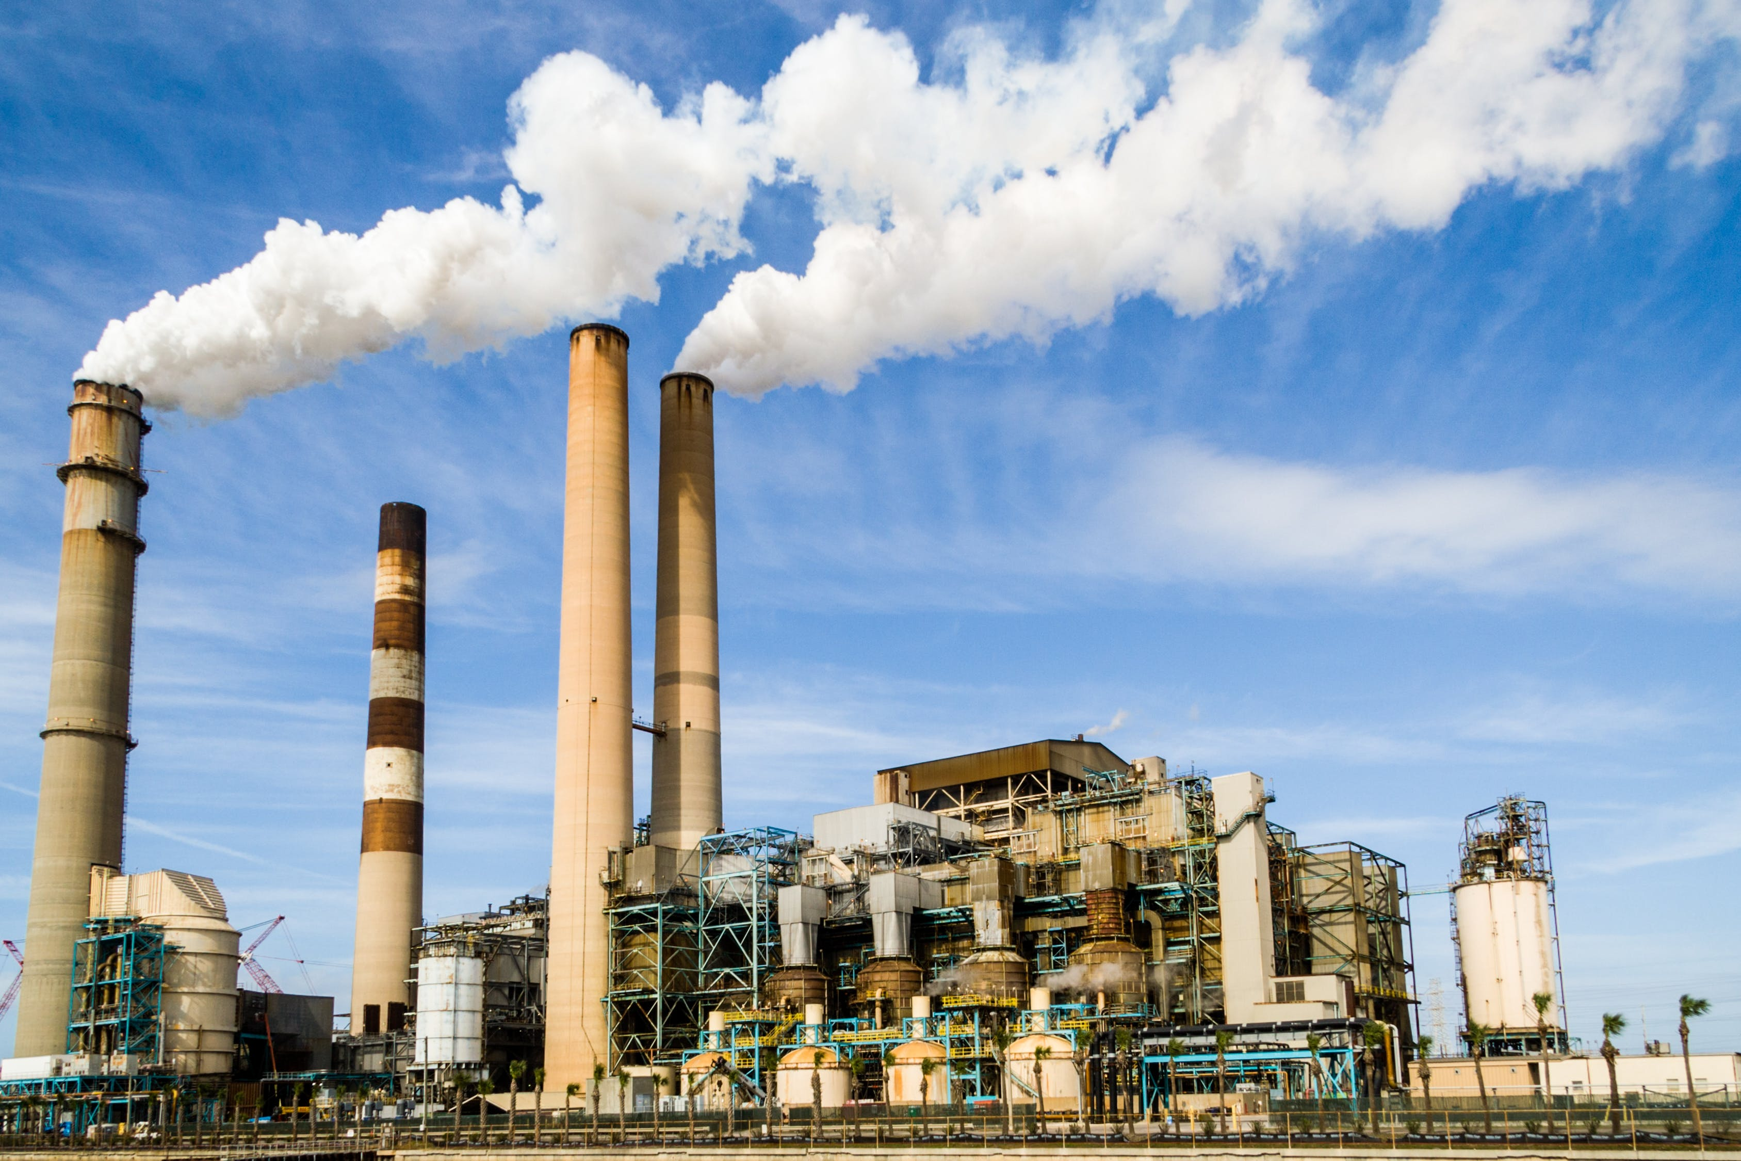
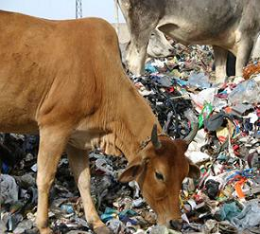
Disadvantages of Plastic and Polyethylene
Many plastics, including polyethylene, are non-biodegradable, meaning they do not break down naturally over time.
The manufacturing of plastics, particularly through processes like polymerization, can contribute to greenhouse gas emissions
The recycling process for plastic is expensive.
Animals that accidentally eat plastic suffer and often die as a result of it.

Slide 6
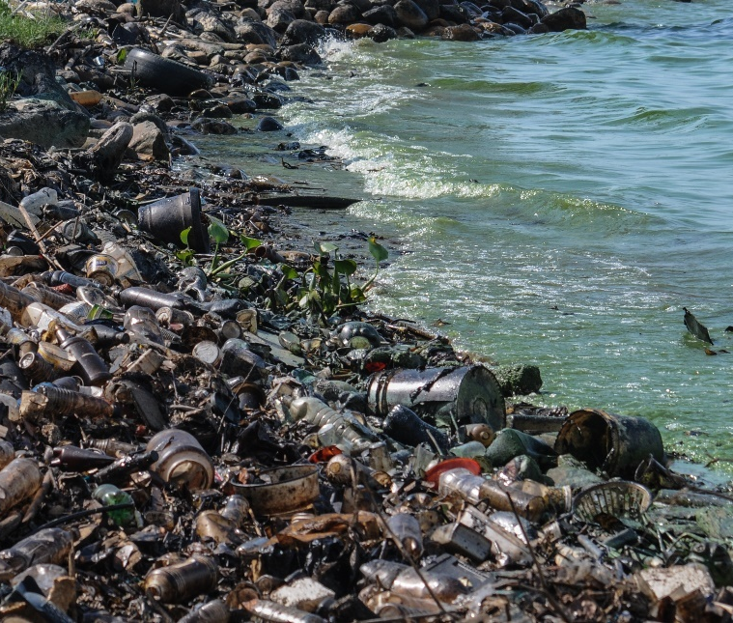
Plastic and the Environment
The biggest problem with unwanted plastic is the pollution and damage it causes the environment.
Plastic breaks into tiny pieces, which then get blown around by the wind and the rain.
It ends up in our streams, rivers and the ocean.

Slide 7
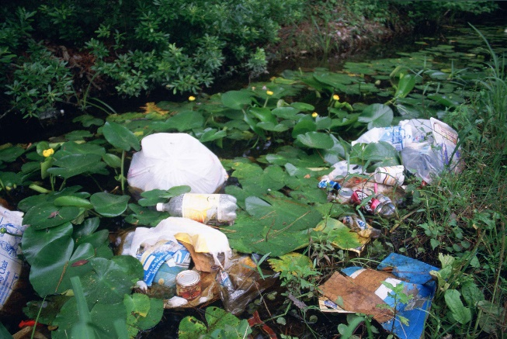
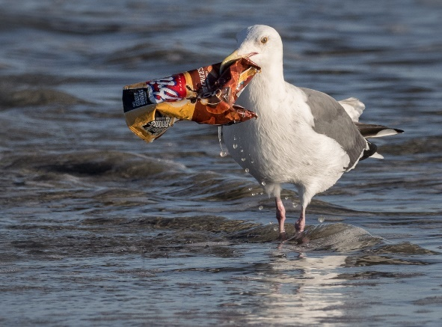
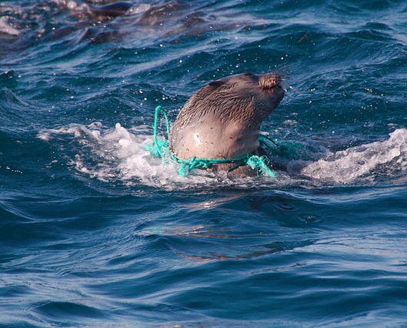
Plastic Pollution
All living things should be able to live free from pollution and harm from plastics. So, what can we do?
Photo courtesy of Ingrid Taylar (@flickr.com) - granted under creative commons licence - attribution

Slide 8
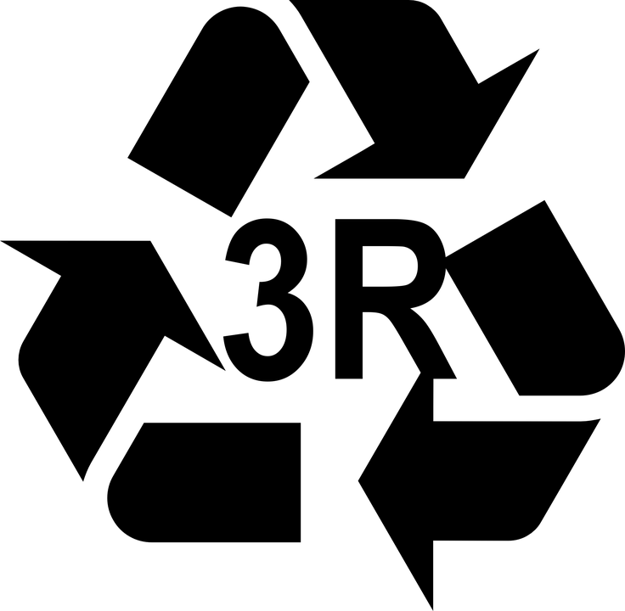
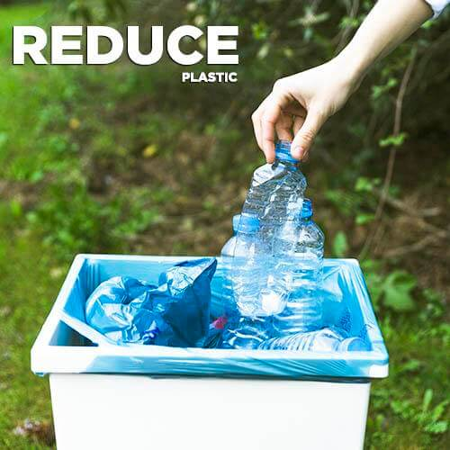
Our Responsibility
Reduce – The First “R” of Waste Hierarchy: -
The first R in the waste hierarchy is “Reduce.” The crucial thing in the waste management procedure is to maintain a perfect balance in consumption and recycle & reuse. If the consumption is less, the rate of recycling or reuse will also be less.

Slide 9
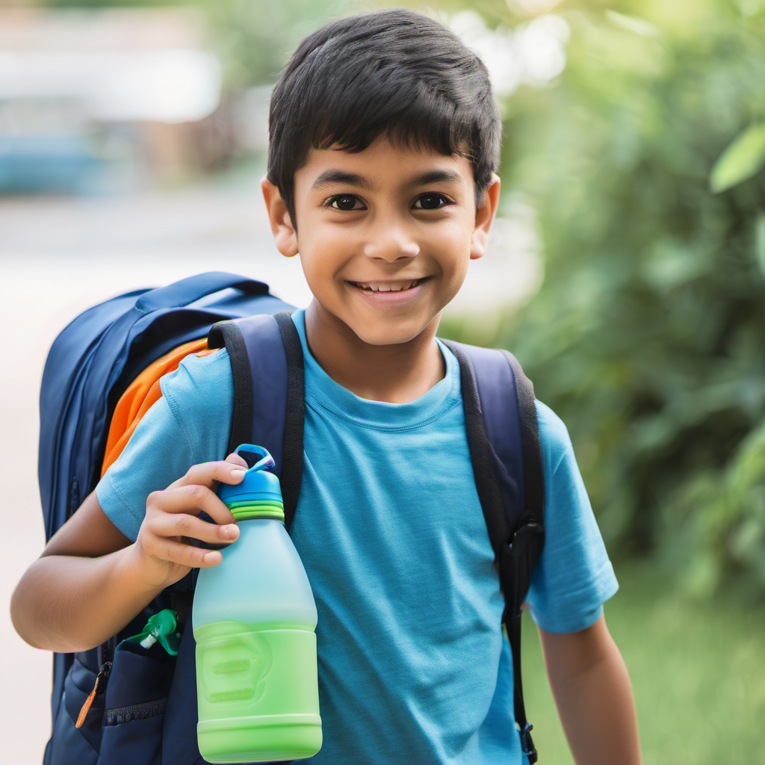
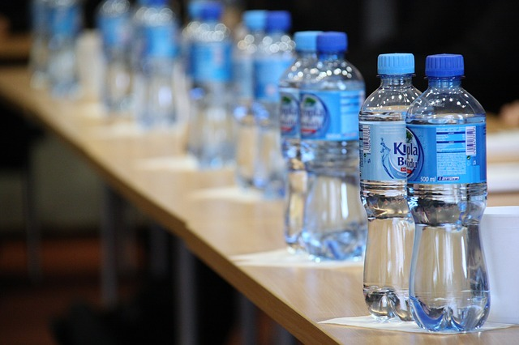
What You Can Do
Water bottles are one of the main causes of environmental pollution. Instead of using lots of water bottles and throwing them away, have your own water bottle.

Slide 10
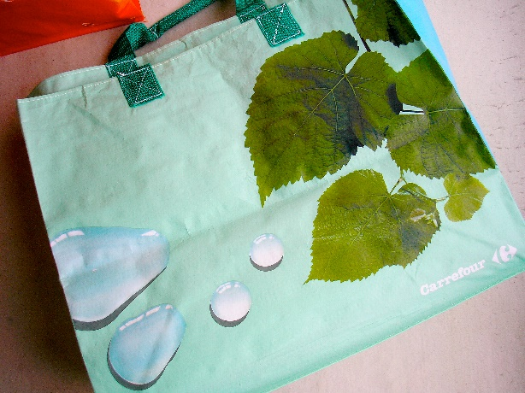
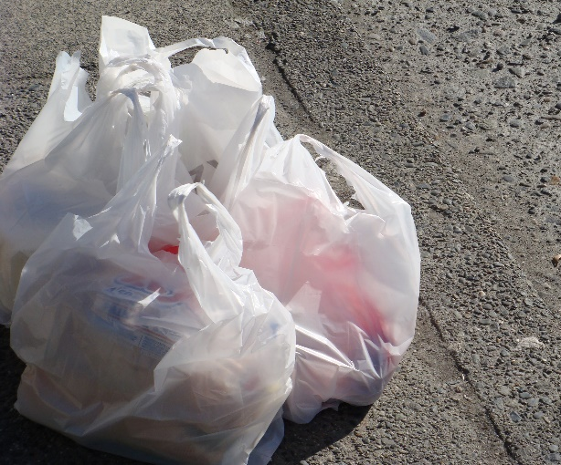
What You Can Do
Carrier bags are often used once and thrown away. Instead, buy a bag for life and keep using it. Since many shops charge 5p per bag, a reusable one is cheaper too!
Photo courtesy of Michael Francis McCarthy, velkr0 (@flickr.com) - granted under creative commons licence - attribution

Slide 11
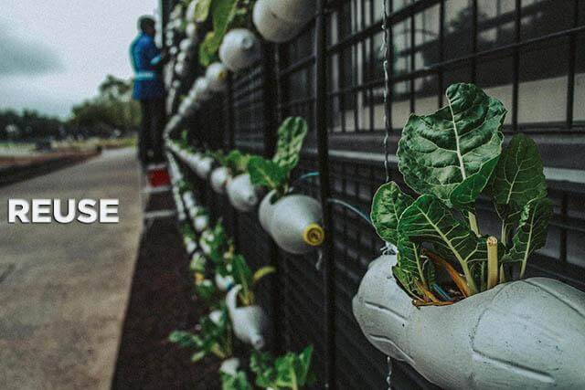
Reuse – The Second “R” of Waste Hierarchy: -
If you have a bag full of old things that are not in use, then you can find out a way to reuse these thrown away things. The reuse of old stuff can reduce waste and does not affect the waste hierarchy. If you do not have any use of any of these thrown away items, then you can also donate it to someone who needs it.

Slide 12
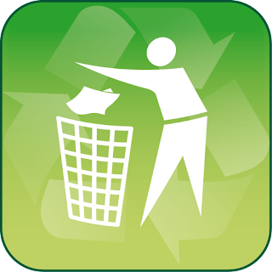
Recycle – The Third “R” of Waste Hierarchy: -
Recycling is the third stage of the waste management process. Recycling is a process in which the dumping items are transformed into a new item. You can also send your unused items to recycling centers. It is vital that you are well aware of the things that can be recycled.

Slide 13

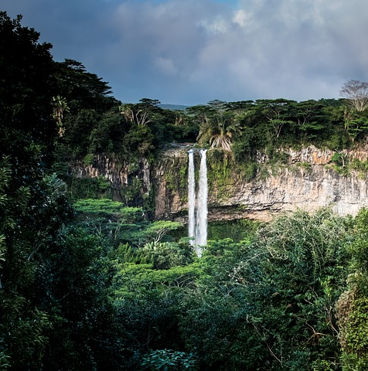
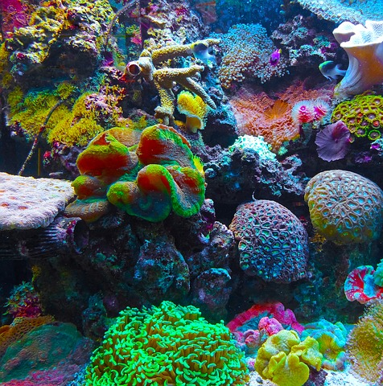
By making small changes, we can all make a difference. Let’s all work together to make the Earth a healthier and cleaner place for everything.

Slide 14
Thankyou

