Slide 1
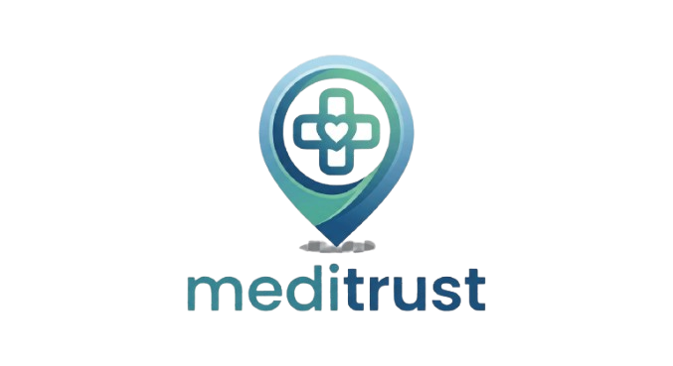

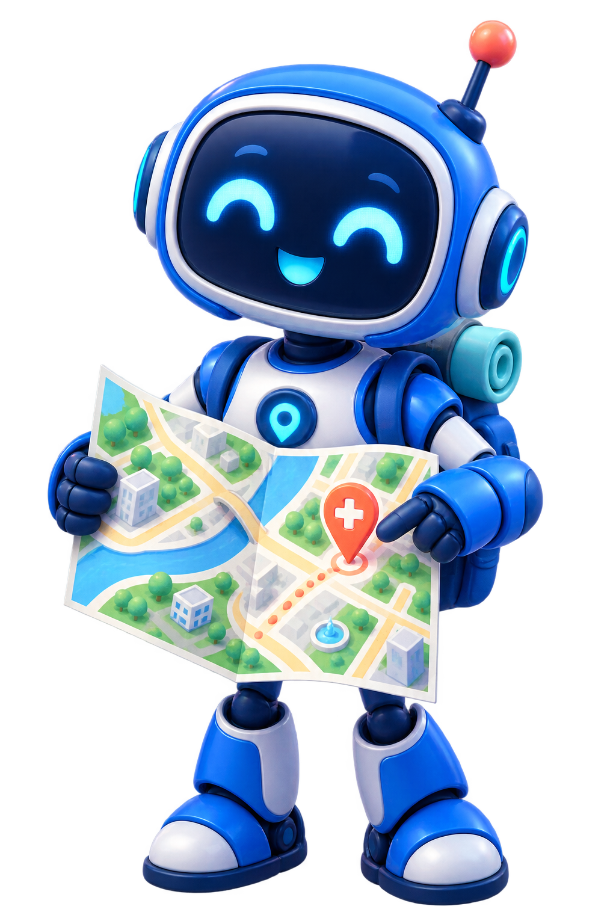
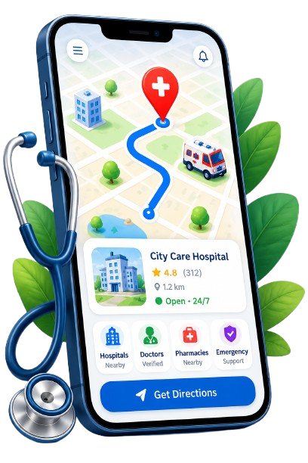
NEXHACK 2.0
mediTrust
Trusted Healthcare Navigation, Wherever You Are.
User | mediTrust
I need medical help.. | I know where to go.
Team Name: Hack Horizon 2.0
Solution on: Healthcare & Life Sciences
Team Members-
Adnan Khan
Tushar Soni
Shranshikha Somkuwar
Tanushree Patwa

Slide 2
THE PROBLEM
Healthcare search has an information & navigation problem
Imagine you're in a new city and suddenly need medical help. You search:
CURRENT JOURNEY
“Best doctor near me”
Search
→
Compare
sources
→
Call
→
Outdated
info
→
Travel
→
Try
another
...but the results rarely answer what actually matters:
Result: uncertainty, wasted trips, and a search that never really ends.
?
Is the doctor actually available today?
?
Is the clinic address / phone still correct?
?
Walk-ins accepted, or appointment only?
WHO FEELS THIS MOST
•
People in unfamiliar cities
•
Travellers
?
Is the consultation fee up to date?
?
Which specialist do I even need?
Families seeking care
Elderly patients & caregivers
•
•
The real problem: Patients don't just need a list of doctors — they need trustworthy, up-to-date, and actionable healthcare information.

Slide 3
OUR SOLUTION
Introducing mediTrust
An AI-powered healthcare navigation platform — two ways to start.
A
I know which specialist I need
B
I don't know which specialist I need
State
→
City
→
Speciality
→
Doctors
Concern
→
AI CarePath
→
Speciality
→
Doctors
Fast, direct path for people who already know what they want.
AI reads the symptom and recommends a speciality — with reasoning.
THE MEDITRUST JOURNEY
1
→
2
→
3
→
4
→
5
→
6
Health
Concern
AI Guidance
Location
Relevant
Doctors
Trust &
Availability
Call / Directions
AI CAREPATH — EXAMPLE
Suggests: Gastroenterologist
“I've been having persistent stomach problems.”
AI
with a short explanation and alternatives when appropriate.

Slide 4
WHY MEDITRUST
Not another doctor directory
Trust + Freshness + Navigation
1
Information Confidence
2
“Can I Visit Now?”
3
Explainable Results
How fresh is each detail, and when was it verified?
Ranked by real-time timing, walk-ins, distance.
Plain-language reasons — never a mystery ranking.
INFORMATION CONFIDENCE
CAN I VISIT RIGHT NOW?
HIGH
Dr. Sharma — Dermatologist
2.1 km
Open today
Walk-ins ok
Verified today
✓
Doctor identity
Verified
✓
Clinic address
Confirmed 3 days ago
✓
Doctor timing
Confirmed today
WHY YOU'RE SEEING THIS DOCTOR
⚠
Consultation fee
Last checked 30 days ago
✓
2.3 km away · relevant speciality
✓
Available today · verified recently
Users see exactly how fresh the information actually is — no more guessing.
✓
Hindi & English listed

Slide 5
TECHNOLOGY & FEATURES
MERN + AI architecture, built for a complete experience
Frontend
Backend
Database
AI Layer
React.js + Tailwind
Node.js + Express
MongoDB + Mongoose
LLM-based Guidance
• Doctor discovery UI
• REST APIs & auth
• Doctors & clinics
• Symptom → speciality
• AI CarePath UI
• Verification system
• Verification records
• Safety & validation
• Admin dashboard
• Reports & availability
• Locations & timings
• Explanation generation
AI GUIDANCE FLOW
User
→
React
→
Express API
→
Safety Check
→
AI Model
→
Speciality DB
→
Doctor Search
KEY PATIENT FEATURES
✓
State → City → Speciality discovery
✓
AI CarePath specialist guidance
✓
Information Confidence signal
✓
“Can I visit now?” live ranking
✓
Traveller Mode & language filters
✓
Community-powered verification
✓
Maps, directions & accessibility
✓
Secure admin & clinic verification

Slide 6
ROADMAP & IMPACT
From doctor directory to healthcare navigation network
ROADMAP
IMPACT
1
Doctor discovery + verified info
Patients
Less searching · better specialist selection · easier access
2
AI specialist guidance
Info Confidence + community verification
Doctors
Accurate presence · better discoverability · less misinformation
3
4
Live clinic availability
“Doesn't Practo already do this?”
We don't compete on doctor count or appointments — our focus is information confidence and navigation for someone unsure which specialist to consult, or whether what they see is still current.
5
Doctor / Clinic self-serve portal
6
Appointments + digital queue
7
Multilingual AI navigation
“Don't just find a doctor. Find the right path to care.”
mediTrust — Clearer care choices
06

