Slide 1

EWATTS PROTOCOL
Energy-backed neutral settlement layer
Phase 2: Testnet 84 tests 0 warnings Permissionless Private by default

Slide 2

Money without a ruler
Current monetary systems lack a verifiable physical anchor.
Bitcoin: 25-30% annual efficiency drift from ASICs. Fiat: policy-dependent supply. Gold: expensive to store and move.
eWatts replaces speculation with physics. Every coin costs measurable energy to produce. The anchor is DRAM latency, a bottleneck that has not improved in 17 years.

Slide 3
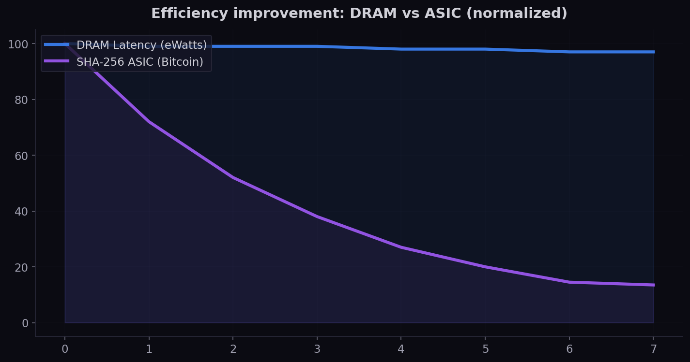
Why DRAM?
The only physical bottleneck that has not improved in 17 years
Source: historical ASIC specifications and JEDEC DRAM standards

Slide 4

3-Layer Architecture
Strict separation of execution, interpretation, and validation
L1: Protocol Core
L2: Economic Hypothesis
L3: Adversarial Consensus
Deterministic state machine Block validity, UTXO Emission function Verifiable by any node
Interpretation layer only Substrate class analysis Improvement rate differential Falsifiable conditions
Robustness under chaos Fork reality model Network stochasticity Strategic miner competition

Slide 5

Emission Formula
Elastic supply, anchored to real bandwidth
R = BASE_EMISSION x (total_eff / historical_avg) | Clamped [0.05x, 20x]
BASE_EMISSION
100 eWatt/block
Historical Avg
4,300 blocks (30 days)
Ramp-up (1-10k blocks)
80% cap per miner, excess burned
Founder lock
max(50,000, block + 40,000)
Privacy threshold
95% miners + 95% nodes

Slide 6

Nuhub: DePIN Marketplace
Where spare compute meets stable payments
GPU Inference
Storage
Compute
Bandwidth
Pay-as-you-go AI inference Seller proves with signature over result hash
Rent unused disk space Payment on proof of regular data integrity
Idle CPU batch processing Verified by random recomputation sampling
Edge content delivery Seller earns eWatt per GB served

Slide 7
Roadmap
● DONE
● NOW
● NEXT
● FUTURE
Phase 1: Foundation
Phase 2: Testnet
Phase 3: Mainnet
Phase 4: Maturity
Protocol, privacy, MBPoW Local testnet, 84 tests
Public testnet, community Nuhub escrow prototype
Launch, wallet, exchange Nuhub marketplace release
Community governance Cross-chain, wallet support

Slide 8
A more honest store of energy.
eWatts is an energy-backed neutral settlement layer. Permissionless. Private. Physics-based.
github.com/4Ewatts/ewatts-protocol
Phase 2: Testnet | 84 tests passing | MIT License

