Slide 1
eWatts Protocol
Energy-backed neutral settlement layer
Phase 2 — Testnet • 84 tests • 0 warnings

Slide 2
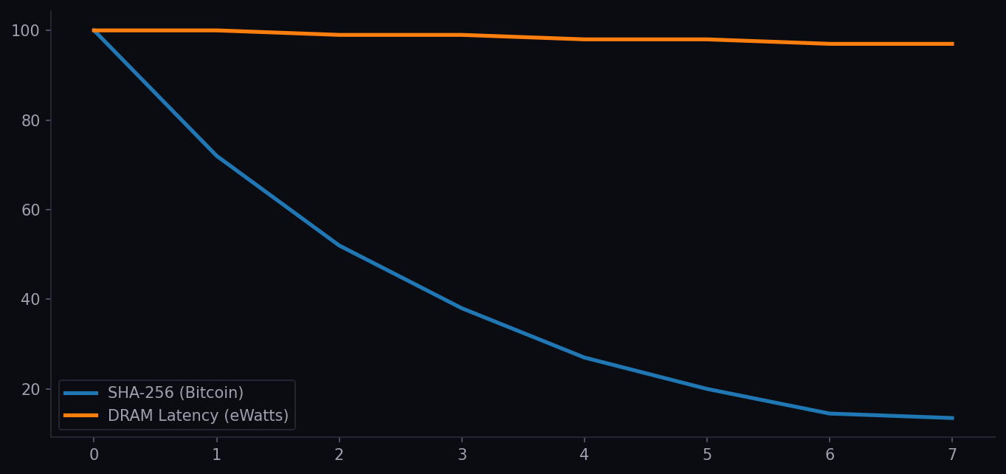
ASIC Efficiency Improvement vs DRAM Latency (normalized)

Slide 3
Emission Formula
R = BASE_EMISSION x (total_eff / historical_avg), clamped [0.05x, 20x]
• BASE_EMISSION: 100 eWatt/block
• Historical window: 4,300 blocks (30 days)
• Ramp-up (blocks 1-10k): 80% cap per miner, excess burned
• Founder lock: max(50,000, block + 40,000)
• Privacy change threshold: 95% miners + 95% nodes

Slide 4
3-Layer Architecture
Layer 1 — Protocol Core
Deterministic state machine. Block validity, UTXO, emission invariants, consensus. Verifiable by any node.
Layer 2 — Economic Hypothesis
Interpretation layer. Substrate classes (ASIC vs DRAM), improvement rate differential, falsifiability conditions.
Layer 3 — Adversarial Consensus
Robustness engine. Fork reality, network stochasticity, threat models, convergence bounds.

