Slide 1
SERVICE MANAGEMENT SYSTEM LOGISTICS
(PROCUREMENT, WAREHOUSING, ASSET MANAGEMENT, PROJECT MANAGEMENT, VENDOR PORTAL, FLEET MANAGEMENT, AUDIT MANAGEMENT, VEHICLE RESERVATION, MRO)

Slide 2
TECH-TRENDZ SERVICES
Service Management System
The Tech-Trendz Services is a Service Management System that uses a huge modular system that covers almost all aspects of a service-oriented corporation. In order to have a service-management mindset, an organization must understand the level of process maturity required to become a service-oriented corporation.

Slide 3
LOGISTICS SYSTEM
Logistics is the detailed process of planning and carrying out an operation. When it comes to business, that process refers to the flow of work from beginning to conclusion in order to meet customer and organizational expectations. Logistic Management assists the company in lowering costs and managing customer service more effectively.

Slide 4
GOALS AND OBJECTIVES
Timely and accurate reporting of data.
Improve Data Integrity.
Reduce workload.
Improve processing time.

Slide 5
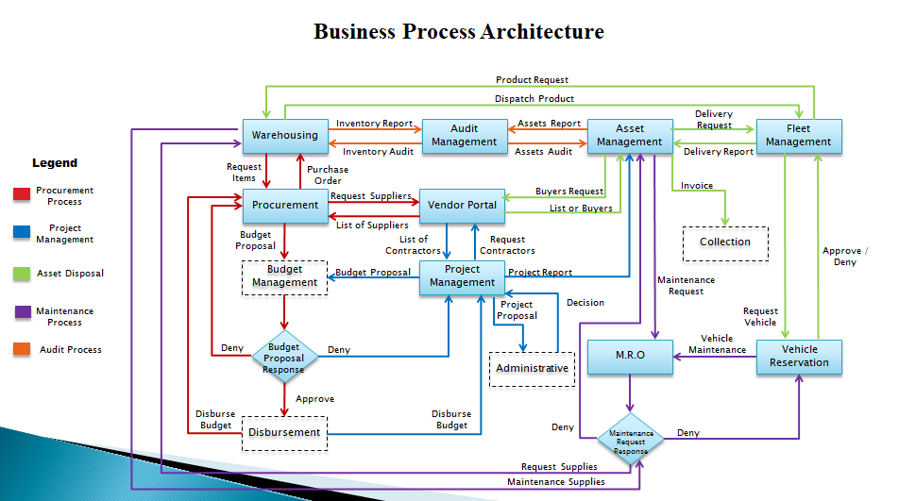

Slide 6
Business Process Architecture
Product Request
Dispatch Product
Inventory Report
Assets Report
Delivery Request
Warehousing
Audit Management
Asset Management
Fleet Management
Inventory Audit
Assets Audit
Delivery Report
Legend
Request Items
Purchase Order
Procurement Process
Buyers Request
Invoice
Procurement
Request Suppliers
Vendor Portal
List or Buyers
Project Management
Budget Proposal
List of Suppliers
Collection
List of Contractors
Request Contractors
Approve / Deny
Asset Disposal
Budget Management
Budget Proposal
Project Management
Project Report
Asset Maintenance
Project Proposal
Decision
Maintenance Process
Maintenance Request
Request Vehicle
Request Maintenance
Audit Process
Deny
Budget Proposal Response
Deny
M.R.O
Vehicle Reservation
Administrative
Vehicle Maintenance
Approve
Disburse Budget
Disburse Budget
Disbursement
Deny
Maintenance Request Response
Deny
Request Supplies
Maintenance Supplies

Slide 7
Thank You so much

