Slide 1
SERVICE MANAGEMENT SYSTEM LOGISTIC
(PROCUREMENT, WAREHOUSING, ASSET MANAGEMENT, PROJECT MANAGEMENT, VENDOR PORTAL, FLEET MANAGEMENT, AUDIT MANAGEMENT, VEHICLE RESERVATION, MRO)

Slide 2
SERVICE MANAGEMENT SYSTEM
The Service Management System is a huge modular system that covers almost all aspects of a service-oriented corporation. In order to have a service-management mindset, an organization must understand the level of process maturity required to become a service-oriented corporation.

Slide 3
LOGISTICS SYSTEM
Logistics is the detailed process of planning and carrying out an operation. When it comes to business, that process refers to the flow of work from beginning to conclusion in order to meet customer and organizational expectations. Logistic Management assists the company in lowering costs and managing customer service more effectively.

Slide 4
GOALS AND OBJECTIVES
Timely and accurate reporting of data.
Improve Data Integrity.
Reduce workload.
Improve processing time.

Slide 5
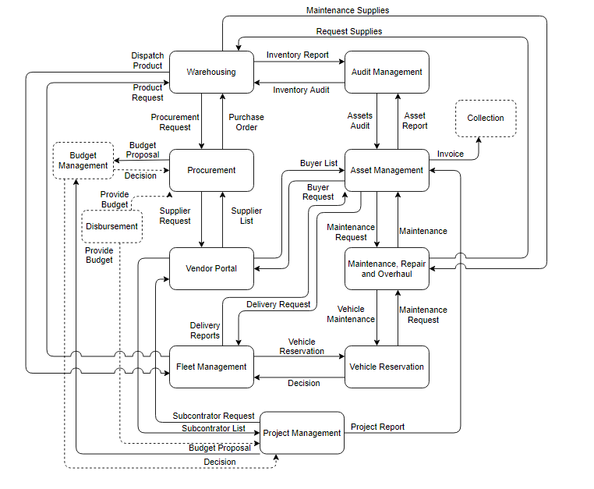
Business Process Architecture

Slide 6
Business Process Architecture
Product Request
Dispatch Product
Inventory Report
Assets Report
Delivery Request
Warehousing
Audit Management
Asset Management
Fleet Management
Inventory Audit
Assets Audit
Delivery Report
Legend
Request Items
Purchase Order
Procurement Process
Buyers Request
Invoice
Procurement
Request Suppliers
Vendor Portal
List or Buyers
Project Management
Budget Proposal
List of Suppliers
Collection
List of Subcontractors
Request Subcontractors
Approve / Deny
Asset Disposal
Budget Management
Budget Proposal
Project Management
Project Report
Maintenance Request
Maintenance Process
Reserve Vehicle
Audit Process
Deny
Budget Proposal Response
Deny
M.R.O
Vehicle Maintenance
Vehicle Reservation
Approve
Approve
Disburse Budget
Disburse Budget
Disbursement
Maintenance Request Response
Approve
Request Supplies
Maintenance Supplies

Slide 7
Business Process Architecture
Product Request
Dispatch Product
Inventory Report
Assets Report
Delivery Request
Warehousing
Audit Management
Asset Management
Fleet Management
Inventory Audit
Assets Audit
Delivery Report
Legend
Request Items
Purchase Order
Procurement Process
Buyers Request
Invoice
Procurement
Request Suppliers
Vendor Portal
List or Buyers
Project Management
Budget Proposal
List of Suppliers
Collection
List of Subcontractors
Request Subcontractors
Approve / Deny
Asset Disposal
Budget Management
Budget Proposal
Project Management
Project Report
Maintenance Request
Maintenance Process
Reserve Vehicle
Deny
Budget Proposal Response
M.R.O
Vehicle Maintenance
Vehicle Reservation
Audit Process
Deny
Deny
Approve
Disburse Budget
Disburse Budget
Disbursement
Maintenance Request Response
Deny
Request Supplies
Maintenance Supplies

Slide 8
Thank You so much

