Slide 1
SERVICE MANAGEMENT SYSTEM LOGISTIC
(PROCUREMENT, WAREHOUSING, ASSET MANAGEMENT, PROJECT MANAGEMENT, VENDOR PORTAL, FLEET MANAGEMENT, AUDIT MANAGEMENT, VEHICLE RESERVATION, MRO)

Slide 2
SERVICE MANAGEMENT SYSTEM
The Service Management System is a huge modular system that covers almost all aspects of a service-oriented corporation. In order to have a service-management mindset, an organization must understand the level of process maturity required to become a service-oriented corporation.

Slide 3
LOGISTIC SYSTEM
Logistics is the detailed process of planning and carrying out an operation. When it comes to business, that process refers to the flow of work from beginning to conclusion in order to meet customer and organizational expectations. Logistic Management assists the company in lowering costs and managing customer service more effectively.

Slide 4
GOALS AND OBJECTIVES
Timely and accurate reporting of data.
Improve Data Integrity.
Reduce workload.
Improve processing time.

Slide 5
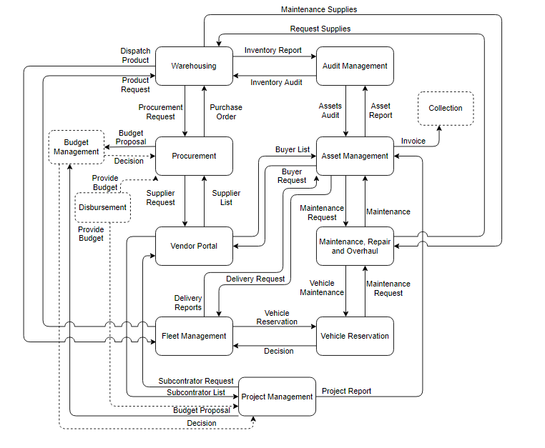
Business Process Architecture

Slide 6
Warehousing
Request Items
Purchase Order
List of Suppliers
Procurement
Vendor Portal
Request Suppliers
Budget Proposal
Procurement Process
Deny
Budget Management
Disburse Budget
Budget Proposal Response
Approve
Disbursement

Slide 7
Subcontractor List
Project Management
Request Subcontractor
Vendor Portal
Budget Proposal
Project Report
Budget Management
Project Management
Deny
Asset Management
Disburse Budget
Budget Proposal Response
Approve
Disbursement

Slide 8
Asset Management
Delivery Report
Fleet Management
Delivery Request
Reserve Vehicle
Request Buyer
Buyer List
Product Request
Dispatch Product
Asset Disposal
Invoice
Vehicle Reservation Response
Vendor Portal
Warehousing
Collection
Vehicle Reservation

Slide 9
Asset Management
Maintenance Request
Deny
Maintenance Process
Request Supplies
M.R.O
Maintenance Request Response
Warehousing
Maintenance Supplies
Vehicle Maintenance Request
Deny
Vehicle Reservation

Slide 10
Asset Audit Request
Audit Management
Asset Management
Assets Report
Auditing Process
Inventory Request
Inventory Report
Warehousing

Slide 11
Thank You so much

