Slide 1
TCP/32764 backdoor
Or how linksys saved Christmas !

Slide 2

Who?
Eloi Vanderbeken
@elvanderb
https://github.com/elvanderb
eloi vanderbeken gmail com
Interested in reverse and crypto.
Don’t like to write reports :D
Angrish is hard!
Certified Ethical Dauber |Microsoft Paint MVP
.
@
.

Slide 3




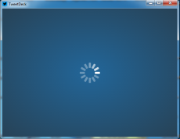

When? Christmas!!!

Slide 4

(1Mb/s) / (10 users * 68dB) =

Slide 5

IDEA !

Slide 6

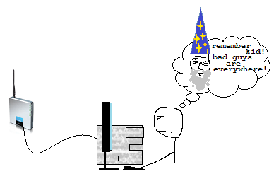


But… few years ago…
/me now
WAG 200G
/me then
Very long and complex

Slide 7

For the record…
NOTHING
NOTHING
NOTHING
wheat
REALLY NOTHING
FAAAAR away, the DSLAM
cow
Mothership
corn
NOTHING
NOTHING
NOTHING (or a cow)
sugar beet
A little bit of nothing
NOTHING

Slide 8

Challenge:
No access to the http[s] administration tool.
No admin password anyway…
NEED DA INTERNET!

Slide 9

Nmap
Few interesting ports:
ReAIM (http://reaim.sourceforge.net/)
Possibly vuln…
Unkown service listening on TCP/32764
Responds ScMM\xFF\xFF\xFF\xFF\x00\x00\x00\x00 to any requests.

Slide 10
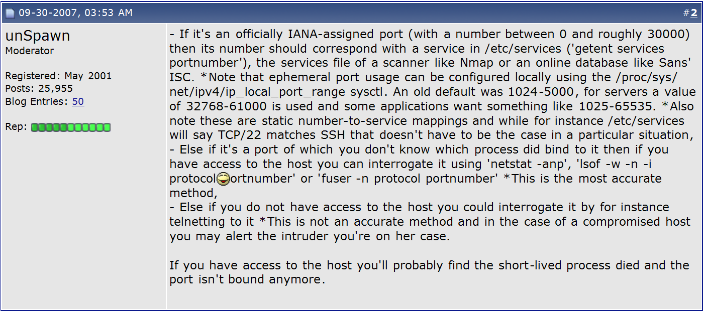
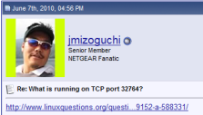
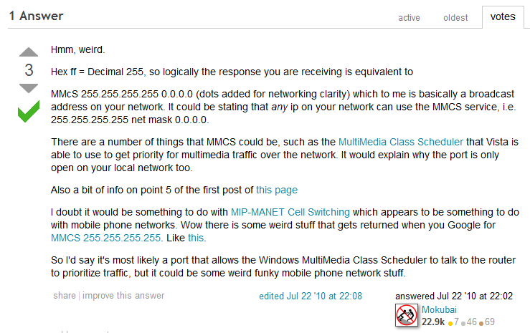
GO-GO-GADGET GOOGLE
Hmkay. Actually you don’t know...
Mister Guessing 2010!

Slide 11
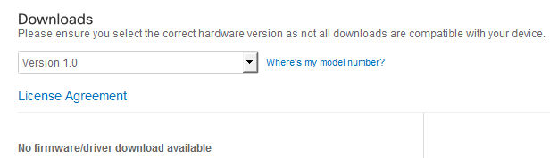
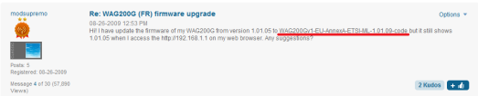
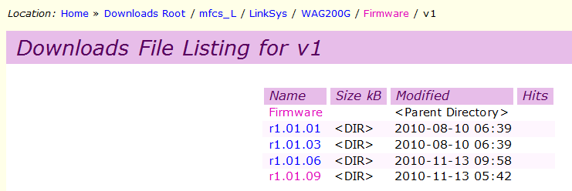
Let’s get the firmware!
http://support.linksys.com/en-us/support/gateways/WAG200G/download
-> FU linksys!
http://community.linksys.com/t5/Cable-and-DSL/WAG200G-FR-firmware-upgrade/m-p/233170
-> Thks users!
http://download.modem-help.co.uk/mfcs-L/LinkSys/WAG200G/Firmware/v1/
-> Thks modem-help & google!

Slide 12
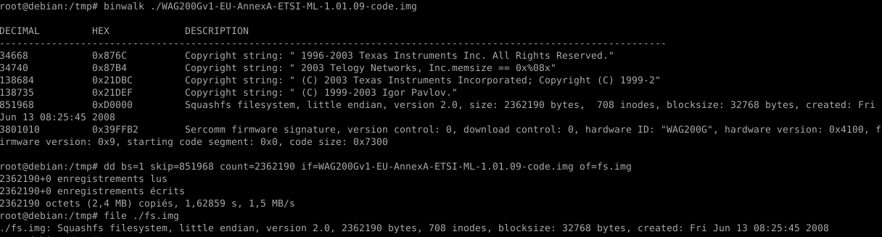

WHER IZ U ƦᴓФŦ-Ƒ$?!

Slide 13

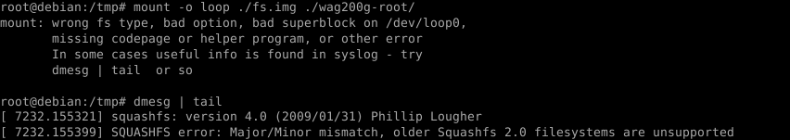
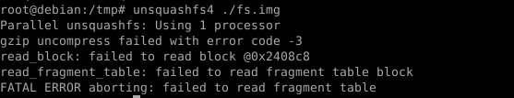
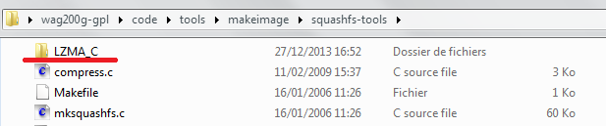

WHER IZ U ƦᴓФŦ-Ƒ$?! Cont’d

Slide 14

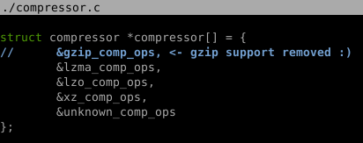

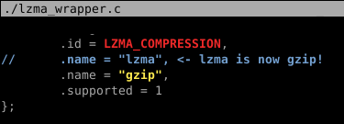
Chainsaw time!
Get LZMA SDK 4.65
Modify squashfs-tools’ Makefile:
Use your chainsaw on source code:

Slide 15
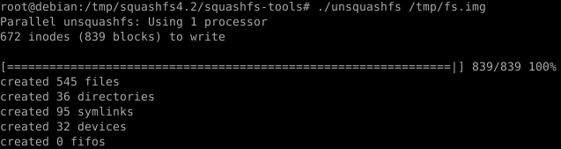
Found you!

Slide 16
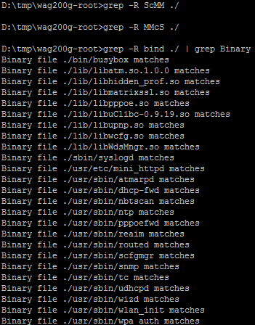
Where’s Waldo^wthe service?
FU, maybe it’s in little endian…
FU!!! Let’s get dirty!
Just use grep and IDA to find the good one ☺

Slide 17

First steps
No symbols, MIPS:
We’ll have to reverse ☺
I love reversing and MIPS is easy so it’s OK :D
Very simple binary protocol:
Header (0xC bytes) followed by a payload
Header structure:

Slide 18
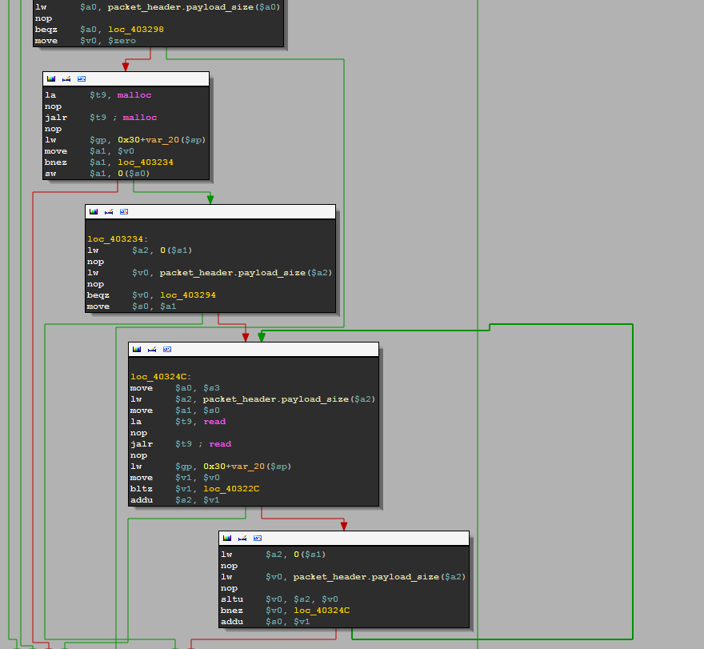
Easy protocol, isn’t it?
Heap base buffer overflow

Slide 19
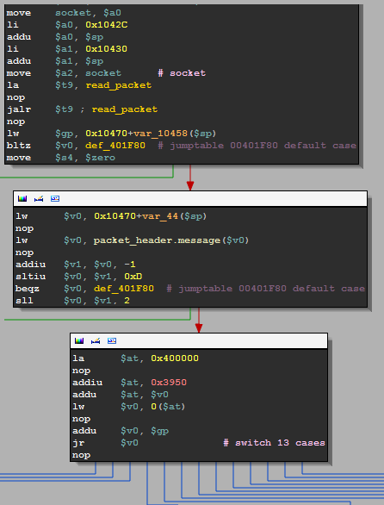
Messages…

Slide 20
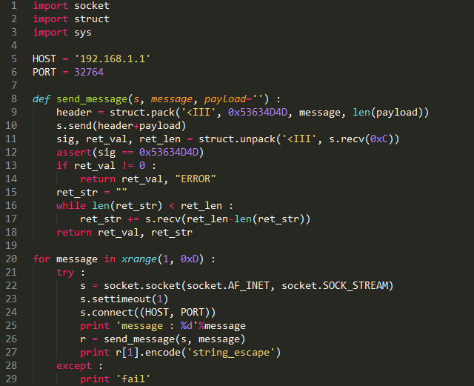
Let’s bruteforce them!

Slide 21
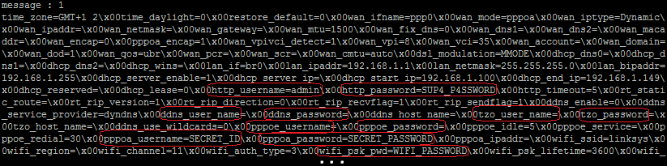
WTF?!

Slide 22
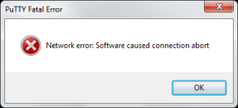
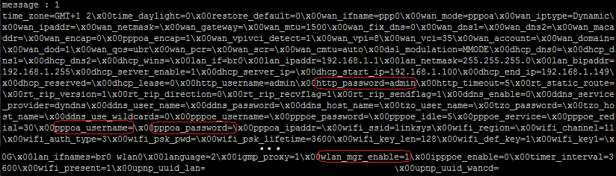
WTFFFFFFUUUUU?!
NO MOAR INTERNETZ?!
When we restart the script :
Configuration is reset?!?!!!

Slide 23
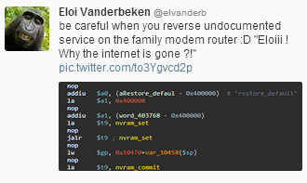
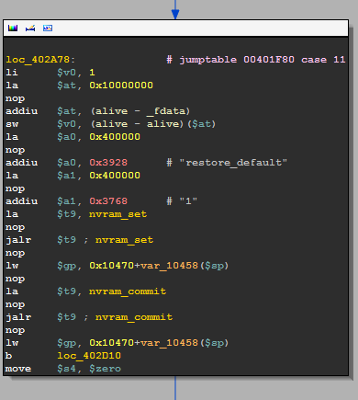


Slide 24
Quick messages’ reverse…
Dump configuration (nvram)
Get configuration var
possible stack based buffer overflow (if variable is controlled by the user)
Set configuration var
stack based buffer overflow, output buffer (size ≈ 0x10000) is on the stack.
Commit nvram
set nvram (/dev/mtdblock/3) from /tmp/nvram ; check CRC
Set bridge mode ON (not sure, I didn’t have the time to test it)
nvram_set(“wan_mode”, bridgedonly)
nvram_set(“wan_encap”, 0)
nvram_set(“wan_vpi”, 8)
nvram_set(“wan_vci”, 81)
system(“/usr/bin/killall br2684ctl”)
system(“/usr/bin/killall udhcpd”)
system(“/usr/bin/killall -9 atm_monitor”)
system(“/usr/sbin/rc wan stop >/dev/null 2>&1”)
system(“/usr/sbin/atm_monitor&”)
Show measured internet speed (download/upload)

Slide 25
Quick messages’ reverse… cont’d
cmd (yep, it’s a shell…)
special commands :
exit, bye, quit -> quit... (alive = 0)
cd : change directory
other commands :
buffer overflow on cmd output (same buffer again)…
write file
file name in payload
root dir = /tmp
directory traversal might be possible (not tested but it’s an open(sprintf(“/tmp/%s”, payload))… )
return version
return modem router ip
nvram_get(“lan_ipaddr”)
restore default settings
nvram_set(“restore_default”, 1)
nvram_commit)
read /dev/mtdblock/0 [-4:-2]
dunno what it is, I didn’t have the time to test it
dump nvram on disk (/tmp/nvram) and commit

Slide 26
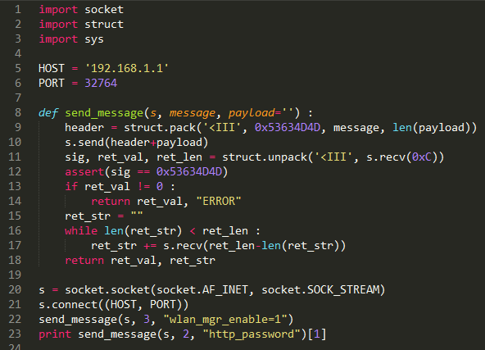
So if you need an access to the admin panel….

Slide 27
Thank you Linksys!!!
You saved my Christmas ☺

Slide 28
Some more lolz…
I only had 1 day to test my codes/assumptions so the following slides are just some random thoughts/observations…
It wasn’t tested but it’s probably interesting ☺

Slide 29
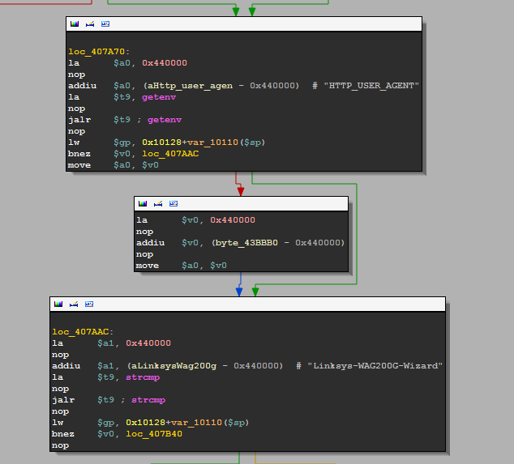
In setup.cgi ☺

Slide 30
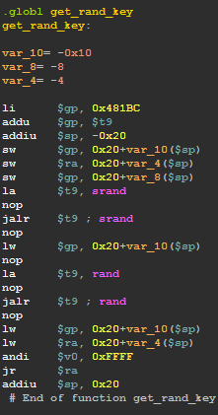
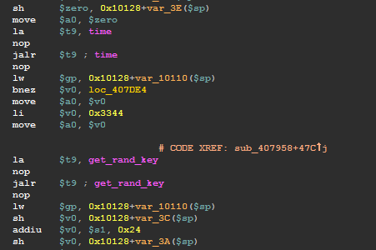
A little bit further in setup.cgi…
get_rand_key ???
Generate the key used to encrypt
Routercfg.cfg (if I’m right)
libtea.so

Slide 31
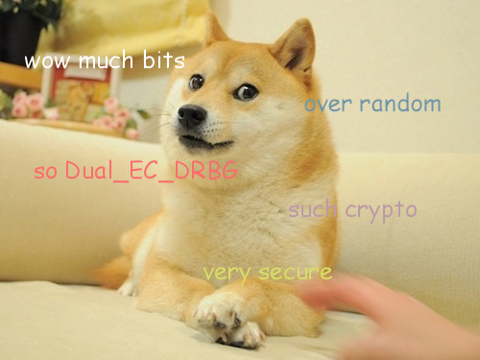

Slide 32
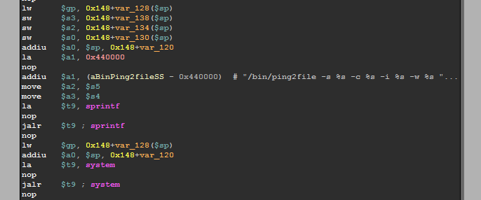
Again in setup.cgi
Not sure but I think we control this ☺

Slide 33
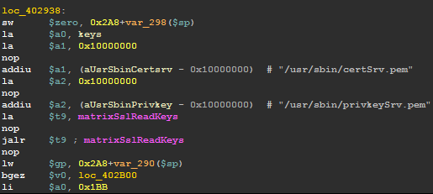
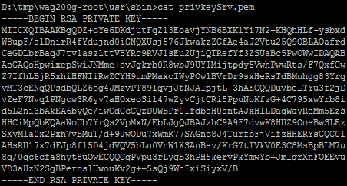
mini_httpd
Hardcoded 1024bit RSA private key ☺
May I show Doge… again?

Slide 34
To be continued…
Backdoor is only confirmed on WAG200G, if you know/find other concerned hardware, let me know ☺

