Slide 1
FRaME Facial Recognition and Matching Engine Group No. 43 Rohan Chavan (4) Saniket Patil (85) Kshitij Shukla (84)

Slide 2
Introduction & Problem Statement :-
Traditional Methods of Transactions include Card payments and Cash Payments.
But these methods are not efficient, because as you know not everyone can carry cash at all times and not all vendors accept cards.
We need a system where a person can be able to transact even when he has nothing.
Incomes the new age method Facial Recognition where you are your own database and you are your own transaction source.
Face Recognition will be able to confirm your identity and it’ll be linked to a Database.

Slide 3
Abstract
Currently when you book a Cab, at the end of the ride you make the transactions with either cash or Card/UPI/E-Wallet.
Sometimes these methods are not hassle-free as they cause inconvenience to the customer.
We propose a new System for transactions in Cabs, where your face is your Transaction method.
The system in the Cab will calculate your fare based on the distance and then it’ll authenticate your face and transact via the connected central database.

Slide 4
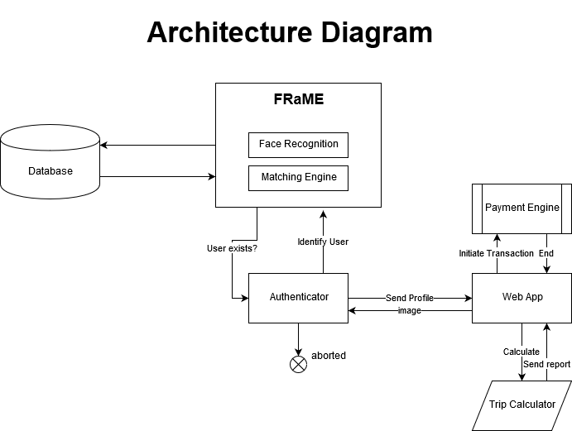

Slide 5
Future Scope
Our Facial Recognition Transaction engines can be implemented in various forms of life like:-
A electric vehicle would start only if the owner is authenticated by FRaME thereby reducing the risks of car theft.
An All round payment solution not just for cabs, but everywhere like Restaurants, Petrol Pumps, Grocery Stores.
A Single Sign on using FRaME.
A android app synchronization with FRaME.

Slide 6
Thank You

