Slide 1
Final year project
Group members:
Anushri Sankhe 1142081
Shubhankar Vaidya 2162007
Aniket Patel 2162014
Saloni Raorane 2152005
Group no-38
Project Guide- Mrs.Vidya Kawtikwar

Slide 2
Online Blood Bank Management System
Introduction to domain:
Web Designing:
Web design is the process of creating websites.
It encompasses several different aspects, including webpage layout, content production, and graphic design.
While the terms web design and web development are often used interchangeably, web design is technically a subset of the broader category of web development.
Web designers build webpages using HTML tags that define the content and metadata of each page.

Slide 3
Abstract:
This project is aimed to developing an online Blood Donation Information. The entire project has been developed keeping in view of the distributed client server computing technology, in mind. The Blood Donation Agent is to create an e-Information about the donor and organization that are related to donating the blood. In this application the languages used are HTML (for webpages), PHP, MySQL (for database). Online blood bank management system is a web application that allows to access the whole information about blood bank management software, readily scalable and adaptable to meet the complex need of blood bank who is the key facilitator for the health care sector; it also supports all the functionalities of blood bank. It is used for maintaining information about the campus. The project includes three main modules admin, donor, and acceptors. The admin module focuses on both the admin and acceptors. Each member in a donor and acceptor is given a user id and password, which identifies them uniquely.

Slide 4
Problem statement:
At present, the public can only know about the blood donation events through conventional media means such as radio, news paper or television advertisements. There is no information regarding the blood donation programs available on any of the portal.
The current system that is using by the blood bank is manual system. With the manual system, there are problems in managing the donors' records. The records of the donor might not be kept safely and there might be missing of donor's records due to human error or disasters. Besides that, errors might occur when the staff keeps more than one record for the same donor.
There is no centralized database of volunteer donors. So, it becomes really tedious for a person to search blood in case of emergency. The only option is to manually search and match donors and then make phone calls to every donor.

Slide 5
Future scope:
Donor/Recipient Management :
The records of all donors/recipient and their history are kept in one centralized database and thus reducing duplicate data in the database. The record of donation is maintained by the system.
Payment method:
A separate payment method will be added, this will enable the option of making payment to the blood bank online.
Display record of blood donor:
This function will keep a separate record of the blood donor, thus the receiver can know the personal details of the donor and can likewise choose the donor.

Slide 6
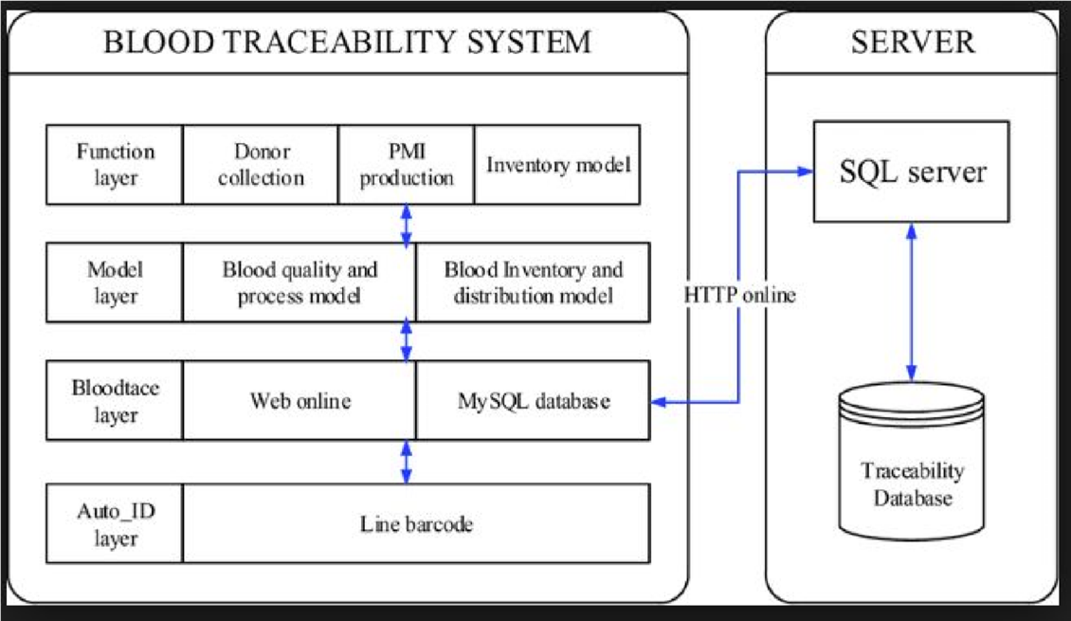
Architecture diagram:

Slide 7
References:
“Blood Bank Management Information System in India” by Vikas Kulshreshtha and Dr. Sharad Maheshwari.
A Study on Blood Bank Management System” by A. ClemenTeena, K. Sankar and S. Kannan.
In “MBB: A Life Saving Application” by Narendra Gupta, RamakantGawande and Nikhil Thengadi.

Slide 8
Introduction to domain:
Computer Vision:
Computer vision is an interdisciplinary field that deals with how computers can be made for gaining high-level understanding from digital images or videos
Computer vision tasks include methods for acquiring, processing, analyzing and understanding digital images, and extraction of high-dimensional data from the real world in order to produce numerical or symbolic information

Slide 9
INTELLIGENT IMAGE CAPTION GENERATOR
Abstract:
Image Captioning is a cornerstone in Computer Vision, a field which has seen many technical advancements in recent years. Currently caption generation systems do exist, however they are relatively slow and more resource hungry. Faster-RCNN improvises on Fast-RCNN by sharing resources to create the RoI (Regions of Interest) layer. LSTM provides a better approach to meaningful sentence creation using the different objects detected in the image using Faster-RCNN. By blending Faster-RCNN and LSTM, it is possible to considerably reduce the amount of time and resources consumed by the system, also the captions generated by our system will be Semantically more accurate.

Slide 10
Problem statement:
Image captioning is the process of generating a descriptive sentence for an image.
The fact that humans can do this with remarkable ease makes this a very interesting/challenging problem for AI, combining aspects of computer vision and natural language processing.

Slide 11
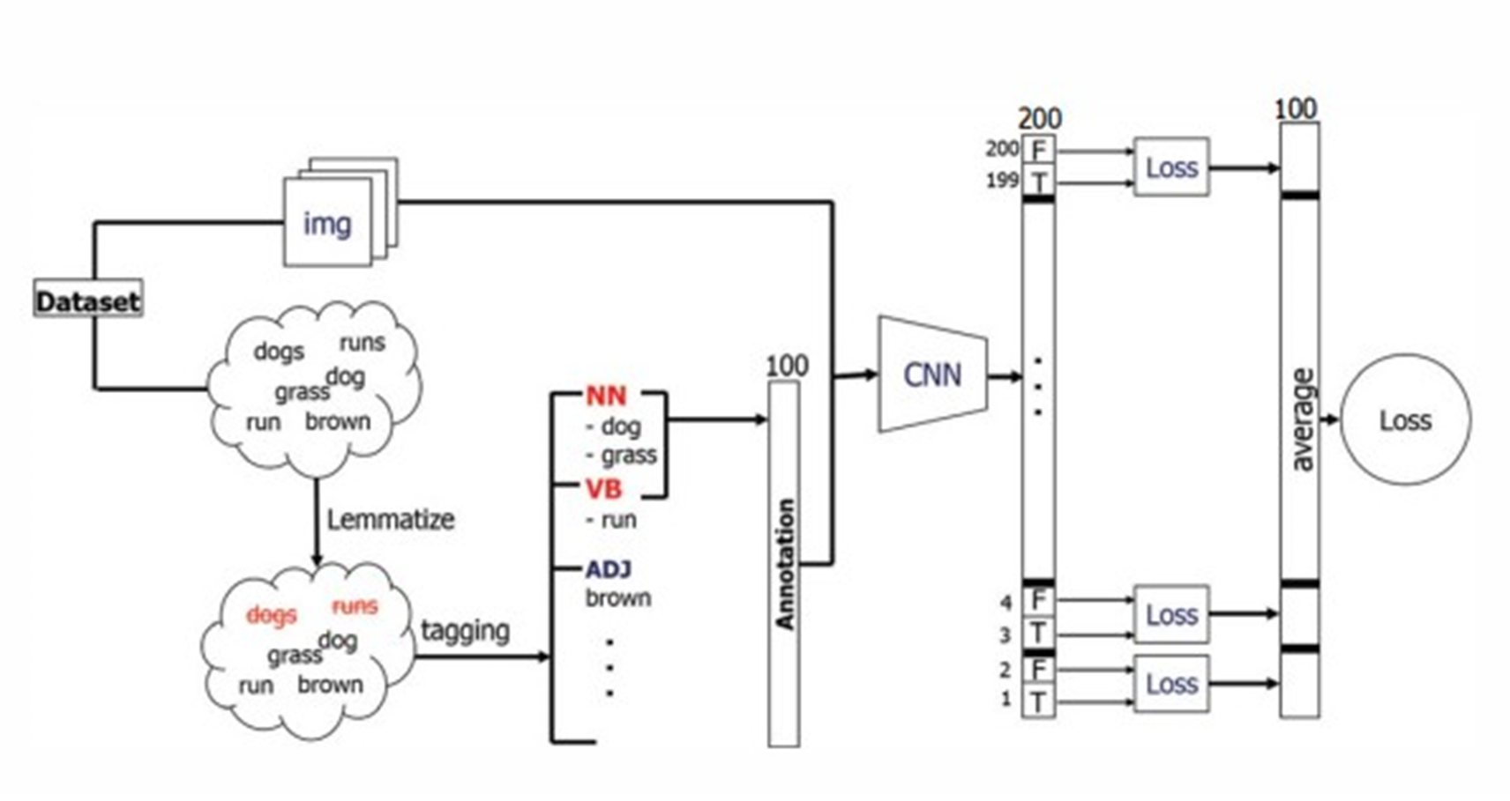
Architecture diagram:

Slide 12
References:
Sentence Learning on Deep Convolutional Networks for Image Caption Generation.
A Parallel-Fusion RNN-LSTM Architecture for Image Caption Generation.
Deep Learning based Image Description Generation.

Slide 13
CONTENT SEARCH USING OBJECT DETECTION AND AUDIO ANALYSIS
Abstarct:
Searching for a particular content in a video without actually traversing the entire video so as to only watch the part we wish to watch. Today if we wish to watch only a particular part of the video we have to watch the entire length of the video to find the exact time of occurrence. Users would like to search the video contents based on the keywords or the objects present in the video. This software will focus on to point out by searching the occurrence of a keyword in the audio/narration of the video. To point out the occurrence of a particular object in a video, so that the video can be played from that point. To recognize every unique occurrence of the specified content.

Slide 14
Problem statement:
Searching for a particular content in a video without actually traversing the entire video so as to only watch the part one requires.
Today if we wish to watch only a particular part of the video we have to watch the entire length of the video to find the exact time of occurrence.
Users would like to search the video contents based on the keywords or the objects present in the video.

Slide 15
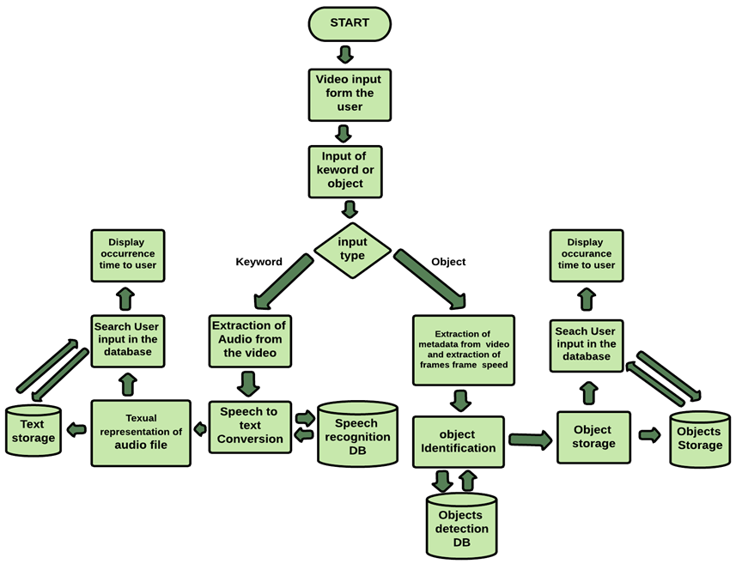
Architecture diagram:

Slide 16
References:
Kang Li, Sheng Li, Sangmin Oh, Yun Fu, ‘Videography-Based Unconstrained Video Analysis,’ IEEE Transactions on Image Processing, Volume:26 , Issue: 5 , May 2017
Lin-shan Lee, James Glass, Hung-yi Lee, Chun-an Chan, ‘Spoken Content Retrieval Beyond Cascading Speech Recognition with Text Retrieval,’ IEEE/ACM Transactions on Audio, Speech, and Language Processing, Volume: 23 , Issue: 9 , Sept. 2015
Kuan-Yu Chen, Shih-Hung Liu, Berlin Chen, Hsin-Min Wang, Ea-EeJan, Wen-Lian Hsu, Hsin-Hsi Chen, ‘Extractive Broadcast News Summarization Leveraging Recurrent Neural Network Language Modeling Techniques,’ IEEE/ACM Transactions on Audio, Speech, and Language Processing Volume: 23 , Issue: 8 , Aug. 2015
Zhong-Qiu Zhao ; Peng Zheng ; Shou-Tao Xu ; Xindong Wu,‘Object Detection With Deep Learning: A Review,’IEEE Transactions on Neural Networks and Learning Systems Early Access , Jan. 2019
[Kai Kang, Hongsheng Li, Junjie Yan, Xingyu Zeng, Bin Yang, Tong Xiao, Cong Zhang, Zhe Wang, Ruohui Wang, Xiaogang Wang, Wanli Ouyang, ‘T-CNN: Tubelets With Convolutional Neural Networks for Object Detection From Videos,’IEEE Transactions on Circuits and Systems for Video Technology, Volume: 28 , Issue: 10 , Oct. 2018
Apoorva Raghunandan ; Mohana ; Pakala Raghav ; H. V. Ravish Aradhya, ‘Object Detection Algorithms for Video Surveillance Applications,’

Slide 17
Thank you!

