Slide 1
Content search using object detection and audio analysis
St. John College of Engineering and Management
Presented by:
Anushri Sankhe (PID No.1142081)
Shubhankar Vaidya (PID No.2162007)
Aniket Patel (PID No.2162014)
Guided by:
Mrs. Vidya Kawtikwar

Slide 2
Contents:
Abstract
Introduction to Domain
Problem Definition
Proposed System
Objectives
Scope
Literature Survey
Requirement Analysis
System Architecture
System Design
Implementation
References

Slide 3
Abstract:
When dealing with documents containing text, if we wish to find a particular text or phrase in a document we can simply do that by using 'Ctrl+F' but if we wish to view a content specific part of a video, one has to surf through the entire video until they reach to the part they want. Traversing the video forward and backward repeatedly and yet not be able to pin-point a perfect location can be quite irritating. The proposed application points out the occurrence time of the content specified by the user. The application aims to reduce the efforts required for searching content in a video and provides the user a direct access to the location of the content. The application analyzes the video to find the occurrence of a particular object in the video and performs an audio analysis to find the occurrence of the word. The application uses Google Speech Recognition for the audio analyses and Mask-RCNN for the video analyses to effectively provide a very specific point of occurrence of the content specified by the user.

Slide 4
Introduction to Domain:
Computer Vision:
Computer vision is an interdisciplinary field that deals with how computers can be made for gaining high-level understanding from digital images or videos
Computer vision tasks include methods for acquiring, processing, analyzing and understanding digital images, and extraction of high-dimensional data from the real world in order to produce numerical or symbolic information

Slide 5
Introduction to Domain:
Example:
Image processing is a method to convert an image into digital form and perform some operations on it, in order to get an enhanced image or to extract some useful information from it.
It is a type of signal dispensation in which input is image, like video frame or photograph and output may be image or characteristics associated with that image.

Slide 6
Problem Statement:
Searching for a particular content in a video without actually traversing the entire video so as to only watch the part one requires.
Today if we wish to watch only a particular part of the video we have to watch the entire length of the video to find the exact time of occurrence.
Users would like to search the video contents based on the keywords or the objects present in the video.

Slide 7
Proposed System:
The proposed system should clearly define the core idea/solution to the problem statement(s).
Title of the project should be stated along with proper justification.

Slide 8
Objectives:
To point out the occurrence of a keyword in the audio/narration of the video.
To point out the occurrence of a particular object in a video.
To recognize every unique occurrence of the specified content.
To ease the task of knowing the objects present in the audio and video.

Slide 9
Scope:
In case of multiple occurrences, each unique occurrence will be pointed.
Project scope is limited to detect objects which are neatly present in the frame.
Project scope is limited to a certain number of detectable objects present in dataset.
The audio of extracted should have clear pronunciations and the accent should be recognizable.
The objects to be detected that are not present in the training models will not be detected.

Slide 10
Literature Survey I:
Using videography [1] fairly lengthy videos are reduced to shorter segments these segments are then analyzed to find objects via unsupervised learning to create a videography dictionary that allows the system to access the objects that are detected by creating a form of library.The extraction of features is essentially a two step process.
The first step consists of development of novel techniques for videography analysis of high-level videography. The second step consists of retrieval and summarizing videography quantization for representation at intermediate levels

Slide 11
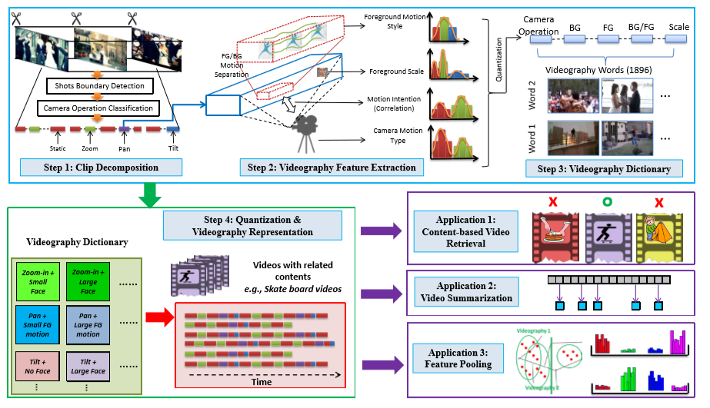
Literature Survey I: System Architecture:

Slide 12
Literature Survey I:
Advantages:
Videography captures unique aspects of videos and can be jointly used with other features to improve content based video analysis.
Disadvantages:
The analysis of long videos requires quite high processing power.

Slide 13
Literature Survey II:
Speech recognition using cascading methods [2] and retrieval of text is categorized into five directions: Modification for Recognition of Speech and Retrieval, Information Exploitation overlooked by ASR, Direct matching of Acoustic levels excluding ASR, Semantic Retrieval of Spoken Content and Presenting retrieved objects efficiently by retrieving interactively which can be used for effective speech recognition.

Slide 14
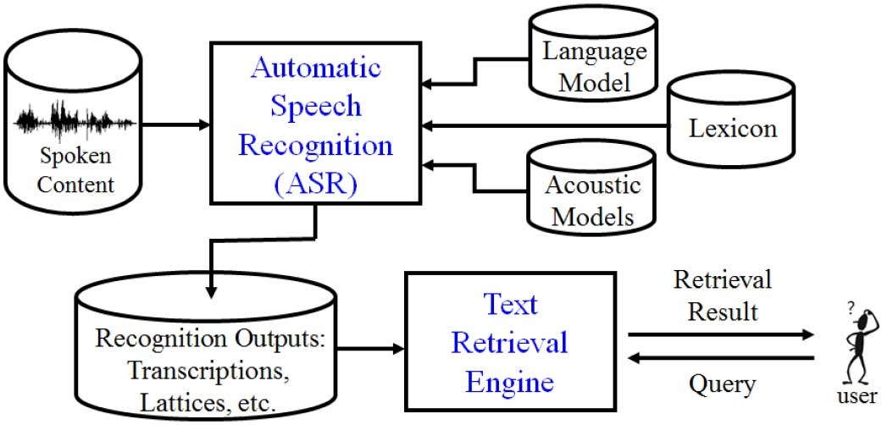
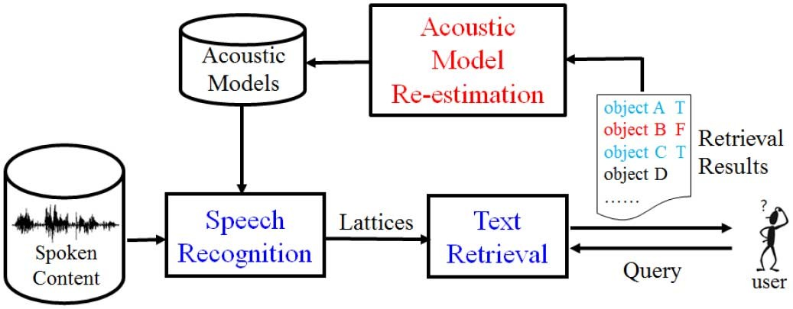
Literature Survey II:
System Architecture:
Nxhbnnxgguxjnbm

Slide 15
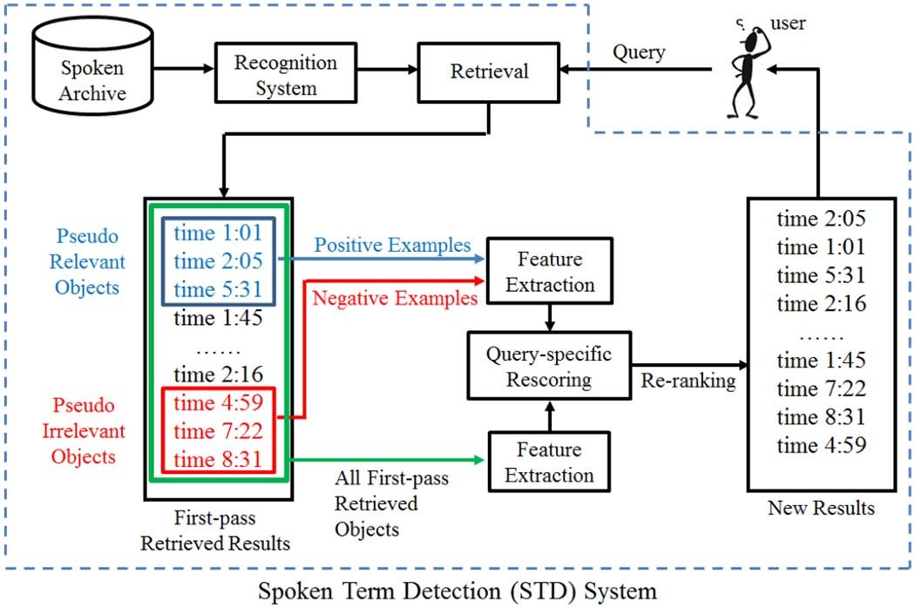
Literature Survey II:

Slide 16
Literature Survey II:
Advantages:
Very wide space for integration among the five directions are actually possible, although very limited results have been reported.
Disadvantages:
Cascading ASR with text retrieval has been very successful but inevitably becomes less adequate for more challenging real-world tasks.

Slide 17
Literature Survey III:
Extracting Broadcast News Summarizing[3] uses wide array extraction speech summarizing methods that have been developed. They are classified into three main categories : methods simply based on sentence position or structure information, methods based on unsupervised sentence ranking, and methods based on supervised sentence classification. Important sentences are selected based on supervised or unsupervised learning algorithms.

Slide 18
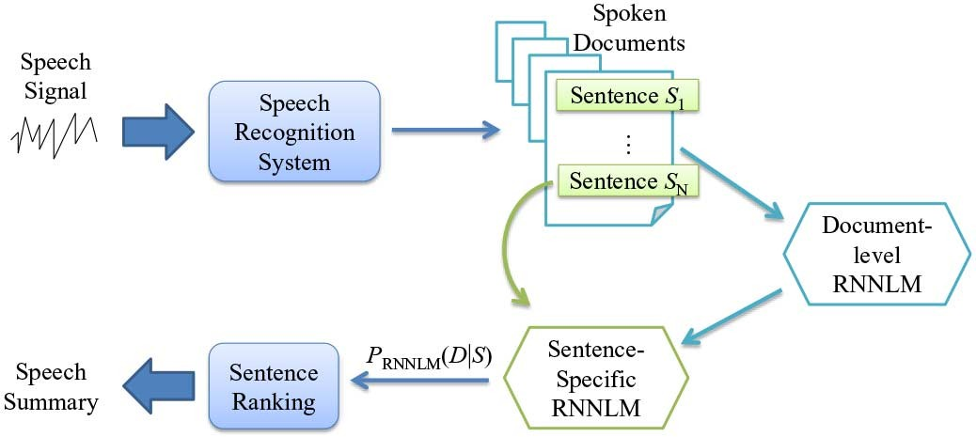
Literature Survey III:
System Architecture:

Slide 19
Literature Survey III:
Advantages:
RNNLM can be crystallized so as to render both word usage cues and long-span word co-occurrence relationships that are deemed beneficial for speech summarization.
Disadvantages:
Exploring the use of different kinds of prosodic, lexical and semantic information cues needs to be incorporated into this framework .

Slide 20
Requirement Analysis:
Functional Requirements:
Software should be able to detect the objects from the video input correctly.
Software should be able to detect the words from audio input correctly.
Input keyword or object should be compared and placed accurately.
Only the first time chunk in which object has appeared should be considered.
Objects with half appearance should be detected.

Slide 21
Requirement Analysis:
Non-Functional Requirements:
Software should process video in minimal time.
Input provided should be a valid word.
Software should search in both audio as well as graphical format.
It should be able to handle video length of 600 seconds.

Slide 22
Requirement Analysis:
Hardware Requirements:
Intel Core i3
RAM 4GB
Minimum memory of 256GB
Good GPU

Slide 23
Requirement Analysis:
Software Requirements:
Python IDE 2.7
Python Google Speech to Text
Operating System.

Slide 24
System Architecture:
Video input
Python’s Google speech recognition library
CSV file 1
Mask R-CNN Algorithm
CSV file 2
Input object to be searched
Dataset
Output occurrence time
Fig. content search using object detection and audio analysis

Slide 25
DFD Level 0:
Video input
Content Searching using object Detection and Audio analysis
Detection object Timings
Audio input

Slide 26
DFD Level 1:
Dataset
Video input
Mask R-CNN algorithm
CSV file 1
Python’s Google speech to text library
CSV File 2
Input object to be searched
Output occurrence with time

Slide 27
DFD Level 2:
Dataset
Video input
Mask R-CNN algorithm
Divide the video in chunks
Python’s Google speech to text library
Detect time of Occurrence
Input object to be searched
CSV File 2
Save Word occurrence with time
Compare input object for occurrence with its time.
CSV file 1
Output occurrence with time

Slide 28
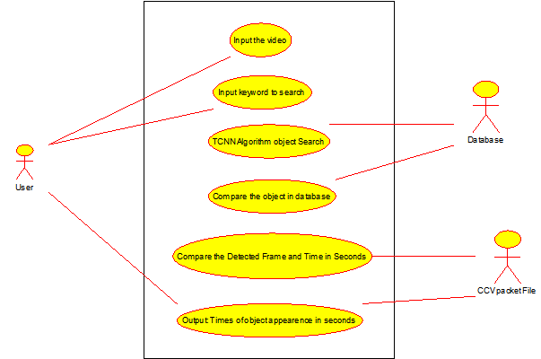
System Design:
Use Case Diagram

Slide 29
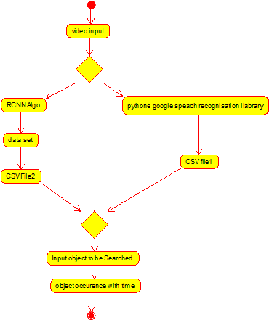
Activity Diagram

Slide 30
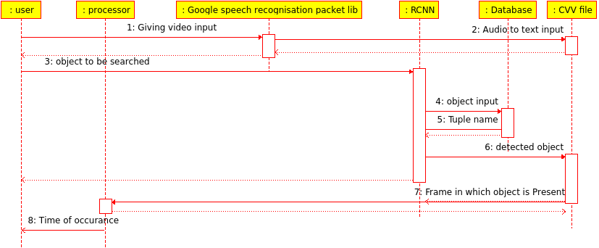
Sequence Diagram:

Slide 31
Implementation:
Extract the audio from the video file attached by the user. The audio obtained above is analyzed and divided into equal intervals of 3 seconds called segments for better accuracy .Each segment is overlapped over it’s previous segment by 0.5 seconds to avoid breaking of words over two segments. The speech in these segments of audio file is then converted into text using google speech recognition. The text obtained is stored in a file along with it’s the start and the end time of each segment. The file containing the text is searched to match the keyword or sentence that the user wants to search. Every unique occurrence of the match keyword or sentence along with its time of occurrence is given as output to the user.

Slide 32
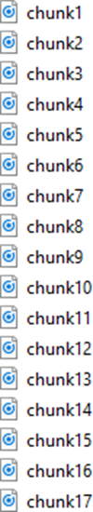
1. Division of audio
This divides the extracted audio into segments where each segment is of 3 seconds. This division helps better recognition of words.

Slide 33
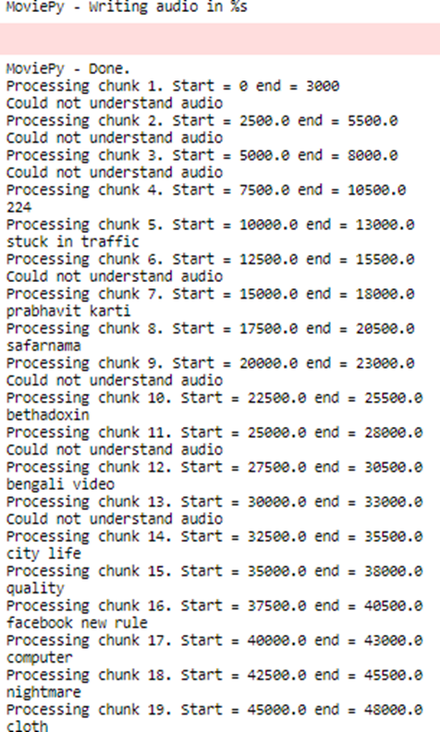
2.Conversion of Audio
This processes each segment and converts each segment into text.

Slide 34
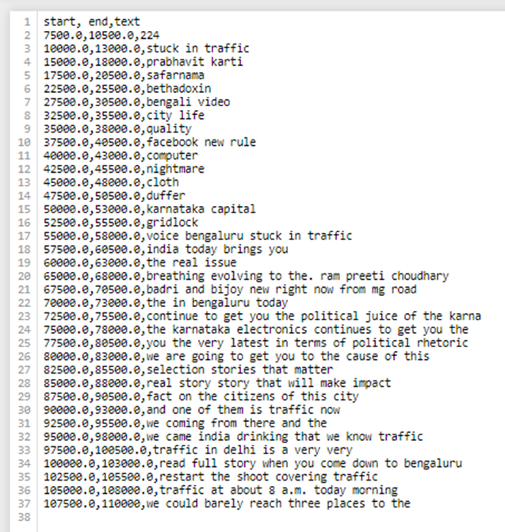
3. Storing of text
The above converted segments are stored in a CSV file. The CSV file contains the start time of the segment, end time of the segment and the converted text of the segment.

Slide 35
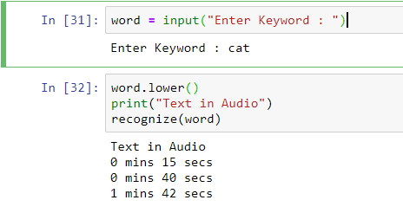
4.Output for audio
The final resultant output shows the occurrence time of the searched word(which is cat in this case).

Slide 36
References:
[1] Kang Li, Sheng Li, Sangmin Oh, Yun Fu, ‘Videography-Based Unconstrained Video Analysis,’
IEEE Transactions on Image Processing, Volume:26 , Issue: 5 , May 2017
[2] Lin-shan Lee, James Glass, Hung-yi Lee, Chun-an Chan, ‘Spoken Content Retrieval Beyond Cascading Speech Recognition with Text Retrieval,’
IEEE/ACM Transactions on Audio, Speech, and Language Processing, Volume: 23 , Issue: 9 , Sept. 2015
[3] Kuan-Yu Chen, Shih-Hung Liu, Berlin Chen, Hsin-Min Wang, Ea-EeJan, Wen-Lian Hsu, Hsin-Hsi Chen, ‘Extractive Broadcast News Summarization Leveraging Recurrent Neural Network Language Modeling Techniques,’
IEEE/ACM Transactions on Audio, Speech, and Language Processing Volume: 23 , Issue: 8 , Aug. 2015

