Slide 1
BigSix Data Hosting Module
Make your own league another La Liga.
1652819 阿思亘
1652757 奇巴图
1651482 殷在浩
1652175 孙韬

Slide 2
General Idea
Sports league data platform.
Basic content management & data services.
Advanced prediction service.
Fast server response.

Slide 3
Functionalities
League management
Team management
Match management
Data visualization
Results Prediction

Slide 4
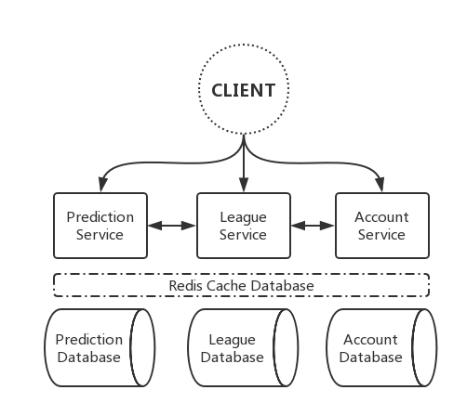
Functional Services

Slide 5
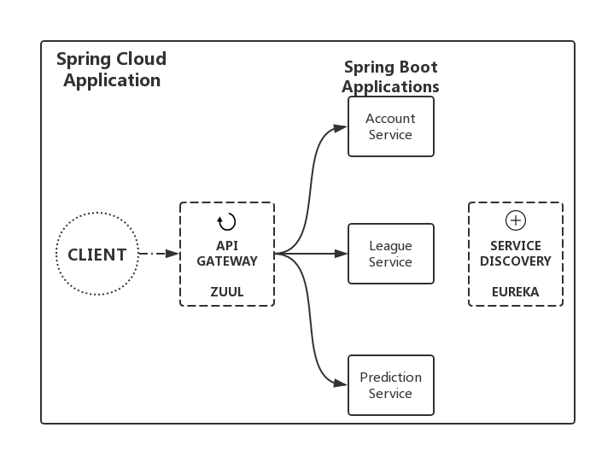
Micro Service Architecture
Notes:
Client-side service discovery allows services to find and communicate with each other without hard coding hostname and port. The only ‘fixed point’ in such an architecture consists of a service registry with which each service has to register.
A drawback is that all clients must implement a certain logic to interact with this fixed point. This assumes an additional network round trip before the actual request.
With Netflix Eureka each client can simultaneously act as a server, to replicate its status to a connected peer. In other words, a client retrieves a list of all connected peers of a service registry and makes all further requests to any other services through a load-balancing algorithm.
To be informed about the presence of a client, they have to send a heartbeat signal to the registry.
To achieve the goal of this write-up, we will implement three microservices:
a service registry (Eureka Server),
a REST service which registers itself at the registry (Eureka Client) and
Zuul is a JVM-based router and server side load balancer by Netflix.
The volume and diversity of Netflix API traffic sometimes results in production issues arising quickly and without warning. We need a system that allows us to rapidly change behavior in order to react to these situations.
Zuul uses a range of different types of filters that enables us to quickly and nimbly apply functionality to our edge service.

Slide 6
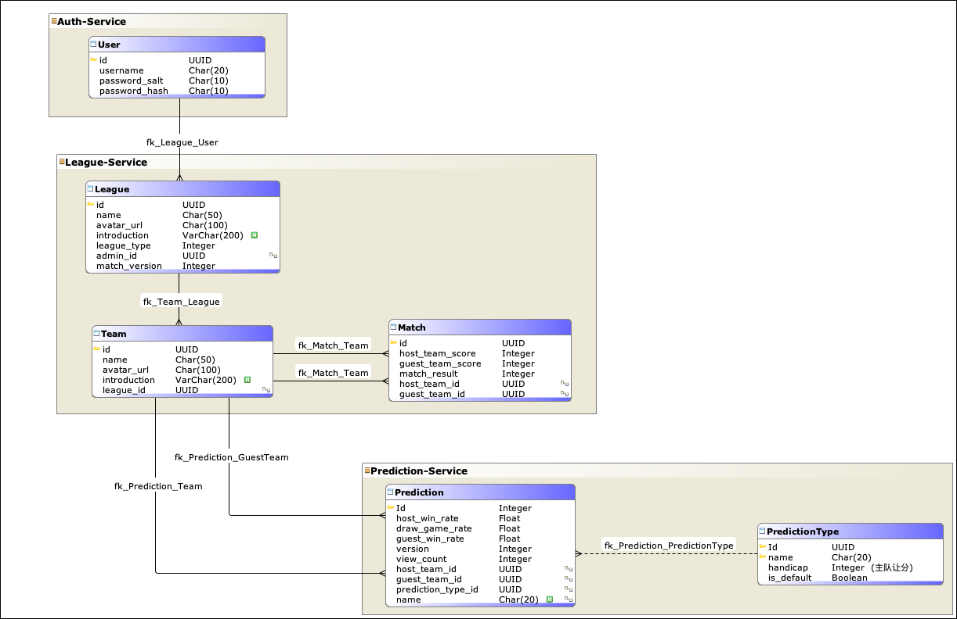

Database Design
Object Storage(pic)
Cache Database(prediction)
Notes:
If a certain prediction was viewed for multiple times, we have a field for counting it (view_count), then we may store it in Redis Cache Server. As generating a prediction consumes a lot of calculation because of the complexity of the algorithm, so if we store it in Redis we can save the time and energy caused by that.

Slide 7
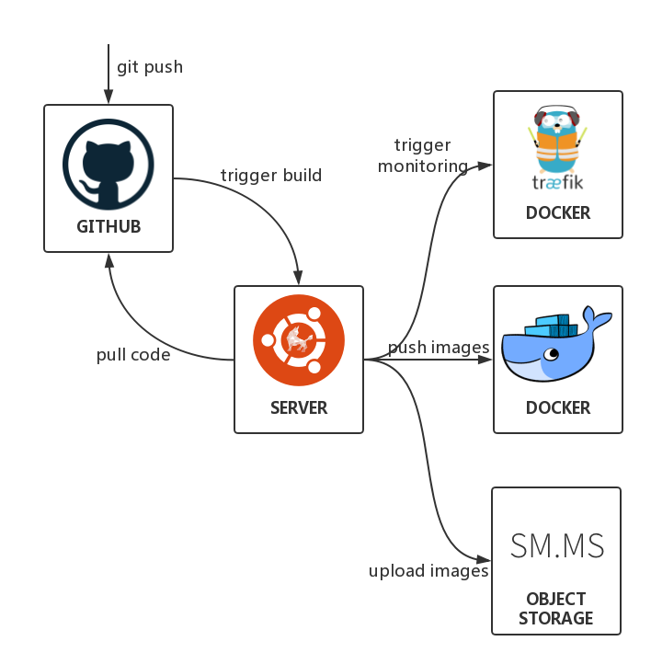
Workflow
Notes:
Traefik is a modern HTTP reverse proxy and load balancer that makes deploying microservices easy. Traefik integrates with your existing infrastructure components (Docker) and configures itself automatically and dynamically. Pointing Traefik at your orchestrator should be the onlyconfiguration step you need.

Slide 8
BigSix Result Prediction Module
Make your own league another La Liga.
1652723 林钰涵
1652741 杨丁豪
1652782 张智源

Slide 9
Prediction
Goal: To predict the probabilities of future games
An naïve solution:
Use the average win rate of past games
Problems:
Win rate regards all teams equally.
To defeat a “weaker” team is easy; to defeat a “strong” is challenging.
Win rate only considers the explicit performance.
The explicit performance can be affected by luck or random factors.

Slide 10
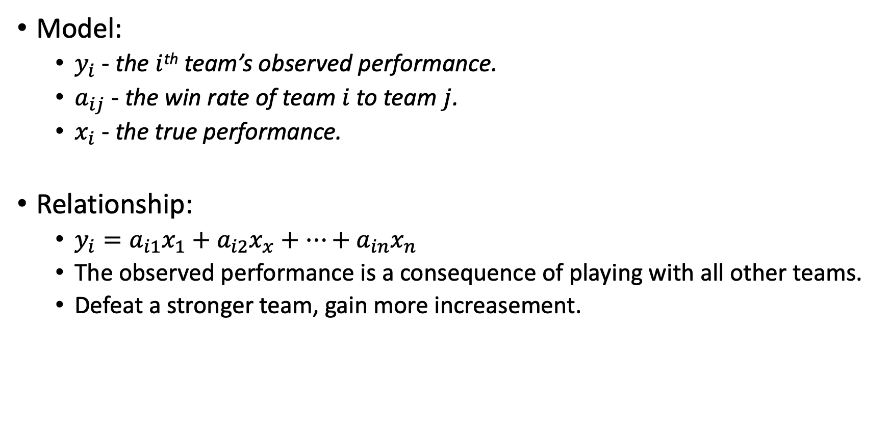
Prediction: How to model?
Model:
$y_{i}$ - the $i$^{th} team’s observed performance.
$a_{ij}$ - the win rate of team $i$ to team $j$.
$x_{i}$ - the true performance.
Relationship:
$y_{i}=a_{i1}x_{1}+a_{i2}x_{x}+…+a_{in}x_{n}$
The observed performance is a consequence of playing with all other teams.
Defeat a stronger team, gain more increasement.

Slide 11
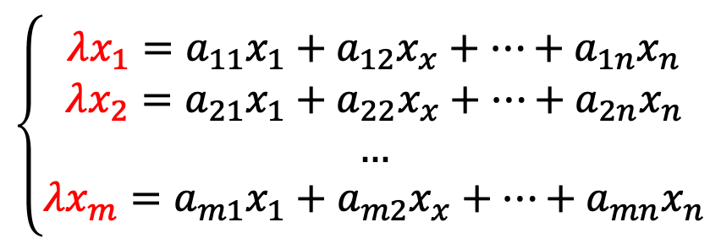
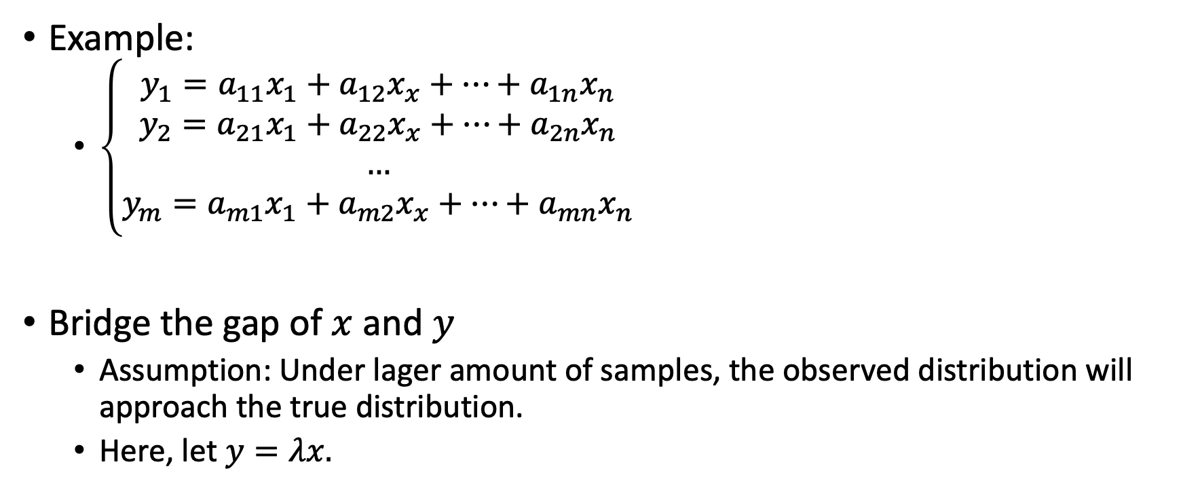
Prediction: How to model?
Example:
$\left\{\begin{aligned}y_{1}=a_{11}x_{1}+a_{12}x_{x}+…+a_{1n}x_{n} \\ y_{2}=a_{21}x_{1}+a_{22}x_{x}+…+a_{2n}x_{n} \\ … \\ y_{m}=a_{m1}x_{1}+a_{m2}x_{x}+…+a_{mn}x_{n}\end{aligned}\right.$
Bridge the gap of $x$ and $y$
Assumption: Under lager amount of samples, the observed distribution will approach the true distribution.
Here, let $y=λx.$
$$\left\{\begin{aligned}λx_{1}=a_{11}x_{1}+a_{12}x_{x}+…+a_{1n}x_{n} \\ λx_{2}=a_{21}x_{1}+a_{22}x_{x}+…+a_{2n}x_{n} \\ … \\ λx_{m}=a_{m1}x_{1}+a_{m2}x_{x}+…+a_{mn}x_{n}\end{aligned}\right.$$

Slide 12
Efficient Java Matrix Library
A linear algebra library for manipulating real/complex/dense/sparse matrices.
A computational and memory-efficient tool for both small and large matrices

Slide 13
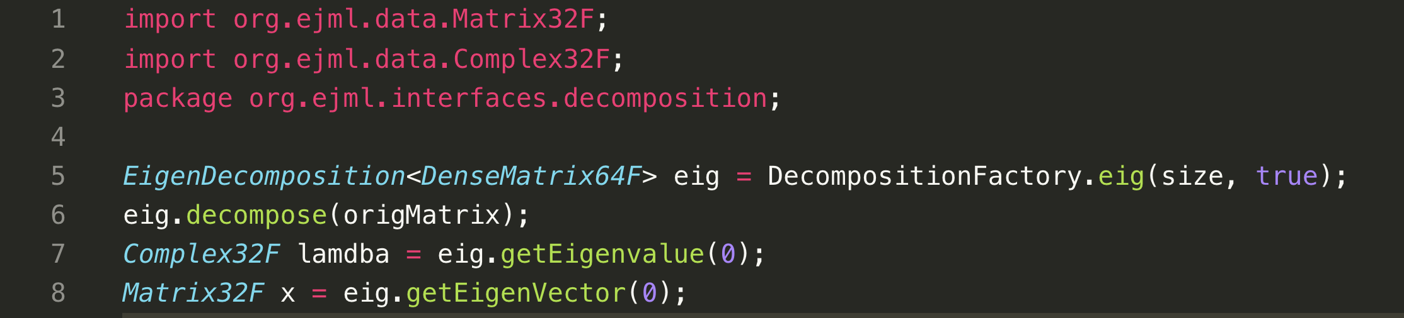

Prediction: How to solve?
A Linear algebra form:
$$Ax=λx$$
Wow! $λ$is the Eigenvalue and $x$ is the Eigenvector.
Calculation by EgienDecomposition:

Slide 14
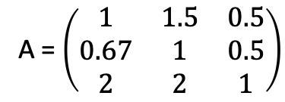
Prediction: Get the true performance
TeamA vs TeamB 3 : 2
TeamA 0.46
TeamB vs TeamC 1 : 2
A = $\left(\begin{matrix}1 & 1.5 & 0.5 \\ 0.67 & 1 & 0.5 \\ 2 & 2 & 1\end{matrix}\right)$
TeamA 0.35
TeamA vs TeamC 1 : 2
TeamA 0.81
Observed performance
Models
True performance

Slide 15





Prediction: Quantitative Study
We defined a probability space to represent the result of a game
$$c_{ij}=\frac{x_{i}+a}{x_{j}+a}$$
Set two thresholds to divide the space into three parts: win, draw, lose

Slide 16
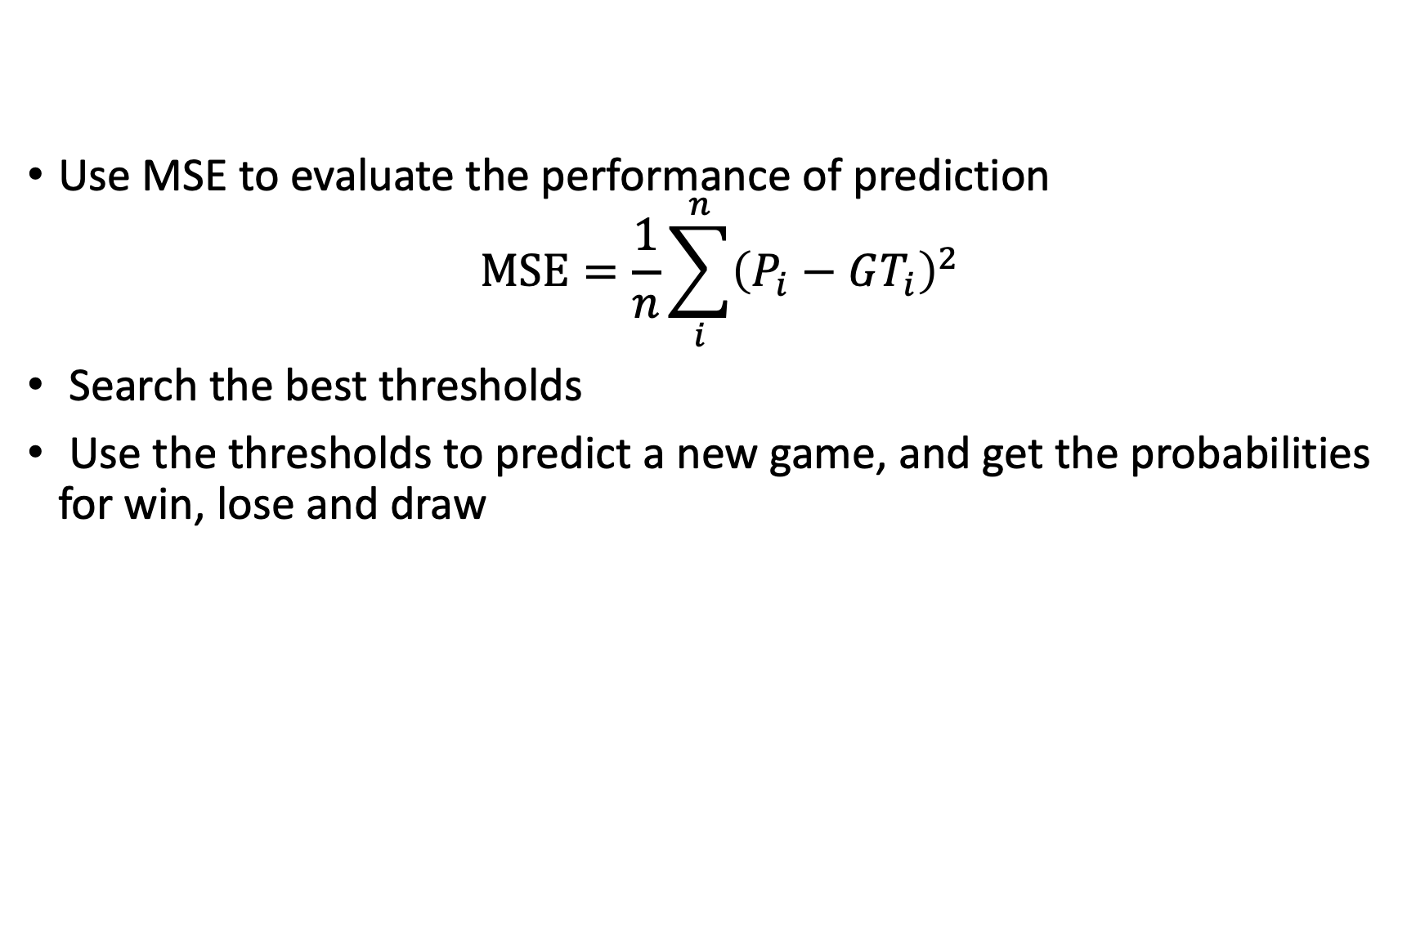
Prediction: Quantitative Study
Use MSE to evaluate the performance of prediction
$$MSE=\frac{1}{n}\sum_{i}^{n}{{\left(P_{i}−GT_{i}\right)}^{2}}$$
Search the best thresholds
Use the thresholds to predict a new game, and get the probabilities for win, lose and draw

Slide 17
Prediction: Get the result
P(win)
Get the true performance
Get the best thresholds
Input two team and their history game records
P(draw)
P(lose)

Slide 18
Q & A

Slide 19
Thanks!

