Slide 1

Title: Project proposal for a Library Management system for Wagberi high school Unit :Project programming BIT 03105
SCHOOL OF TECHNOLOGY
Presenter: Yussuf Ahmed Yassin - 21/05125
Supervisor: Dr Simon N. Mwendia

Slide 2
OUTLINE
Introduction
Background
Problem statement
Main Objective
System objectives
Significance of Study
Literature review
Methodology
Budget and resources
Project schedule

Slide 3
Introduction
Nestled in Township sub-county of Wajir county in the north-eastern region of Kenya, Wagberi high school stands as a symbol of educational excellence. The school has a rich history of nurturing young minds, fostering a love for learning and achieving remarkable results in producing great minds in our country.
In this paper I propose the development of the Library Management system. The students are the fundamental members of a university and are the target of this project. The Library management system is meant to help in bridging the gap of accessing books automatically without actually visiting the library between students, lecturers and the administration with help of information technology, specifically website technology.

Slide 4
Background
Currently, book borrowing in Wagberi high school is done primarily through the librarian inside the library. This is a designated place where books from the administration and advertisers are posted. Books posted here range from school course work books, research books, art books, extracurricular books etc. The mode of posting is by physically place the books in the library for the students to access.
The other means is through representatives who are given information to transmit to their respective representation groups. The class representatives have various channels to do this namely:
physically announcing books to the class, where the class has a group, individually informing all the class members physically.

Slide 5
Problem statement
The current books communication channels are flawed on several levels. However, the problem this research focuses on is the inefficiency of the current system. The traditional Library is inefficient because it doesn’t achieve its intended purpose as expected i.e. doesn’t reach intended audience conveniently, books are subject to verification questions, it is untimely.

Slide 6
Problem solution
I here by propose the creation of the library management system. This web application will do the following:
Digital posting of books
Provide a log in account to access the library management system.
A library management system admin will be responsible for the posting, edition and deletion of books making the books verified.
Outdated books deletion, to ensure the library management system is updated.
Archiving of the books in the databases for record keeping purposes.

Slide 7
Main objectives
Resource management: Efficiently manage and organize the university’s collection of books, journals and other types of information resources.
User management: Maintain uesr records, including students, faculty and staff, enabling them to access library resources.
Circulation control: Facilitate the circulation of library materials, including check-in, check-out, renewals while keeping track of due dates and fines.
Resource access: Provide seamless access to electronic resources and databases, ensuring authentication, licensing compliance and remote access for authorized users.
Preservation: Implement startegies for preserving and archiving digital and physical materials to protect the university’s intellectual assets.

Slide 8
System objectives
To bridge the communication gap between students, lecturers, administration.
To ensure efficient communication of books/ information.
To assure users that the information is verified.
To indulge students more in their study life.

Slide 9
Significance of study
The university is sure to have seamless running of affairs.
The university saves on time and costs associated with miscommunication issues.
Students are more actively involved and conscious of their study life.
The university events and activities get higher attendance.
Satisfaction of library services for the students, lecturers and the whole Wagberi high school fraternity.

Slide 10
Literature review
Library is regarded as the brain of any institutes, of course many institute understand the importance of the library to the growth of the institute and their esteem users which we categorically call the students. An integrated library system, also known as a library management system (Adamson et al., 2008) is an enterprise resource planning system for a library, used to track items owned, orders made, bills paid, and users who have borrowed.
The first library management system to be reviewed is the KOHA library management system. Since the original implementation in 1999, KOHA functionality has been adopted by thousands of libraries worldwide, each adding features and functions, deepening the capability of the system. With the 3.0 release in 2013, and the integration of the powerful Zebra indexing engine, KOHA became a viable, scalable solution for libraries of all kinds. LibLime KOHA is built on this foundation. With its advanced feature set, LibLime KOHA is the most functionally advanced open source Integrated Library System in the market today. The major setback of this Library Management System is that it is a web based and as a result it is not security conscious because hackers could have the database hacked and access or modify the information of such user. (www.koha.org).

Slide 11
Methodology
Introduction
A research is to be conducted to determine;
How the current system functions i.e its shortcomings, advantages, future scope? etc.
What the users feel about it?
What the users expect from the library management system?
The following are the methodologies used in the research and development of the application. The two were identified in order to achieve the best possible results.
In order to acquire data regarding the Library Management system, several tools and techniques will be used as discussed below:
The target - the target population for this research is Wagberi high school. This research will seek to identify the current system, what all stakeholders of the university think of it, how they operate, how they can best solve their problems etc. A random sample of 30 people comprising of students, academic and non-academic staff will be chosen for data collection purposes.

Slide 12
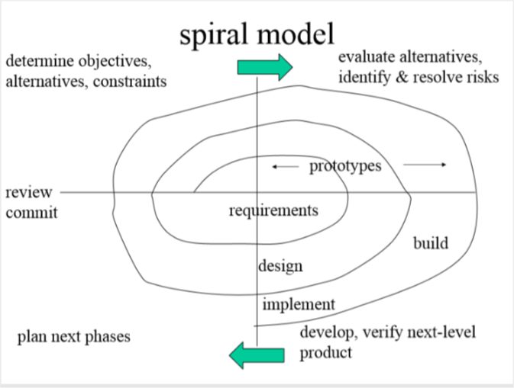
Development methodology
The suitable development methodology for this project I identified the spiral model. It is specifically suitable for the following reasons;
This model of development combines the features of the prototyping model and the waterfall model. The spiral model is favored for its quality projects. This model uses many of the same phases as the waterfall model, in essentially the same order, separated by planning, risk assessment, and the building of prototypes.
The spiral model could be seen as another view of waterfall model, at each stage of the development project a greater level of detail is considered. More knowledge is gathered at end of each stage review scope and risk and decides whether to commit to the next stage.
The spiral model is depicted in the figure 3.1
The project will be web based, the front-end will be html, css and javascript and the back-end will be php and mysql.

Slide 13
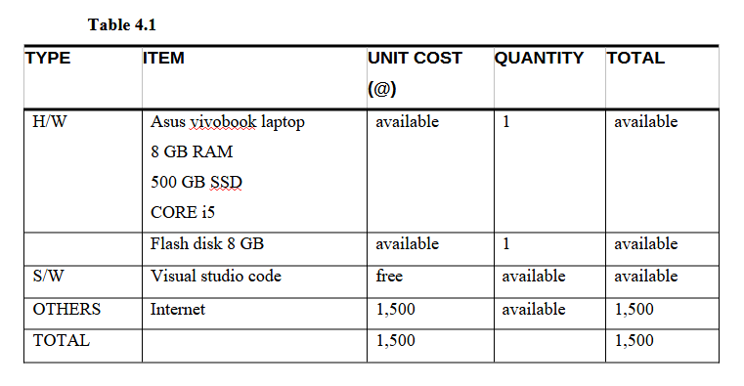
Budget and resources
Listed below are the resources required for the project and their respective prices.

Slide 14
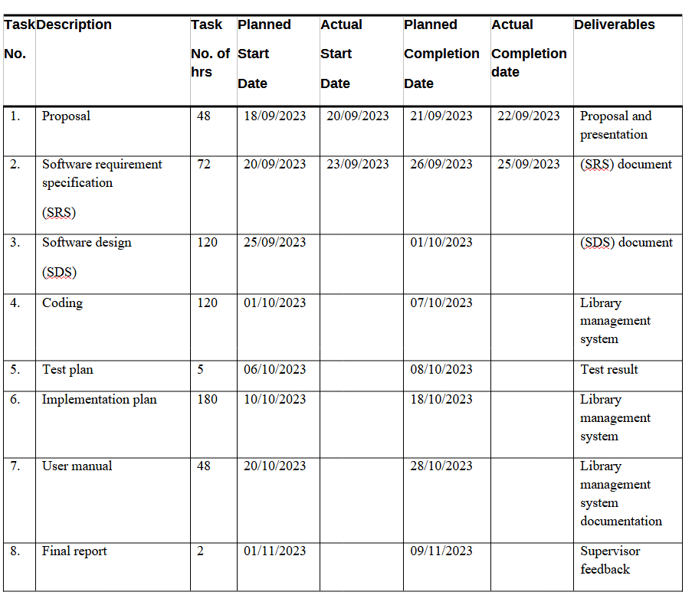
Project schedule

Slide 15
Reference
Adamson and Veronica. (2008). JISC & SCONUL Library Management Systems Study. Sheffield, UK: Sero Consulting. p. 51. Retrieved on 06 August 2015.
IEEE Recommended Practice for Software Design Descriptions, IEEE Standard 1016–1998.
C.YungChang, J.PingSheu “Design and implementation of ad hoc classroom and eSchoolbag systems for ubiquitous learning” IEEE International Workshop on Wireless and Mobile Technologies in Education, Pg. 8 – 14, 2012
J.P.Dixion,” automated systemPro”http://www. automated systempro.com/index.html, 2011.

Slide 16
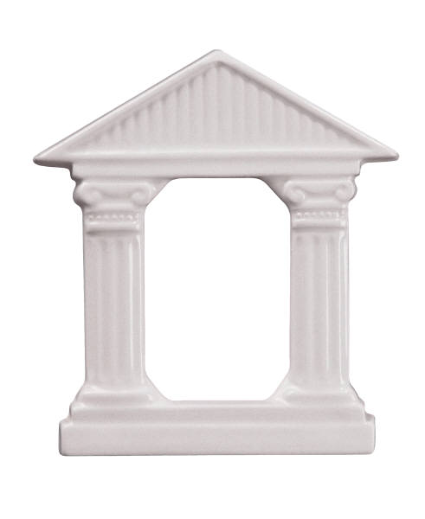
Thank you!!

