Slide 1
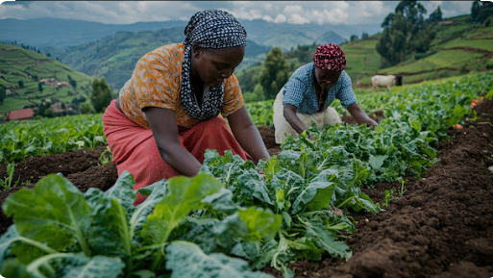
Title: PL/SQL-Based Market Access System for Rwandan Smallholder Farmers
Course: Database Development with PL/SQL (INSY 8311)
Lecturer: Eric Maniraguha
Date: March 25, 2025
Student Name & ID: ISHIMWE HONORE & 26578

Slide 2
Problem Statement & Objective
Problem Definition:
Rwandan farmers struggle to access fair, reliable markets.
Challenges: Digital barriers, weak logistics, middlemen dominance.
Results: Low income, post-harvest wastage, supply chain inefficiency.
Project Objective:
Develop a PL/SQL Oracle database for a structured market system.
Automate transactions, improve trade fairness and reduce losses.
Database Design – Key Entities & Relationships
Main Entities:
Farmer: Registers & lists available produce.
Buyer: Places and manages orders.
Order: Connects farmers & buyers.
Logistics: Organizes delivery & tracking.
Payment: Handles secure transactions.
Relationships:
Farmers supply Buyers (Many-to-Many).
Orders link to Payments (One-to-One).
Logistics coordinates deliveries (One-to-Many).

Slide 3
Expected Benefits & PL/SQL Role
System Benefits:
Fair Pricing: Eliminates unfair middlemen.
Reduced Wastage: Demand-driven sales prevent losses.
Automated Workflow: Orders, payments, and logistics are managed efficiently.
Secure Transactions: Data integrity & fraud prevention ensured.
Expanded Market Access: More farmers can trade fairly.
PL/SQL Role:
Triggers automate stock & payment updates.
Stored Procedures secure & streamline transactions.
Constraints enforce data accuracy & consistency.

