Slide 1
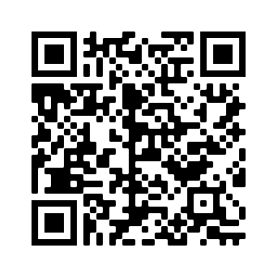

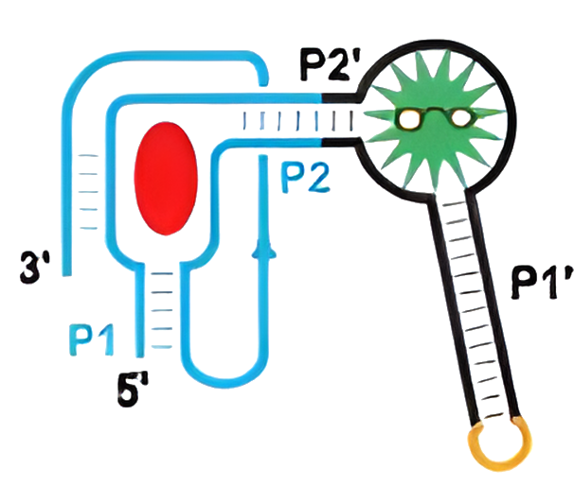
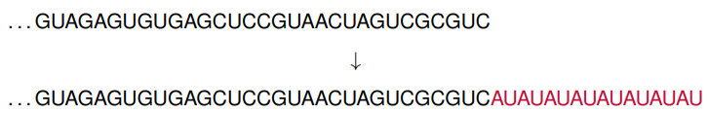


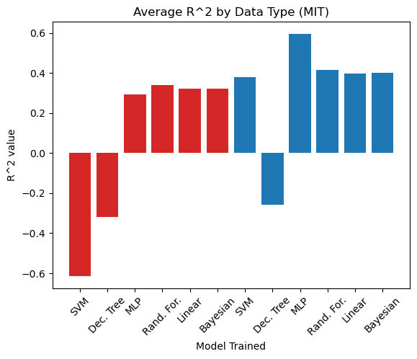
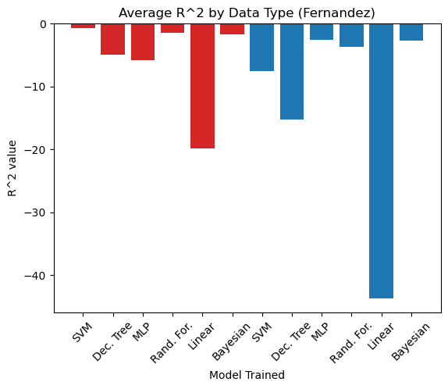
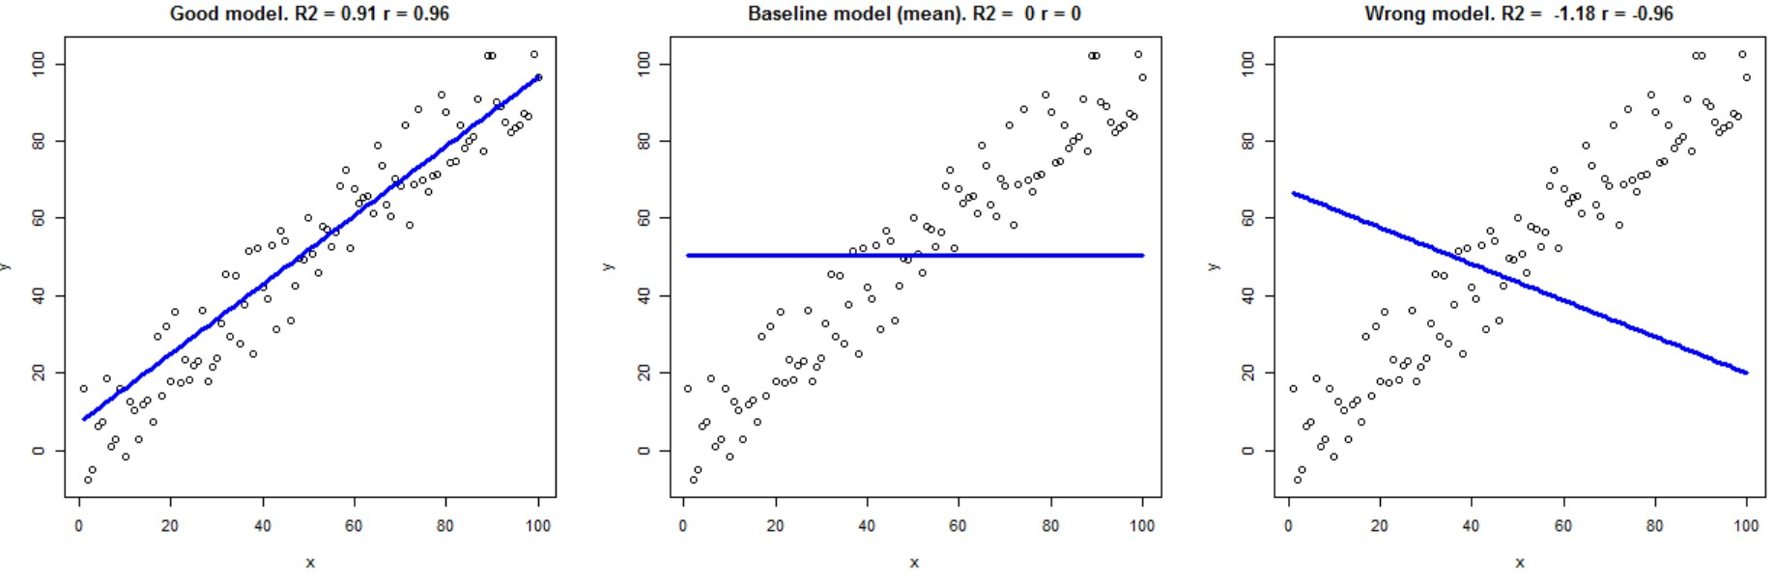
Machine Learning Enhancing the Design of
Biosensors for the Detection of Dopamine
James Craven, Matthew Lindsey, Dr. Zachary Abernathy, and Dr. Kristen Abernathy
Winthrop University, Rock Hill, South Carolina 29733
GitHub Repo
Introduction
Data Preparation
Dopamine is a neurotransmitter and plays a role in a variety of functions such as memory, learning, and reward systems. Detecting dopamine levels could help with diagnosing:
Addiction
Mental Illness
Neurodegenerative Disorders
Research Questions:
Using both the toehold switch dataset and the Fernandez lab data, do models perform better when trained on nucleotide sequences than thermodynamic parameters? Additionally, does the MLP outperform other regression-based models for both datasets?
Can we leverage the 90,000+ labeled toehold switch dataset to train a ML model and make accurate predictions on the Fernandez ribosensor data?
Most machine learning models require the input data to have the same dimensionality. An option to handle sequences of variable length is to pad them to the same length.
In addition, sequence data must be adequately formatted before being used to train a machine learning model. Plain-text characters can’t be used directly, so one-hot-encoding was used to format the data.
Figure 1: Dopamine biosensor with fused-design
adapted from Su, Y. and Hammond, M.C. Curr. Opin. Biotechnol. 2020.
The two data sets also have two distinct target values, namely fold increase and on/off ratio. To properly compare the results of the data sets, these two values were normalized using range-based normalization.
Results
Coefficient of Determination
Summary of Results:
Sequence data appears to be better for model training due to potential information loss in calculating thermodynamic parameters.
Neural Networks are effective models for this type of problem.
There is either not enough similarity between the datasets or there is not enough data, in general, to do cross-training between the two.
We utilize scikit-learn’s implementation of the coefficient of determination:
Understanding the Problem
To better understand how machine learning is currently used in synthetic biology, we came across the work of Angenent-Mari et al. [1]. Results from this work include:
Creation of a dataset of over 90,000 toehold switches
Training of a multilayer perceptron (MLP) to adequately predict fluorescence for the toehold switch data
The MLP outperforms other regression-based models in predicting fluorescence
All models tested performed better when trained on nucleotide sequences instead of derived thermodynamic parameters
Future Project Directions
Future Directions of the Project:
Pre-training the neural net on Harvard data and then unfreezing layers and retraining on a portion of Fernandez data.
Semi-supervised learning by generating millions of sensor sequences and using Large Language Models (LLM) to learn general RNA patterns that can be applied to the smaller labeled dataset.
Revisiting the literature to see if other data sources are closer in design to our dopamine sensors.
Works Cited
Acknowledgements
[1] Nicolaas M Angenent-Mari, Alexander S Garruss, Luis R Soenksen, George Church, and James J Collins. A deep learning approach to programmable rna switches. Nature communications, 11(1):5057, 2020.
[2] Ann-Christin Groher, Sven Jager, Christopher Schneider, Florian Groher, Kay Hamacher, and Beatrix Suess. Tuning the performance of synthetic riboswitches using machine Learning. ACS synthetic biology, 8(1):34–44, 2018.
[3] Jacqueline A Valeri, Katherine M Collins, Pradeep Ramesh, Miguel A Alcantar, Bianca A Lepe, Timothy K Lu, and Diogo M Camacho. Sequence-to-function deep learning frameworks for engineered riboregulators. Nature communications, 11(1):5058, 2020.
Support for this research was provided by the National Science Foundation EPSCoR Program, Dr. Zachary Abernathy, Dr. Kristen Abernathy, and the Winthrop University Department of Mathematics.

