Slide 1


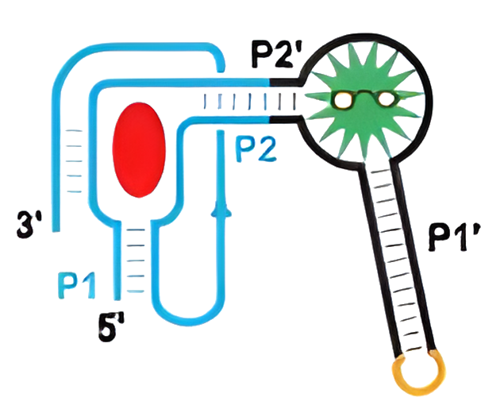
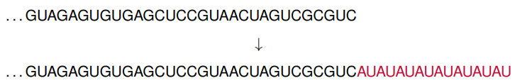

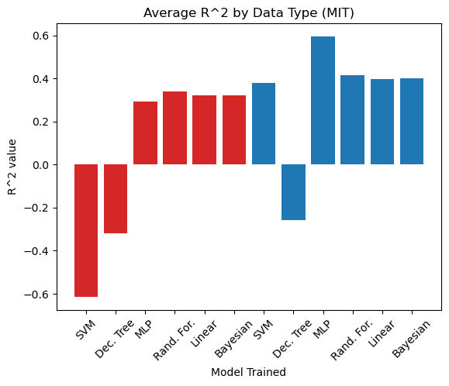
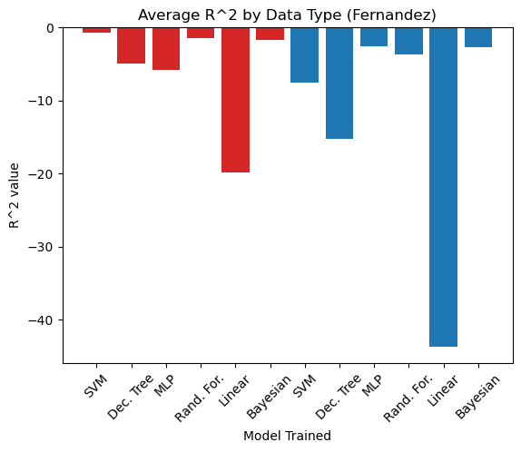
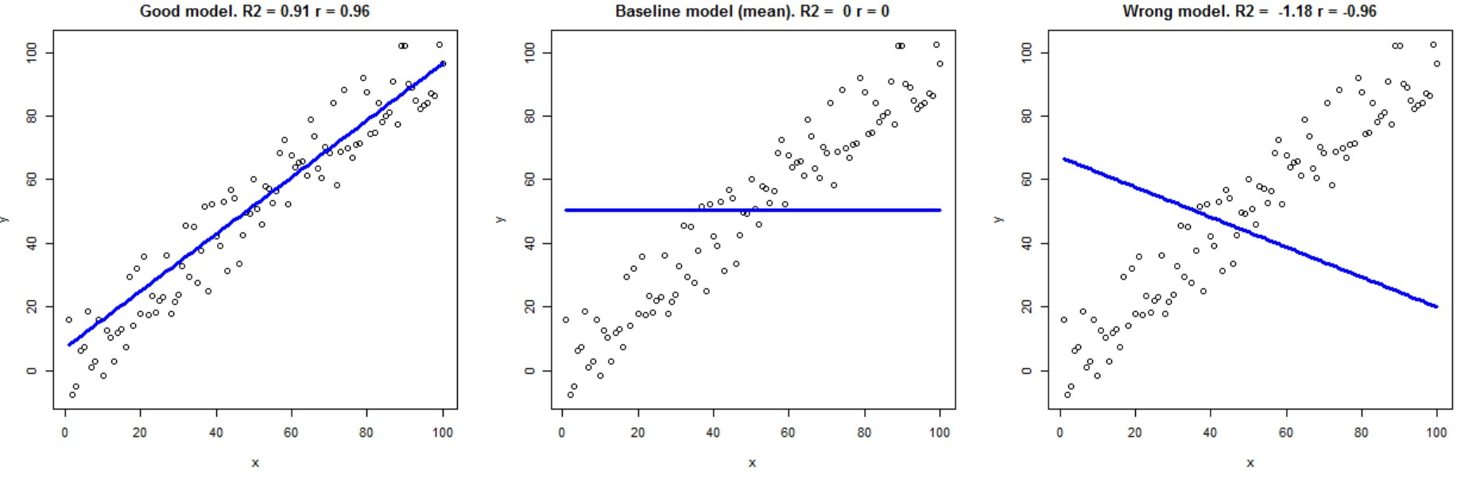
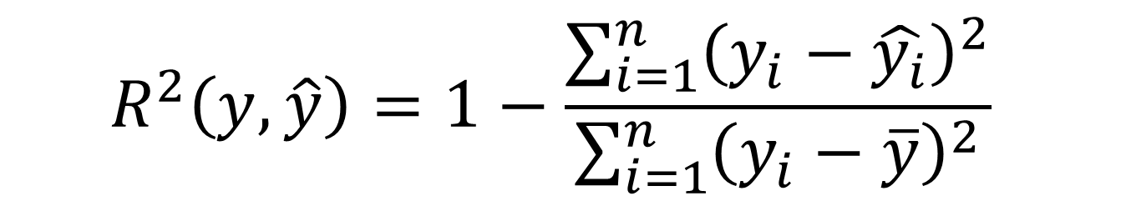
Machine Learning to Enhance the Design of
Biosensors for the Detection of Dopamine
James Craven, Matthew Lindsey, Dr. Zachary Abernathy, Dr. Kristen Abernathy, and Dr. Timea Fernandez
Winthrop University, Rock Hill, South Carolina 29733
GitHub Repo
Introduction
Data Preparation
Dopamine is a neurotransmitter and plays a role in a variety of functions such as memory, learning, and reward systems. Detecting dopamine levels could help with diagnosing:
Addiction
Mental Illness
Neurodegenerative Disorders
Research Questions:
How can we utilize machine learning (ML) to inform the design of biosensors to emit a strong fluorescence in the presence of dopamine?
For both a published toehold switch dataset and Fernandez lab data, do models perform better when trained on nucleotide sequences or thermodynamic parameters?
Can we leverage the 90,000+ labeled toehold switch dataset to train a ML model and make accurate predictions on the smaller Fernandez biosensor data?
Most machine learning models require the input data to have the same dimensionality. One option to handle sequences of variable length is to pad them to the same length.
In addition, sequence data must be adequately formatted before being used to train a machine learning model. Plain-text characters can’t be used directly, so one-hot-encoding was used to format the data.
Figure 1: Dopamine biosensor with fused-design
adapted from Su, Y. and Hammond, M.C. Curr. Opin. Biotechnol. 2020.
The two data sets also have two distinct target values, namely fold increase and on/off ratio. To properly compare the results of the data sets, these two values were normalized using range-based normalization.
Results
Coefficient of Determination
Summary of Results:
Sequence data (blue) appears to be more predictive due to potential information loss in calculating thermodynamic parameters (red)
Neural Networks are effective models for this type of problem
There is either not enough similarity between the two datasets or not yet enough biosensor data to achieve adequate cross-training
We utilize scikit-learn’s implementation of the coefficient of determination:
Background
A similar approach for deploying machine learning to inform synthetic biology problems can be found in Angenent-Mari et al. [1]. Results from this work include:
Creation of a dataset of over 90,000 toehold switches
Training of a multilayer perceptron (MLP) to adequately predict fluorescence for the toehold switch data
The MLP outperforms other regression-based models in predicting fluorescence
All tested models performed better when trained on nucleotide sequences instead of derived thermodynamic parameters
$$R^{2}\left(y,\hat{y}\right)=1−\frac{\sum_{i=1}^{n}{{\left(y_{i}−\hat{y_{i}}\right)}^{2}}}{\sum_{i=1}^{n}{{\left(y_{i}−\overline{y}\right)}^{2}}}$$
Future Project Directions
Future Directions of the Project:
Pre-training the neural net on toehold switch data and then unfreezing layers and retraining on a portion of Fernandez data.
Semi-supervised learning by generating millions of sensor sequences and using Large Language Models (LLM) to learn general RNA patterns that can be applied to the smaller labeled dataset.
Revisiting the literature to see if other data sources are closer in design to the Fernandez lab dopamine sensors.
Works Cited
Acknowledgements
[1] Nicolaas M Angenent-Mari, Alexander S Garruss, Luis R Soenksen, George Church, and James J Collins. A deep learning approach to programmable rna switches. Nature communications, 11(1):5057, 2020.
[2] Ann-Christin Groher, Sven Jager, Christopher Schneider, Florian Groher, Kay Hamacher, and Beatrix Suess. Tuning the performance of synthetic riboswitches using machine Learning. ACS synthetic biology, 8(1):34–44, 2018.
[3] Jacqueline A Valeri, Katherine M Collins, Pradeep Ramesh, Miguel A Alcantar, Bianca A Lepe, Timothy K Lu, and Diogo M Camacho. Sequence-to-function deep learning frameworks for engineered riboregulators. Nature communications, 11(1):5058, 2020.
Support for this research was provided by ADAPT in SC, an EPSCoR program supported by NSF Award #OIA-2242812. We also wish to thank the Winthrop University Department of Mathematics and the SURE program.

