Slide 1
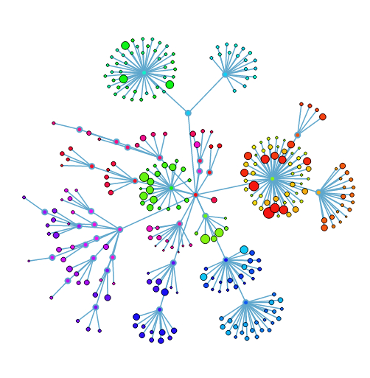
Source code management: Git

Slide 2
The Plan
Source code management
Using Git for versioning
Branching
Working with other people
Advanced topics

Slide 3
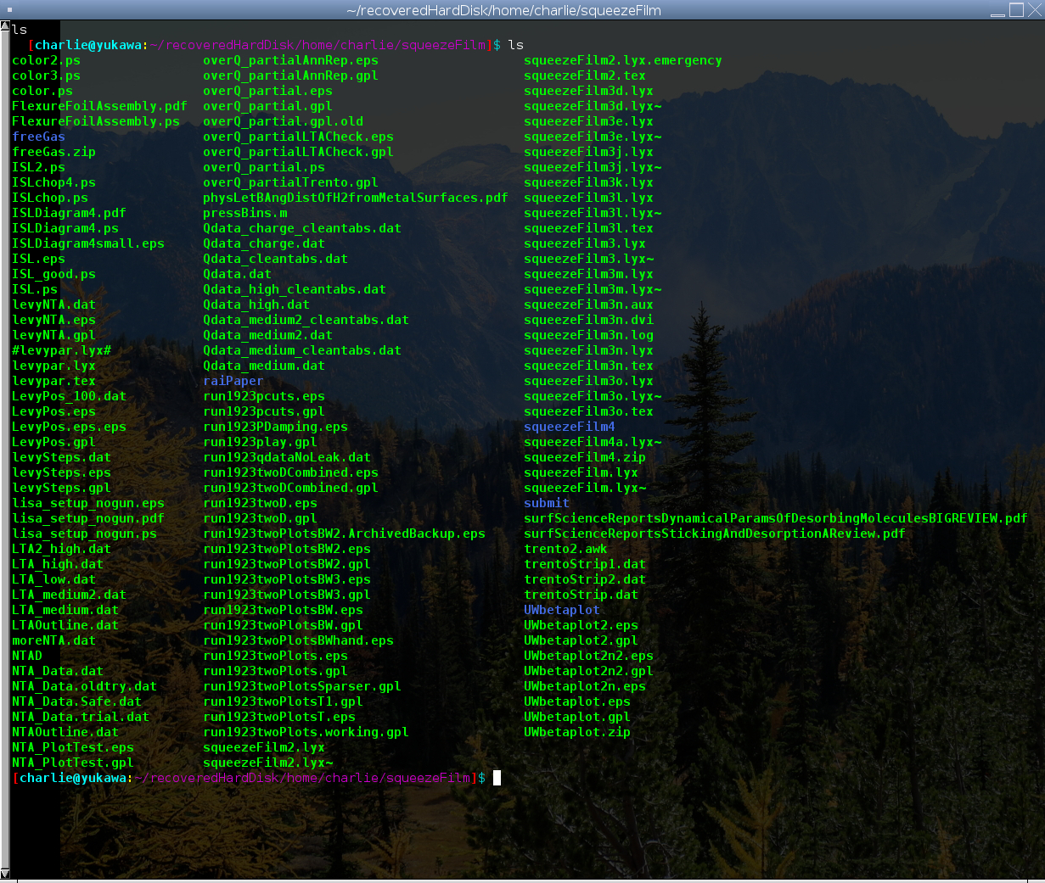
The problem

Slide 4
Historical context
CVS/Subversion – centralized, versions well
  One server, one person at a time
Bitkeeper
  Distributed – everyone has a copy of everything
Git / Mercurial – modern paradigm
  Merges well, fast, common usage

Slide 5
Git
Init
Status
Stage
Commit
Log
diff

Slide 6
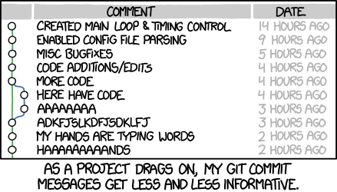
Good commit practices
Commit early, commit often
Make small commits
https://xkcd.com/1296/

Slide 7
More tools
Git rm
Git mv
.gitignore

Slide 8
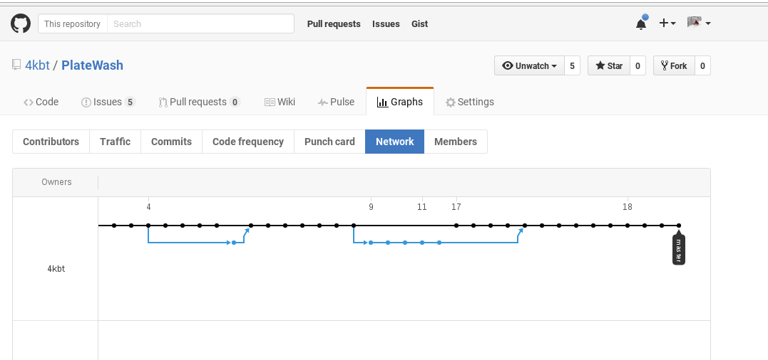
How does Git work?
Linked list of changes
Tracks SHA hash of changes
Tracks changes, not files
Not optimal for binary files.

Slide 9
Branching

Slide 10
Branching
git checkout -b NewBranch
git branch
You can try out new ideas safely!
Branch often, merge often

Slide 11
Working with others

Slide 12
Working with others
git clone
git push
git pull
You have your own complete copy
CENPA has its a git repository with RepositoryHosting, but GitHub is prettier/easier to use.

Slide 13
Add your names to the awesome list
git clone https://github.com/4kbt/CENPAGitDemo.git
Edit PeopleWhoAreAwesome.txt
Commit the change
Push! (must have GitHub permissions)
Extra credit: Add your name to this slide.

Slide 14
Advanced topics

Slide 15
Advanced Topics
git revert
Branching from an old commit
‘everything is just git rebase’
Submodules

Slide 16

“How do I make things better when things break?”

Slide 17
“How do I make things better when things break?”
Push to remote often
Understand simple commands and git’s datastructure
Slow down, think.
Google.

