Slide 1
Land Use and Vegetation Change Detection in Bengaluru (2018–2024)
Using Sentinel‑2 remote sensing data
Name: Krunal Bhatia
Course: Geo‑Informatics WS25‑26
Matriculation number: 37553

Slide 2
Introduction
Bengaluru is one of the fastest growing metropolitan areas in India, making it an ideal case study for analyzing vegetation change caused by urban expansion.
Rapid urban growth influences vegetation and land cover.
Remote sensing enables monitoring of environmental changes.
NDVI provides a reliable indicator of vegetation health.
This study examines vegetation changes in Bengaluru,India between 2018 and 2024.

Slide 3
Research Objectives
1. Calculate NDVI for Sentinel-2 imagery from 2018 and 2024.
2. Classify vegetation density using NDVI thresholds.
3. Detect vegetation change between the two years.
4. Evaluate classification accuracy using validation points.

Slide 4
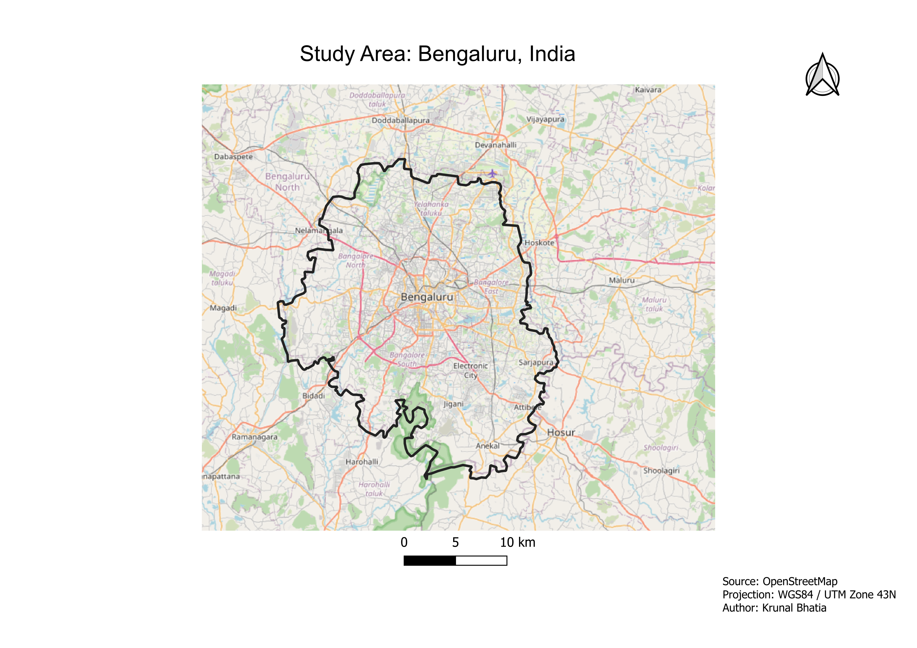

Slide 5
Data Sources
Sentinel‑2 satellite imagery (10m spatial resolution)
Sentinel-2 Bands Used:
Band 4 (Red)
Band 8 (Near Infrared)
Images from 2018 and 2024
Bengaluru administrative boundary
Data obtained from Copernicus Data Space Ecosystem

Slide 6
Sentinel‑2 Image Dates (Justification)
2018 Image Date: 25.12.2018
2024 Image Date: 27.04.2024
Image Selection Criteria
Cloud cover below 10%
Clear Sentinel-2 scenes covering Bengaluru
Suitable image quality for NDVI calculation
Enables reliable comparison between 2018 and 2024

Slide 7
NDVI Concept
NDVI = (NIR − Red) / (NIR + Red)
(NDVI values range from −1 to +1.)
Higher NDVI values indicate healthier vegetation.
Lower values represent bare soil, water or built‑up areas.

Slide 8
NDVI Classification
< 0 : Water / Built‑up
0 – 0.2 : Bare Soil
0.2 – 0.4 : Sparse Vegetation
0.4 – 0.6 : Moderate Vegetation
> 0.6 : Dense Vegetation
These thresholds are commonly used in remote sensing studies to differentiate vegetation density levels.

Slide 9
Methodology Workflow
Satellite Data Acquisition: Sentinel‑2 imagery (2018 and 2024)
Pre‑processing: Image clipping to Bengaluru boundary
NDVI Calculation: (NIR − Red) / (NIR + Red)
NDVI Classification into vegetation categories
NDVI Change Detection (2018–2024)
Accuracy Assessment using 100 random validation points

Slide 10
Software and Tools
QGIS 3.44.8
Raster Calculator
Processing Toolbox
Group Stats plugin used for confusion matrix generation

Slide 11
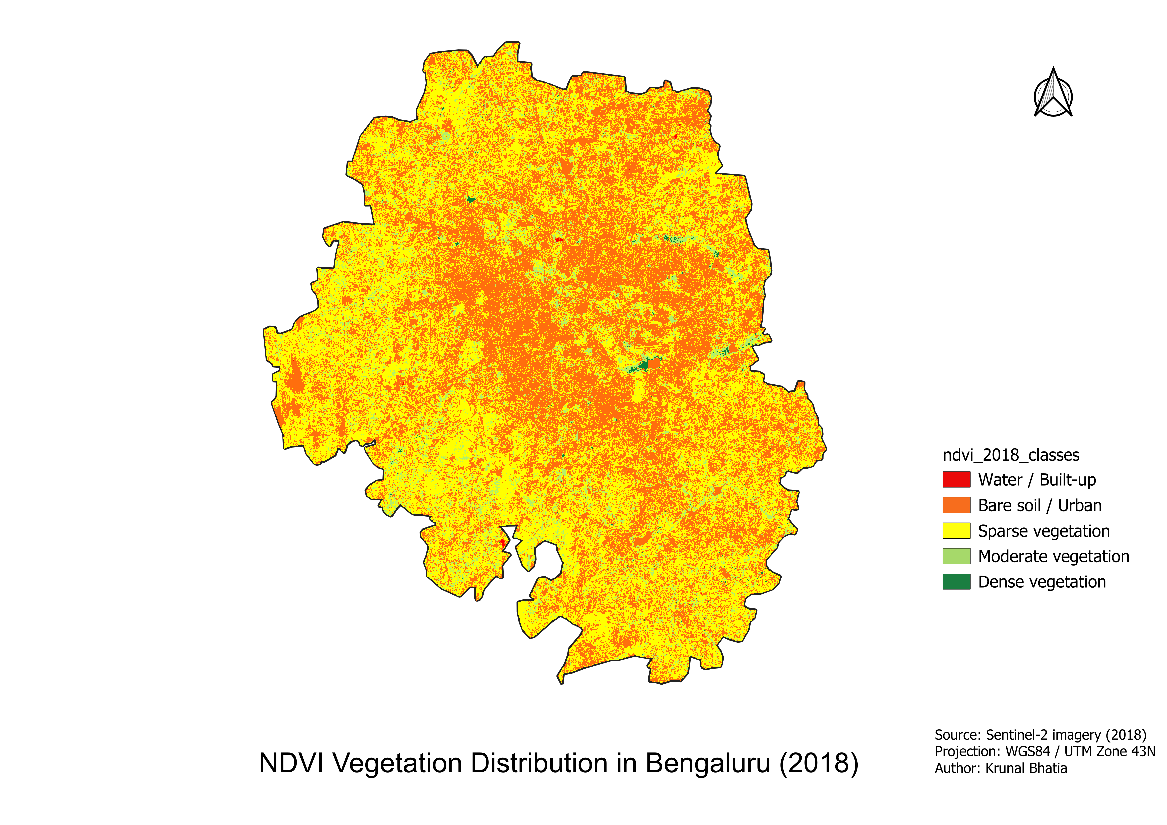
NDVI Map – 2018

Slide 12
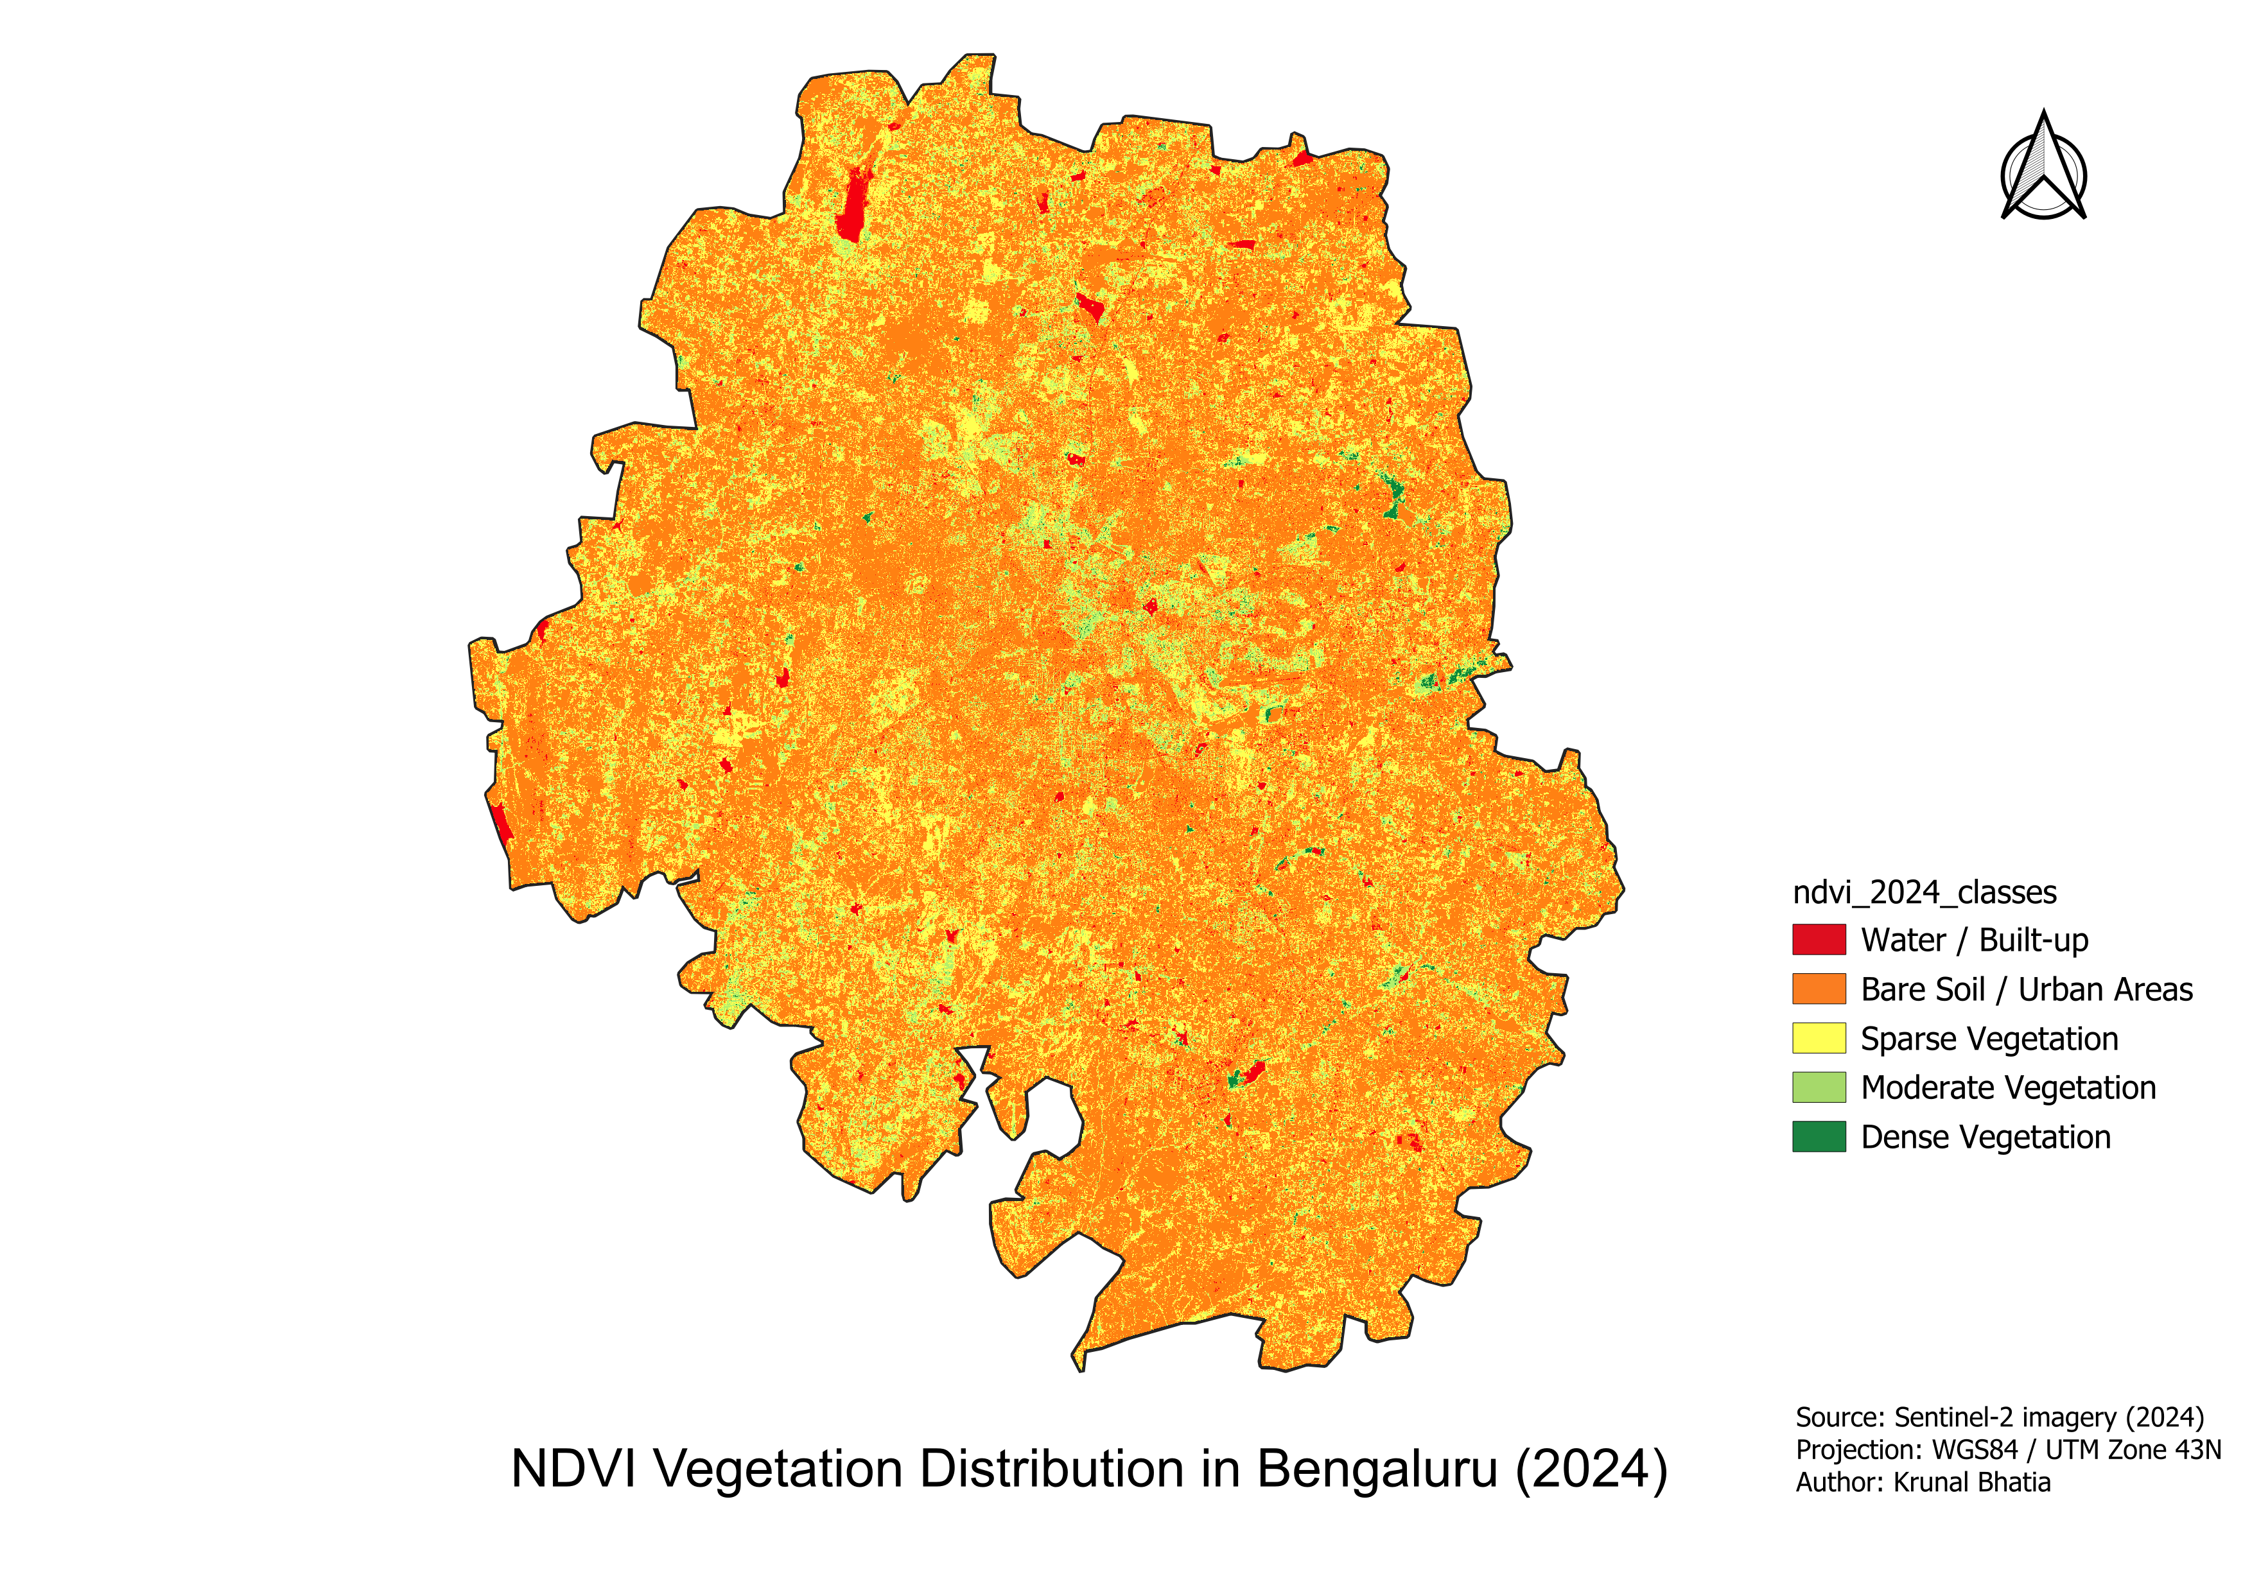
NDVI Map – 2024

Slide 13
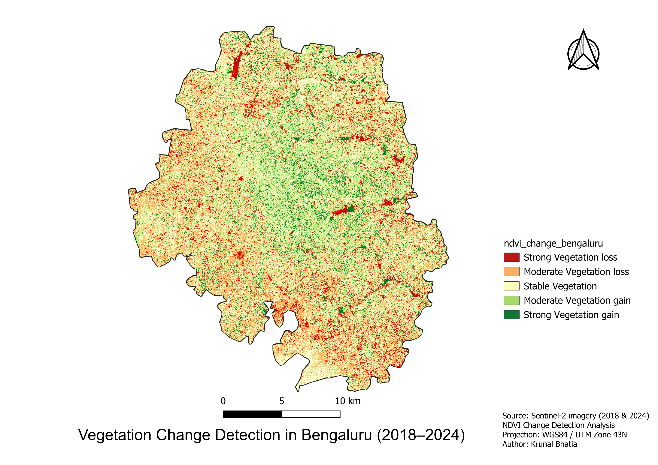
NDVI Change Detection Map

Slide 14
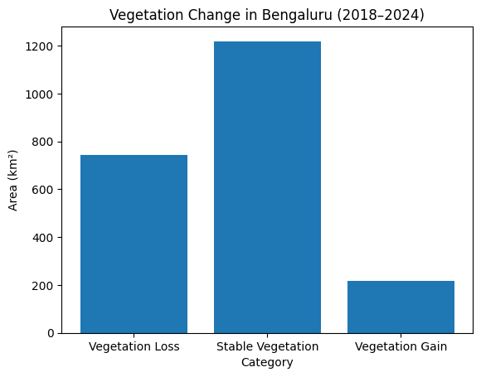
Vegetation Statistics
The area of vegetation loss (743 km²) is significantly larger than vegetation gain (219 km²), indicating a net decline in vegetation cover between 2018 and 2024.

Slide 15
Accuracy Assessment
Validation method: 100 random sample points generated across Bengaluru
Reference data obtained through visual interpretation of Sentinel‑2 imagery
Confusion matrix used to compare classified and reference values
Overall accuracy calculated from correct classifications
Overall accuracy ≈ 85%
Accuracy assessment evaluates how reliable the classification results are.

Slide 16
Confusion Matrix Table
Reference \ Classified | Bare soil | Sparse Vegetation | Moderate Vegetation | Dense Vegetation | Water/Built-up
Bare Soil | 53 | 0 | 0 | 0 | 0
Sparse Vegetation | 3 | 24 | 0 | 1 | 1
Moderate Vegetation | 1 | 1 | 6 | 0 | 0
Dense Vegetation | 1 | 0 | 0 | 1 | 1
Water/Built-up | 8 | 0 | 0 | 0 | 1
Overall Accuracy = 85/100 = 85 %

Slide 17
Key Findings
NDVI analysis reveals a clear spatial contrast between the urban center and the peripheral areas of Bengaluru. Central regions exhibit lower NDVI values, indicating dense built-up infrastructure and limited vegetation cover.
Peripheral zones show higher NDVI values, reflecting the presence of agricultural land, open spaces, and remaining green areas.
The change detection results indicate that vegetation loss (743 km²) is significantly higher than vegetation gain (219 km²) between 2018 and 2024.
This suggests a net decline in vegetation cover, likely associated with ongoing urban expansion and infrastructure development in Bengaluru.

Slide 18
Limitations
NDVI does not always distinguish built-up areas from bare soil.
Limited temporal dataset (two years).

Slide 19
Conclusion
Vegetation change analysis conducted using NDVI from Sentinel‑2 imagery
Comparison between 2018 and 2024 shows areas of vegetation loss and gain
Urban expansion contributes to vegetation loss in several zones
Some regions show stable or increased vegetation due to parks and green zones
NDVI change detection is effective for monitoring urban environmental change
These results demonstrate how satellite remote sensing can support urban environmental monitoring and sustainable planning.

Slide 20
References
Copernicus Sentinel‑2 Data
QGIS Documentation
Remote Sensing NDVI Literature

Slide 21
Thank You

