Slide 1

Jostein Garai Davidsen
Kristian Smedsrud Iversen
Jürgen Josef Markl
Petter Wang Tveit
Marcus Ringen Ulleberg

Slide 2
System parts
Jostein Garai Davidsen Flipper control
Kristian Smedsrud Iversen Machine engineering
Jürgen Josef Markl Electrical engineering
Petter Wang Tveit Web design
Marcus Ringen Ulleberg Unity simulation

Slide 3
Early consepts
Tank
Rc-car.
Table tennis serving machine.
Drone.

Slide 4
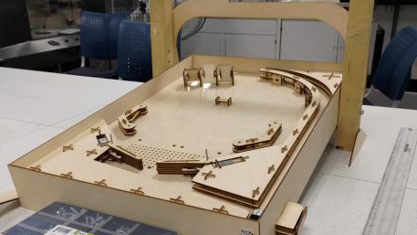
Final consept

Slide 5
Timeline of the main system
Week 2 Concept chosen.
Week 4 PCB’s designed.
Week 6 3D model finished.
Week 7 All wood-components assembled.
Week 8 Matrixes finished.
Week 9 Matrixes working.
Week 11 First complete manual test run.
Week 12 Automatic flipper control working.

Slide 6
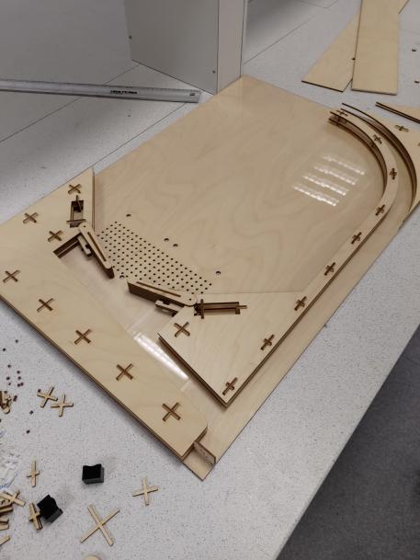
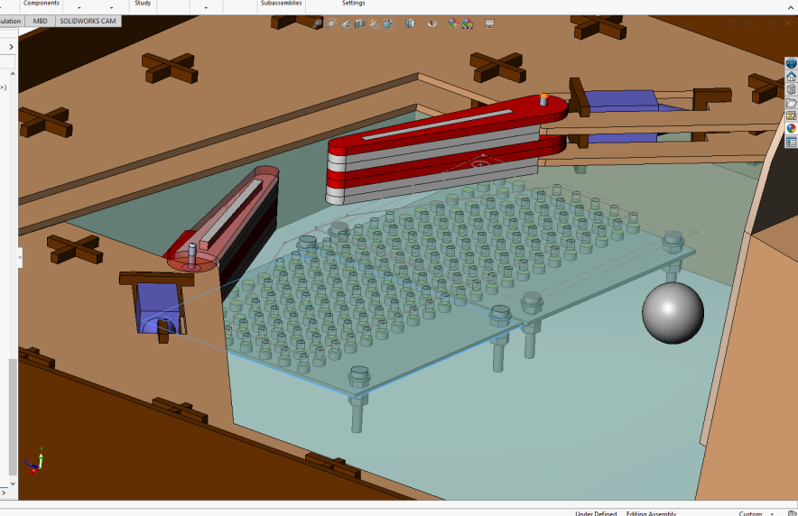
Mechanical systems

Slide 7
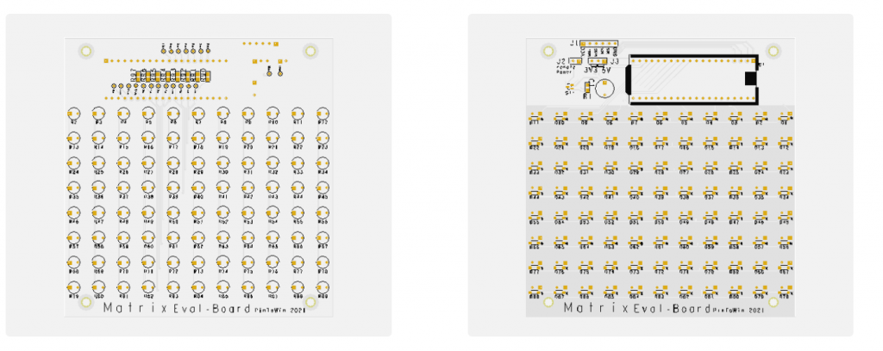
Electical systems

Slide 8
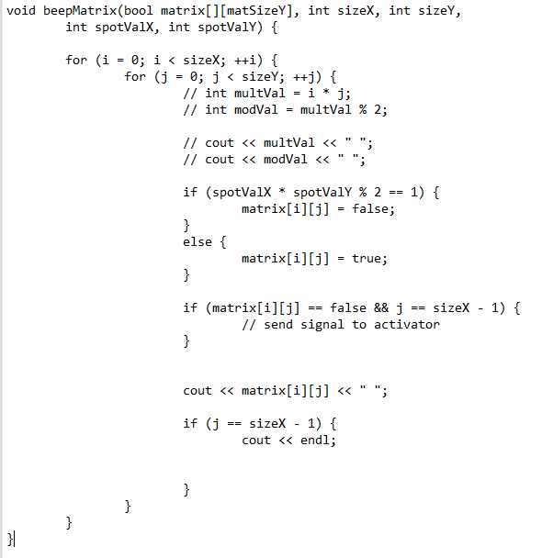
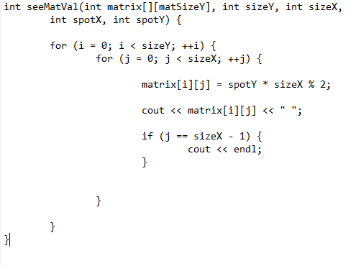
Flipper control

Slide 9
Scoring system

Slide 10
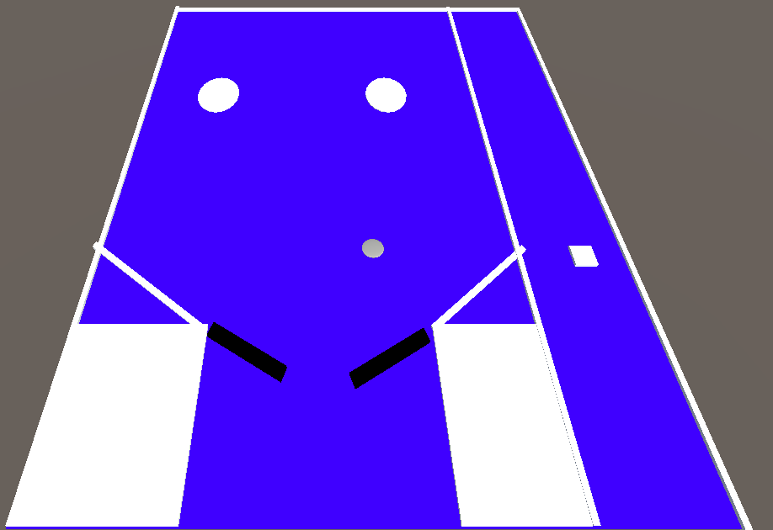
Unity simulation

Slide 11
Live demo

