Slide 1
BeaconWise
Track the Trackers

Slide 2
BeaconWise: A Wearable Beacon Detector
Are ultrasound beacons in use around you?
Study: 234 Android Play Store apps always listening!
Signals emitted by:
Stores and shopping malls
Television ads
Music recordings
Apps!

Slide 3
BeaconWise: More Beacons!
WiFi, NFC and Bluetooth beacons
Augmented Reality (AR)
GPS beacons
Areas to avoid – crime APIs etc?
Geocaching
Beacons you choose – not advertisers

Slide 4
RFduino wearables + phone …
Aware of other wireless services around you (WiFi, cell frequencies)
Biofeedback from phone sensors/peripherals
Timers and alarms
Smartwatch-style notifications

Slide 5
Android App
Microphone Input
Fast Fourier Transform
Find Patterns

Slide 6
DEMO TIME
WILL IT WORK???

Slide 7
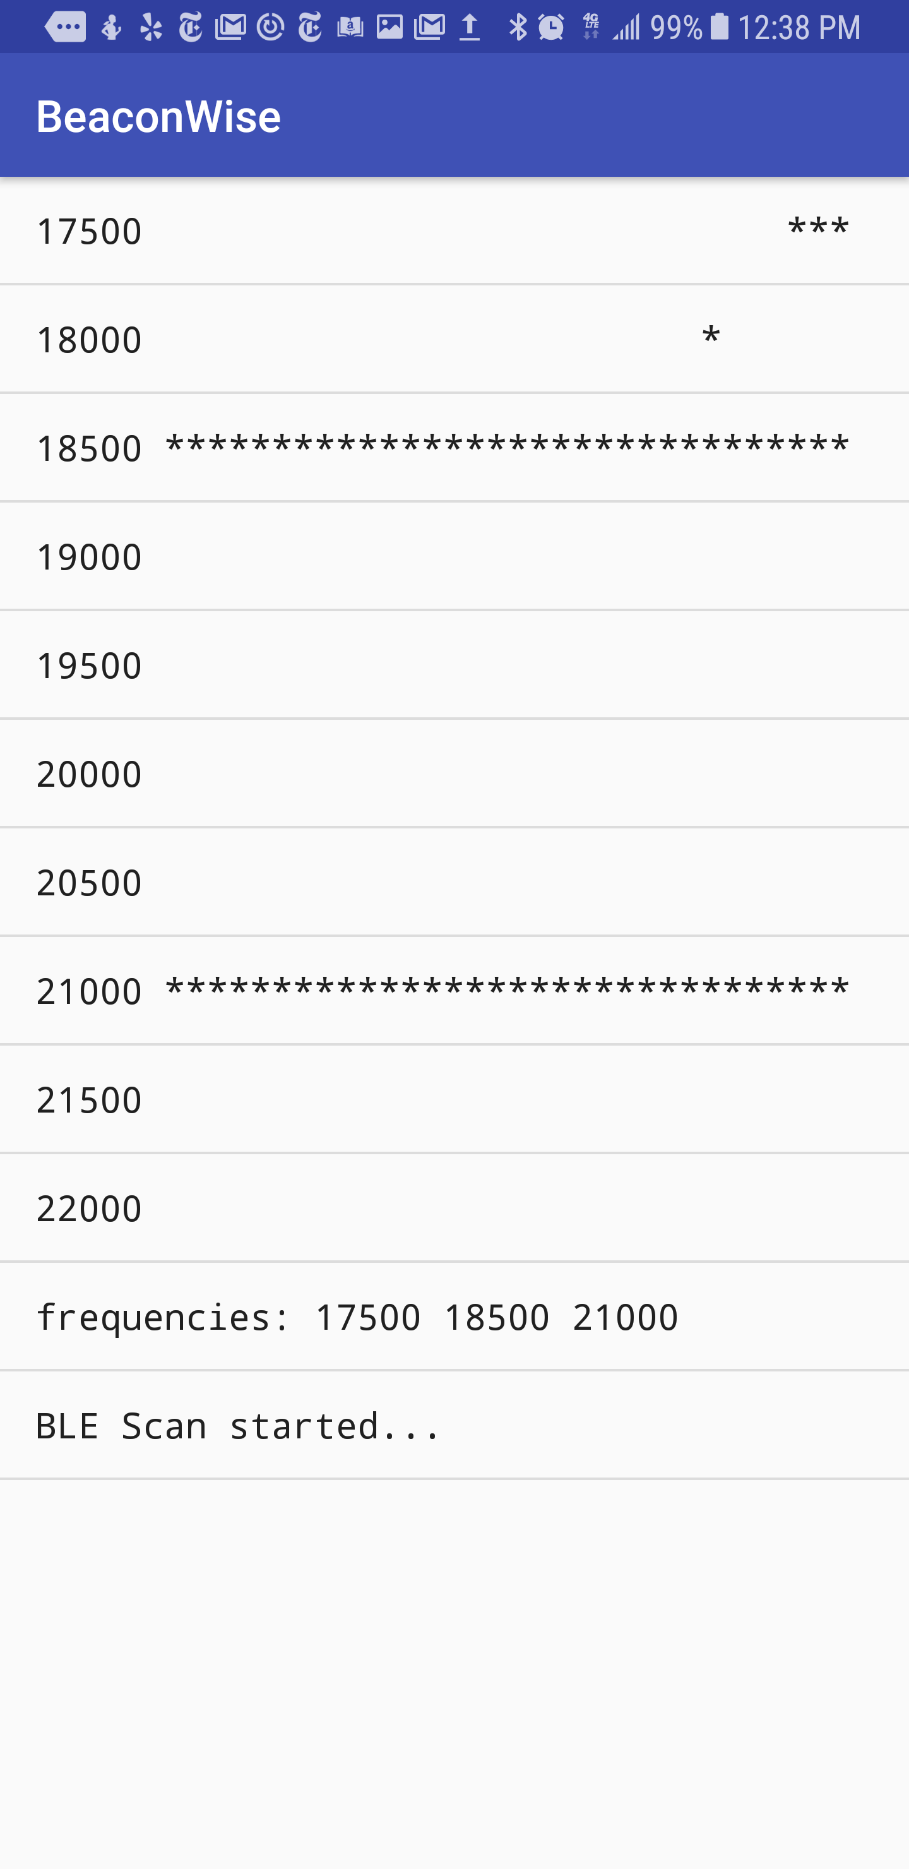
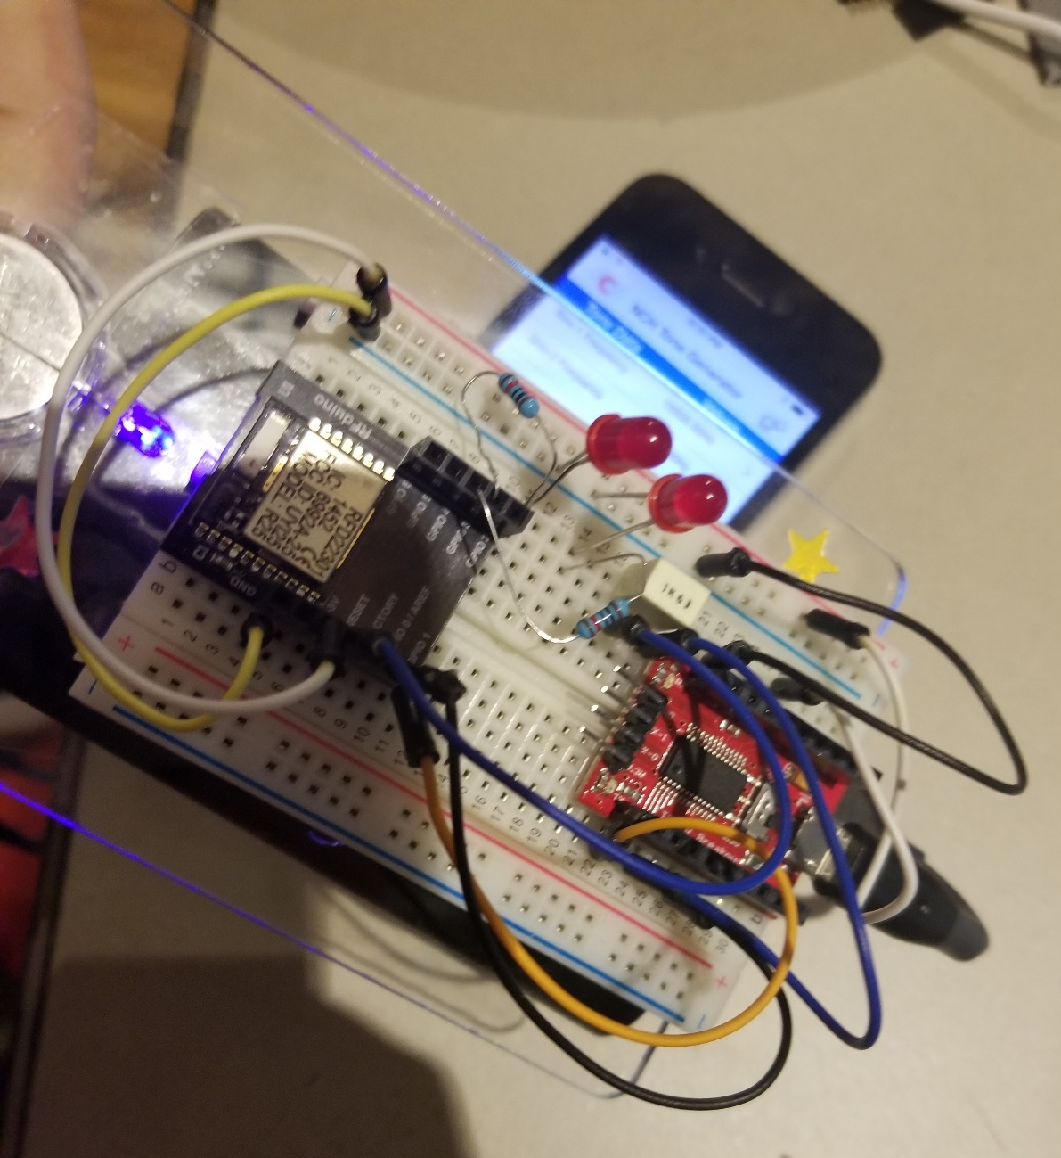

Slide 8
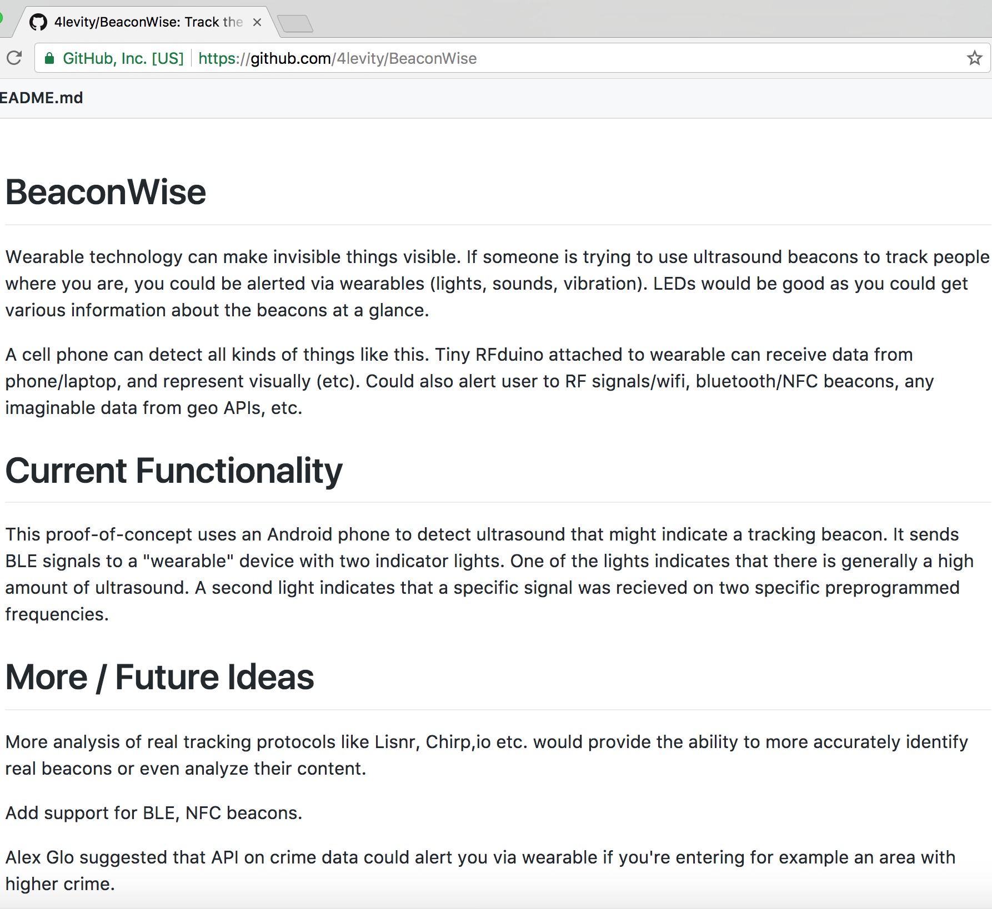
FIN
https://github.com/4levity/BeaconWise

