Slide 1
The Blindinator
By Ivan Cooper & Meena Shah
* Computer Vision with SimpleCV *
* USB Servo/Laser control *

Slide 2

SimpleCV
Free Python 2.7 based computer vision API
Based on OpenCV
Easy to work with images, cameras, display
Built in ability to detect some objects/features
Training functions

Slide 3
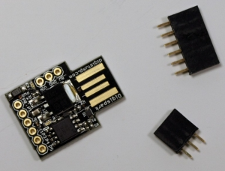
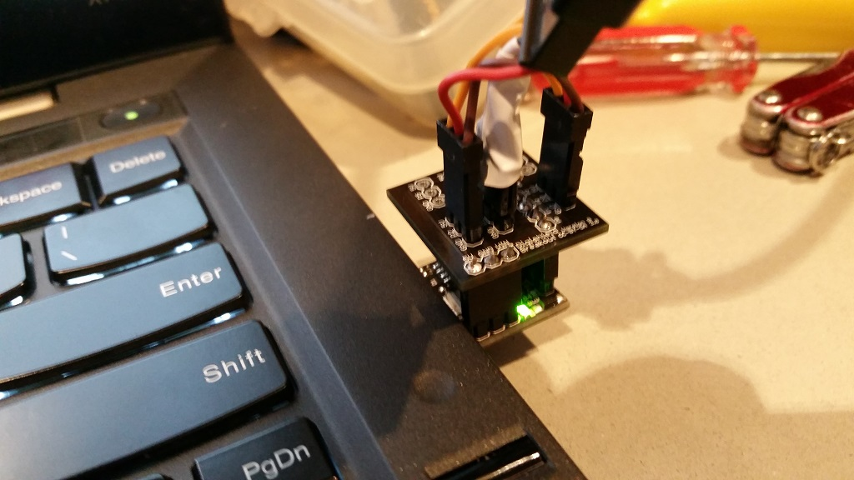
Digispark USB
Tiny USB microcontroller
Plugs directly into laptop
Compatible with some Arduino code and libraries
Software emulated USB – convenient but imperfect...

Slide 4
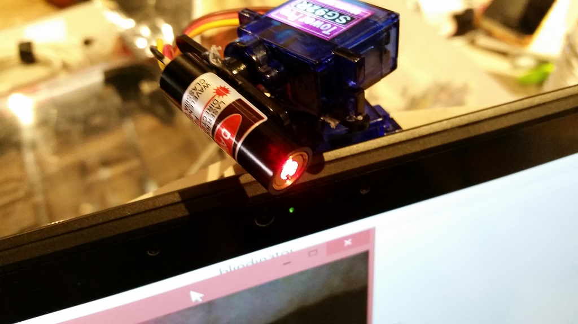
Laser and Servos (from Adafruit)
5mW Class IIIA TTL-controlled laser
Tower Pro SG92R Servos
All parts plug directly into microcontroller
Everything is powered by the USB port

Slide 5

Testing and Demonstration
Safety first!
Manual calibration
Keyboard controls
DON'T TRY THIS
AT HOME, KIDS

