Slide 1


Super Optimizers
Stéphane Donnet
Rick Wertenbroek
HPC - 2016
Focusing on LLVM

Slide 2
Summary
HPC
2016
Classic Optimizations
Super Optimizers
SMT (Satisfiability Modulo Theories)
Souper
Who are Super Optimizers for ?
Which optimizations are worth implementing ?
Demo, Conclusion and Questions

Slide 3
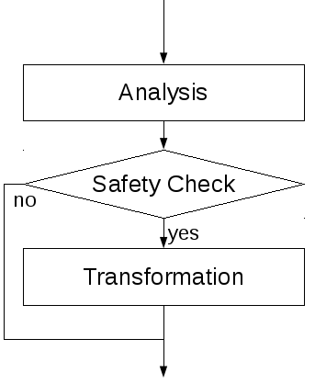
Classic Optimizations
HPC
2016
As done in GCC or LLVM with -OX

Slide 4
What are Super Optimizers
HPC
2016
Basically they are programs that search and discover optimizations.
There are two main advantages
We don’t have to code the optimizations by hand
They discover optimizations we never thought of
Modern Super Optimizers prove their optimization is correct before using it. (Real proof, not just some test cases)

Slide 5
Super Optimizers
HPC
2016
First appeared in 1987 – Massalin ’87
Brute-Force the smallest machine code for a given task, verified with just a few tests.
Super Optimizer to find new optimisations
Lots of easy optimizations found to implement in existing compilers – Sands ’11
From unreliable to reliable
Many optimizations where changed the behaviour of the code. Solution : add automated theorem prover – Denali ‘01 ‘03

Slide 6
SMT (Satisfiability Modulo Theories)
HPC
2016
Instruction are converted into predicates
Thoses predicates form a theorem
The solver tries to prove this theorem with less predicates (other predicates may be used)
This « proof » is converted into instructions again
We are sure these instructions do the same thing

Slide 7
Souper
HPC
2016
https://github.com/google/souper
Open Source Super Optimizer, works with LLVM
Works with an Intermediate Representations (bytecode, basically a simplified LLVM IR)
Transforms instructions in a DAG
Easy to (de)serialize, easy to cache
Turns instructions into predicates (SMT-LIB format)
Works with a SMT Solver to prove the optimizations
Passes through LLVM again until no more changes occur. (will remove dead code etc…)

Slide 8
Who are Super Optimizers for ?
HPC
2016
Compiler users (of course)
LLVM Devs (to implement the missing optimizations)
To find bugs in Compilers (Found bugs in GCC, LLVM and even CompCert)
Everybody benefits !

Slide 9
Which optimizations are worth implementing ?
HPC
2016
How to answer ?
Profiling of course !
1) The most used at compile time
Easy to measure but not necessarily a good indication
2) The most used at runtine in the optimized code
Gives us the really useful optimizations

Slide 10
Demo, Conclusion & Questions
HPC
2016
Basic examples LLVM –O3 vs LLVM –O3 + Souper
Things that Souper does but LLVM doesn’t
Sometimes Souper is of little use… (and why)
Questions ?

