Slide 1
aUToronto
Mobility Innovation Challenge
Prithvi, Amanda, Forest, Ailing, Nevan
Notes:
https://docs.google.com/document/d/12NJtYnlEtjYRFlIpw6SslYtBeWyIxcDOogzXbM6-SCs/edit?tab=t.0

Slide 2
Elevator Pitch
Every day, drivers across America waste $72.7 billion worth of time and fuel searching for parking.
In New York City alone, the average driver loses 107 hours per year — over 4.4 full days — just circling for a spot. That is wasted time, wasted fuel, and a problem that gets worse as cities grow denser.
We are aUToronto AutoPark — a full-stack autonomous self-parking system. We let the car drop you at the door and handle parking entirely on its own: finding, navigating, and completing the maneuver without any driver input.
We are targeting a $10 billion smart parking market growing at 17% per year, with a clear path to licensing our platform to major automotive OEMs. Today we are seeking seed investment to deploy our first pilot RSUs and sign our first parking lot partners.

Slide 3
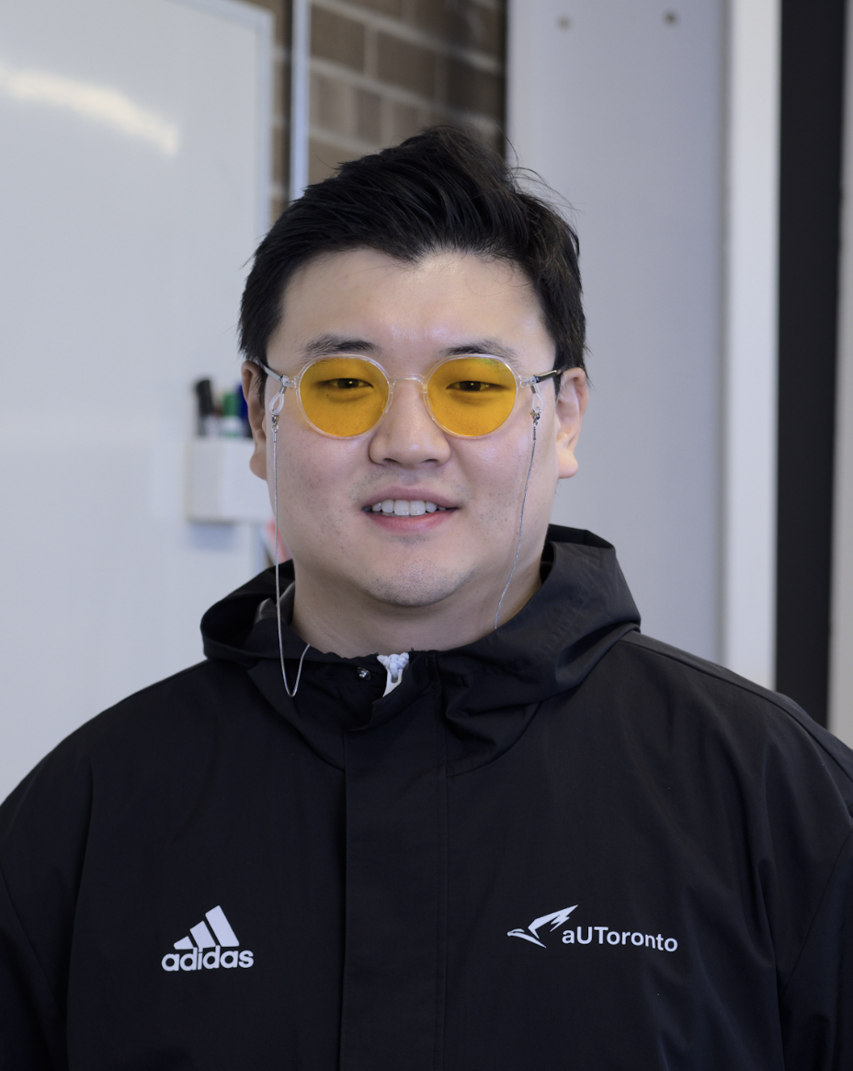
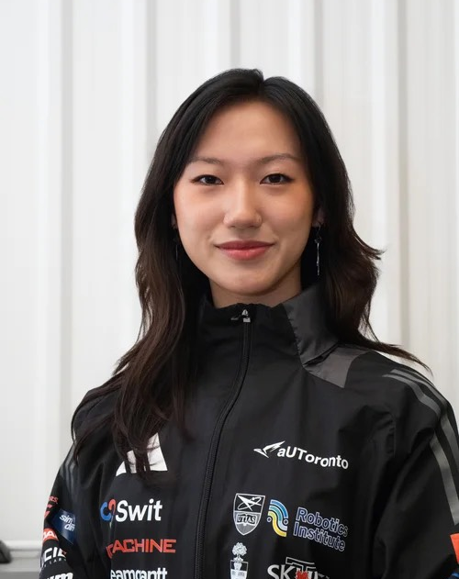


aUToronto’s Mobility Innovation Team
Chad Paik
Team Principal
Amanda Liu
Mobility Innovation Lead
Prithvi Seran
Mobility Innovation Lead
Forest Li
Member
Ailing Ji
Member
Nevan Kho
Member
Notes:
Introduce Artemis
Team structure
Or introduce when it’s mentioned
Different because of the sensor rack
Take out

Slide 4
Agenda
1.
Problem Statement
2.
Stakeholders & Impacts
3.
Benchmarking & Market Assessment
4.
Our Solution
5.
System Integration
6.
Business Plan

Slide 5
Problem Statement

Slide 6
What is the problem we are solving?
Urban parking is time-consuming, inefficient, and stressful.
Drivers spend an average of 107 hours/year (over 4.4 days) in New York City searching for parking.
This wastes time, fuel, and creates an estimated $72.7 billion in annual costs from wasted time and fuel in the US alone.

Slide 7
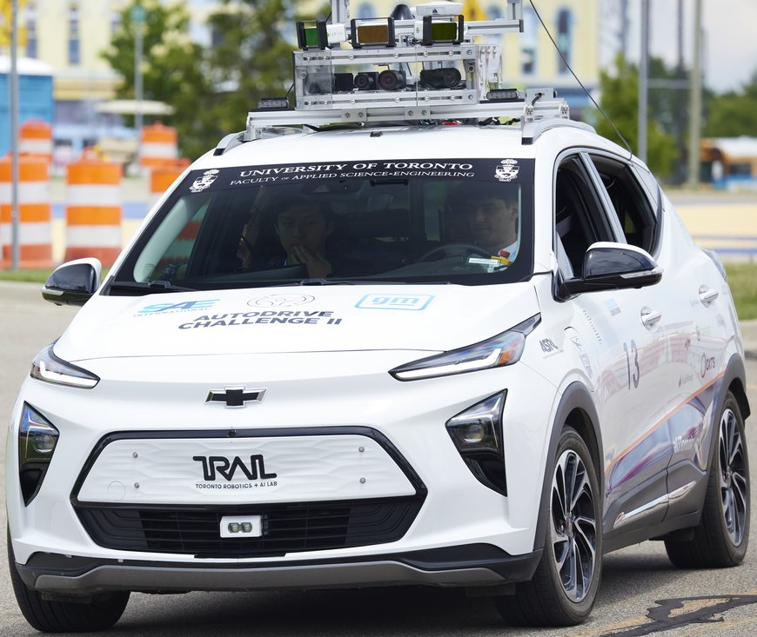
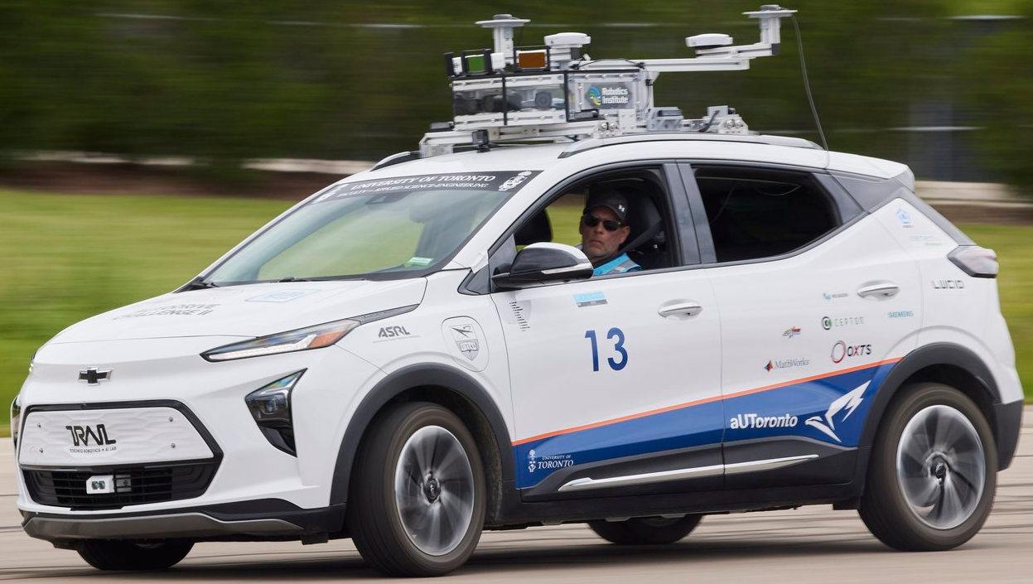
Artemis
Notes:
Introduce Artemis
Team structure
Or introduce when it’s mentioned
Different because of the sensor rack
Take out

Slide 8
Our Solution: Autopark

Slide 9
What is Autopark?
AutoPark is a smart self-parking system that enables vehicles to autonomously locate, navigate to, and park in available spots without driver input. By integrating with existing navigation infrastructure (via APIs like Google Maps) and leveraging modern sensors, AutoPark identifies safe and compatible parking locations based on real-time data. Once a space is located and reserved, the system autonomously executes the parking maneuver.

Slide 10
AutoPark is built on four integrated components:
Mobile App: Used by the driver to browse and select a parking spot.
Cloud Software Service: Manages user and vehicle data, and delivers smart parking recommendations.
OBU (On-Board Unit): Installed in the vehicle to authenticate at parking gates.
RSU (Road-Side Unit): Deployed in parking lots to communicate with the OBU and verify vehicle access.

Slide 11
Stakeholders & Impacts

Slide 12
Primary Beneficiaries
Primary Customer (B2B): Automotive OEMs (e.g., General Motors, Ford)
In a feature war, they need to differentiate their AVs.
The "AutoPark" software module is a high-value, licensable feature they can build into their new vehicles.
End-User (B2C Experience): The AV Owner / Rider
Core "customer experience" value. They get a true "curbside-to-curbside" experience — dropped off at the door, and the car vanishes, handling the parking task entirely.
Key Partners (Data & Infrastructure)
Parking Infrastructure Owners (e.g., municipalities, shopping malls, airports, commercial garages) — provide real-time data on which spots are open.
Data Aggregators (e.g., Google Maps) — their APIs are needed to find available lots, and they need the system to offer a premium "park-for-me" feature.

Slide 13
Benchmarking & Market Assessment

Slide 14
Market size and growth
In 2025, market research firms like Straits Research and Precedence Research place smart/autonomous parking value between $9.3 and $11.2 billion
Projected to grow to over $33 billion by 2033 = 17.4% CAGR (17–20% range)

Slide 15
Summary of Market Projections
Research Firm | 2024 Estimate | 2025 Estimate
Straits Research | $7.98 Billion | $9.37 Billion
Precedence Research | $9.15 Billion | $11.18 Billion
The Business Research Co. | $8.5 Billion | $10.27 Billion
IMARC Group | $5.7 Billion | (No 2025, but a lower base)

Slide 16
External tailwinds
Urbanization and Congestion: More people are moving to cities, leading to a massive increase in vehicles, traffic congestion, and parking demand.
Environmental Concerns: Reducing the time spent "cruising" for parking directly reduces fuel consumption and carbon emissions, which is a major goal for cities and corporations.
Smart City Initiatives + IoT and Connectivity: Widespread adoption of IoT sensors, 5G, and cloud computing makes it cheaper and easier to get real-time data on which spots are open.

Slide 17
System Integration

Slide 18
System Design

Slide 19
Autopark’s servers
Autopark will have a software application that runs on a server, which handles everything the user doesn't directly see or interact with.
Data management (store our user information)
Business Logic (authenticating the cars as the enter the parking gate, getting the available parking lots, our recommendation engine, etc)
APIs and communication (our infotainment system, mobile app, and the RSU will be communicating with our servers).
We call this part of the software application the “backend”

Slide 20
Backend Stack
Purchasing and managing our own personal servers will take too long, too expensive, and we will need a dedicated team for this.
Instead, we will use cloud providers.
We will be using AWS
ECS for hosting our application
RDS for database
SageMaker for hosting our recommendation model

Slide 21
Database Schemas
We will be using a relational database to store our data (data categorized in columns).
These are the tables we will be using in our database:
User (id, car_id, name, email, phone, created_at, password_hash)
payment_history (id, user_id, date, payment_token_hash, amount, currency)
parking_waiting (id, car_id, payment_hash)
real_time_parking (id, name, address, live_count, capacity)
Relationships:
payment_history.user_id → user.id
payment_history.payment_token_hash → parking_waiting.payment_hash

Slide 22
System flow (Phase 1)
The server returns the recommendations from the server cache.
Car is moving
User wants to park
The user selects a spot and pays
HTTP GET request to the server to get the recommendations
Every 100 meters, Autopark’s infotainment will poll the server via HTTP GET request,
Phase 2 starts!
The server pulls parking lot data from parking data aggregator APIs and from the realtime_parking table in our database
The data is prepared and fed to our recommendation model
The recommendations are stored in the server cache.
{
“car_id”: 68,
{
“1”: “Lot X”,
“2”: “Lot Y”,
…
“N”: “Lot Z”,
},
“created_at”: “<some date time>”
}

Slide 23
System flow (Phase 2)
User pays for the parking lot on the phone. (Apply pay, manual debit/credit card number, etc)
HTTP Post request is made to Autopark’s backend
User selects a parking lot
A unique ID is created for the parking_waiting table, and stored in the database for the parking gate to recognize.
The UHF writer receives the id, and writes the id to the UHF RFID.
(The OBU)
Sends the ID through the CAN bus
Cellular module receives the parking_waiting_id
Backend sends HTTP SSE to the car’s cellular module
parking_waiting
id | car_id | payment_hash
1 | 68 | f5g6h7j8

Slide 24
System flow (Phase 3)
The car has started moving to the parking lot.
Tag backscatters the parking_waiting_id
The car is in 8m range of the parking lot’s RSU
The RSU picks up the broadcasted ID
Autopark (the infotainment app) is still running, polling the location of the car
UHF RFID reader at gate scans the RFID tag.
The parking door opens, and the car enters the lot!
HTTP GET request to our backend to confirm the car has requested a spot
Sends back the status of the check
parking_waiting
id | car_id | payment_hash
1 | 68 | f5g6h7j8
Backend checks if the broadcasted parking_waiting ID matches with the car’s parking_waiting ID in the database.
We compare the payment_hash for the specific car_id and the payment_ash that was broadcasted

Slide 25
System flow (Phase 4)
The car has entered the parking lot, and needs to find a lot. Note that we will most likely find a spot, as this lot was recommended to the user due to it being free.
The realtime_parking table is updates with the parked lot
The payment is fully completed
The car’s entry in parking_waiting is removed
HTTP POST request is made to the backend
The car finds a spot
The car parks itself
We are done!
The car circles around the. Lot to find a spot
HTTP POST request made to the backend to send notification
User does not choose a spot
An SMS notification is sent to the user, which outlines them to the app where the new recommendations are shown.
The app chooses top recommendation
Phase 3 starts again!
The car does not find a spot
The car leaves the lot
User chooses a spot
Phase 3 starts again!

Slide 26
Internal Architecture

Slide 27
App Development
The app will be developed in-house
Getting the parking recommendations are Relatively straight forward, as it just fetching the backend cache.
We will need to work with the developers of the OEM to create the APIs for sending the car to the parking lot and summoning the car.
This would start by signing an NDA and technical access agreement, granting us access to their internal SDK documentation
After developing, we would test our software in their simulation environment (Hardware-in-the-loop)

Slide 28
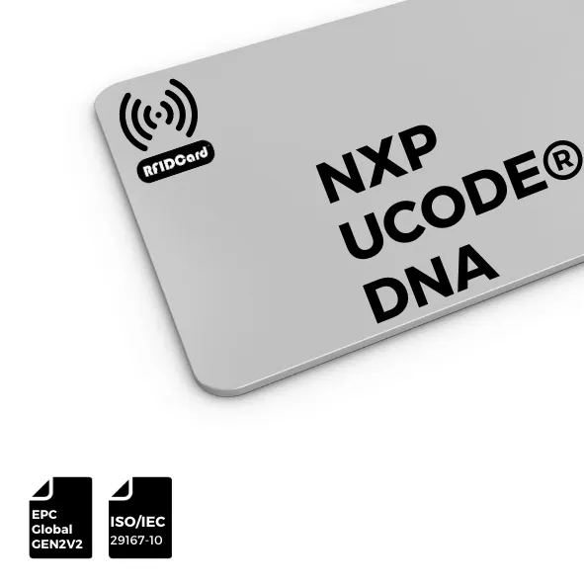
The OBU
The OBU will be comprised of a UHF Writer module, and a UHF tag.
The OBU will be connected to the CAN bus of the car, and placed right below the dashboard.
Alongside the OBU, we will need to add custom firmware to the Telematics Control Unit (TCU). This is the module that manages the CAN bus communication. This will be the main logic that will control the states of Autopark.
Frequency Band: UHF 860~960 MHz

Slide 29
The OBU
UHF RFID tag
UCODE DNA RAIN RFID
UHF Writer module (the M6E Nano is our strongest one)
M6E Nano
Impinj-based modules
M5Stack JRD-4035
Chainway/Zebra OEM modules
We would also need a CAN bus bridge to convert the CAN frames and format it into a write command to send to the RFID module.
We can just use a STM32 microcontroller

Slide 30
Phase 1 Firmware
Polling while driving
Read GPS position from the car's GPS module via CAN
Every 100 meters, trigger an HTTP GET to your backend to fetch parking recommendations
Pass the returned recommendations up to the CarPlay app via the TCU's app communication layer

Slide 31
Phase 2 Firmware
After payment
Maintain a persistent connection to your backend to receive the SSE (server-sent event)
On receiving the SSE, extract the parking_waiting_id
Send a CAN message to the UHF writer module instructing it to write that ID to the tag
Store the parking_waiting_id locally on the TCU in case it's needed again

Slide 32
Phase 3 Firmware
Approaching the gate
Continuously monitor GPS position
Detect when the car enters the ~8–10m geofence radius around a known gate location
At that point the UHF reader at the gate handles everything — the firmware doesn't need to do anything active here, the tag is already written and passive

Slide 33
Phase 4 Firmware
Inside the lot
Monitor GPS, speed, gear position, and engine state via CAN
On successful park, send HTTP POST to backend to finalize the session
Clear the parking_waiting_id from local storage and send a CAN message to the UHF writer to wipe the tag

Slide 34
The RSU
We will need to interface with the main processor of the parking gate, the component that is responsible for opening and closing the gate.
Every commercial parking gate (FAAC, CAME, SKIDATA, etc) has a dry contact input, two terminals on the gate’s control board that are specifically designed for external systems to trigger.
Our RSU would be connected to these terminals

Slide 35
The RSU
The RSU will be comprised of 4 main parts
Application processor (RSU logic)
NXP I.MX8M Mini
Internet module (to make HTTP requests)
Quectel AG55xQ Internet Module
Relay module (to communicate with the processor of the braking gate)
Sequent Microsystems Industrial I/O HAT
UHF RFID Reader
STid SPECTRE UHF Reader

Slide 36
OEM firmware integration
This Firmware logic will be packaged as an Adaptive AUTOSAR application, the industry standard for 3rd party software (Autopark) to conform to the software of OEMs.
This is just a standard that outlines how 3rd party software should be packaged for seamless integration into their system (how the software should be structured, should communicate, and how they are integrated).

Slide 37
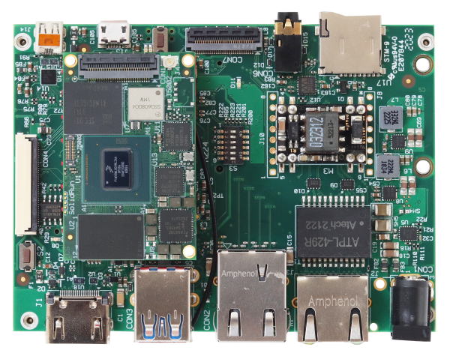
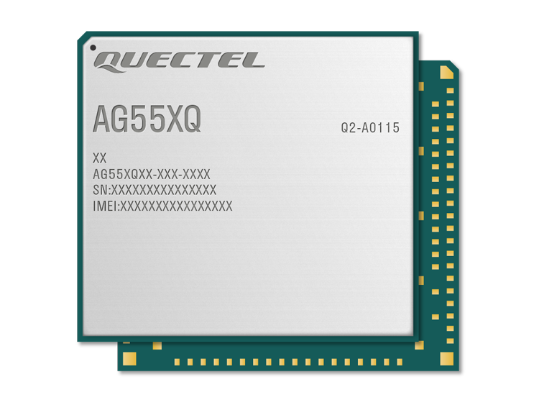
The RSU
2. Main processor (receives ID from antenna, sends ID to backend)
a. Internet message module (network connection + backend)
b. Small application processor (runs software stacks)
c. Microcontroller unit (receives commands + relay)
ISolidRun HummingBoard i.MX8M Plus
Quectel AG55xQ Series
???

Slide 38
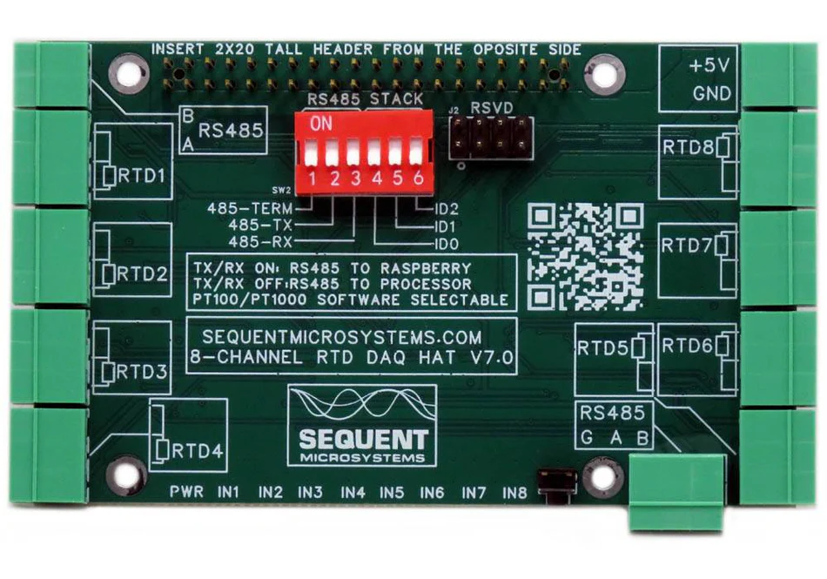
The RSU
3. Relay Module (closes gate's manual-open circuit)
Sequent Microsystems Industrial I/O HAT

Slide 39
Recommendation Model

Slide 40
The recommendation model
The SOTA recommendation models are:
Two-Tower, DLRM, HSTU, DCN-V2
But these models are suited for Neflix, Spotify, TikTok style of data
For parking data, we have objective constraints, small candidate set, no long term user preference learning, and real-time data is more important than history.

Slide 41
The LGMRanker model
We need a ranker model, not a recommendation model. This is why we will be using a ranker model.
We are solving "sort these 50 nearby spots by utility", not "which of 10M items does this user want?”
LGMRanker has the lowest latency, the least compute needed (runs on a CPU), and only needs a ml.c5.xlarge Sagemaker instance.

Slide 42
Integration

Slide 43
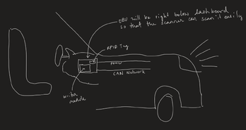
OBU Integration with the car

Slide 44
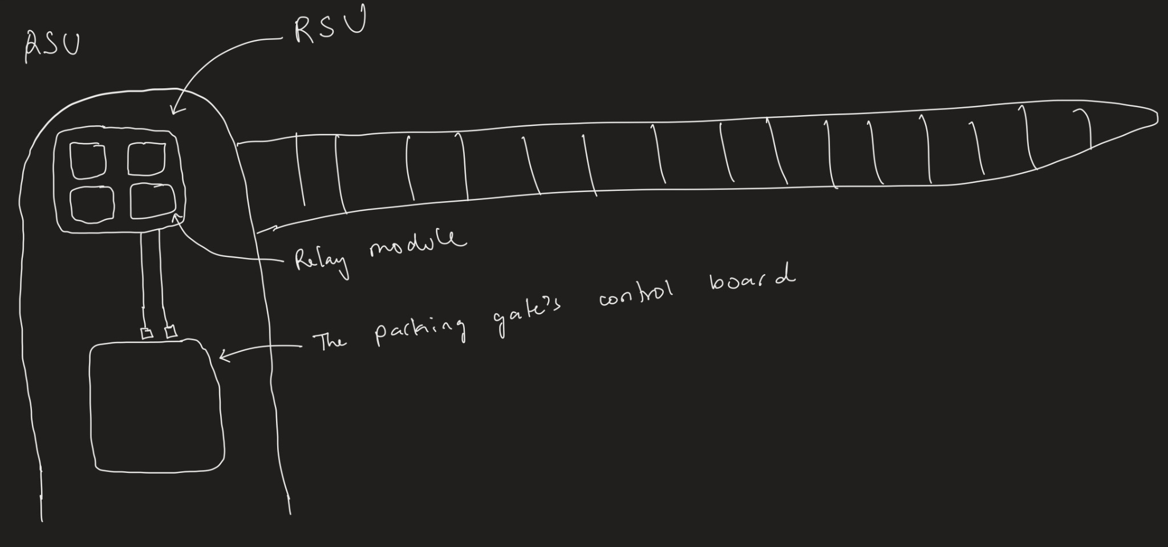
RSU integration with parking gate
The RSU will be installed in the parking gate controller gate

Slide 45
Expenses

Slide 46
OBU BOM
Component | Part | Supplier | Est. Unit Cost
UHF RFID Tag | NXP UCODE DNA RAIN RFID inlay | Smartrac / Avery Dennison RBIS | ~$1–3
UHF Reader/Writer Module | SparkFun M6E Nano | SparkFun / DigiKey | ~$50–70
CAN Bus Bridge | STM32G431 | DigiKey / Mouser | ~$3–5
Estimated OBU unit cost: ~$55–78 at prototype quantities

Slide 47
RSU BOM
Component | Part | Supplier | Est. Unit Cost
Application Processor | NXP I.MX8M Mini | DigiKey / Mouser / Arrow | ~$20–35
Internet Module | Quectel AG55xQ | Quectel directly / DigiKey | ~$40–60
Relay Module | Sequent Microsystems Industrial I/O HAT | Sequent Microsystems website | ~$50–70
UHF RFID Reader | STid SPECTRE UHF Reader | STid directly / authorized resellers | ~$300–500
Estimated RSU unit cost: ~$410–665 at prototype quantities

Slide 48
App Development
The app will be engineered by us (the founders). So there will be no extra cost or in development.
We will need to pay for the developer accounts for the Apple and Android platforms
~$150

Slide 49
Cloud service cost
Service | What it does | 1–10 gates | 10–50 gates | 50–200 gates | 200+ gates
ECS | Hosts the application | ~$30–50 | ~$80–150 | ~$200–400 | ~$500–1,200
RDS | Database (PostgreSQL) | ~$50–80 | ~$100–180 | ~$250–500 | ~$600–1,500
SageMaker | Recommendation model inference | ~$60–100 | ~$100–200 | ~$300–600 | ~$800–2,000
Data transfer | RSU ↔ cloud traffic | ~$5–10 | ~$15–30 | ~$40–100 | ~$150–400
Total/month |  | ~$145–240 | ~$295–560 | ~$790–1,600 | ~$2,050–5,100

Slide 50
Hardware sourcing
Short term: We will be outsourcing both OBU and RSU to validate the business model before investing in hardware engineering. Getting to market fast matters more than unit economics right now.
Long term: We will bring the OBU in-house as its the component that scales with every vehicle, so owning the design has the biggest cost impact. Keep the RSU outsourced longer since it's a one-time install per parking lot.

Slide 51
Business Plan

Slide 52
Go-to-Market: Two-Phase Strategy
Phase 1 (2026–2028): Bridge Revenue via Smart Parking App — We launch as a SpotHero-style parking aggregator. Users pay through our app; we collect a 15–30% dynamic commission per transaction. This generates real revenue from day one while we build the brand, sign parking lot partnerships, and validate the OBU/RSU hardware.
Phase 2 (2028+): Full Autonomous Parking Platform — As AV adoption grows, we transition to a full L4/L5 integration play. Our RSUs enable true hands-free autonomous parking. Revenue streams expand to include OEM SDK licensing deals, per-vehicle subscription fees, and premium lot access tiers.
Monetization: 15–30% commission on every parking transaction; per-gate SaaS fee for lot operators ($50/gate/month); OEM licensing fees for SDK access.
Competitive Moat: Our RSU hardware creates a physical installation barrier — once a lot is equipped, switching costs are high. Combined with OEM integrations, this locks in both supply (lots) and demand (vehicles) simultaneously.

Slide 53
Revenue Model & Unit Economics
RSU Hardware Cost: ~$401 per gate (NXP processor + Quectel LTE module + relay + UHF reader). In Phase 1, subsidised 100% to drive lot adoption.
Revenue per Transaction: At a $15 average ticket, 35% gross commission = $5.25 gross. After Stripe payment fees (~$0.78), net revenue per transaction = ~$4.47.
Hardware Payback Period: At our base case of 15 transactions/gate/day → $67/gate/day net → RSU pays back in approximately 6 days.
5-Year LTV per Gate: ~$81,600 in net revenue per RSU gate over 5 years. LTV:CAC ratio ≈ 40:1 at base case.
Scale Economics: Cloud infrastructure scales sub-linearly — AWS costs grow from ~$190/month at 10 gates to ~$1,300/month at 200 gates while revenue scales linearly, so margins improve with every new gate deployed.

Slide 54
Financial Projections: J-Curve & NPV
The J-Curve: Years 1–2 are cash-flow negative as we subsidise RSU hardware and build the lot network. Revenue ramps sharply in Year 3 as the installed base grows and per-gate economics compound. Cash flow turns positive by Year 3 in the base case.
Three Scenarios: Bear (8 txns/day/gate): ~$26/gate/day net. Base (15 txns/day/gate): ~$67/gate/day net. Bull (25 txns/day/gate): ~$112/gate/day net.
NPV at 25% WACC (5 Years): Bear case NPV ≈ slightly negative at aggressive growth assumptions; Base case NPV strongly positive; Bull case NPV reflects significant value creation. Reflects genuine technology and execution risk priced at a 25% discount rate appropriate for early-stage hardware-software ventures.
Revenue Milestone: 200 gates × 15 txns/day × $4.47 net × 365 days = ~$490K annual net revenue at steady state. At 500 gates (target Year 3 base case): ~$1.2M annual net revenue before OEM licensing.
Funding Ask: Seed capital will fund pilot hardware (50 RSU gates at ~$20K), cloud infrastructure, and 12 months of runway to reach first commercial parking lot partnership and OEM pilot agreement.

Slide 55
Exit Strategy: OEM Acquisition
The Thesis: Autonomous vehicle OEMs need a differentiated self-parking feature to win the AV feature war. Rather than build this in-house, the most efficient path is acquisition. AutoPark becomes an embedded software module licensed — or acquired — by a major OEM like General Motors, Ford, or Stellantis.
Why GM: GM's Cruise AV division is actively building the full AV software stack. AutoPark fills a gap in their curbside-to-curbside experience, and our RSU network creates a defensible data and infrastructure moat that complements Cruise's on-vehicle autonomy.
Valuation Method 1 — Revenue Multiple: At $1.2M ARR (Year 3 base) × 15x SaaS multiple (comparable to smart mobility peers) = ~$18M valuation.
Valuation Method 2 — DCF / NPV: 5-year discounted cash flow at 25% WACC with terminal value reflects a fair enterprise value consistent with the revenue multiple approach.
Valuation Method 3 — Precedent Transactions: Precedent AV feature acquisitions (e.g., GM/Cruise at ~$1B, Ford/Argo, Bosch/various parking tech) imply a 5–15x revenue acquisition premium for proven AV parking platforms. Our target exit range at scale: $50M–$200M depending on strategic fit.

Slide 56
Conclusion
AutoPark is not just a parking feature — it is the missing link in the autonomous vehicle experience.
We have proven the technical architecture: working OBU/RSU stack, a cloud backend scaling to thousands of gates, and an app that makes self-parking invisible.
The economics work: $401 RSU gate payback in 6 days, 40:1 LTV:CAC, and a clear path to $1M+ ARR by Year 3.
The market is ready: a $10B+ smart parking market growing at 17% annually — and no incumbent with a complete end-to-end solution.
Help us deploy our first 50 pilot RSU gates, sign our first commercial lot, and begin the OEM pilot that puts AutoPark on every autonomous vehicle on the road.
The future of parking is autonomous. Help us build it.

Slide 57
Templates:

Slide 58
Reflection
Biggest lessons learned
Things we would do differently
Challenges and pivots that shaped our team
Simulation’s place within aUToronto’s team structure
System Showcase
Scenario Variation and Testing
Low Traction Dynamics
Reflection

Slide 59
aUToBridge R2Y4 - Simulation Framework
Controls
Planning
Localization
Vehicle Software
Vehicle Dynamics (aUToBridge)
Simulink
RoadRunner
Visualization
Notes:
Add inputs and outputs - block diagram
Too much noise
Simplify stuff
Block diagram and show one by one
I/O
RR interface
Show data flow

Slide 60
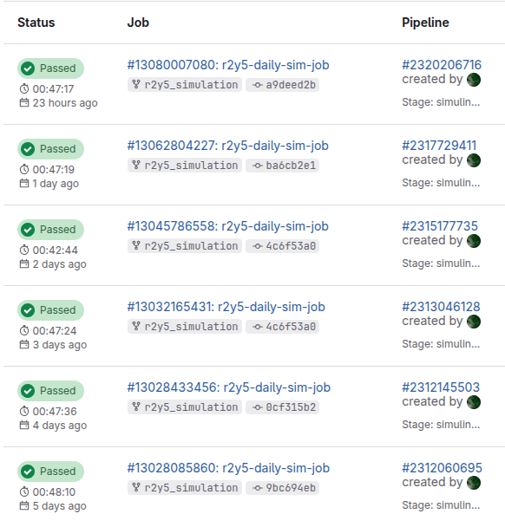



Automation for Executing Simulation
Sanity test triggered by push
or merge requests
Daily scheduled builds
Artifacts for result analysis
System Showcase
Scenario Variation and Testing
Low Traction Dynamics
Reflection

Slide 61
Innovation - AI-Assisted Triage
Locally-built large language model (LLM)
Store semantic representation of codebase for context-aware analysis
Create a secure bridge to expose local LLM to web-based CI/CD dashboard
Obtain commit information (code differences, simulation results)
AI-assisted triage
System Showcase
Scenario Variation and Testing
Low Traction Dynamics
Reflection

Slide 62
Major Feature Testing
Perception
Planning & Controls
Localization
Overview
Overview
Overview
Scenario Variation
Scenario Variation
Scenario Variation
Metrics
Metrics
Metrics
System Showcase
Scenario Variation and Testing
Low Traction Dynamics
Reflection

Slide 63
Simulation Pipeline
2DOD
Vehicle Software
Tracking
3DOD
CARLA
Visualization
Weather and Obstacle Variation, Sensor Status
System Showcase
Scenario Variation and Testing
Low Traction Dynamics
Reflection

Slide 64
Perception – Scenario Variations: Lidar Fog Modelling
Disturbance point with soft intensity i_soft
i_soft > i_hard
Calculate i_soft and i_hard of a hypothetical “soft target” and “hard target” along ray direction
Clear sky LiDAR points
Original point with hard intensity i_hard
https://arxiv.org/pdf/2108.05249
CI/CD
Scenario Variation and Testing
Low Traction Dynamics
Reflection
Notes:
s

Slide 65

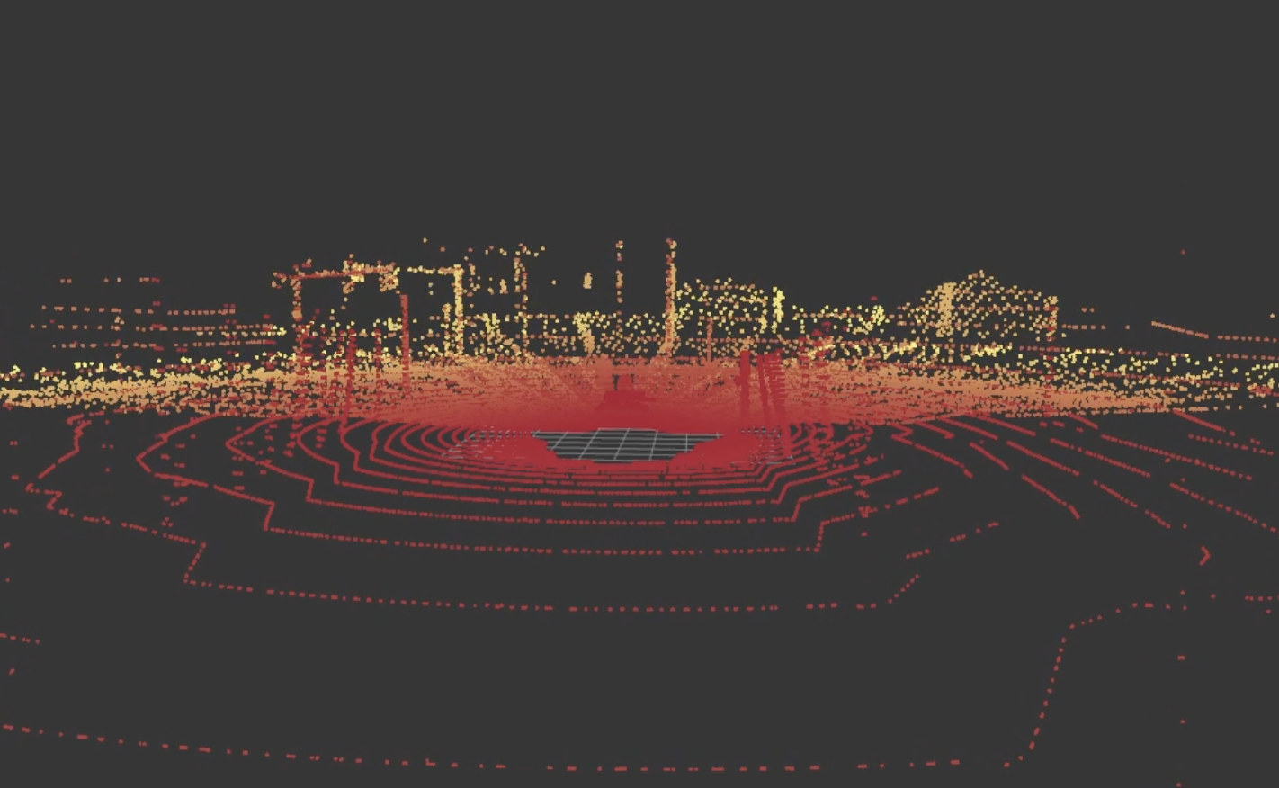
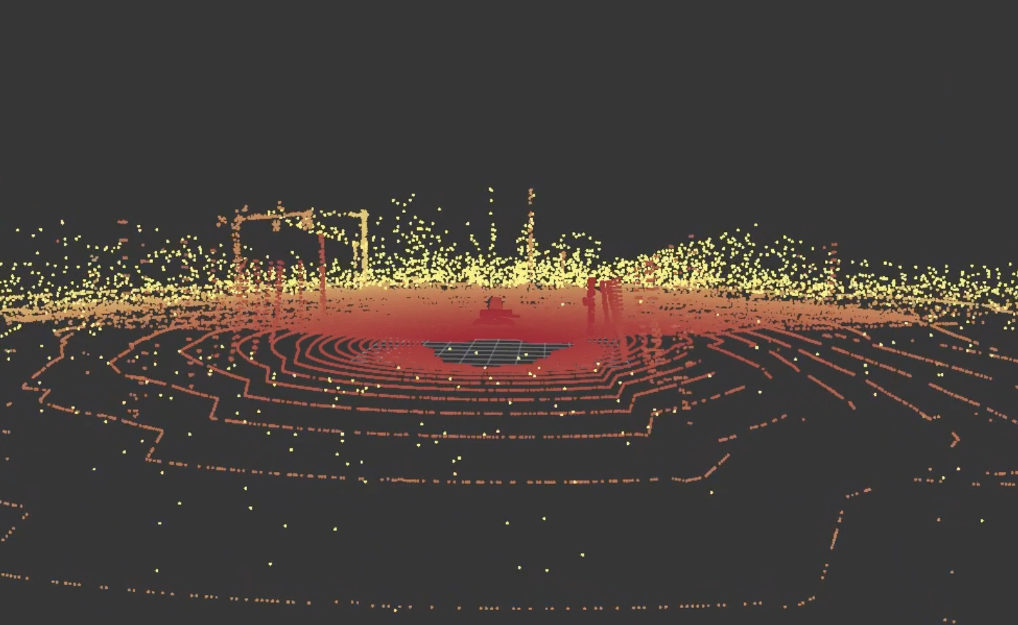
Scenario Variation: LiDAR Fog Modelling
Loss of detail
High intensity
Low intensity
Clear sky point cloud
Foggy point cloud
System Showcase
Scenario Variation and Testing
Low Traction Dynamics
Reflection

Slide 66
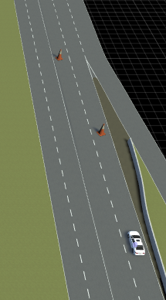
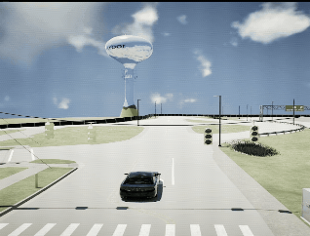
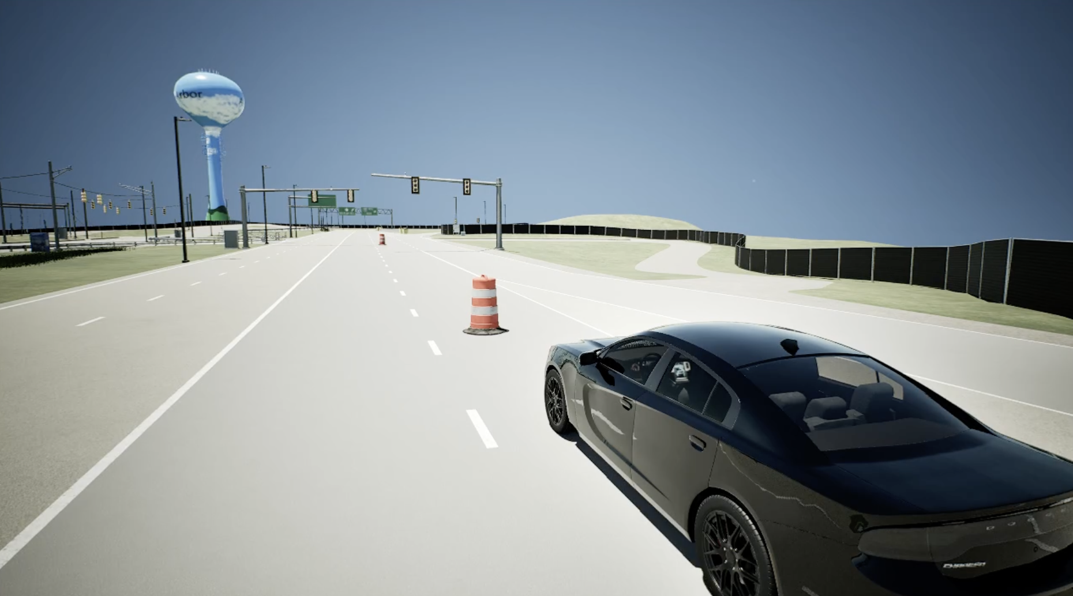
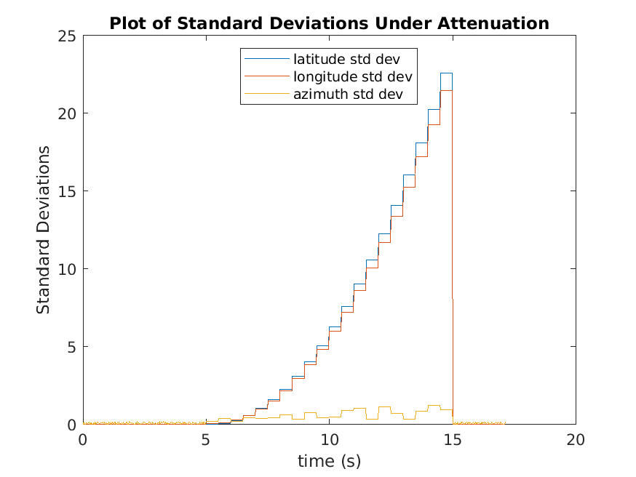
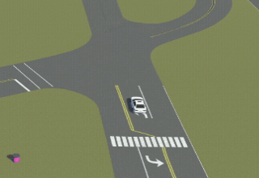
Metrics-Informed Development
Perception
Planning & Control
Localization
Integration
System Showcase
Scenario Variation and Testing
Low Traction Dynamics
Reflection

Slide 67
Innovation: Custom Variable-Friction Maps
Original
RoadRunner
Create friction material with constant friction value and assign to polygon
MATLAB
Draw polygons
Export as .tif
Import as Lookup Table
MATLAB
Draw polygons and assign friction
Save as Lookup Table
Innovation
System Showcase
Scenario Variation and Testing
Low Traction Dynamics
Reflection

Slide 68
Q&A
Thank you for listening
Special Thanks To:
Cecilia Li – Localization
Aiden Wang – Tracking
Satvick Acharya – DLA
Adam Roberge and Tae Kim – 2DOD
Abdus Shaikh and Saaim Raad – 3DOD
Robert Ren and Morgan Tran – Student Advisors

