Slide 1

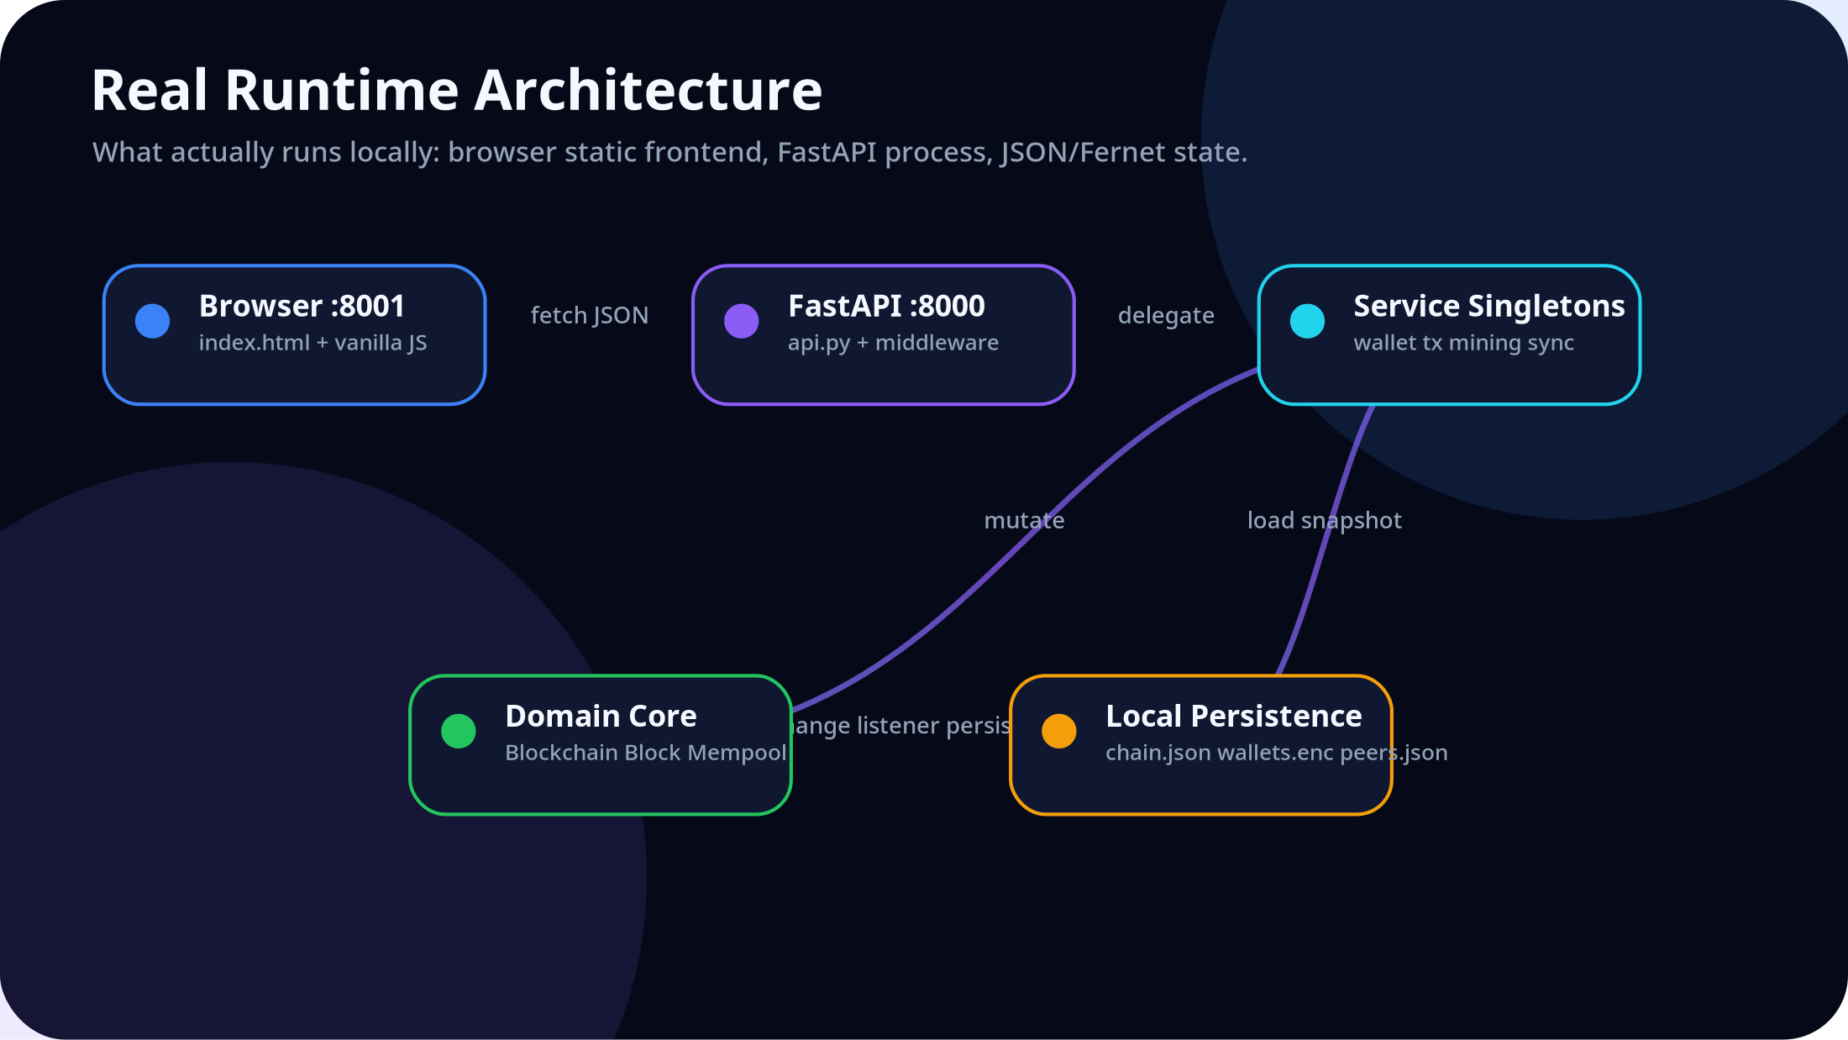
CHAIN EXPLORER
A source-grounded blockchain systems presentation
Educational account-model PoW simulator · FastAPI · Vanilla JS · SHA-256 · ECDSA · JSON/Fernet persistence
July 02, 2026

Slide 2
PROBLEM
Blockchain education hides the implementation behind abstractions
Learners see terms
The code path is invisible
Production chains are too large
Hash, nonce, mempool, signature, fork and consensus are usually introduced as vocabulary before students see state changes.
A UI click often hides request validation, signing, balance checks, mining, persistence and chart aggregation.
Bitcoin/Ethereum are accurate, but too complex for first-principles architecture review in one defense.
This project solves the observability problem: it makes the ledger, API, validation rules and security failures inspectable in one local system.

Slide 3
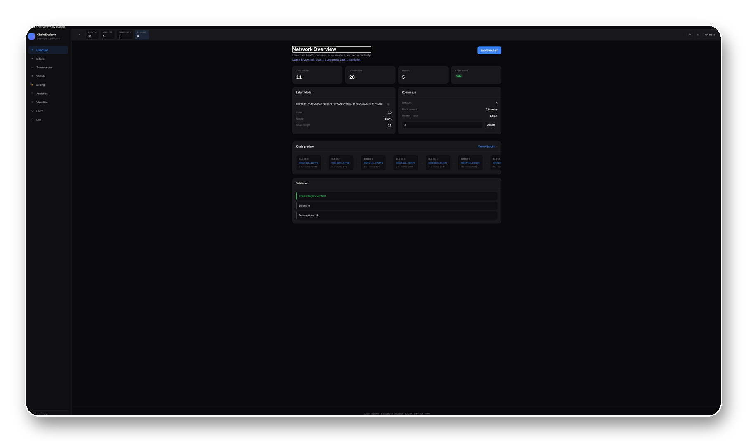
SOLUTION
A teaching ledger where every concept maps to running code
Local-first
Two processes: static frontend and FastAPI API.
Inspectable
OpenAPI docs, live stats, blocks, mempool, wallets.
Safe experiments
Tamper and 51% demos are educational and isolated.

Slide 4
EVIDENCE
The presentation is derived from the implementation, not generic blockchain copy
Backend
Frontend
36 Python modules read: routes, services, domain, persistence, sync, middleware.
32 HTML/CSS/JS files read: view shell, rendering, cache, lazy modules, a11y.
Runtime
Not detected
23 OpenAPI paths discovered; live chain validates with 11 blocks.
No auth, SQL database, Docker, workers, React build, or admin panel in source.

Slide 5
RUNTIME
The actual deployment is intentionally small

Slide 6
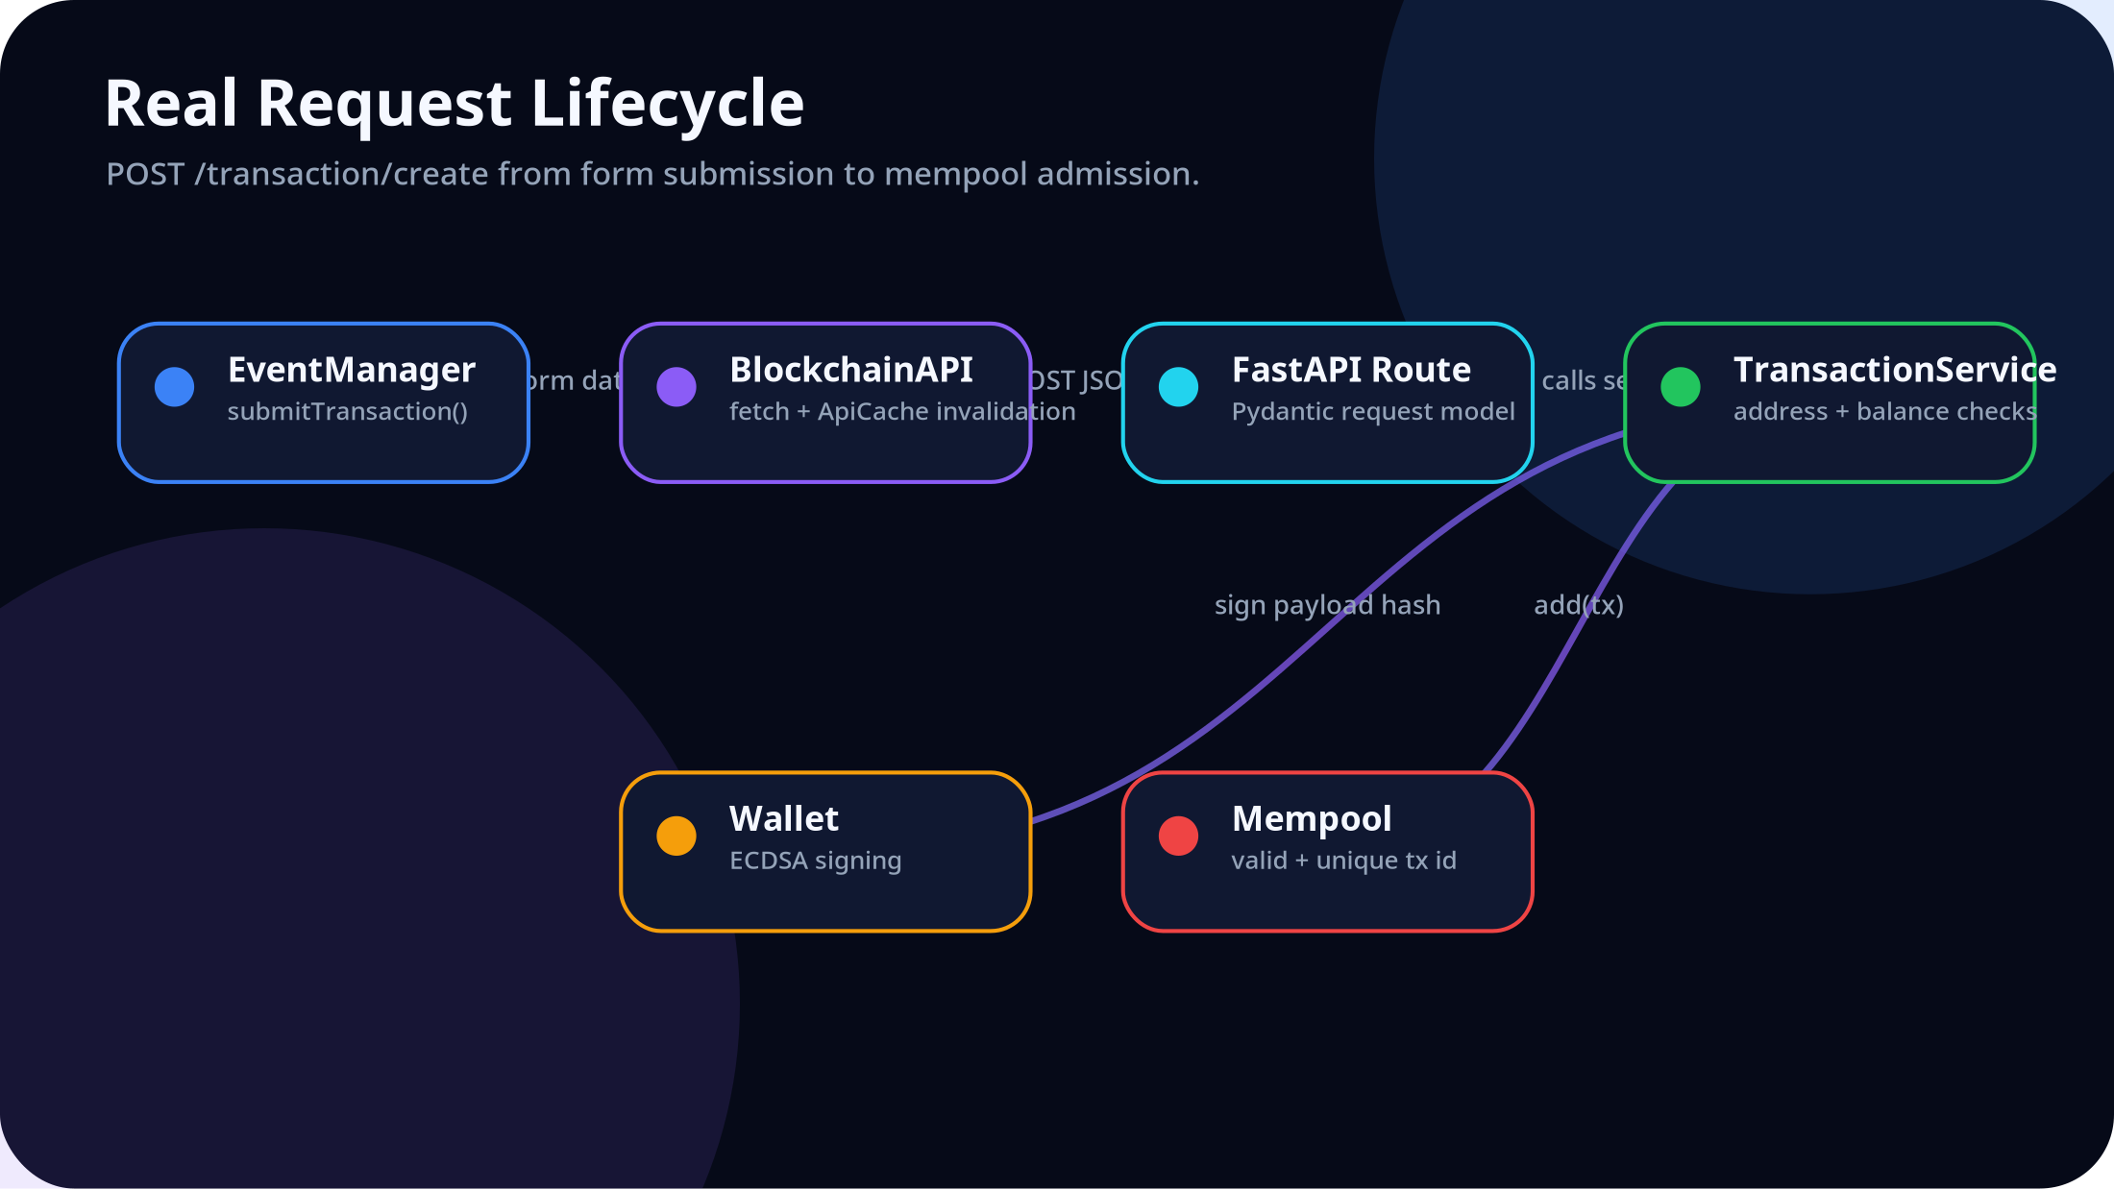
REQUEST FLOW
A transfer is admitted only after route validation, signing, balance reservation and mempool checks

Slide 7
SERVICE LAYER
api.py stays thin because behavior lives in dedicated orchestration services
BlockchainService
WalletService
TransactionService
Loads/saves chain, validates chain, exposes stats, replaces longer valid chains.
Creates ECDSA wallets, keeps names, persists private keys through WalletStore.
Validates addresses/amounts, checks pending outgoing balance, signs, admits to mempool.
MiningService
AnalyticsService
SyncService
Validates miner wallet, creates Miner, mines synchronously, returns nonce/time/hash.
Computes chart series, miner rewards, storage size, health and sync progress.
Registers peers and asks ChainSynchronizer for longer chains.

Slide 8
LEDGER MODEL
The simulator chooses account balances because the learning objective is transaction flow
Implemented
Why here
Limits
Account balances are not stored as rows. `Blockchain.get_balance()` rebuilds a cache by replaying confirmed transactions and invalidates it on mutation.
For teaching, Alice -> Bob transfers are easier to follow than UTXO coin selection. The trade-off is less production realism.
Float amounts, no account nonce, no fees, no gas, no supply cap, no Merkle root in block headers.

Slide 9
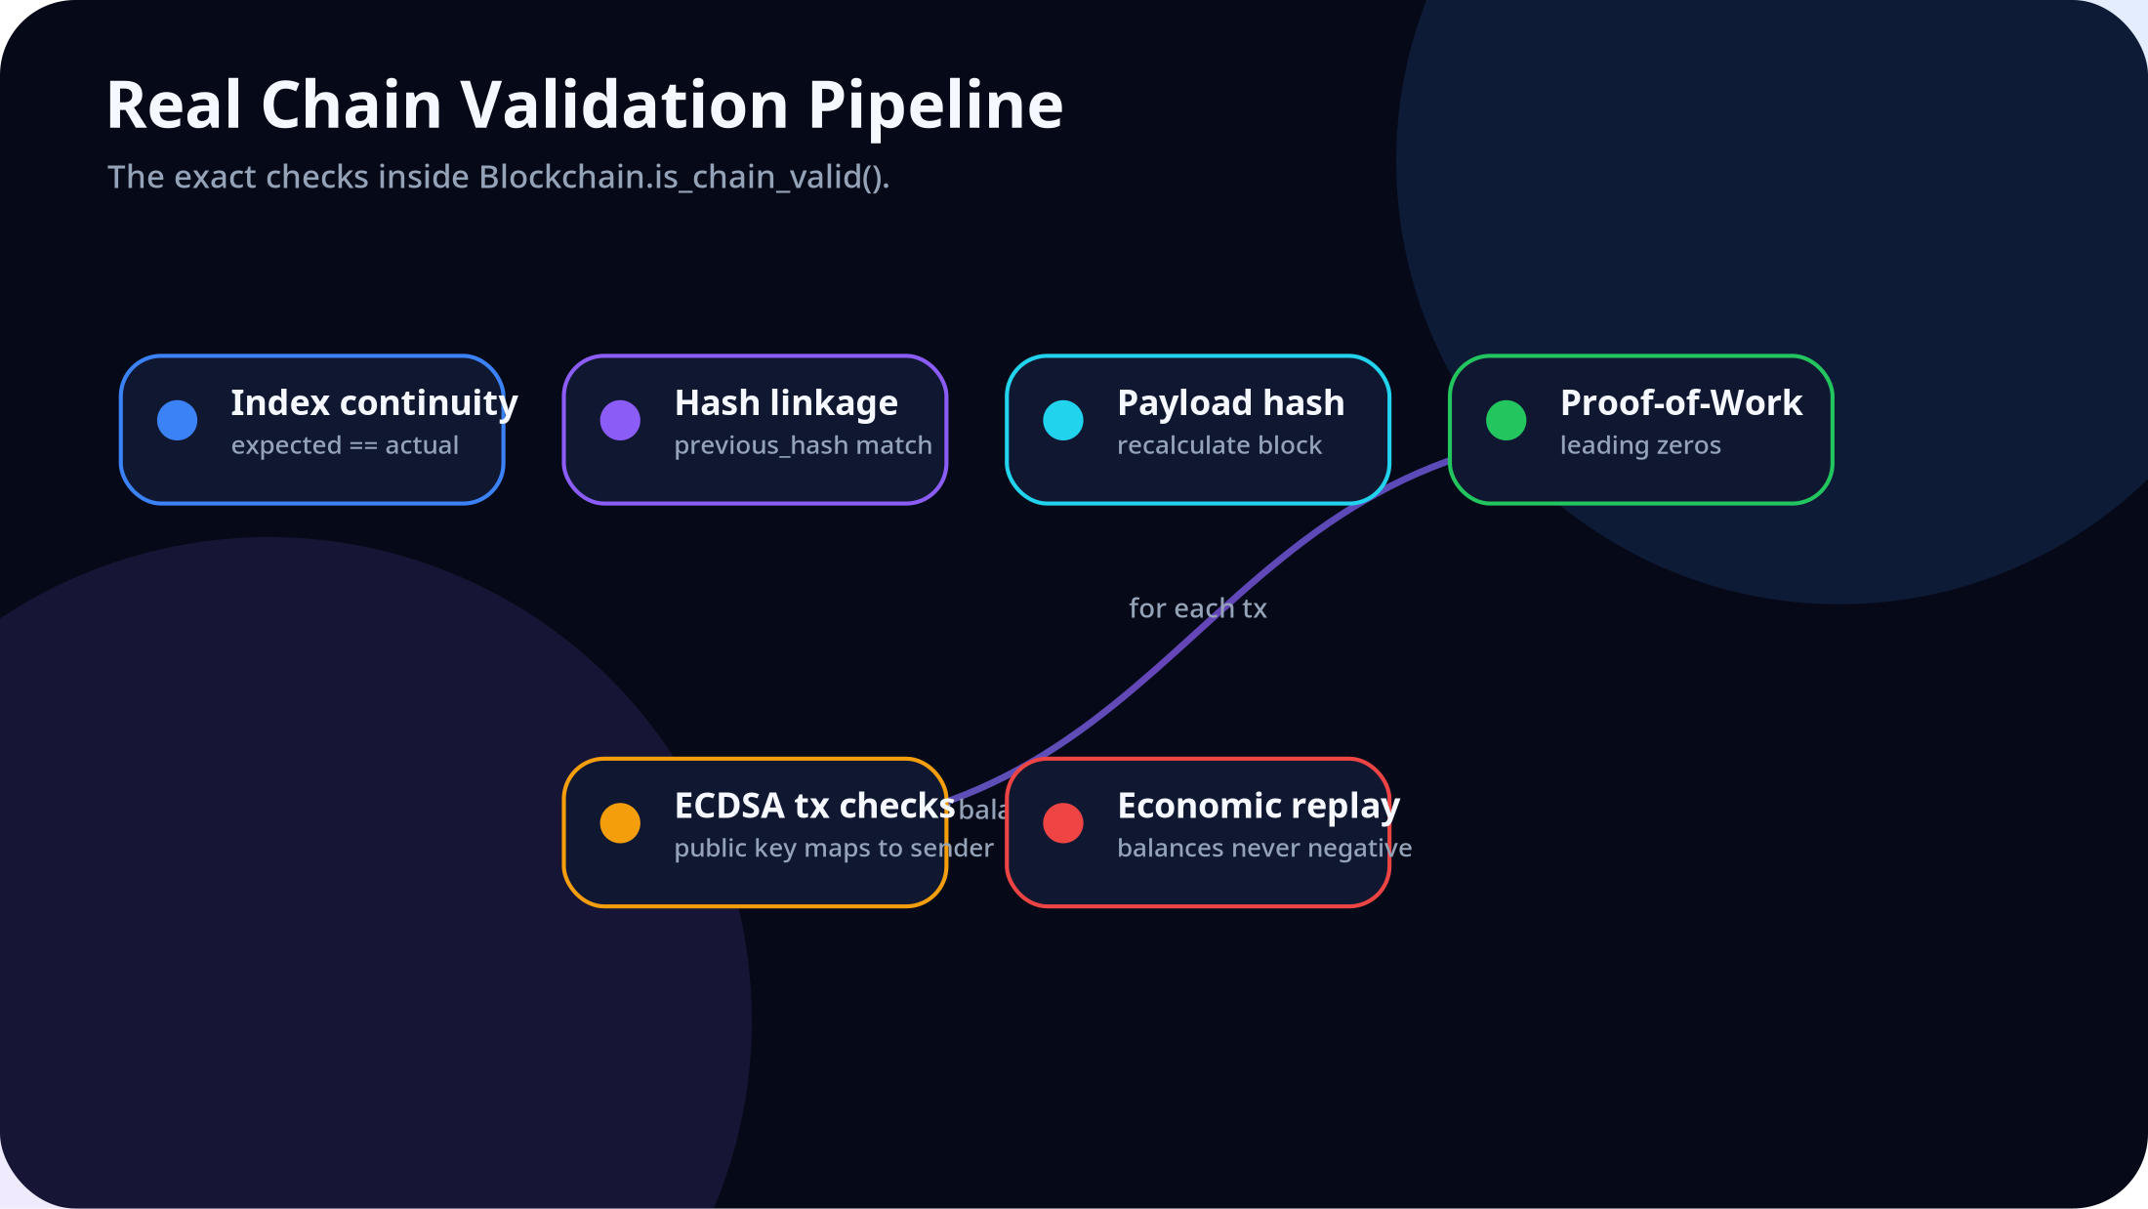
VALIDATION
Consensus safety is enforced by deterministic replay

Slide 10
CRYPTOGRAPHY
Real primitives are used, but custody is simplified for education
SHA-256
ECDSA NIST256p
Fernet at rest
Blocks and transactions hash deterministic JSON using `sha256_dict(..., legacy=True)` so stored chains remain compatible.
Wallets generate ECDSA key pairs. Transactions sign the payload hash and validation checks public key -> address mapping.
Private keys are stored in `data/wallets.enc`; the API never returns private keys, but signing is server-side by design.

Slide 11
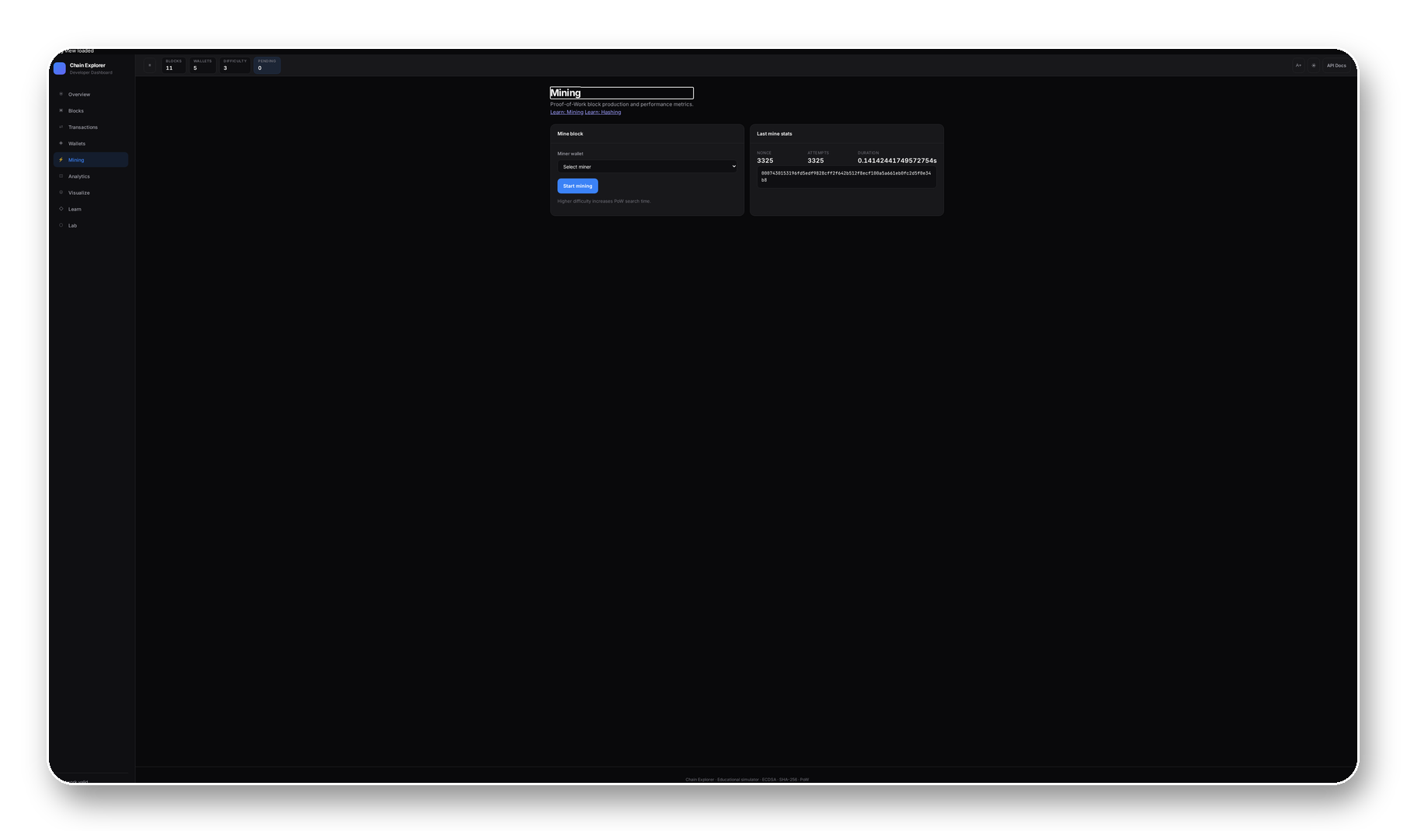
MINING
Proof-of-Work is implemented as a visible nonce search
Target
Reward
`hash.startswith('0' * difficulty)`
`SYSTEM` transaction mints 10.0 coins
Trade-off
Mining runs synchronously on the API thread. This is acceptable at low difficulty and makes the educational timing visible.

Slide 12
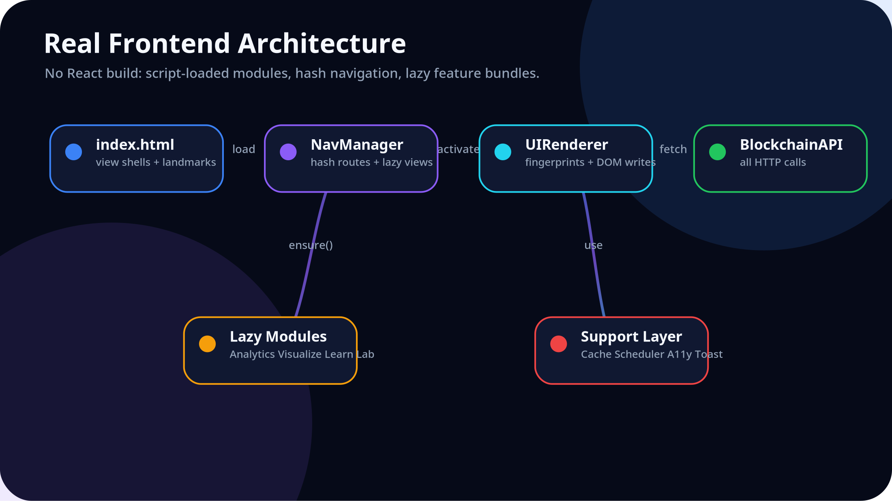
FRONTEND
The browser architecture is intentionally transparent

Slide 13
PERFORMANCE
Most optimizations are small, local, and visible in source
ApiCache
Mutation invalidation
Fingerprints
TTL cache plus in-flight dedup prevents duplicate GET calls.
POST actions invalidate affected prefixes: blocks, stats, wallets, analytics.
Renderer skips DOM updates when block/stat/wallet fingerprints are unchanged.
VirtualList
Scheduler
Lazy modules
Blocks table windows rows after 40 items.
DOM writes are batched with requestAnimationFrame; polling pauses when tab is hidden.
Chart.js, Visualize, Learn and Lab load only when opened.

Slide 14
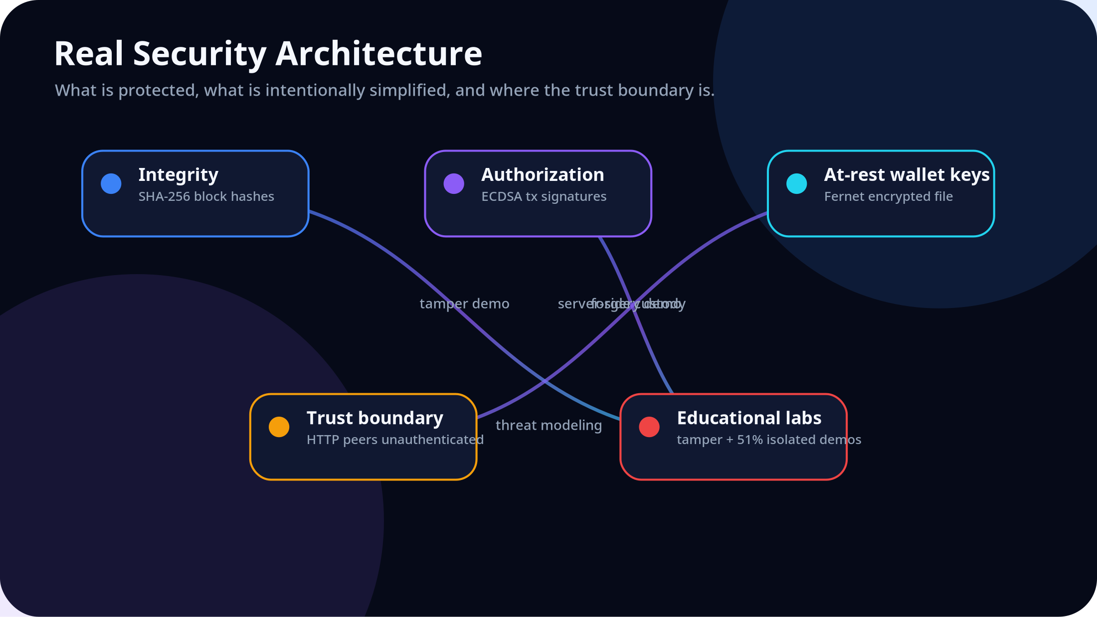
SECURITY
The security model is honest about its trust boundaries

Slide 15
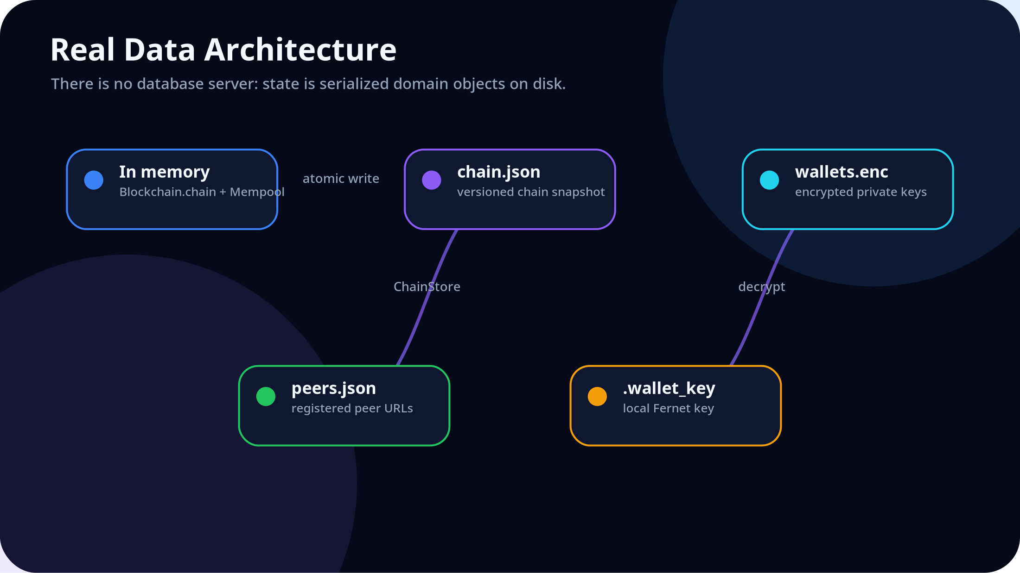
DATA
There is no hidden database: persistence is JSON and encrypted files

Slide 16
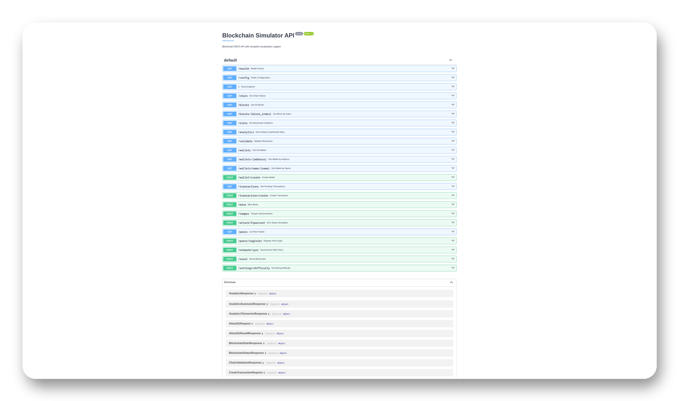
API
The REST surface mirrors the teaching workflow
Observe
/health /chain /stats /analytics /blocks
Act
/wallet/create /transaction/create /mine
Stress
/tamper /attack/51percent /validate
Network
/peers /peers/register /network/sync

Slide 17
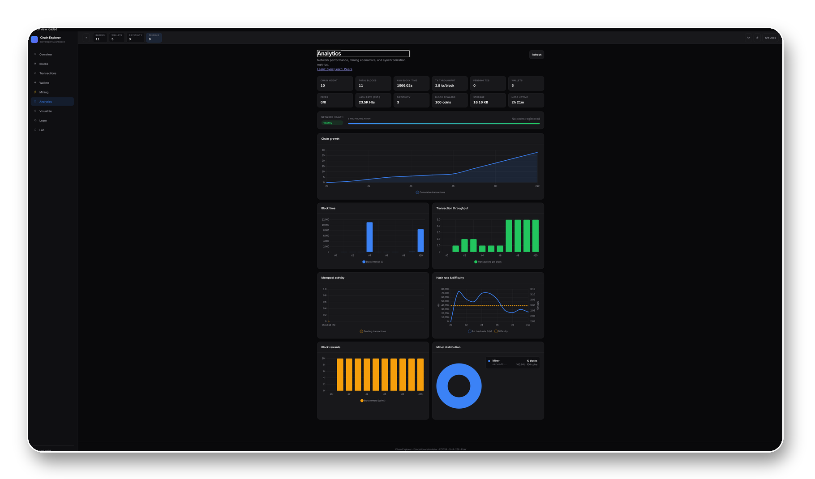
ANALYTICS
The charts are computed from chain objects, not a separate telemetry store
Height
Tx/block
Hash rate
Storage
10
2.8
23.5K H/s
16.16 KB

Slide 18
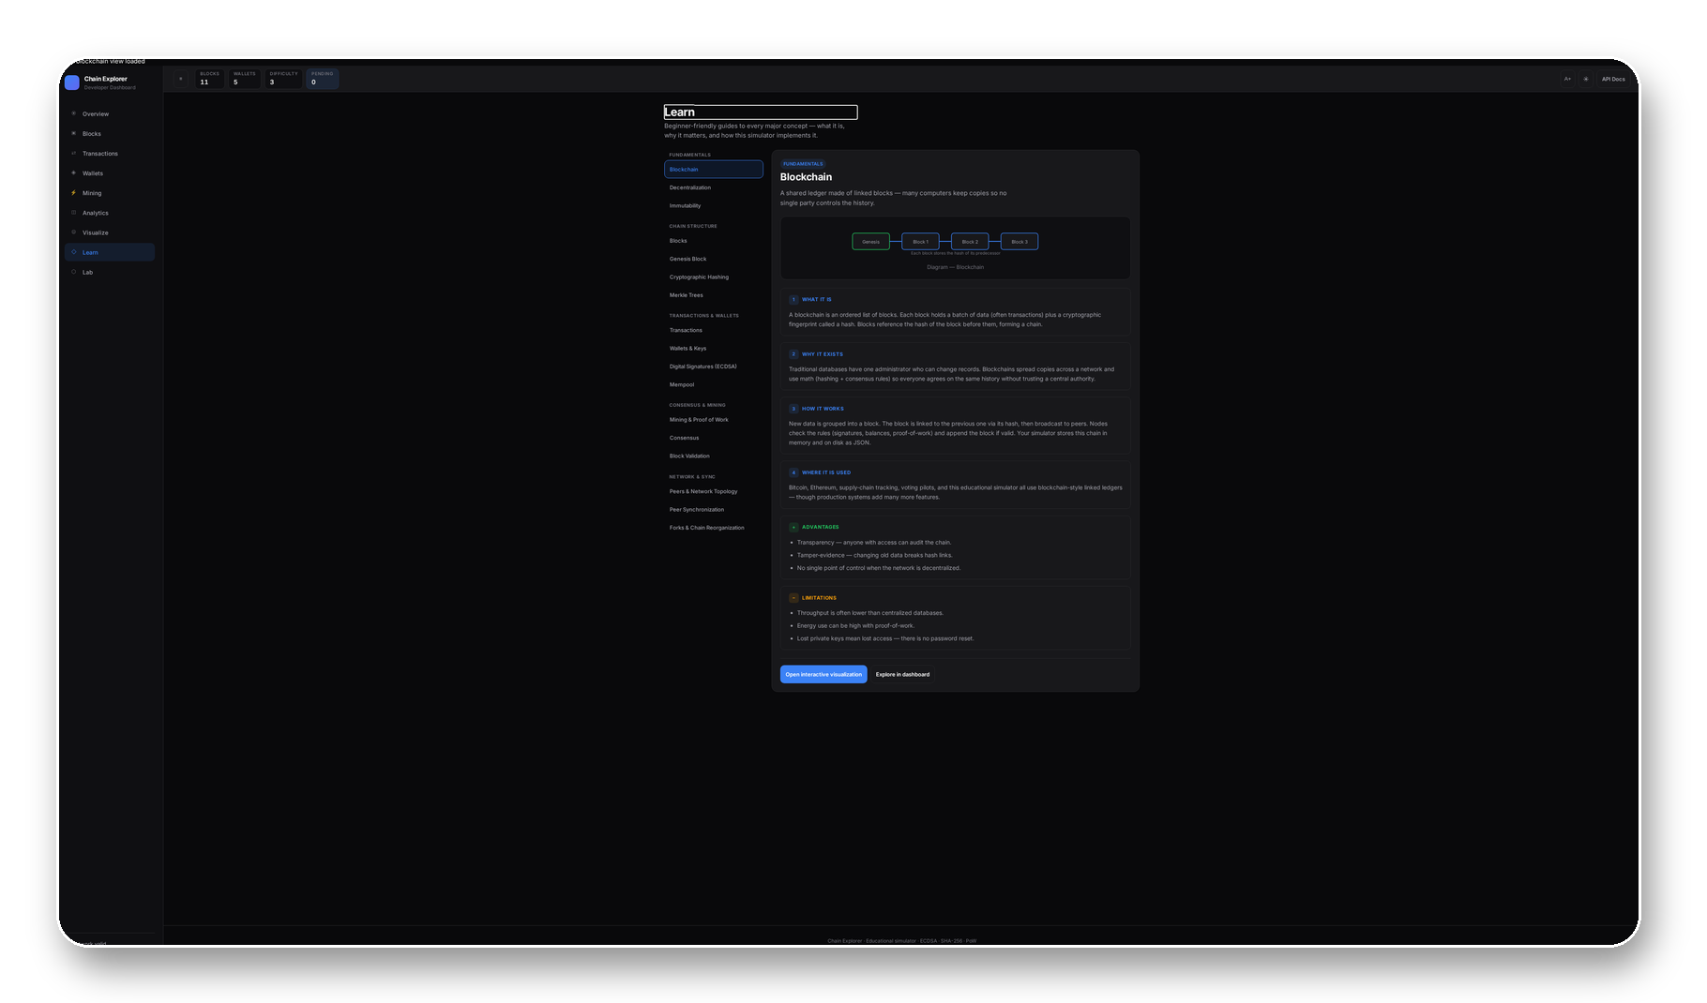
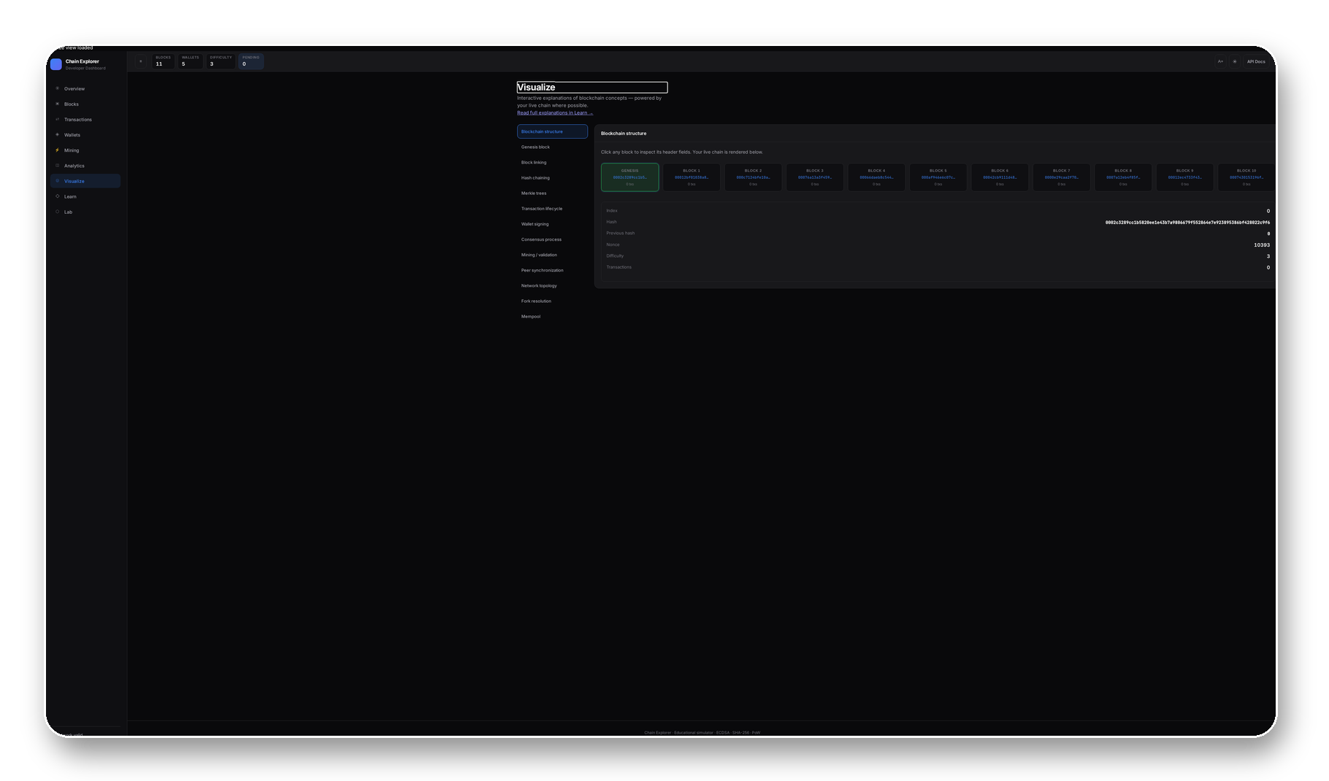
LEARNING UI
Education content is wired back to live visualizations and dashboard views

Slide 19
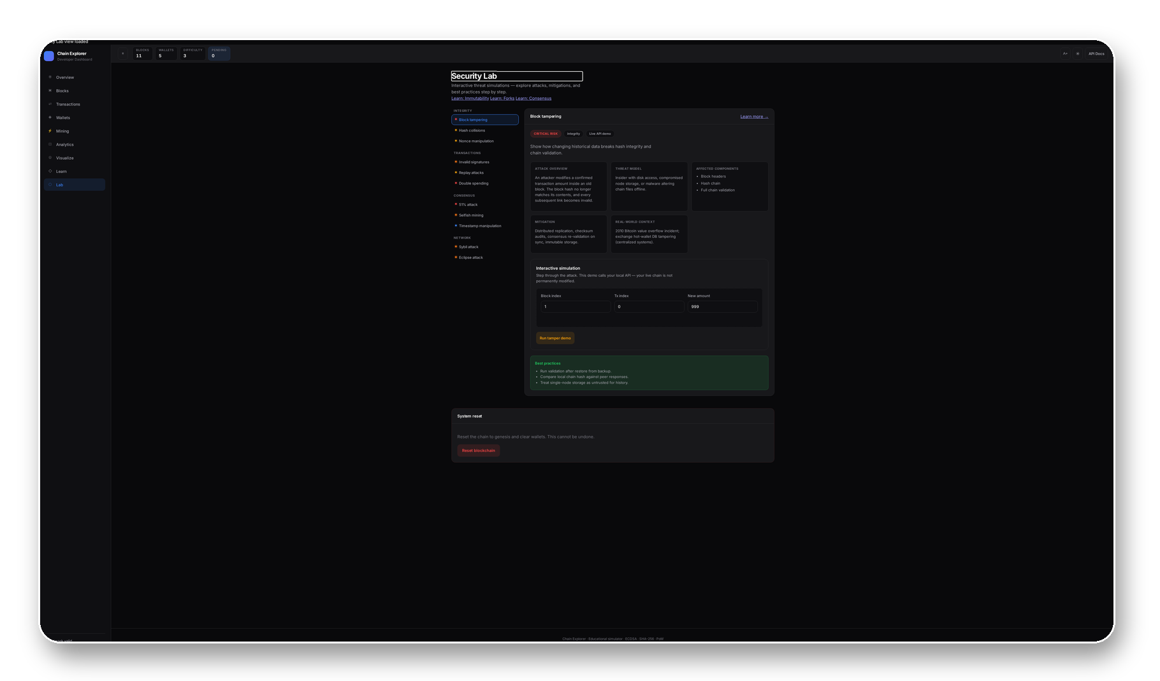
SECURITY LAB
Threat modeling is part of the product, not an appendix
Threat catalog
11 topics across integrity, transaction, consensus and network categories.
Live API demos
Tamper detection and 51% attack call backend endpoints.
Non-destructive
Tamper service restores original chain state after demonstration.

Slide 20
ACCESSIBILITY
The dashboard is built for classroom and defense environments
Landmarks
Keyboard
Announcements
main, banner, nav, contentinfo and table captions.
Tab order, Escape for mobile menu, '?' shortcuts, roving topic lists.
ARIA live region for view changes, status and connection events.
Contrast
Motion
Touch
A+ toggle, prefers-contrast and forced-colors rules.
prefers-reduced-motion disables animation-heavy effects.
44px targets for buttons and navigation.

Slide 21
USER JOURNEY
A learner moves from identity to validated history
Create wallet
Send transfer
Attack lab
WalletService + Fernet
→
Mine reward
→
TransactionService + ECDSA
→
Validate
→
Tamper / 51% simulation
→
Explain
MiningService + SYSTEM tx
Blockchain replay
Learn + Visualize

Slide 22
ENGINEERING DECISIONS
Every simplification serves the educational simulator
FastAPI
Vanilla JS
JSON persistence
Chosen here because Pydantic route models and OpenAPI make API behavior inspectable during demos.
Chosen here so students can read the UI without a bundler, component compiler or framework layer.
Chosen here because chain snapshots can be opened and compared during architecture review.
Server-side signing
HTTP sync
Account balances
Chosen here to keep wallet UX simple; documented as non-production custody.
Chosen here to demonstrate longest-chain adoption without implementing native P2P gossip.
Chosen here to teach transfer flow before UTXO complexity.

Slide 23
LIMITATIONS
The project is clear about what it does not implement
No authenticated peers
No transaction nonce
Float amounts
HTTP sync trusts registered URLs.
Mempool dedup prevents exact duplicates, not full account replay semantics.
Acceptable for demos, not financial precision.
No Merkle header
Synchronous mining
No production wallet custody
Visualize teaches Merkle trees; block hash uses flat tx list.
Simple for low difficulty; unsuitable for heavy workloads.
Private keys are server-side for teaching UX.

Slide 24
COMPARISON
Chain Explorer is a microscope, not a public chain
Implementation-aligned matrix
Dimension
Chain Explorer
Bitcoin
Ethereum
Purpose
Education
Peer money
Programmable settlement
Ledger
Account balances
UTXO
Accounts + contracts
Consensus
PoW demo
PoW
PoS
Network
HTTP sync
Native P2P
P2P
Storage
JSON/Fernet
Client DB
Client DB
Contracts
Not implemented
Script
EVM

Slide 25
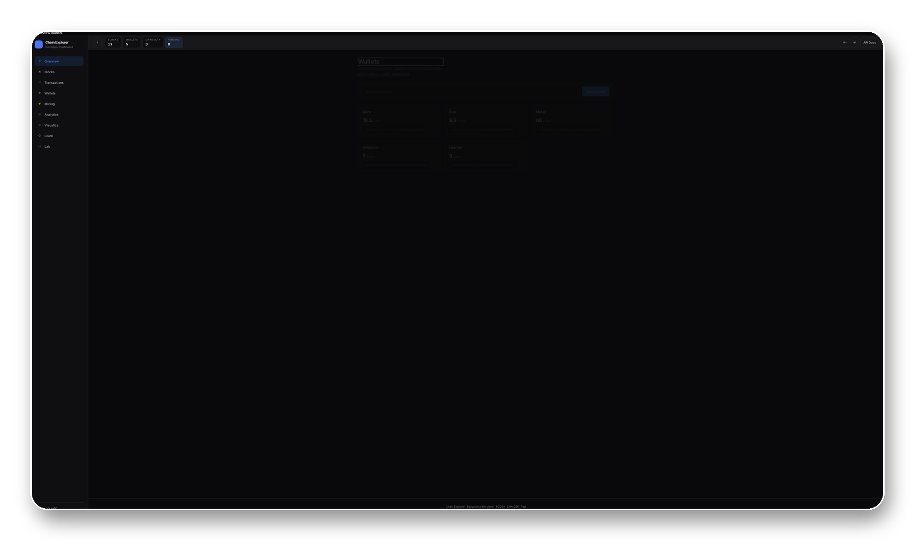
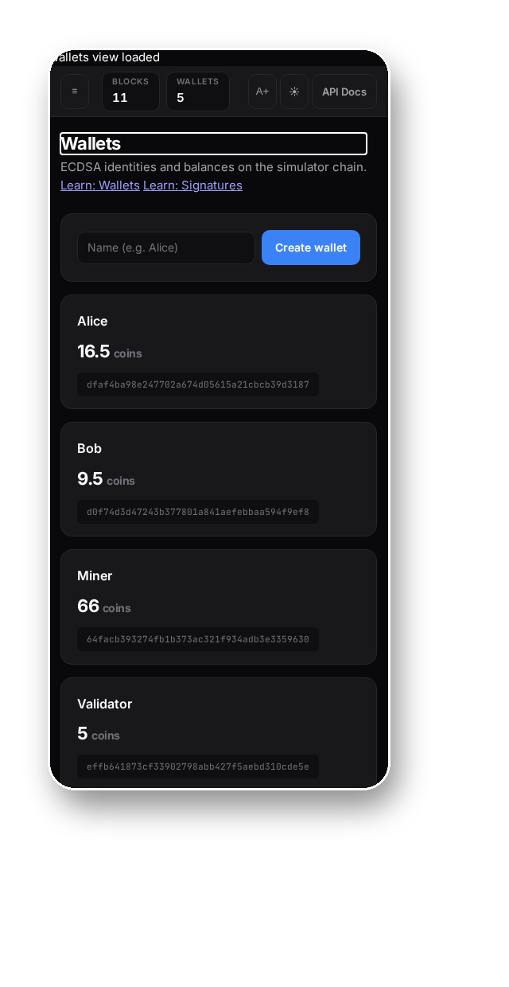
LIVE DEMO
The system can be presented as a coherent product

Slide 26
ROADMAP
The next work should preserve explainability while adding guardrails
Tests
Docker
Client keys
pytest for validation, crypto, services; UI smoke via Playwright.
Repeatable multi-node classroom labs.
Move signing to browser for production-like custody.
Auth for peers
Integers
CI/CD
Signed peer metadata or allowlist trust model.
Replace float amounts with smallest-unit integers.
Lint, tests, artifact build and presentation regeneration.

Slide 27
Conclusion
A complete learning platform for blockchain systems architecture
Technical contribution
Educational contribution
Engineering maturity
Connects cryptography, validation, mining, persistence, APIs and UI state in one inspectable simulator.
Turns hidden blockchain mechanics into interactive workflows and attack simulations.
Explicit boundaries, documented trade-offs, caching, a11y, structured errors and reproducible artifacts.
Thank you. Questions?

