Slide 1
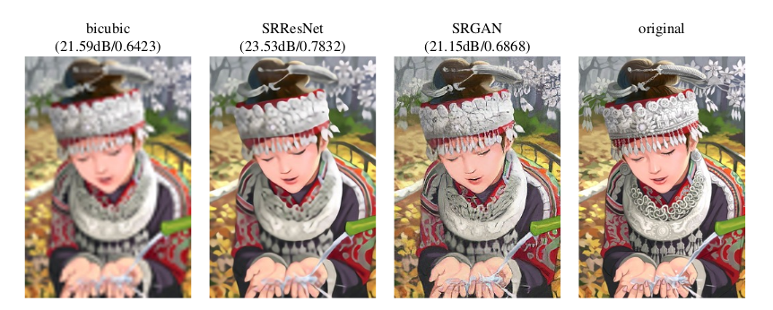
Photo Realistic Single Image Super Resolution Using a GAN (CVPR 2017)
Amanpreet Singh
U1209323
Computer Vision Project- Spring 2019

Slide 2
References :
Shi, Wenzhe, Jose Caballero, Ferenc Huszár, Johannes Totz, Andrew P. Aitken, Rob Bishop, Daniel Rueckert, and Zehan Wang. "Real-time single image and video super-resolution using an efficient sub-pixel convolutional neural network." In Proceedings of the IEEE conference on computer vision and pattern recognition, pp. 1874-1883. 2016. https://arxiv.org/pdf/1609.05158.pdf
Ledig, Christian, Lucas Theis, Ferenc Huszár, Jose Caballero, Andrew Cunningham, Alejandro Acosta, Andrew Aitken et al. "Photo-realistic single image super-resolution using a generative adversarial network." In Proceedings of the IEEE conference on computer vision and pattern recognition, pp. 4681-4690. 2017. https://arxiv.org/pdf/1609.04802.pdf

Slide 3
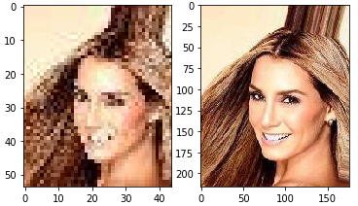
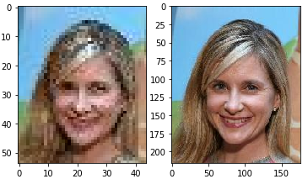
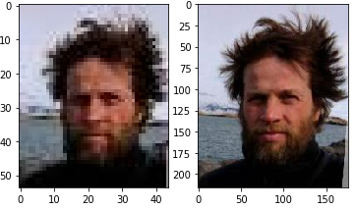
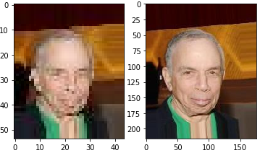
Dataset selected: CELEB-A
203,000 images, of size 178 x 216
10,177 unique people

Slide 4
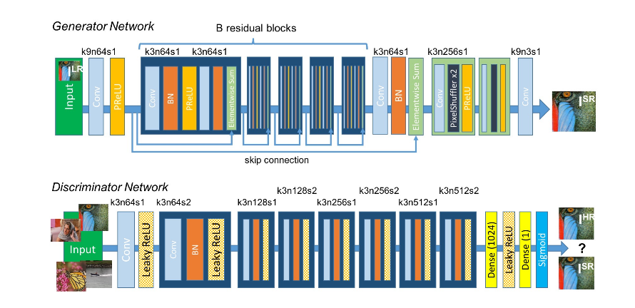
Network Architecture :

Slide 5
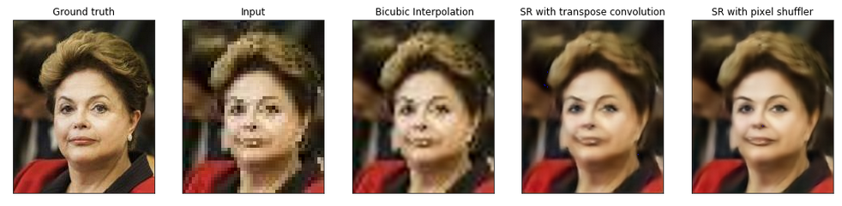
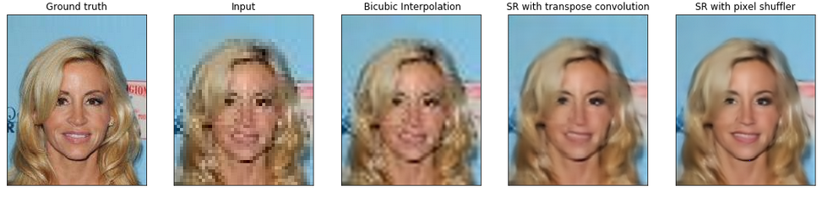
My results:

Slide 6
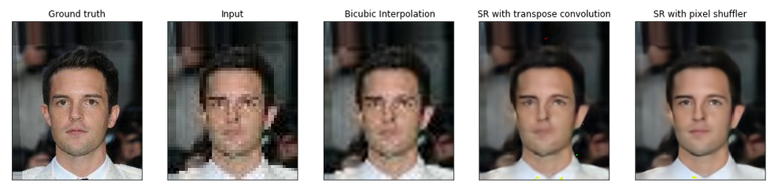
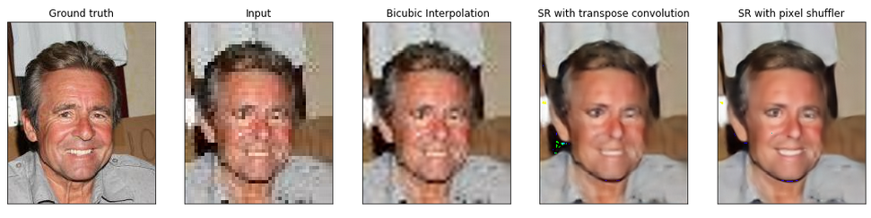
My results:

Slide 7
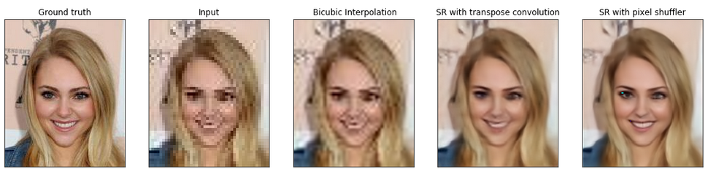
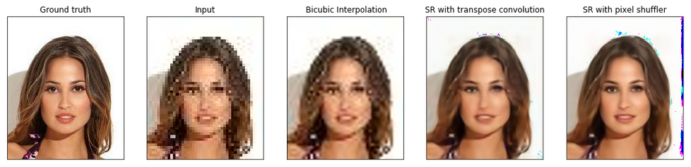
My results:

Slide 8
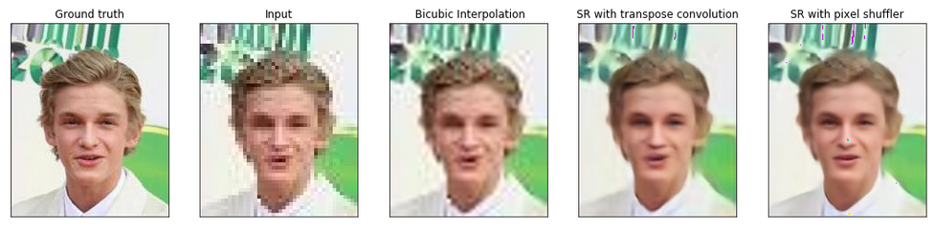
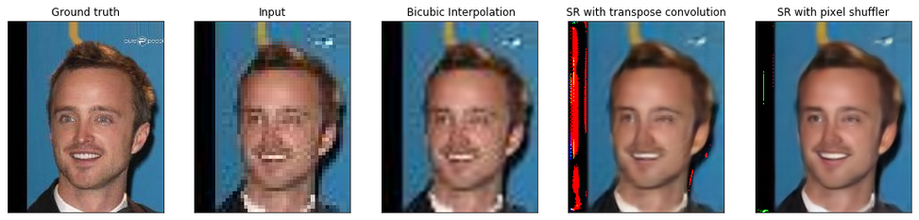
My results:

Slide 9
Conclusion and Future Work:
The network works quite well given that all the results are on images that are never seen by it during the training.
Train the network for at least another 10 epochs as we still get some artifacts in some images.
Test a facial Recognition algorithm, trained on the ground truth, on the results obtained by the network.

Slide 10
THANK YOU

