Slide 1
Mini SaaS Task Manager
A Modern, Productive, and Beautiful Task Management Solution
Built with React & Supabase

Slide 2
Project Overview
The Mini SaaS Task Manager is a full-stack application designed for simplicity and productivity. It features a real-time dashboard, interactive task management, and advanced data portability options.

Slide 3
Key Features
Comprehensive Task Control
  • CRUD Operations: Create, Edit, Toggle, and Delete tasks in real-time.
  • Advanced Categorization: Priority labeling and situational categories.
  • Data Portability: Export to JSON/CSV and Import from JSON.
  • Themes: Fluid transitions between Light and Amoled Dark modes.

Slide 4
Technical Architecture
Frontend Framework: React.js (Vite)
Backend & Auth: Supabase (PostgreSQL)
Styling: Vanilla CSS with Modern Variables & Glassmorphism
Real-time State: Supabase Auth & DB Listeners

Slide 5
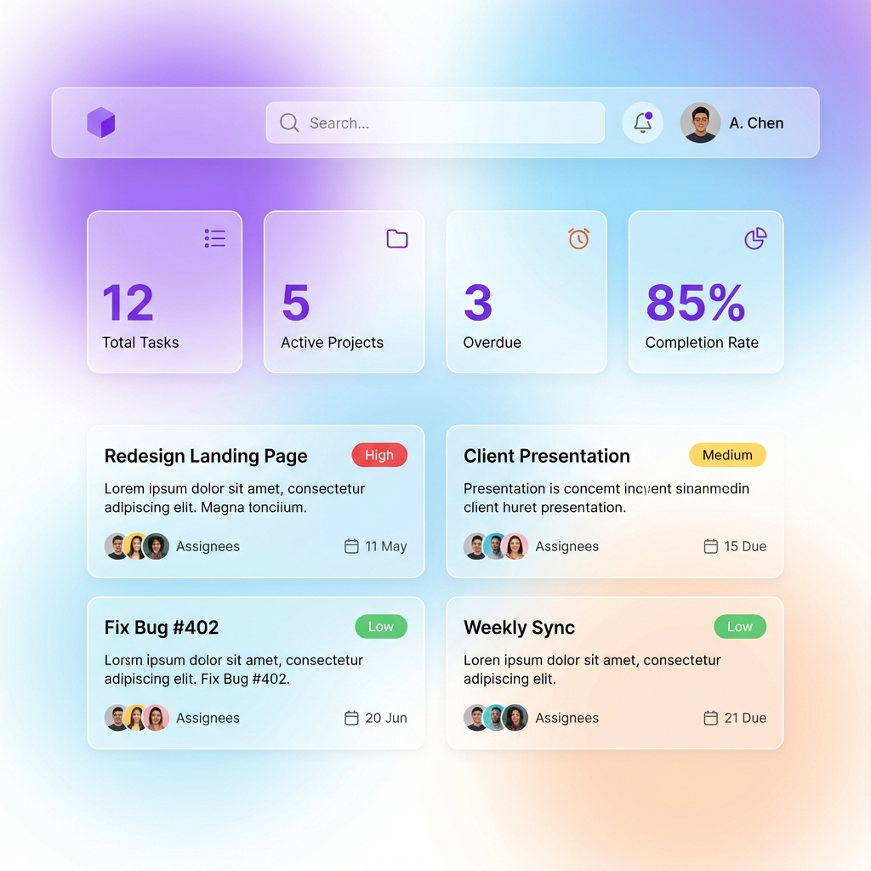
Modern Light Interface

Slide 6
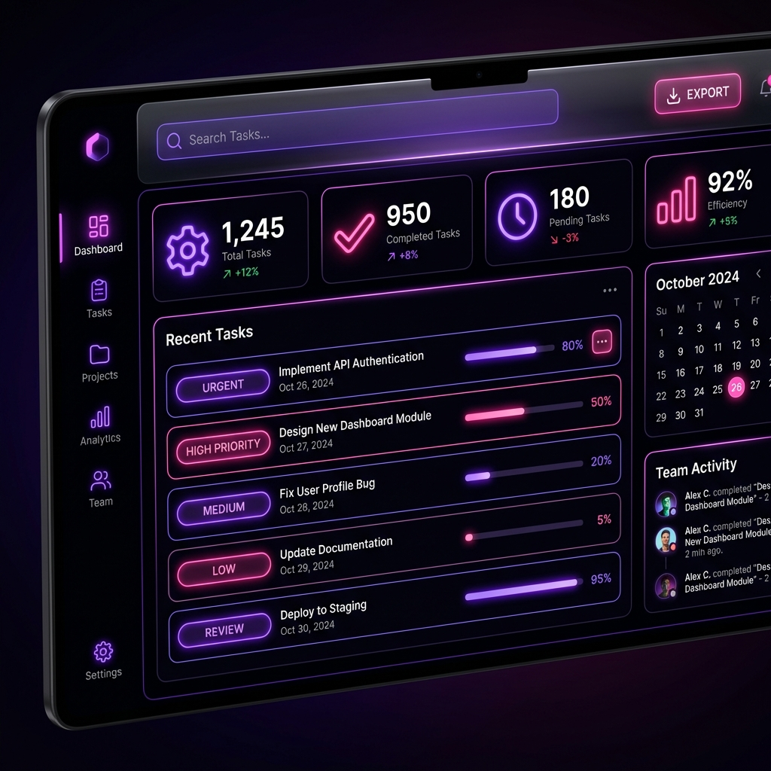
Ultra Dark 'Amoled' Mode

Slide 7
Dashboard Analytics
The dashboard provides instant visual feedback:
  • Real-time Task Breakdown by Priority.
  • Completion Rate Progress Visualization.
  • Category-wise Active Task Tracking.

Slide 8
Thank You!
A Premium Task Management Experience
Questions & Feedback

