Slide 1
CS1501 Introduction to Blockchain
Fridays 1-1:50PM,
Thornton Hall D115

Slide 2
Roadmap
Background
Course Goals and Expectations
Getting Up to Speed on Blockchain
State of the Space

Slide 3


Teaching Staff
Professor David Evans
Research focuses on secure multi-party computation, adversarial machine learning, and web security
Taught cryptocurrency course in 2014 at UVA
Amar Singh
4th year Math & CS

Slide 4
Course Goals
Students come from diverse backgrounds with varying levels of exposure to blockchain.
The purpose of this class is to
Provide a technical introduction to blockchain technology for students of all levels
Encourage the sharing of knowledge
Push ambitious students to learn, build, and launch new projects in this space

Slide 5
Expectations
There are no mandatory assignments
Every week:
Lecture
Reading List
Quiz
Optional Coding Projects/Curriculum
Discussion forum to coordinate side projects
Culture: inclusive and non-judgmental

Slide 6
Getting Up To Speed on Blockchain
Speech by Matt Condon, XLNT [1]

Slide 7









Database

Slide 8
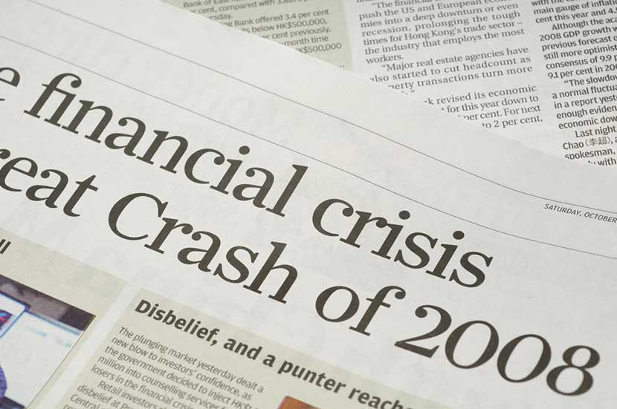
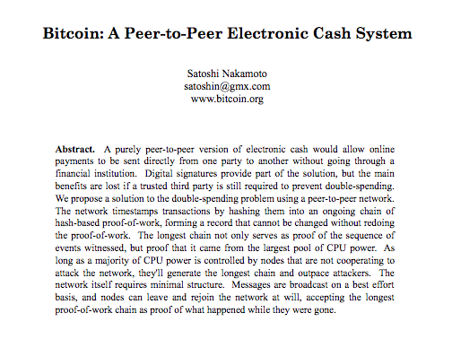
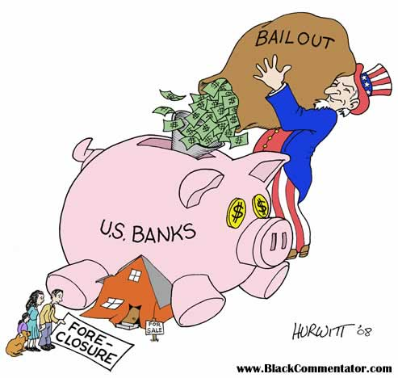
Bitcoin: Paradigm Shift

Slide 9
Since then…
Ethereum
ZCash
Layer 2 Scaling
Sharding
Proof of Stake
Lots of open source development and research!

Slide 10
Plug In
Information is power.
Student Onboarding Page
I’ll send out reading lists every week
Discussion forum to post links and host debates; there is doc that describes acceptable conduct and unacceptable conduct

Slide 11
Blockchain vs. Cryptocurrency

Slide 13
References
https://www.youtube.com/watch?v=PvO3J4AKLWo

