Slide 1
CS1501 Introduction to Blockchain
Fridays 1-1:50PM,
Thornton Hall D115

Slide 2
Roadmap
Incentive Loops
Removing Stakeholder Friction
Review: Bitcoin’s Incentive Loop
Decentralized ⬄ Trustless
Byzantine Generals Problem
Sybil Attacks
Bitcoin’s Solution
More
Polkadot/Tendermint/Casper
Other Things

Slide 3
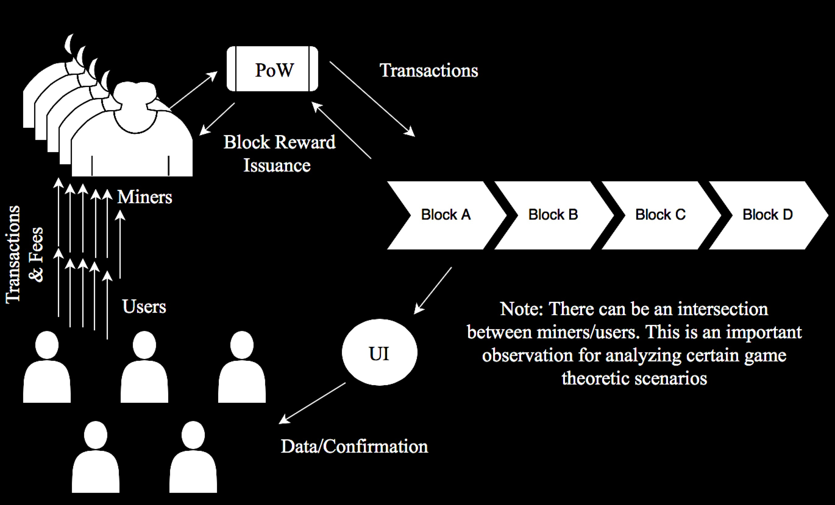
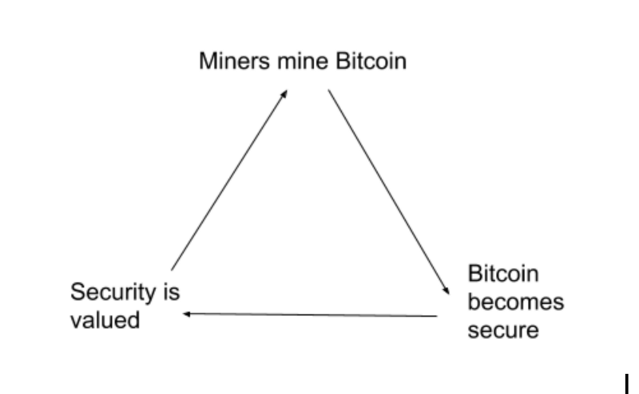
Review: BTC’s Incentive Model

Slide 4
“Decentralized => Trustless”
Distributed database that isn’t controlled by any single actor/entity
Requirements:
Permissionless
Secure?
Private?
Scalable?

Slide 5
Byzantine Generals Problem
Byzantine Empire is planning to capture Charlottesville
There is fierce resistance from Charlottesville but the Byzantine army has encircled the city
The army has $n$ divisions and each division has a general. The generals communicate through messengers.
All generals must agree upon 1 of the 2 plans of action (to Attack or to not). If the attack is w/o full strength, Charlottesville will win.

Slide 6
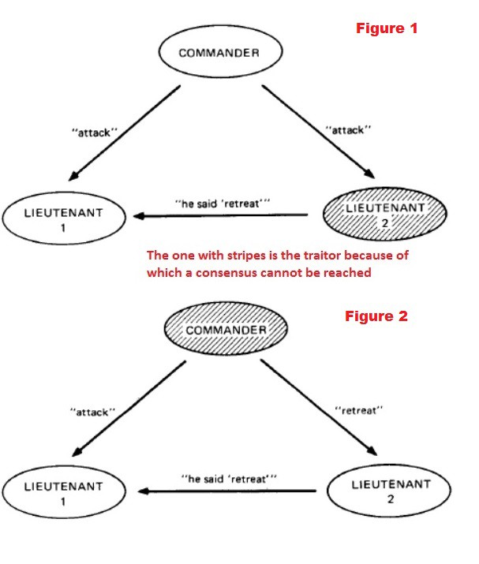
Traitors
Some messenger and even a few generals/commanders are traitors!

Slide 7
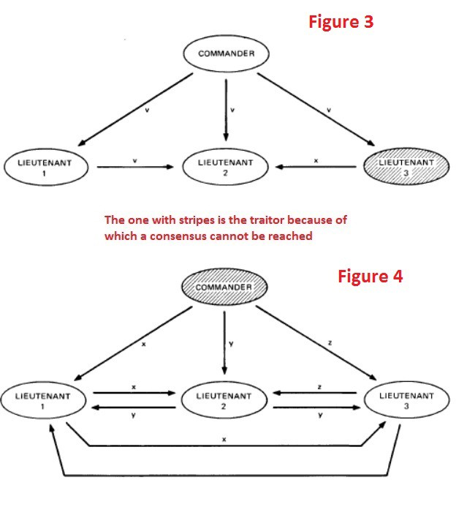
Complexity Increases with Number of Nodes
Imagine a system where all servers can be equal in hierarchy with no central server as well.
If equal hierarchy is established, a network of $n$ nodes must have greater than $2n/3$ honest nodes ( <n/3 malicious nodes).

Slide 8
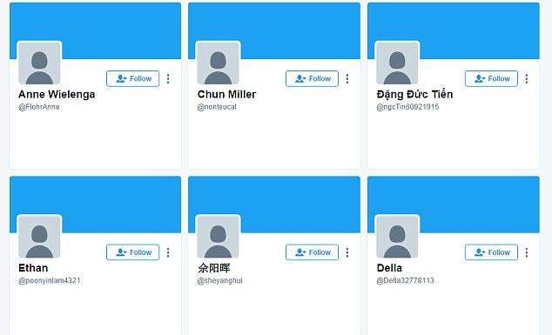
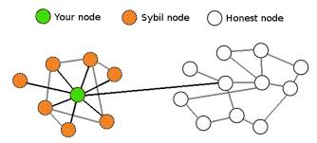
Sybil Attack

Slide 9
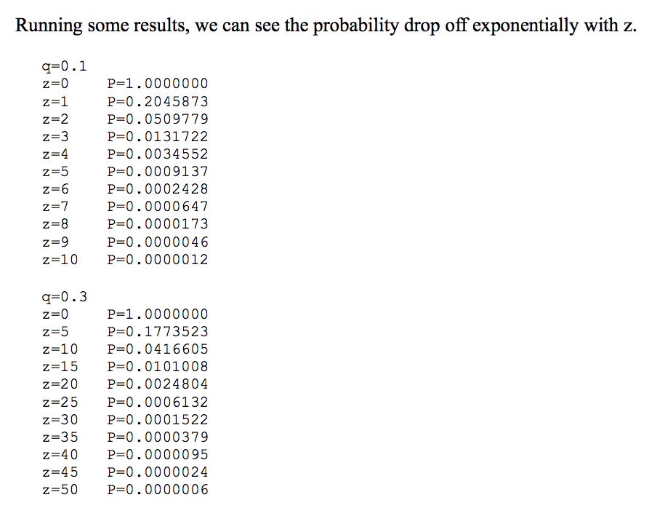
Bitcoin
Probabilistic solution to BGP

Slide 10
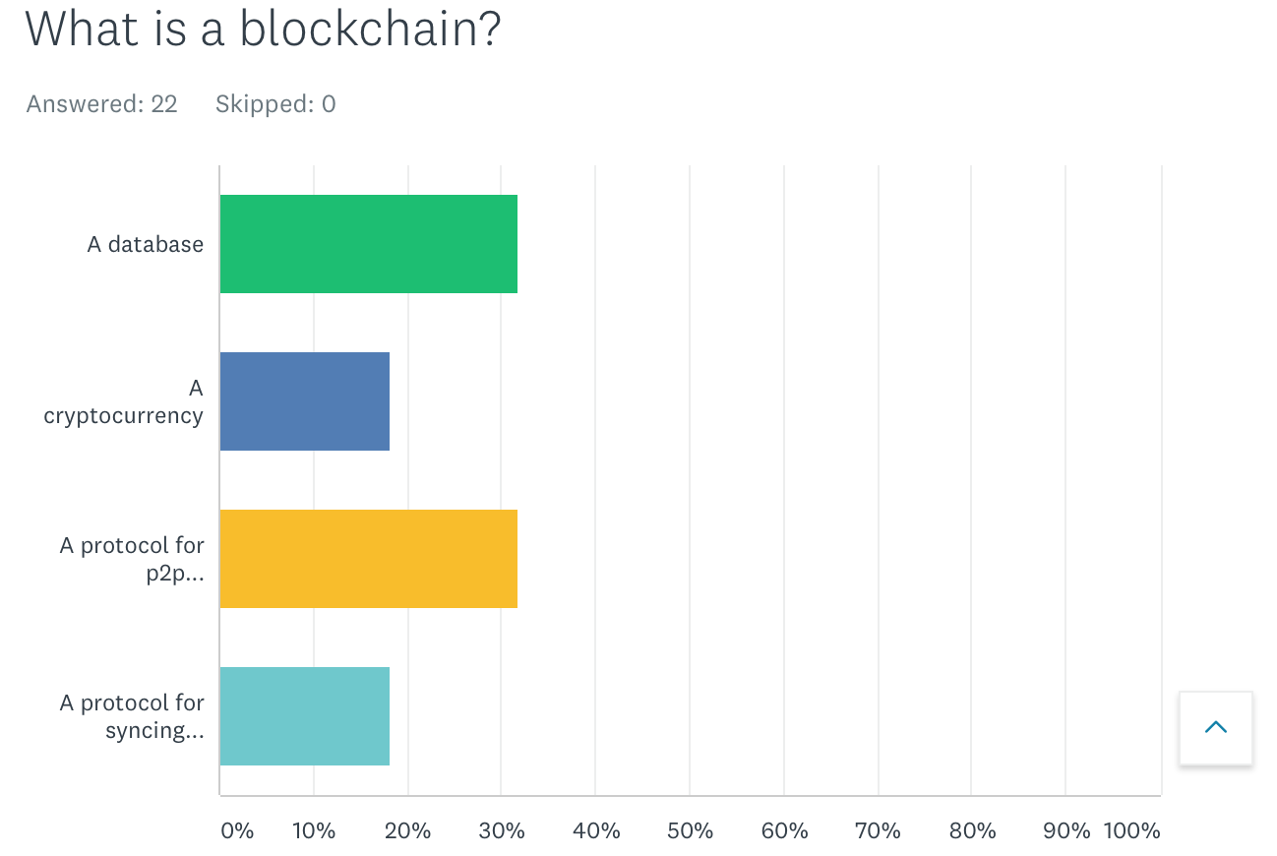

Slide 11
