Slide 1
CS1501 Introduction to Blockchain
Fridays 1-1:50PM,
Thornton Hall D115

Slide 2
Roadmap
Review
Bitcoin’s Incentive Model
Byzantine Fault Tolerance
Decentralized ⬄ Trustless
Permissionless (Proof of Work (PoW) definition)
Pros/Cons of PoW
Proof of Stake
Class Activity
Discussion of Tradeoffs
Modern Proof of Stake Blockchains (Tendermint, Polkadot)

Slide 3
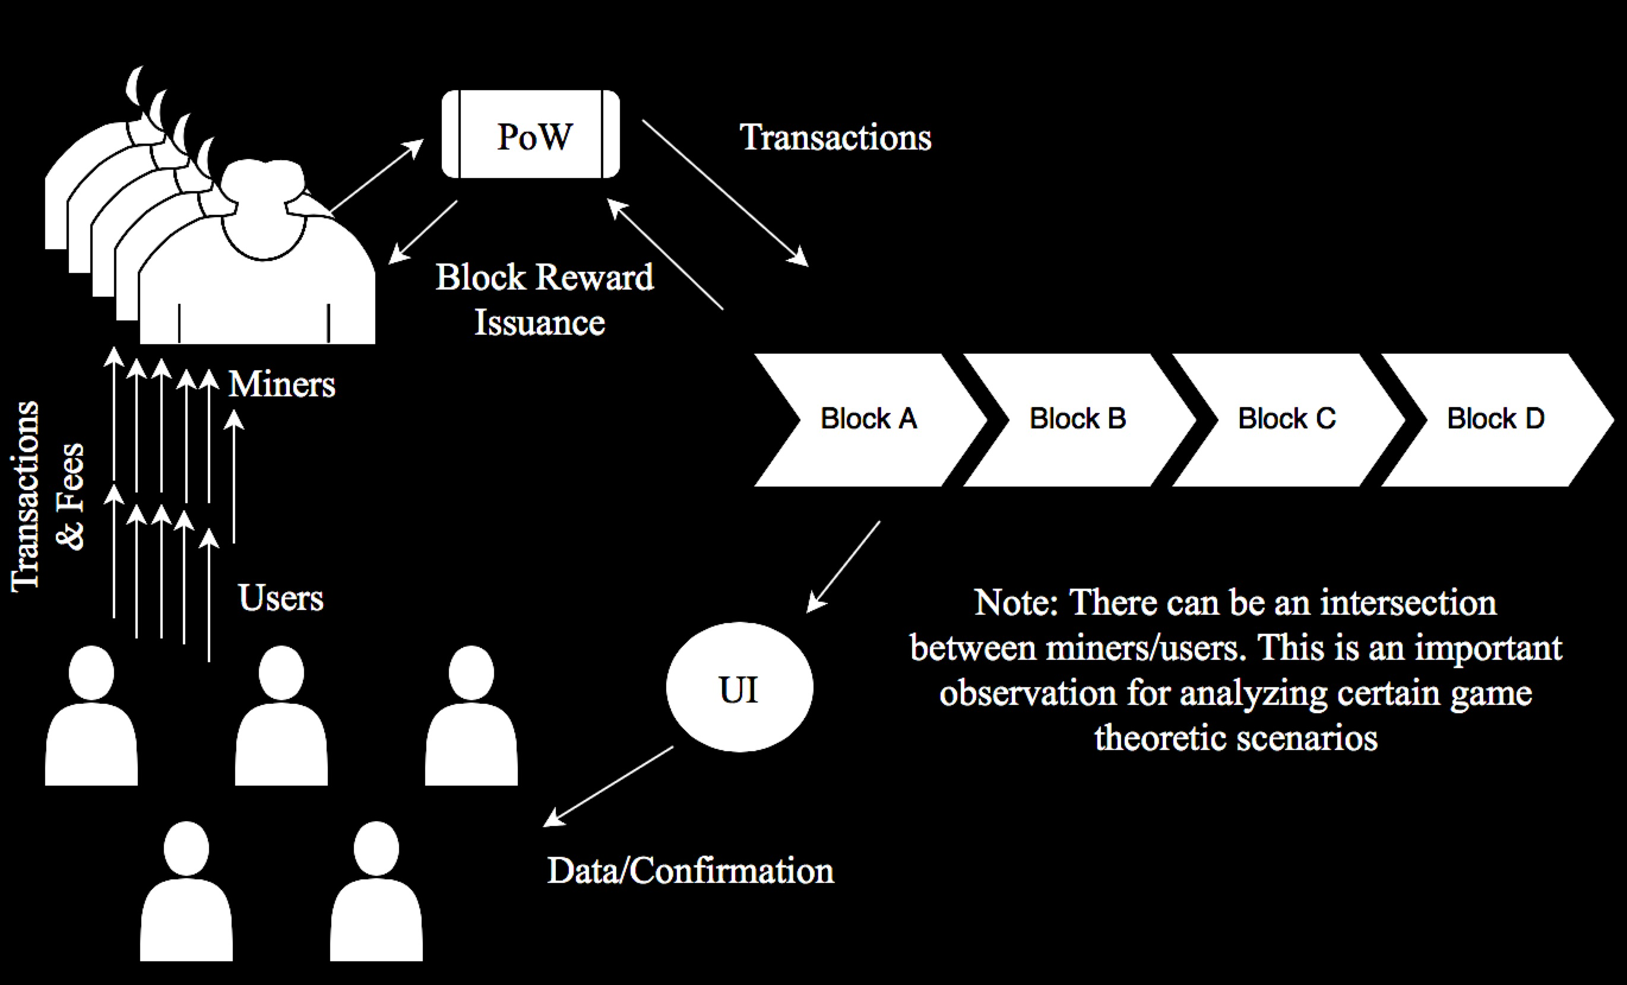
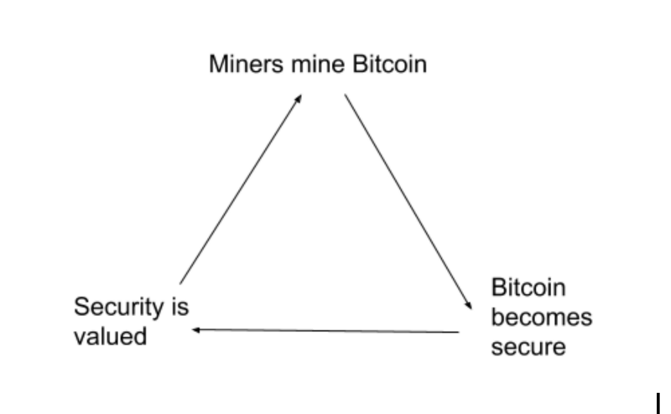
Review: BTC’s Incentive Model

Slide 4
“Decentralized => Trustless”
Distributed database that isn’t controlled by any single actor/entity
Requirements:
Permissionless
Secure?
Private?
Scalable?

Slide 5
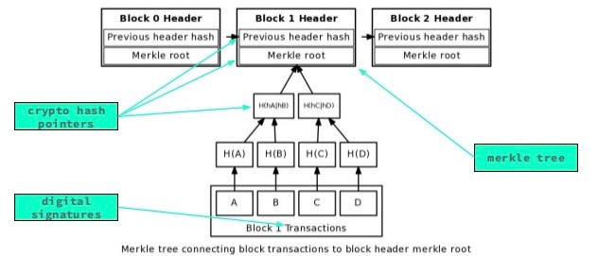
Cryptography

Slide 6
Byzantine Fault Tolerance
Consensus algorithms that are Byzantine Fault Tolerant can reach consensus (agreement) as long as 2/3 of the actors are honest.
“making a reliable system from unreliable parts”
Finality in PoS Blockchains

Slide 7
Bitcoin’s Probabilistic Solution
Bitcoin creates an interactive game in which miners come to agreement on the order of transactions.
Probabilistic guarantee of fair miner compensation according to proportion of hash power contributed.

Slide 8
Properties of Bitcoin’s Reward Schedule
Mean time to next block reward = 10 minutes / (miner percent of total network hashpower)
How much time do I have to wait if I contribute 1% of network hashpower? How about 10%?

Slide 9
Properties
Properties with respect to the amount of time each miner waits between finding blocks:
High average amount of time (between finding blocks)
The variance of the time between blocks is also very high.

Slide 10
Pros and Cons of PoW
Pros
Permissionless (prereq for decentralized maybe? Which is a prereq for trustless/censorship resistant?)
Fair, tamper-proof block proposer selection algorithm
Cons
Electricity
Mining Centralization Risks

Slide 11
Security vs Decentralization in PoW
ASICs raise the barrier to entry for miners
ASICs increase security against outside attackers, but they increase centralization risks
Does centralization threaten security?

Slide 12
Permissioned Blockchain Thought Experiment
Can we create a protocol to come to distributed consensus as a class?
Hint: assume (1) we can generate randomness and (2) each person gets one vote (& identity is linked)

Slide 13
Proof of Stake
How do we make our protocol permissionless?
How do we track identity?
Add accountability for malicious behavior?

Slide 14
Pros/Cons
Pros
Less energy consumption than PoS
Fast economic finality
Cons:
Is this really permissionless? Renting identity?

Slide 15
Security vs Decentralization in PoS
High capital requirements for validators
Limit on node scalability (limit on decentralization)
Capital requirements ⬄ ASIC barrier to entry

Slide 16
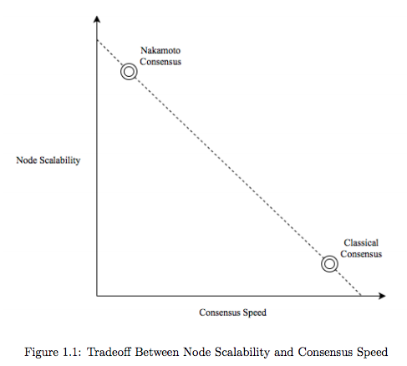
Tradeoff between Time to Finality and Decentralization

Slide 17
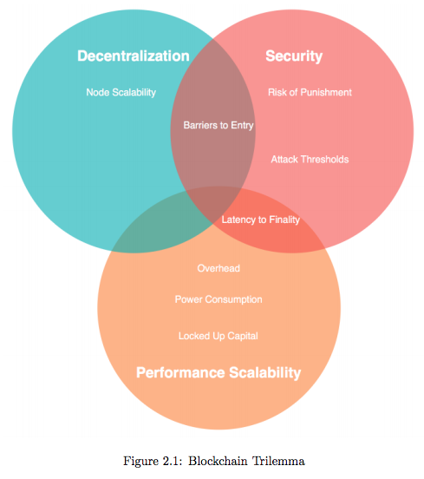
Blockchain Tradeoffs

Slide 18
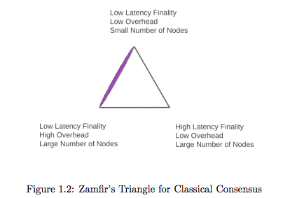
More Tradeoffs

