Slide 1
CS1501 Introduction to Blockchain
Fridays 1-1:50PM,
Thornton Hall D115

Slide 2
Roadmap
Incentive Loops
Removing Stakeholder Friction
Review: Bitcoin’s Incentive Loop
Decentralized ⬄ Trustless
Byzantine Generals Problem
Sybil Attacks
Bitcoin’s Solution
More
Polkadot/Tendermint/Casper
Other Things

Slide 3
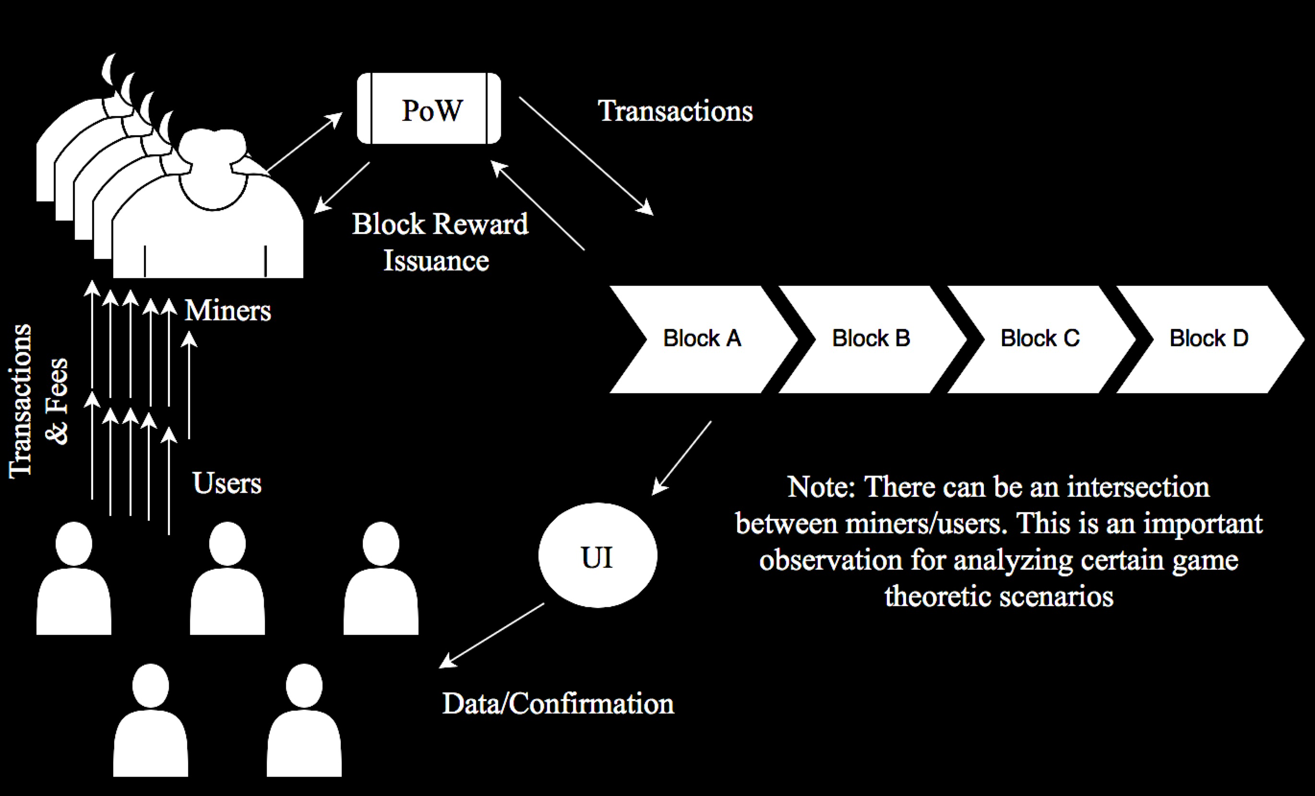
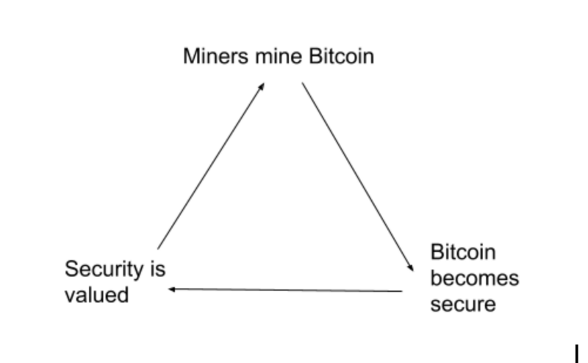
Review: BTC’s Incentive Model

Slide 4
“Decentralized => Trustless”
Distributed database that isn’t controlled by any single actor/entity
Requirements:
Permissionless
Secure?
Private?
Scalable?

Slide 5
Byzantine Generals Problem
Byzantine Empire is planning to capture Charlottesville
There is fierce resistance from Charlottesville but the Byzantine army has encircled the city
The army has $n$ divisions and each division has a general. The generals communicate through messengers.
All generals must agree upon 1 of the 2 plans of action (to Attack or to not). If the attack is w/o full strength, Charlottesville will win.

Slide 6
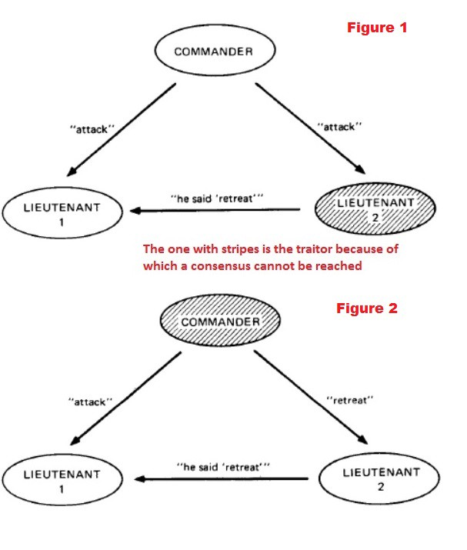
Traitors
Some messenger and even a few generals/commanders are traitors!

Slide 7
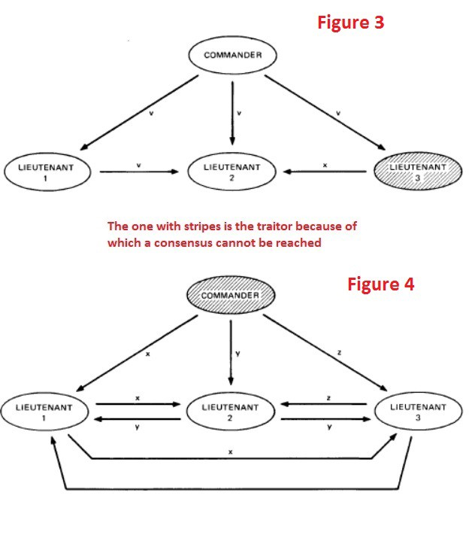
Complexity Increases with Number of Nodes
Imagine a system where all servers can be equal in hierarchy with no central server as well.
If equal hierarchy is established, a network of $n$ nodes must have greater than $2n/3$ honest nodes ( <n/3 malicious nodes).

Slide 8
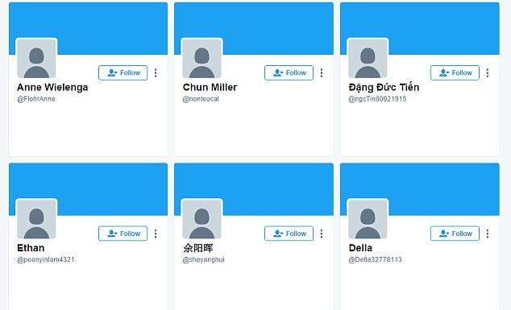
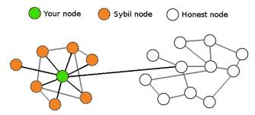
Sybil Attack

Slide 9
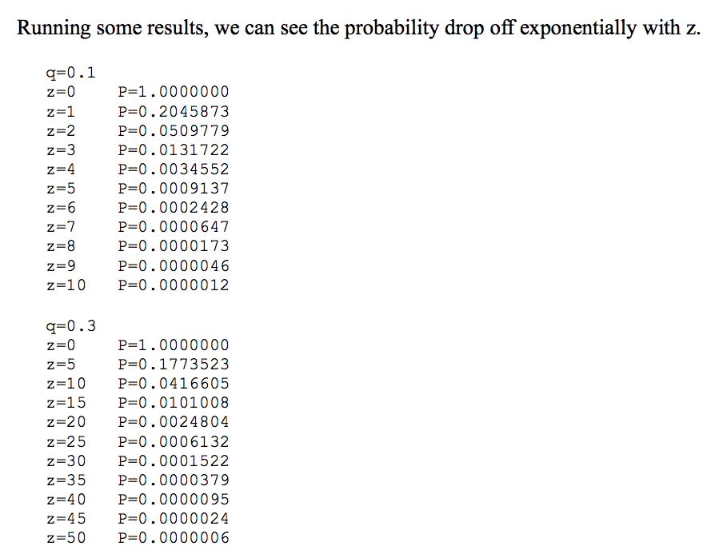
Bitcoin
Probabilistic solution to BGP

Slide 10
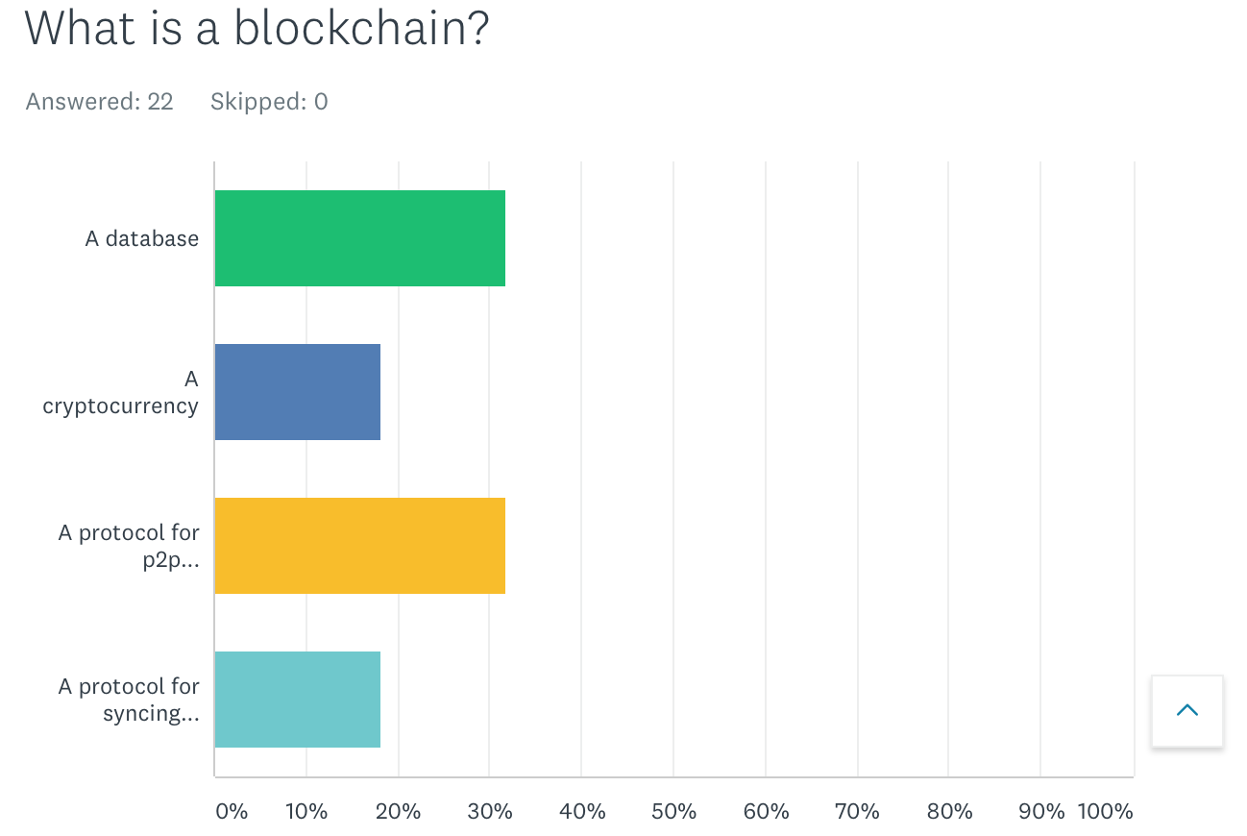

Slide 11
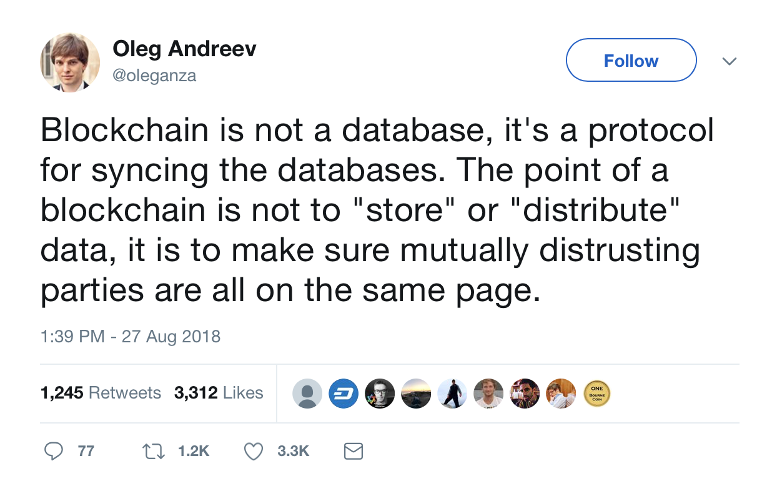

Slide 12
Biases
Ethereum
Zcash
State Channel Research by Counterfactual, L4
Plasma Research by OmiseGo
Governance by Aragon, Ryhope Network, and Harbour Project
Mimblewimble/Grin
Rust (the programming language)

