Slide 1
CS1501 Introduction to Blockchain
Fridays 1-1:50PM,
Thornton Hall D115

Slide 2
Roadmap
Background
Course Goals and Expectations
Getting Up to Speed on Blockchain
State of the Space

Slide 3


Teaching Staff
Professor David Evans
Research focuses on secure multi-party computation, adversarial machine learning, and web security
Taught cryptocurrency course in 2014 at UVA
Amar Singh
4th year Math & CS

Slide 4
Course Goals
Students come from diverse backgrounds with varying levels of exposure to blockchain.
The purpose of this class is to
Provide a technical introduction to blockchain technology for students of all levels
Encourage the sharing of knowledge
Push ambitious students to learn, build, and launch new projects in this space

Slide 5
Expectations
There are no mandatory assignments
Every week:
Lecture
Reading List
Quiz
Optional Coding Projects/Curriculum
Discussion forum to coordinate side projects
Culture: inclusive and non-judgmental

Slide 6
Getting Up To Speed on Blockchain
Speech by Matt Condon, XLNT [1]

Slide 7









Database

Slide 8

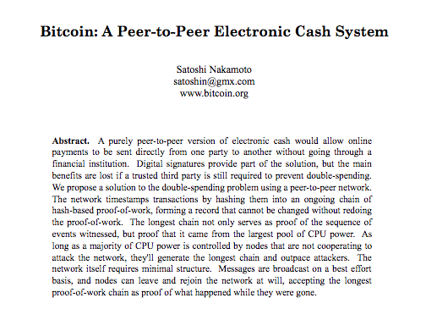
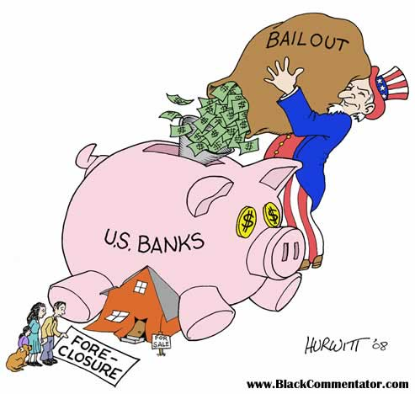
Bitcoin: Paradigm Shift

Slide 9

Since then…
Ethereum
ZCash
Layer 2 Scaling
Sharding
Proof of Stake
Lots of open source development and research!

Slide 10
Plug In
Information is power.
Student Onboarding Page
I’ll send out reading lists every week
Discussion forum to post links and host debates; there is doc that describes acceptable conduct and unacceptable conduct

Slide 11
Blockchain vs. Cryptocurrency

Slide 12
Belief
It is my belief that we can measure the efficiency of the decentralized communities by how fast they can incorporate progress in research into the design/implementation of their blockchain protocols; this requires fast protocol governance…need to communicate that different blockchains offer different value propositions (Bitcoin should prioritize backwards compatibility according to most)

Slide 13
There will probably not be a winner take all system
First go over scalability trilemma and emphasize decentralization – scalability tradeoff
Go Over Roles
Bitcoin for money, store of value; backwards compatibilit; immutability
Ethereum for dapps
Dfinity: scalable computation
EOS for federated decentralization
https://multicoin.capital/2018/04/24/eos-analysis-and-valuation/

Slide 14
References
https://www.youtube.com/watch?v=PvO3J4AKLWo

