Slide 1

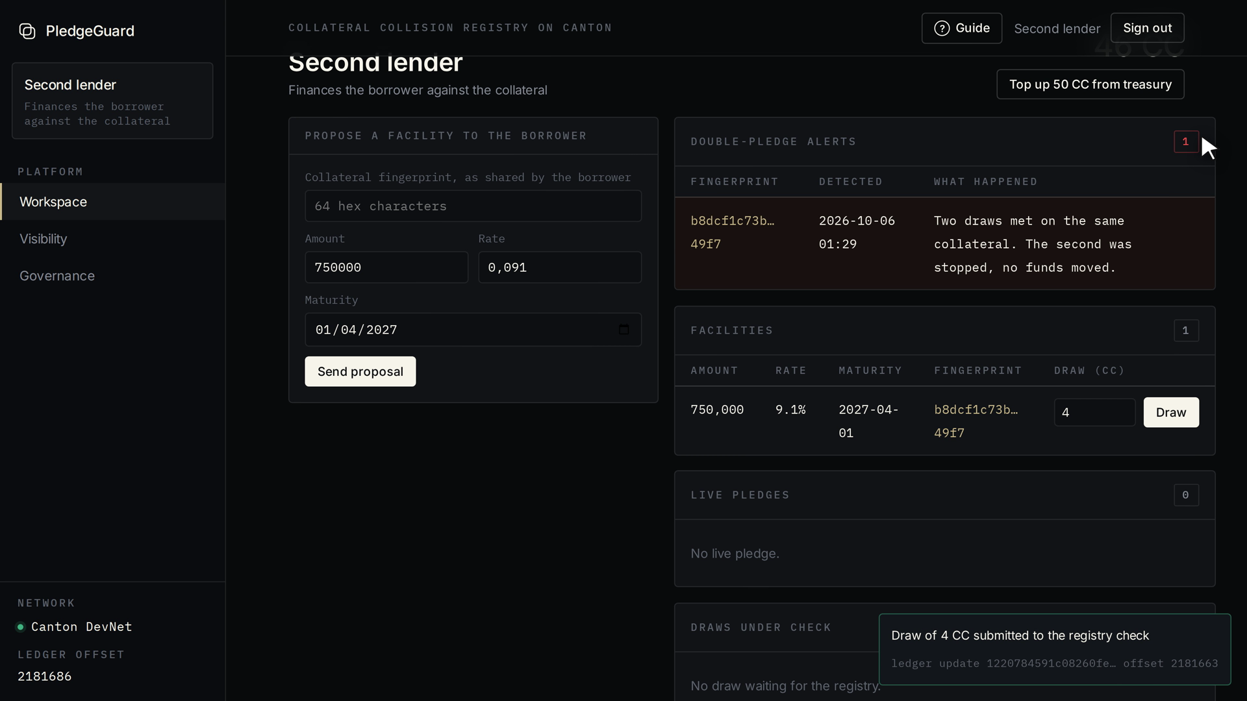
PledgeGuard
One collateral. One live claim.
Stops double-pledged collateral before any money moves, without exposing a single lender's book.
The product, live: a second lender's draw on already pledged collateral, stopped with nothing paid out.
Live on Canton DevNet
Real Canton Coin
2-of-3 decentralized registry
HackCanton Season 3 · RWA & Business Workflows · pledgeguard.fyra.fun
Notes:
PledgeGuard stops the same collateral from being pledged to two lenders, before any money moves, without any lender seeing another's book. It is live on Canton DevNet with real Canton Coin, and the registry's 2-of-3 decentralized governance is proven on a three-node Canton network.

Slide 2
Double-pledged collateral has cost lenders billions
$170M
~$10B
£930M
Tricolor
First Brands
MFS (UK)
JPMorgan's charge-off after the same auto loans were pledged to several banks (2025)
Liabilities at bankruptcy, with receivables financed more than once (2025)
Market Financial Solutions: shortfall facing its lenders over alleged double pledging (2026)
Each lender's diligence was correct on its own book, and blind to the others.
Sources: JPMorgan Q3 2025 disclosure; First Brands Chapter 11 filings; Bloomberg, 27 Feb 2026.
Notes:
Three recent cases. Tricolor: JPMorgan took a 170 million dollar charge-off, and the SEC charged its former executives in August 2026. First Brands collapsed with around 10 billion of liabilities after receivables were financed more than once. Market Financial Solutions left its lenders facing a 930 million pound shortfall in 2026. In every case each lender did its diligence correctly, on its own book, and could not see the other lenders.

Slide 3



Hidden on private books, exposed on public chains
Today: private books
A public chain
Canton with PledgeGuard
Each lender sees only its own loans. A second pledge of the same file is invisible to it.
The double pledge would show, and so would every rival's borrowers, amounts and rates.
The collision is detected while every book stays private, in the same transaction.
The product only exists if detection and confidentiality happen together.
Notes:
Why it stays hidden. Today each lender sees only its own book, so a second pledge is invisible. On a public chain the collision would be visible, but so would every competitor's loans, which no lender accepts. Canton is the only place where the collision can be detected while every book stays private, inside the same transaction.

Slide 4


Why now: fresh losses, money moving on-chain
Double pledging is on every credit committee's agenda
Collateral and settlement are moving onto Canton
Tricolor: SEC charges against former executives, Aug 2026
First Brands: founders indicted, Jan 2026
Market Financial Solutions: administration, Feb 2026
DTCC Tokenization Service: commercial launch scheduled Oct 2026
Broadridge DLR runs repo on Canton every day
USD1 issued natively on Canton since Aug 2026
For the first time, the check and the money can live in the same transaction.
Notes:
Why now. The losses are fresh: the SEC charged Tricolor's former executives in August 2026, First Brands' founders were indicted in January, and Market Financial Solutions went into administration in February. And collateral and settlement are moving onto Canton: DTCC's Tokenization Service is scheduled for commercial launch this month, Broadridge runs repo on Canton every day, and USD1 is issued natively. For the first time, the collateral check and the money can sit in the same transaction.

Slide 5




How PledgeGuard stops a double pledge
1
2
3
Collateral free
The pledge is recorded and the coin moves.
Register
Sign
Draw
The borrower registers a fingerprint of the collateral file, computed in its browser. The file never leaves.
Lender and borrower sign a facility. The registry is not a party to it.
At each draw, the registry checks the fingerprint in the same Canton transaction as the payment.
Already pledged
The draw is stopped, nothing is paid out, both lenders are alerted.
No lender learns who the other lender is. The registry sees fingerprints, never loan terms.
Notes:
Three steps and one decision. The borrower registers a fingerprint of the collateral file; the hash is computed in the browser, so the file never leaves. Each lender signs a bilateral facility; the registry is not a party to it. At every draw, the registry checks the fingerprint inside the same Canton transaction as the payment. If the collateral is free, the pledge is recorded and the coin moves. If it is already pledged, the draw is stopped, nothing is paid out, and both lenders are alerted without learning who the other is.

Slide 6
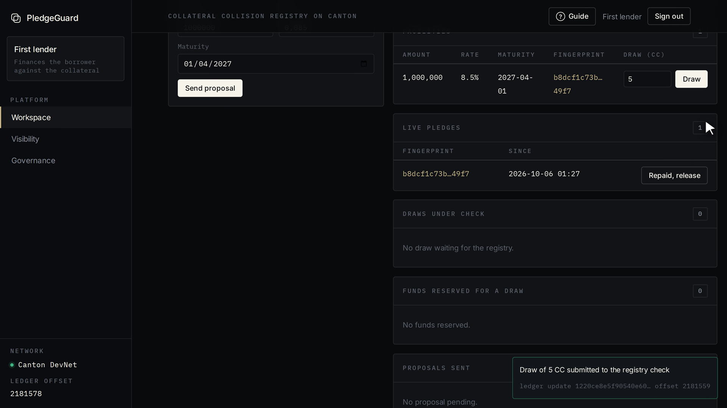
Live on Canton DevNet, with real Canton Coin
50 → 45 CC
The first lender draws 5 Canton Coin: settled, pledge recorded
4 CC
The second lender's draw on the same collateral: reserved, never paid out, released back
5 roles
Borrower, two lenders, registry operator, auditor: one workspace each
pledgeguard.fyra.fun/app · read-only Explore for anyone, a jury access code for the judges
Notes:
This is not a mockup. The platform runs on Canton DevNet with real Canton Coin. The first lender drew 5 coins: balance 50 to 45, pledge recorded. The second lender then drew on the same collateral: its 4 coins were reserved, never paid out, and released back. Each of the five organisations works in its own workspace. Anyone can explore read-only, and judges get an access code to play the whole flow.

Slide 7



A large market, priced per draw
WHO BUYS
THE MONEY THAT MOVES, EVERY YEAR
Warehouse & ABL desks
€4.0T
factored worldwide in 2025 (FCI)
$1.7T
in private credit, moving to asset-based finance (Preqin)
Receivables finance & factoring
Private credit funds
BOTTOM-UP, PER LENDER
$2B
×
1 bp
=
$200k
First on Canton: Alpend, Cenote, ACME Markets.
drawn per year by a mid-size lender
fee per draw
revenue per lender per year
50 lenders = $10M a year
Illustrative assumptions, to validate with the first pilots.
Notes:
Who buys: warehouse and asset-based lending desks, receivables finance and factoring firms, and private credit funds, starting with the credit platforms already on Canton such as Alpend, Cenote and ACME Markets. The money that moves is large: 4 trillion euros were factored worldwide in 2025 according to FCI, and private credit holds about 1.7 trillion dollars according to Preqin. Bottom-up, with illustrative assumptions we will validate in pilots: a mid-size lender drawing 2 billion dollars a year, at one basis point per draw, is 200 thousand dollars a year; fifty such lenders is 10 million dollars of annual revenue.

Slide 8



The lender pays per draw, inside the settlement
Per-draw fee
Annual membership
Members share fees
A few basis points of each draw, taken inside the same settlement transaction: no invoice, no collection.
Paid by participating lenders for access to the registry and its tooling.
A share of the fees for hosting the decentralized party: BitSafe, NODERS and PledgeGuard.
Why the lender pays: it is the party that avoids the loss, and it already pays for diligence that cannot see other lenders.
Notes:
The lender pays, because it is the party that avoids the loss. A per-draw fee of a few basis points is taken inside the same settlement transaction, so there is nothing to invoice or collect. Participating lenders also pay an annual membership. The registry members, BitSafe, NODERS and PledgeGuard, earn a share of the fees for hosting the decentralized party.

Slide 9
What we have proven
24
3
Live
1
transactions in the Daml test suite, every privacy assertion green
Canton participants: 2-of-3 vote executed, a single approval refused
on DevNet: register, sign, draw, stop, release, with real Canton Coin
bypass found by our own review and fixed: re-registering a pledged file
Every number on screen in the video and on the platform carries its ledger update id and offset.
Notes:
What is proven today. A 24-transaction Daml test suite with every privacy assertion green. A three-participant Canton network where the 2-of-3 governance vote executes and a single approval is refused by the ledger. The full workflow live on DevNet with real Canton Coin. And one finding we are proud of: our own review found that a borrower could re-register an already pledged file to get a fresh, empty index; we fixed it, covered it with a test and verified it on the live ledger.

Slide 10
Not another lookup: a check enforced at settlement
 | Borrower reps & UCC searches | Central registry (MonetaGo-style) | Public chain | PledgeGuard
Sees across lenders | ✗ | ✓ | ✓ | ✓
Keeps every lender's book private | ✓ | ✗ | ✗ | ✓
Stops the funding itself | ✗ | advises before funding | only if built in | ✓
No single operator to trust | n/a | ✗ | ✓ | ✓
MonetaGo's duplicate-financing registry is live on Swift, which proves the demand. It sees everyone's documents and advises; PledgeGuard sees only fingerprints and enforces.
Notes:
How PledgeGuard compares. Borrower representations and UCC searches keep books private but cannot see across lenders. A central registry like MonetaGo sees across lenders, which proves the demand, but it sees everyone's documents and only advises before funding. A public chain sees everything and exposes everything. PledgeGuard sees across lenders through fingerprints only, keeps every book private, and stops the funding itself.

Slide 11



Go-to-market: Canton first, then secured finance
1. Canton-native lenders
2. Canton Foundation RFP 12.2
Alpend, Cenote and ACME Markets already hold parties, wallets and stablecoin rails: integration is a Daml package and a few API calls.
A grant track for repo, collateral, lending and servicing workflows, with institutional introductions.
3. BitSafe and node operators
4. Secured-finance associations
BitSafe's Decentralization Manager ecosystem and NODERS bring the registry's independent members.
SFNet and the LSTA reach the ABL, factoring and loan-operations teams beyond Canton.
Notes:
Go-to-market in four steps. First the lenders already on Canton, such as Alpend, Cenote and ACME Markets, for whom integration is a Daml package and a few API calls. Then the Canton Foundation's RFP 12.2 grant track on collateral and lending workflows. BitSafe and NODERS bring the registry's independent members. And beyond Canton, the secured-finance associations SFNet and the LSTA reach the ABL and factoring desks.

Slide 12

Team
NEXT HIRES
Nolwen Sean HONONTA
A credit / ABL lead
Founder, solo builder
To run lender pilots and the fingerprint schema
A Canton engineer
BUILT DURING THE HACKATHON
Daml model and a 24-transaction test suite
Registry automation and its security fixes
The live platform, deployed and hardened
The decentralized registry on a 3-node Canton network
To operate the registry members and integrations
Notes:
PledgeGuard was built by one founder, Nolwen Sean HONONTA: the Daml model and its test suite, the registry automation and its security fixes, the live platform, and the decentralized registry on a three-node Canton network. The next two hires are a credit or ABL lead to run lender pilots, and a Canton engineer to operate the registry members and integrations.

Slide 13


What we are asking for
Grand Final and the AppsFactory accelerator
WHAT IT BUYS IN 90 DAYS
8 weeks to turn the live platform into a pilot-ready product
WEEKS 1 TO 4
Three independent registry members on DevNet; fingerprint schema v1
A Canton Foundation grant (RFP 12.2)
WEEKS 5 TO 8
To fund the registry members, the fingerprint schema and conformance tests
Shadow pilot: 20 real fingerprints, one collision drill
One pilot lender and two registry members
WEEKS 9 TO 12
A 90-day shadow pilot on real facilities, no funds; BitSafe and NODERS as members
First settled stablecoin draw on TestNet; Featured App application
Notes:
What we are asking for. A place in the Grand Final and the AppsFactory accelerator, to turn the live platform into a pilot-ready product in eight weeks. A Canton Foundation grant under RFP 12.2, to fund the registry members, the fingerprint schema and conformance tests. And introductions: one pilot lender for a 90-day shadow pilot on real facilities with no funds at risk, and BitSafe and NODERS as registry members. In 90 days that buys three independent registry members on DevNet, a shadow pilot with 20 real fingerprints and a collision drill, and a first settled stablecoin draw on TestNet.

Slide 14
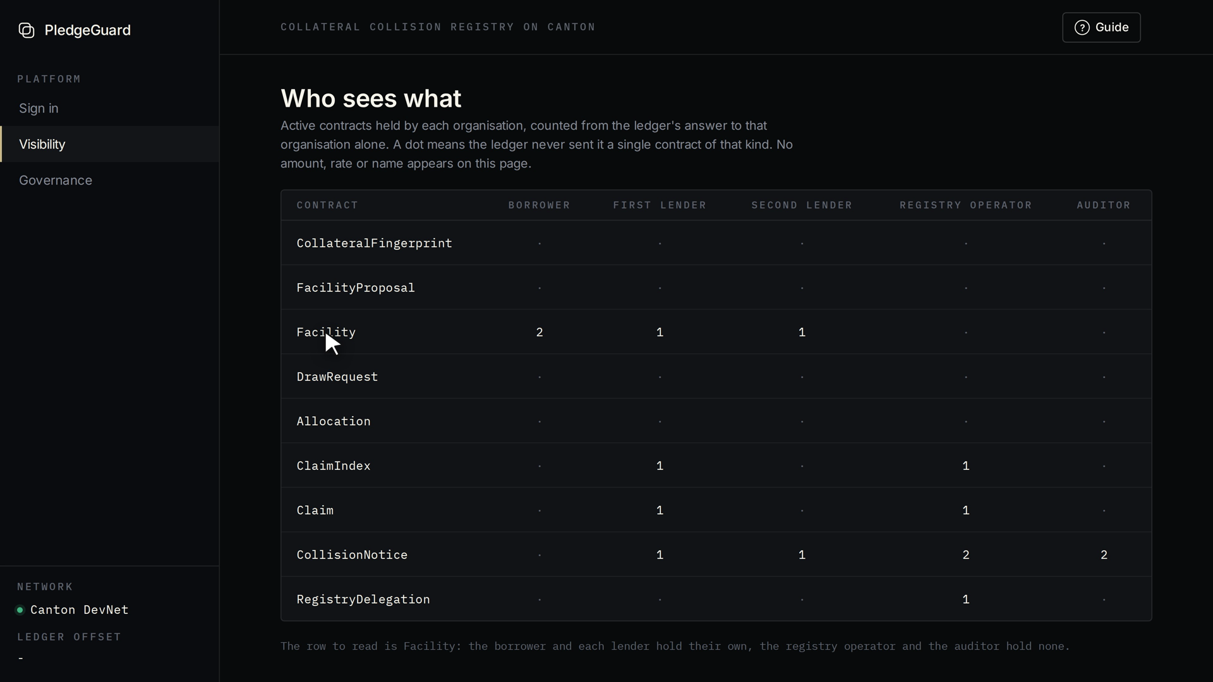
One collateral.
One live claim.
TRY IT
pledgeguard.fyra.fun/app
Who sees what, counted from each organisation's own ledger view.
CODE
github.com/4n0nn43x/pledgeguard
Notes:
PledgeGuard: one collateral, one live claim. The platform is live at pledgeguard.fyra.fun; anyone can explore it read-only, and judges can play the whole workflow with their access code. The code is public on GitHub.

Slide 15

Each organisation sees only its own contracts
Contract | Borrower | First lender | Second lender | Registry operator | Auditor
Collateral fingerprint | yes | never | never | yes | never
Facility (amount, rate, maturity) | both | its own | its own | never | never
Live pledge | never | its own | its own | yes | never
Double-pledge alert | never | its own | its own | yes | yes
Not a screen filter: each column is what that organisation's own ledger view returns. The registry operator and the auditor never receive a single loan.
APPENDIX
Notes:
The privacy matrix, read straight from the ledger. The borrower sees both facilities; each lender sees only its own; the registry operator and the auditor never receive a facility at all. The registry sees fingerprints and who holds the live pledge. The auditor sees only the double-pledge alerts. The same table is public on the platform's Visibility page, computed from each organisation's own ledger view.

Slide 16



Why this only works on Canton
Sub-transaction privacy
A registry blind to loans
Each lender gets its own view of the ledger: the other lender's facility never even exists for it.
A neutral registry party signs the collision check without being a party to any facility.
Atomic check and payment
No single operator
The check and the Canton token-standard transfer are atomic: a colliding draw simply does not fund. No race.
The registry runs as a Canton decentralized party: anything sensitive needs two of three members.
APPENDIX
Notes:
Four Canton properties make this possible. Sub-transaction privacy gives each lender its own view. A registry party can sign the collision check without being a party to any loan. The check and the token-standard payment run in one transaction, so there is no window where two lenders both see the collateral as free. And the registry can run as a decentralized party, so no single operator controls it.

Slide 17

A registry no single institution controls
AUTOMATIC, EVERY DAY
Record a new collateral fingerprint
Check a draw and release the funds
Member 1
Member 2
NEEDS TWO MEMBERS OUT OF THREE
2 of 3
Switch the automatic checks on or off
Free a collateral under dispute
ONE APPROVAL IS NOT ENOUGH
"The requirement 'Enough confirmations to execute action' was not met."
Proven on a three-node Canton network with BitSafe's Decentralization Manager. On DevNet the registry runs as a single party with the same automation.
Member 3
APPENDIX
Notes:
Lenders will not feed a competitor's or a vendor's database, so no single operator should run the registry. The registry is a Canton decentralized party with three members. Everyday checks are automatic under a delegation the members granted once. Anything sensitive, like switching the automation off or freeing a disputed collateral, needs two of three members, and the ledger itself refuses a single approval. We proved this on a three-node Canton network with BitSafe's Decentralization Manager; on DevNet the registry is a single party with the same automation.

