Slide 1
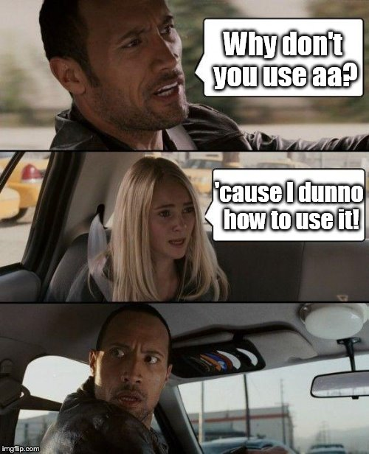
aa: magic explained (MEG)
Tibor Auer
MRC Cognition and Brain Sciences Unit Methods group
Notes:
Prepare:
/imaging/ta02/Workshop
Wiki

Slide 2
What you need
Tasklist
Pipelines describing a series of modules to be executed
<?xml version="1.0" encoding="utf-8"?>
<aap>
<tasklist>
<initialisation>
<module><name>aamod_checkparameters</name></module>
<module><name>aamod_evaluatesubjectnames</name></module>
<module><name>aamod_study_init</name></module>
<module><name>aamod_newsubj_init</name></module>
</initialisation>
<main>
<module><name>aamod_meg_get_fif</name></module>
<module><name>aamod_meg_maxfilt</name></module>
<module><name>aamod_meg_convert</name></module>
<module><name>aamod_meg_denoise_ICA_1</name></module>
<module><name>aamod_meg_denoise_ICA_2_applytrajectory</name></module>
<module><name>aamod_meg_epochs</name></module>
<module><name>aamod_meg_average</name></module>
</main>
</tasklist>
</aap>

Slide 3
What you need
User Master Script (UMS)
Specifies and runs the analysis
Initialise: setup aa
Loads in: default parameters and the tasklist
Customises: parameters and tasks
Specifies: data and model
Runs and cleans up: the main (p)art
Generates: report

Slide 4
What you need
User Master Script (UMS)
Specifies and runs the analysis
Initialise: setup aa
% Automatic analysis
% User master script example (aa version 5.*.*) - c.a. 1.5h
%
% Tibor Auer, MRC-CBSU
% 01-02-2016
clear
aa_ver5

Slide 5
What you need
User Master Script (UMS)
Specifies and runs the analysis
Loads in: default parameters and the tasklist
%% DEFINE SPECIFIC PARAMETERS
% Default recipe with model
aap = aarecipe('aap_parameters_defaults_CBSU.xml','/imaging/xy01/Workshop/Material/4_aa/meg_takslist.xml');

Slide 6
What you need
User Master Script (UMS)
Specifies and runs the analysis
Customises: parameters and tasks
% Modify standard recipe module selection here if you'd like
aap.options.wheretoprocess = 'qsub'; % queuing system % OPTIONS: 'localsingle'|'qsub' for aa engine, typical value 'qsub'
aap.options.email = 'xy01@mrc-cbu.cam.ac.uk';
aap.tasksettings.aamod_meg_maxfilt.downsampling = 10;
aap.tasksettings.aamod_meg_denoise_ICA_2_applytrajectory.toremove = 'spat';
aap.tasksettings.aamod_meg_epochs.timewindow = [-2000 500];

Slide 7
What you need
User Master Script (UMS)
Specifies and runs the analysis
Specifies: data
% Directory & sub-directory for analysed data:
aap.acq_details.root = '/imaging/xy01/Workshop';
aap.directory_conventions.analysisid = 'aa_MEG';
% Add extra files
aap = aas_addinitialstream(aap,'channellabels',{'/imaging/rh01/VectorView_MAG_GRD_EEG_EOG_STI101.mat'});
aap = aas_addinitialstream(aap,'topography',{'/imaging/rh01/Methods/MEGEEGArtifactTemplateTopographies.mat'});
% Directory for raw data:
aap.directory_conventions.rawmegdatadir = '/megdata/cbu/ftd';
aap.directory_conventions.subject_directory_format = 3;
% Add subject (full):
aap = aas_addsession(aap,‘run1');
aap = aas_addsubject(aap,'S1', {[12 442] []},'functional',{'psp_button_press_self_raw.fif'});
aap = aas_addsubject(aap,'S2', {[13 133] []},'functional',{'ftd_0133_bsp_raw.fif'});

Slide 8
What you need
User Master Script (UMS)
Specifies and runs the analysis
Specifies: model
% Add conditions
aap = aas_add_meg_event(aap,'aamod_meg_epochs','S1','run1','BP',{'STI101_down' 8192},34);
aap = aas_add_meg_event(aap,'aamod_meg_epochs','S2','run1','BP',{'STI101_down' 22},34);

Slide 9
What you need
User Master Script (UMS)
Specifies and runs the analysis
Runs and cleans up: the main (p)art
aa_doprocessing(aap);

Slide 10
What you need
User Master Script (UMS)
Specifies and runs the analysis
Generates: report
aa_report(fullfile(aas_getstudypath(aap),aap.directory_conventions.analysisid));

Slide 11
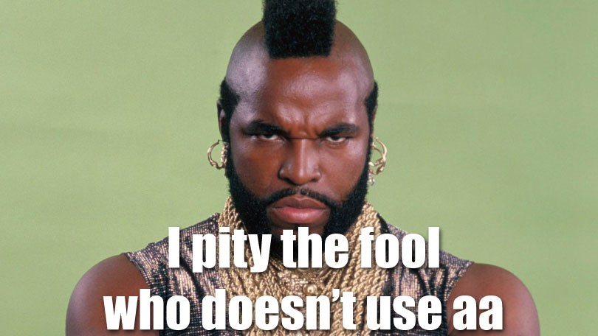

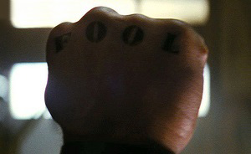
Info/Support
GitHub: https://github.com/rhodricusack/automaticanalysis/wiki
Our Wiki: http://imaging.mrc-cbu.cam.ac.uk/imaging/AA
People (“The AA-team”)
courtesy to Jonathan Peelle

